Slide 1
National Prescribing Indicators
2020–2021
Supporting Safe and Optimised Prescribing

Slide 2
National Prescribing Indicators (NPIs) development process
Developed by the All Wales Prescribing Advisory Group (AWPAG):
May 2019: AWPAG NPI Task and Finish Group review and develop NPIs.
June 2019: Recommendations for NPIs 2020–2021 discussed at AWPAG.
September 2019: Draft consultation paper discussed at AWPAG.
October 2019: Consultation with industry and stakeholders.
December 2019: Final version presented to AWPAG.
February 2020: Final document endorsed by the All Wales Medicines Strategy Group (AWMSG).

Slide 3
Prescribing measures – volume measures
Items
Single item prescribed by a prescriber on a prescription form.
Number of items is a measure of how often a prescriber has decided to write a prescription.
For vaccines and acute treatment such as antibiotics it can be used as a volume measure.
However, a single item can be any quantity or duration (e.g. 1 item = lansoprazole 15 mg od 28 tablets).
Defined daily doses (DDDs)
Developed and maintained by WHO based on international prescribing habits.
Each medicine is given a value, within its recognised dosage range, that represents the assumed average maintenance dose per day when used for its main indication in adults (DDD lansoprazole = 30 mg).
Unit of measurement – not a recommended dose and may not be a real dose. DDD of one medicine is assumed to be functionally equivalent to DDD of any other medicine used for a similar indication; therefore the number of DDDs for two or more such medicines can be added together.
Average daily quantities (ADQs)
Work undertaken in England showed that prescribing in primary care can differ from the international standard.
Measure of prescribing volume that accurately reflects primary care prescribing behaviour in England.
Assumed average maintenance dose/day for a medicine used for its main indication in adults.
Not a recommended dose, but an analytical unit to compare prescribing activity of primary care practitioners (ADQ lansoprazole = 20 mg).
Many ADQs are the same as the corresponding DDD; however, values may differ e.g. when DDD is influenced by use of higher doses in hospital setting.

Slide 4
Prescribing measures – denominators
To allow comparison between health boards, clusters and practices of different sizes, there needs to be a way of weighting prescribing data.
Patients
  Data can be presented per 1,000 patients.
  Only useful if monitoring something that is not influenced by age and gender.
Prescribing units (PUs)
  Introduced in 1983 to take into account the greater need of the elderly population.
  Age < 65 years weighted as 1; age 65 and over weighted as 3.
Specific therapeutic group age-sex related prescribing units (STAR-PUs)
  Introduced in England in 1995.
  Designed to weight individual health board or practice populations based on the age and sex distribution of their practice, for specific therapeutic group for which a particular medicine/group of medicines is prescribed.
  Reviewed regularly (most recently 2013) to take into account changes in prescribing practice: some are cost based, some item based, and ADQ based prescribing units now being introduced.
Analysis has been undertaken to ensure correlation between PUs and STAR-PUs to determine that these measures are relevant to the Welsh population.
Advantage that comparison can also be undertaken with English Clinical Commissioning Groups (CCGs).

Slide 5
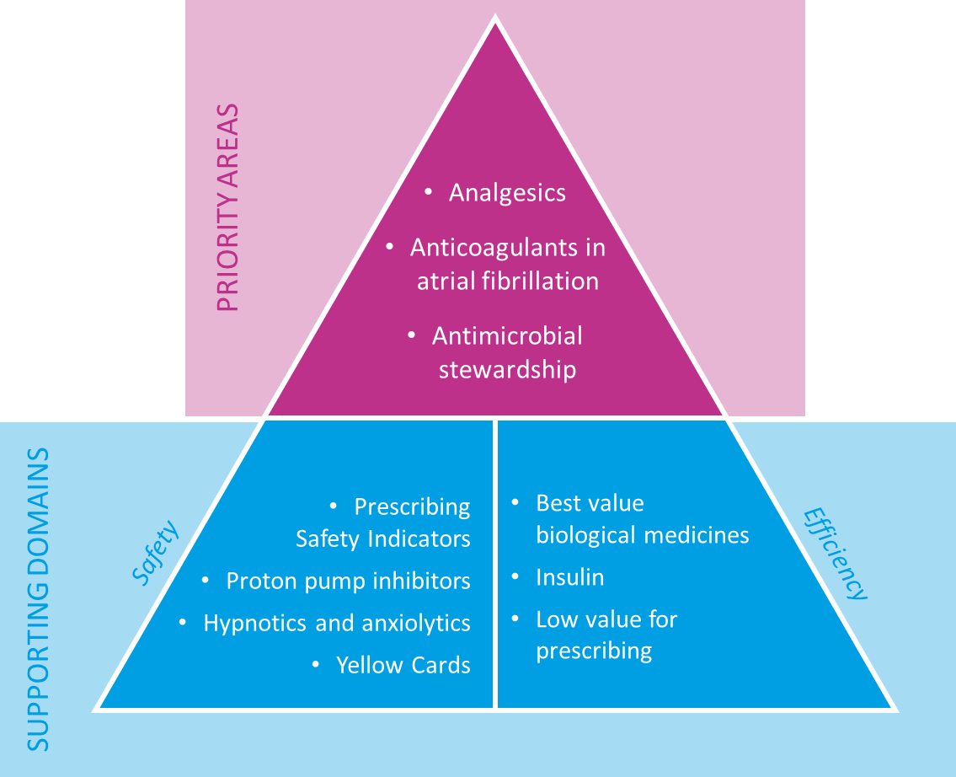
A New Focus
For 2020–2021, the NPIs have been refreshed with a focus on three priority areas, supported by safety and efficiency domains.

Slide 6
National Prescribing Indicators (NPIs)
PRIORITY AREAS

Slide 7
NPIs
PRIORITY AREAS
National Prescribing Indicator | Applicable to: | Unit of measure | Target for 2020–2021
Analgesics | Primary care | Opioid burden user defined group (UDG) ADQs per 1,000 patients | Maintain performance levels within the lower quartile, or show a reduction towards the quartile below
 |  | Tramadol DDDs per 1,000 patients | Maintain performance levels within the lower quartile, or show a reduction towards the quartile below
 |  | Gabapentin and pregabalin DDDs per 1,000 patients | Maintain performance levels within the lower quartile, or show a reduction towards the quartile below
Anticoagulants in atrial fibrillation (AF) | Primary care | The number of patients with AF and a CHA₂DS₂-VASc score of 2 or more who are currently prescribed an anticoagulant, as a percentage of all patients with AF. | To increase the number of patients with AF and a CHA₂DS₂-VASc score of 2 or more prescribed an anticoagulant.
 |  | The number of patients diagnosed with AF who are prescribed an anticoagulant and have received an anticoagulant review within the last 12 months, as a percentage of all patients diagnosed with AF who are prescribed an anticoagulant. | To increase the number of patients who are prescribed an anticoagulant and have received an anticoagulant review within the last 12 months.
 |  | The number of patients diagnosed with AF who are prescribed antiplatelet monotherapy, as a percentage of all patients diagnosed with AF. | To reduce the number of patients with AF prescribed antiplatelet monotherapy.
Antimicrobial stewardship | Primary care | Total antibacterial items per 1,000 STAR-PUs | Health board target: a quarterly reduction of 5% against a baseline of April 2018–March 2019. GP Practice target: Maintain performance levels within the lower quartile, or show a reduction towards the quartile below.
 |  | Number of 4C antimicrobial (co-amoxiclav, cephalosporins, fluoroquinolones and clindamycin) items per 1,000 patients | Health board target: A quarterly reduction of 10% against a baseline of April 2018–March 2019. GP Practice target: Maintain performance levels within the lower quartile, or show a reduction towards the quartile below.

Slide 8
PRIORITY
ANALGESICS – OPIOID BURDEN
Purpose | To encourage the appropriate use and review of all opioids in primary care, minimising the potential for dependence, diversion, misuse and ADRs.
Unit of measure | Opioid burden UDG ADQs per 1,000 patients
Aim | To reduce prescribing.
The prescribing of opioids is often not the most appropriate or effective treatment option for patients with chronic pain, and can risk exposing patients to unnecessary harm.
Despite the lack of evidence for use in chronic non-cancer pain, research has found an escalation of strong opioid prescribing in primary care, predominantly for non-cancer patients.
Across Wales, 1,010,579 prescriptions for opioid analgesics were dispensed during 2007–2008. This increased by 50% over ten years, with more than 1.5 million prescriptions dispensed during 2017–2018.
During the same period, opioid related deaths in Wales increased from 96 in 2007, to 164 in 2018, an increase of 71%.
Opioid analgesics have well established side effects including constipation, nausea and vomiting, and respiratory depression, and repeated administration may cause tolerance and dependence.

Slide 9
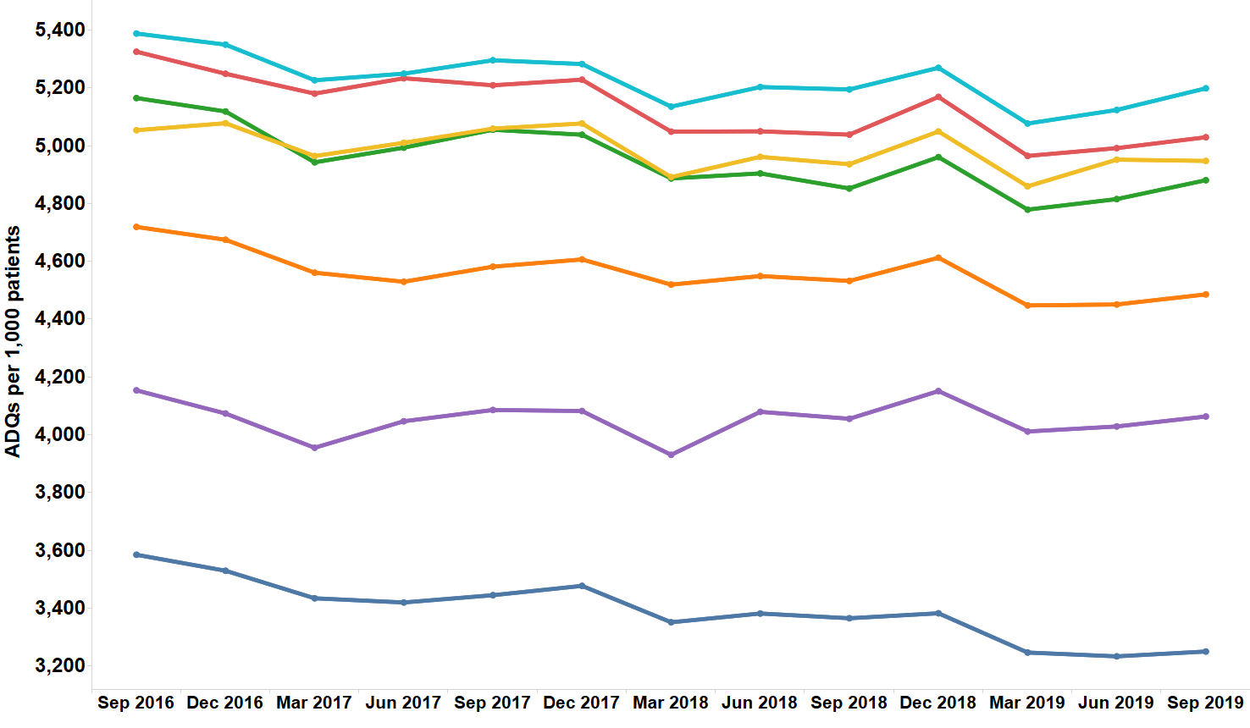
Trend in opioid burden
PRIORITY
OPIOID BURDEN

Slide 10
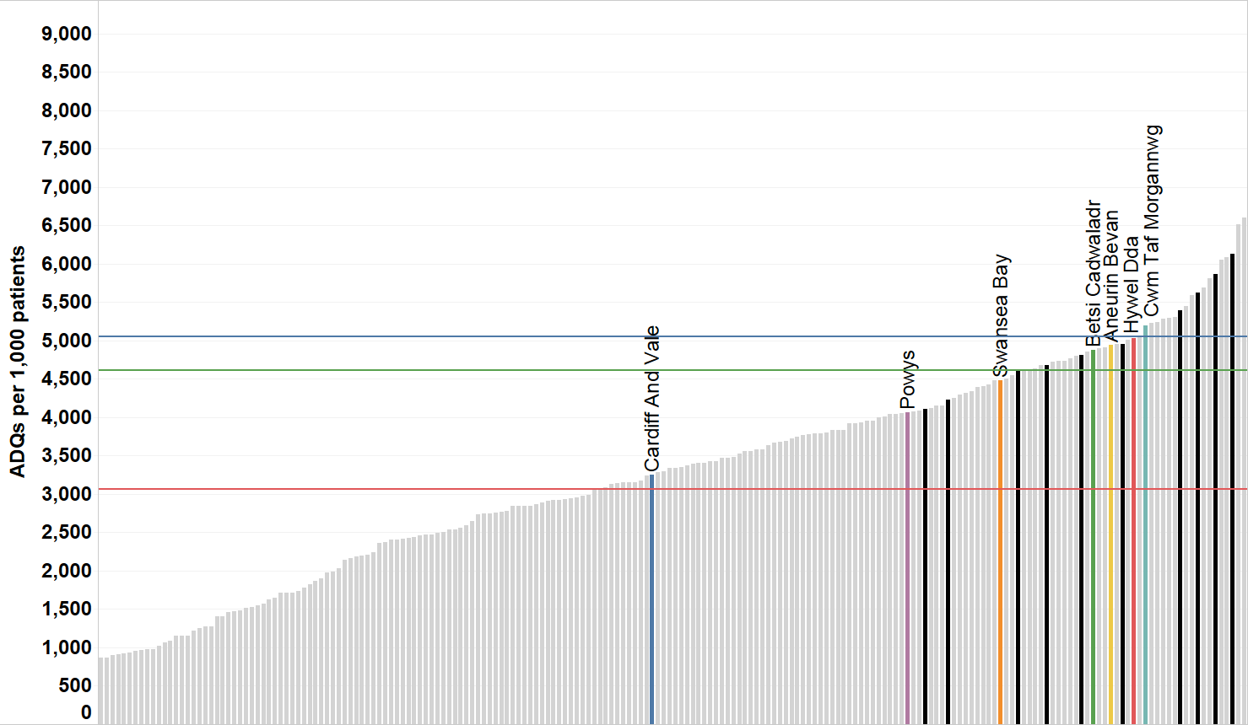
Opioid burden ADQs per 1,000 patients -
Quarter ending September 2019
PRIORITY
OPIOID BURDEN
Wales average
NE England CCGs
England average
Other CCGs
North East England average
CCG/HB

Slide 11
How can changes be made?
PRIORITY
OPIOID BURDEN
?
Ensure that when prescribing opioids, consideration is given to: the benefits of treatment; the risks of prescribing, including dependency, overdose and diversion; all prescribed and non-prescribed medicines the person is taking, and whether the person may be opioid naïve.
If it is thought opioid therapy may play a role in a patient’s pain management, a trial should be initiated to establish whether the patient achieves a reduction in pain with the use of opioids – if not they should be stopped.
Dose escalation should be limited as risk of harm rises as dose increases, especially if there is inadequate relief of pain. Above an oral morphine equivalent daily dose of 120 mg, further benefit is unlikely.
Use The Royal College of Anaesthetists Faculty of Pain Medicine checklist to aid discussions regarding opioid treatment with patients.
Conduct a search to identify patients on an oral morphine equivalent daily dose of ≥120 mg in order to undertake reviews.

Slide 12
PRIORITY
ANALGESICS – TRAMADOL
Purpose | To encourage appropriate use and review of tramadol in primary care, minimising the potential for dependence, diversion, misuse and ADRs.
Unit of measure | Tramadol DDDs per 1,000 patients
Aim | To reduce prescribing.
While there is a recognised place in pain management for tramadol, there are concerns regarding abuse, dependence and deaths involving tramadol, in addition to the risks associated with misuse and diversion.
The unique dual action pharmacological profile of tramadol increased the risk of adverse effects seen in overdose.
Hallucinations, confusion and convulsions as well as rare cases of dependence and withdrawal symptoms have been reported with tramadol at therapeutic doses.
Tramadol should be used with caution in patients taking concomitant medicines that can lower the seizure threshold, such as tricyclic antidepressants (TCAs) and selective serotonin reuptake inhibitors (SSRIs).

Slide 13
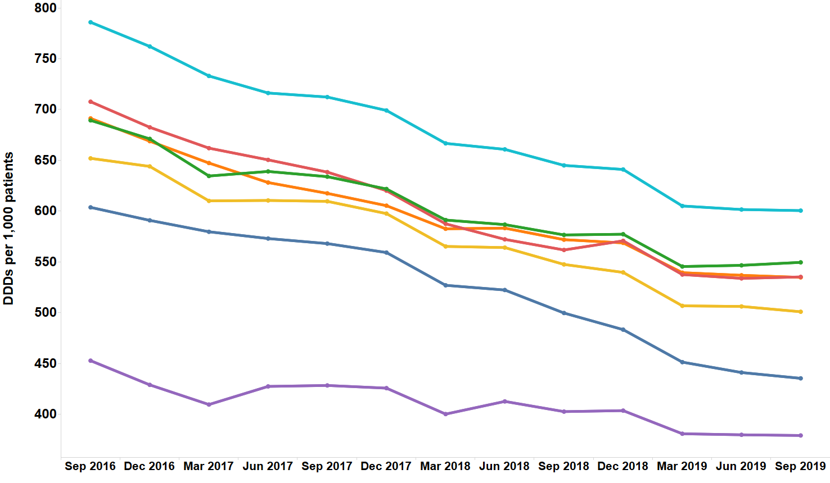
Trend in tramadol prescribing
PRIORITY
TRAMADOL

Slide 14
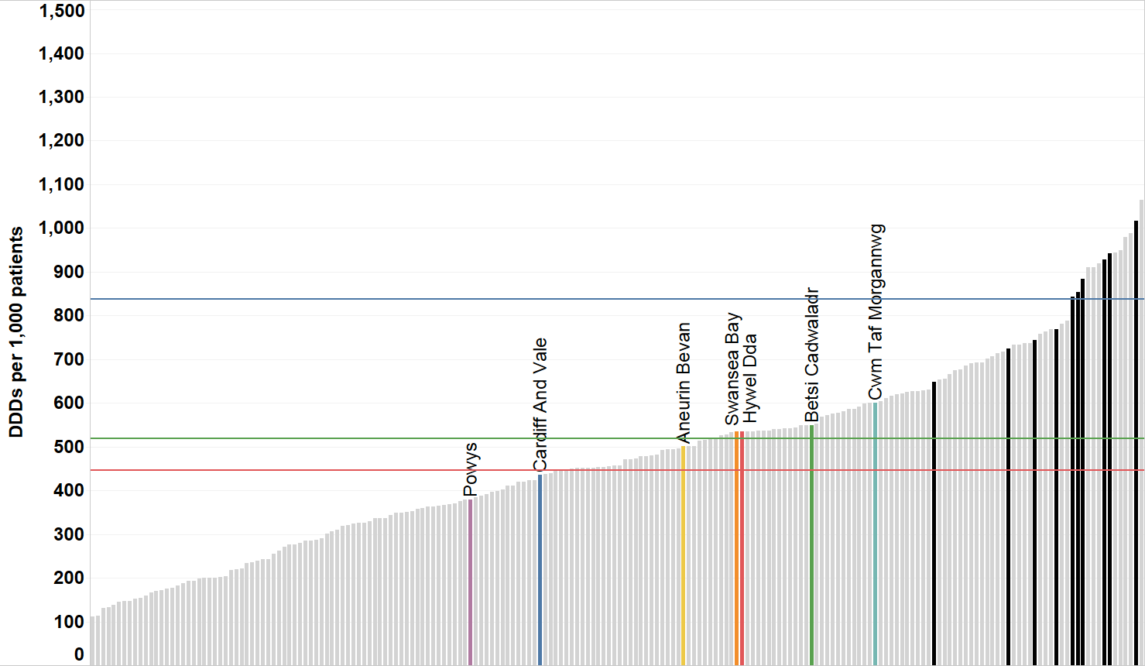
Tramadol DDDs per 1,000 patients -
Quarter ending September 2019
PRIORITY
TRAMADOL
Wales average
NE England CCGs
England average
Other CCGs
North East England average
CCG/HB

Slide 15
How can changes be made?
PRIORITY
TRAMADOL
?
Use the AWMSG Tramadol Shared Decision Making Toolkit with patients when consideration is being given to prescribing tramadol.
Provide patients with the AWMSG Tramadol Patient Information Leaflet where tramadol is initiated.
If it is appropriate for a patient’s tramadol to be stepped down or stopped, reduce the dose slowly to ensure the patient’s safety and to minimise the risk of withdrawal symptoms and/or ADRs. Where physical dependence to tramadol develops, the withdrawal syndrome can be severe, with symptoms typical of opiate withdrawal sometimes accompanied by seizures, hallucinations and anxiety.
To encourage patient engagement and concordance, a suggested approach would be to reduce the dose at each reduction step, e.g. by one 50 mg dose, and to titrate according to how the patient manages, rather than by setting time limits for the next reduction.
Carry out the tramadol audit – AWMSG Tramadol Educational Resource Materials: Audit Materials.

Slide 16
PRIORITY
ANALGESICS – GABAPENTIN AND PREGABALIN
Purpose | To encourage the appropriate use and review of gabapentin and pregabalin in primary care, minimising the potential for dependence, diversion, misuse and ADRs.
Unit of measure | Gabapentin and pregabalin DDDs per 1,000 patients
Aim | To reduce prescribing.
While there is a recognised place in neuropathic pain management for gabapentin and pregabalin, there are concerns regarding the risks associated with dependence, diversion and misuse.
There has been increasing use of gabapentin and pregabalin in primary care over the last 5 years across Wales. In addition, prescribing is high in comparison with England.
There has been an increase in the number of deaths where gabapentin or pregabalin was mentioned on the death certificate in England and Wales, from 64 deaths registered in 2014 to 280 deaths registered in 2018.

Slide 17
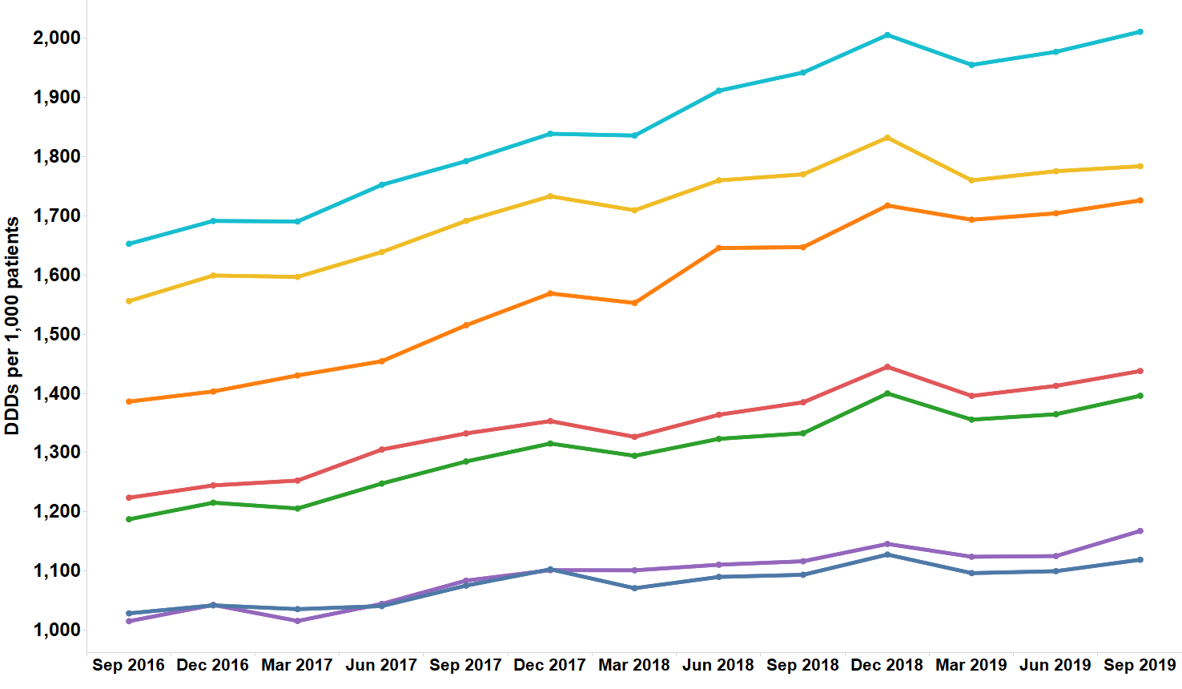
Trend in gabapentin and pregabalin prescribing
PRIORITY
GABAPENTIN AND PREGABALIN

Slide 18
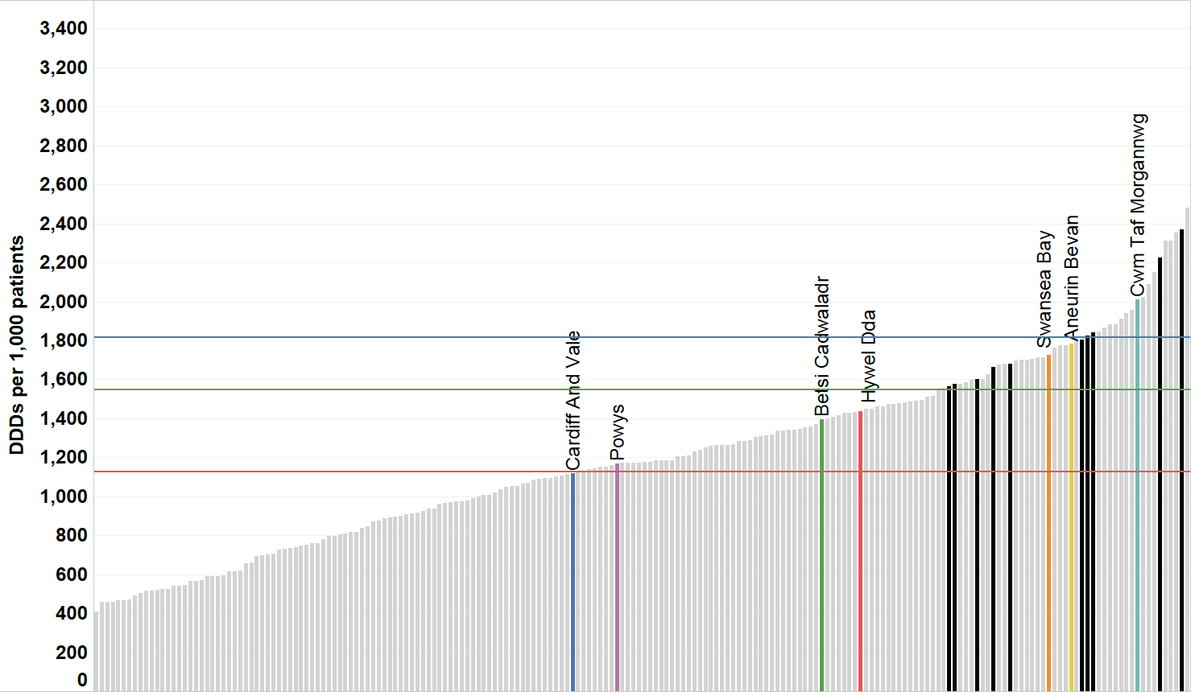
Gabapentin and pregabalin DDDs per 1,000 patients –
Quarter ending September 2019
PRIORITY
GABAPENTIN AND PREGABALIN
Wales average
NE England CCGs
England average
Other CCGs
North East England average
CCG/HB

Slide 19
How can changes be made?
PRIORITY
GABAPENTIN AND PREGABALIN
?
Use a pain scale (for example, the Leeds assessment of neuropathic symptoms and signs [LANSS]) to assess whether the patient’s pain is neuropathic in nature. This will also assist in determining response to treatment.
Inform patients that response to drug treatment in neuropathic pain is often inadequate, with no more than 40–60% of people obtaining partial pain relief.
Once treatment has commenced, NICE recommends early assessment followed by regular reviews to assess and monitor effectiveness including pain control, adverse effects and continued need.
Reduce and stop the gabapentin or pregabalin if the patient has not shown sufficient benefit within eight weeks of reaching the maximum tolerated dose.
Exercise caution in prescribing gabapentin or pregabalin for patients with a history of substance abuse.

Slide 20
PRIORITY
ANTICOAGULANTS IN ATRIAL FIBRILLATION
Purpose | To encourage the appropriate use and review of anticoagulants in patients with atrial fibrillation.
Unit of measure | The number of patients diagnosed with AF who have a CHA₂DS₂-VASc score of 2 or more who are currently prescribed an anticoagulant as a percentage of all patients diagnosed with AF.
Aim | To increase the number of patients with AF and who have a CHA₂DS₂-VASc score of 2 or more prescribed an anticoagulant
Atrial fibrillation causes around 20% of strokes, however this can be reduced by about two thirds if people are anticoagulated.
NICE guidelines recommend that patients with atrial fibrillation are assessed for stroke risk using the CHA₂DS₂VASc score.
Adults with non-valvular atrial fibrillation and a CHA₂DS₂VASc score of 2 or above are at a much higher risk of having a stroke than the general population, and should therefore receive anticoagulation.
NICE recommends anticoagulation with either apixaban, dabigatran etexilate, edoxaban, rivaroxaban or a Vitamin K antagonist.

Slide 21
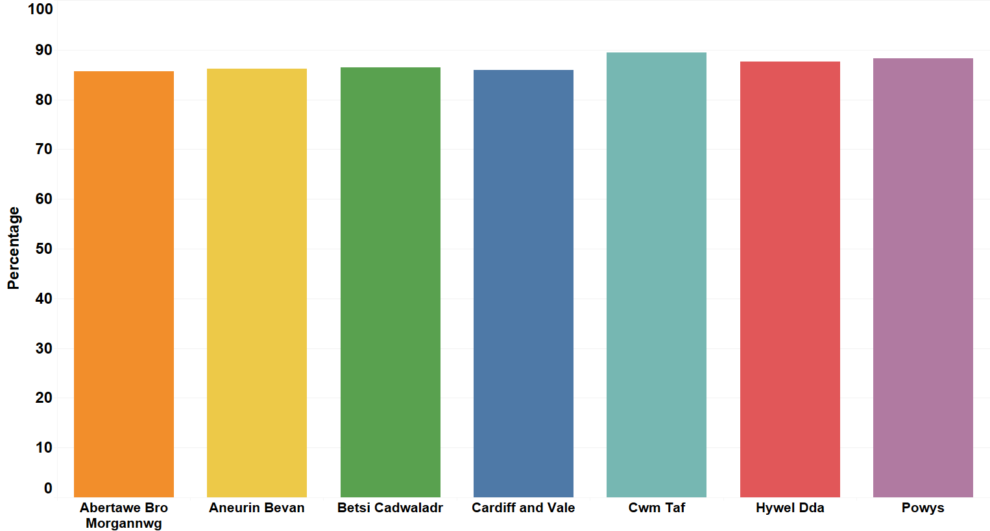
Percentage of patients with AF and a CHA₂DS₂-VASc score of 2 or more who are currently treated with anticoagulant therapy – quarter ending March 2019*
PRIORITY
ANTICOAGULANTS IN ATRIAL FIBRILLATION
* This graph is based on data provided by NWIS for the Quality Assurance and Improvement Framework (QAIF). At the time of publication this data was only available up to March 2019 in the old health board structures.

Slide 22
How can changes be made?
PRIORITY
ANTICOAGULANTS IN ATRIAL FIBRILLATION
?
Patients with persistent or permanent AF should be assessed for stroke risk using the CHA₂DS₂VASc score.
For patients with a CHA₂DS₂VASc of 2 or above, anticoagulation should be offered, taking the patient’s bleeding risk into account.

Slide 23
PRIORITY
ANTICOAGULANTS IN ATRIAL FIBRILLATION
Purpose | To encourage the appropriate use and review of anticoagulants in patients with atrial fibrillation.
Unit of measure | The number of patients diagnosed with AF who are currently prescribed an anticoagulant and have received an anticoagulant review (read codes 8BT3, 6A9, or 66QB) within the last 12 months, as a percentage of all patients diagnosed with AF who are prescribed an anticoagulant.
Aim | To increase the number of patients with AF who are prescribed an anticoagulant and have received an anticoagulant review (8BT3, 6A9, or 66QB) within the last 12 months.
The review of patients with AF who are taking an anticoagulant is vital.
The use of any anticoagulant is associated with some drug-drug interactions which may increase the risk of serious bleeding or diminish stroke prevention.
The NICE guideline on Atrial Fibrillation highlights the need to review anticoagulation and the quality of anticoagulation at least annually, or more frequently if clinically relevant events occur affecting anticoagulation or bleeding risk.
Quality Statement 3 within the NICE Quality Standard for Atrial Fibrillation states that adults with atrial fibrillation who are prescribed anticoagulation should discuss the options with their healthcare professional at least once a year.

Slide 24
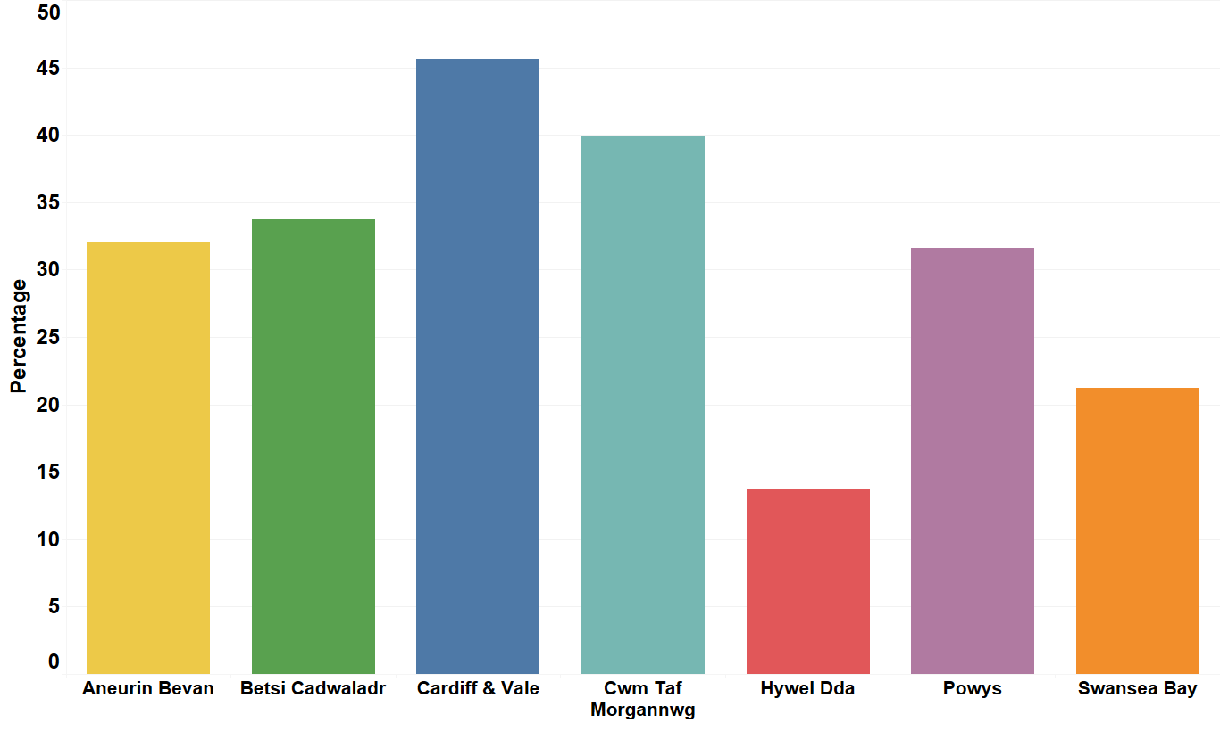
Percentage of patients with AF who are prescribed an anticoagulant and have received an anticoagulant review within the last 12 months – September 2019
PRIORITY
ANTICOAGULANTS IN ATRIAL FIBRILLATION

Slide 25
How can changes be made?
PRIORITY
ANTICOAGULANTS IN ATRIAL FIBRILLATION
?
Review patients on anticoagulation therapy at least annually, or more frequently if clinically relevant events occur affecting anticoagulation or bleeding risk.
Patients should have the opportunity to discuss the choice of suitable anticoagulants with their healthcare professional, in order to improve adherence to treatment.
Adherence to anticoagulation can help to prevent stroke by reducing the likelihood of a blood clot forming.
Ensure that appropriate read codes are used when reviewing patients
A practice template could be developed to ensure that all relevant factors are considered when reviewing anticoagulants.

Slide 26
PRIORITY
ANTICOAGULANTS IN ATRIAL FIBRILLATION
Purpose | To encourage the appropriate use and review of anticoagulants in patients with atrial fibrillation.
Unit of measure | The number of patients diagnosed with AF who are prescribed antiplatelet monotherapy, as a percentage of all patients diagnosed with AF.
Aim | To reduce the number of patients diagnosed with AF prescribed antiplatelet monotherapy.
Antiplatelet medication, i.e. aspirin or clopidogrel, is no longer recommended in patients with atrial fibrillation.
Despite this, data from the Sentinel Stroke audit highlights that 15% of stroke patients across Wales, England and Northern Ireland with atrial fibrillation are still prescribed antiplatelet drugs.
Quality Statement 2 within the NICE Quality Standard for Atrial Fibrillation states that adults with atrial fibrillation should not be prescribed aspirin as monotherapy, as the risks of taking aspirin outweigh any benefits.
This NPI aims to identify patients prescribed antiplatelet monotherapy in order for treatment to be reviewed.

Slide 27
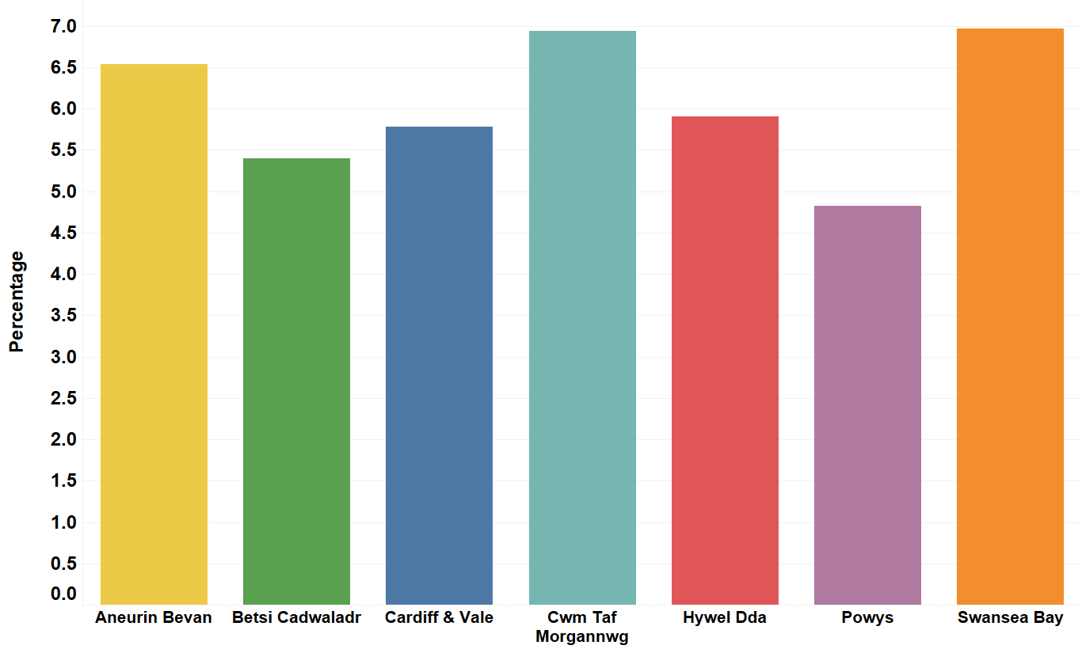
Percentage of patients with AF who are prescribed antiplatelet monotherapy – September 2019
PRIORITY
ANTICOAGULANTS IN ATRIAL FIBRILLATION

Slide 28
How can changes be made?
PRIORITY
ANTICOAGULANTS IN ATRIAL FIBRILLATION
?
Review patients with AF identified as being prescribed antiplatelet monotherapy.
Ensure patients are aware that antiplatelet monotherapy is no longer recommended in patients with AF as the risks outweigh the benefits.
Be aware that patients may need to take antiplatelets for other indications.

Slide 29
PRIORITY
ANTIMICROBIAL STEWARDSHIP – TOTAL ANTIBACTERIAL ITEMS
Purpose | To encourage the appropriate prescribing of all antibiotics in primary care.
Unit of measure | Total antibacterial items per 1,000 STAR-PUs.
Aim | To reduce prescribing.
The widespread and often excessive usage of antimicrobials is one of the main factors contributing to the emergence of antimicrobial resistance.
Despite reductions in prescribing, there is variation between health boards and GP practices. In addition, prescribing in Wales is high in comparison with England.
Indiscriminate or inappropriate use of antibiotics is a key driver in the spread of antibiotic resistance.

Slide 30
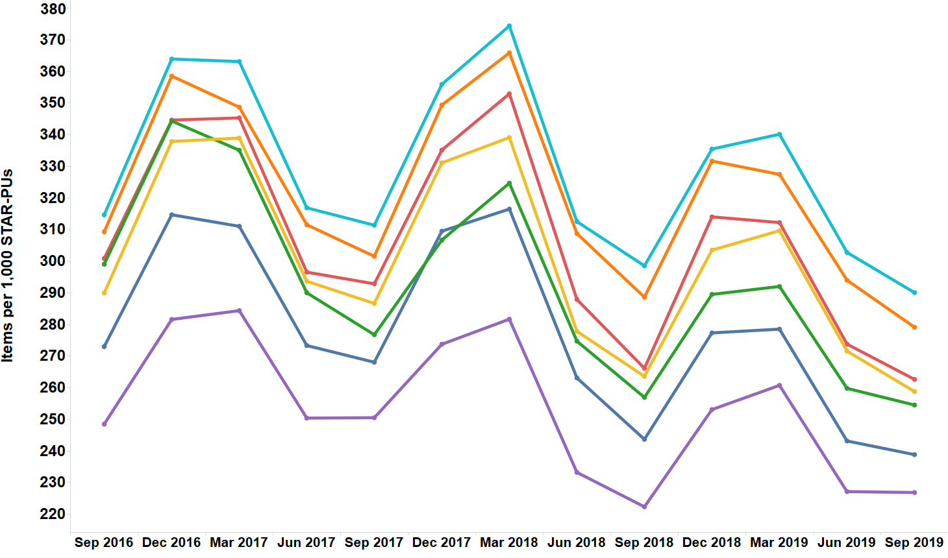
Trend in total primary care antibacterial prescribing
PRIORITY
TOTAL ANTIBACTERIAL ITEMS

Slide 31
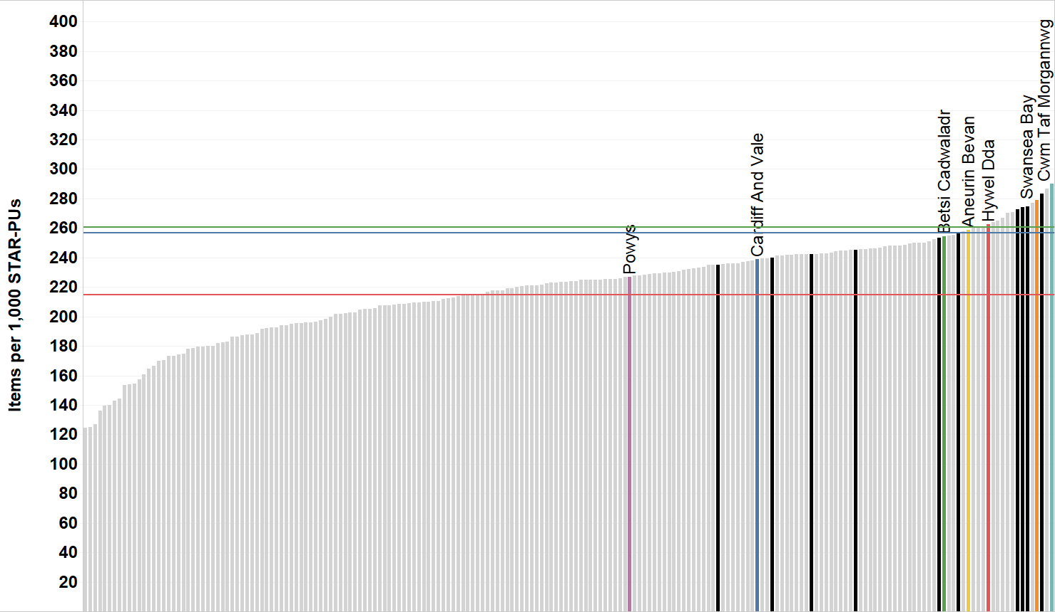
Total primary care antibacterial items per 1,000 STAR-PUs –
Quarter ending September 2019
PRIORITY
TOTAL ANTIBACTERIAL ITEMS
Wales average
NE England CCGs
England average
Other CCGs
North East England average
CCG/HB

Slide 32
How can changes be made?
PRIORITY
TOTAL ANTIBACTERIAL ITEMS
?
Where an antimicrobial is indicated, follow local or national guidelines, prescribing antibiotics for the shortest effective course at the most appropriate dose.
Consider the risk of antimicrobial resistance for individual patients and the population as a whole.
Document and code the clinical diagnosis and reason for prescribing, or not prescribing, an antimicrobial.
Consider a delayed/back up prescription.
Provide patients with leaflets/resources so they are aware of how long they can expect their condition to last and how they can self-care. Resources are available in the TARGET Antibiotics toolkit.
Carry out the AWMSG National Audit: Focus on Antibiotic Prescribing.

Slide 33
PRIORITY
ANTIMICROBIAL STEWARDSHIP – 4C ANTIMICROBIALS
Purpose | To reduce the prevalence of HCAI including Clostridium difficile infection and Staphylococcus aureus bacteraemia caused by MRSA by encouraging a reduction in variation and reduce overall prescribing of the 4C antimicrobials (co-amoxiclav, cephalosporins, fluoroquinolones and clindamycin) in primary care.
Unit of measure | Co-amoxiclav, cephalosporin, fluoroquinolone and clindamycin items combined, per 1,000 patients.
Aim | To reduce prescribing.
Compared with narrow spectrum antibiotics, broad-spectrum antibiotics are more likely to significantly change the gut flora, potentially allowing other bacteria, such as C. difficile, to become established.
The use of simple generic antibiotics and the avoidance of broad-spectrum antibiotics preserve these from resistance and reduce the risk of C. difficile, MRSA and resistant UTIs.
These antimicrobials have a very useful role in specific clinical situations and should be reserved for use as per local guidelines.

Slide 34
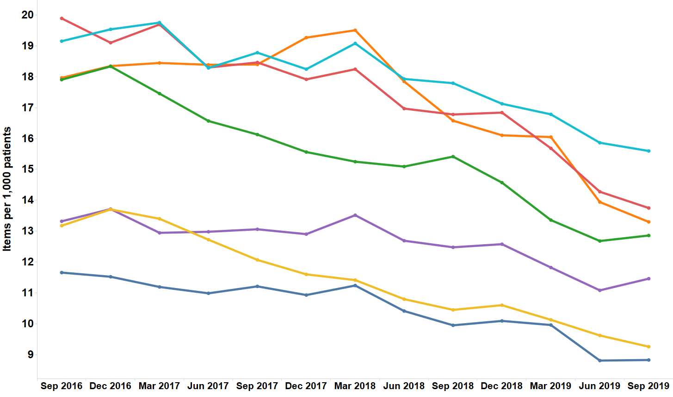
Trend in 4C items per 1,000 patients
PRIORITY
4C ANTIMICROBIALS

Slide 35
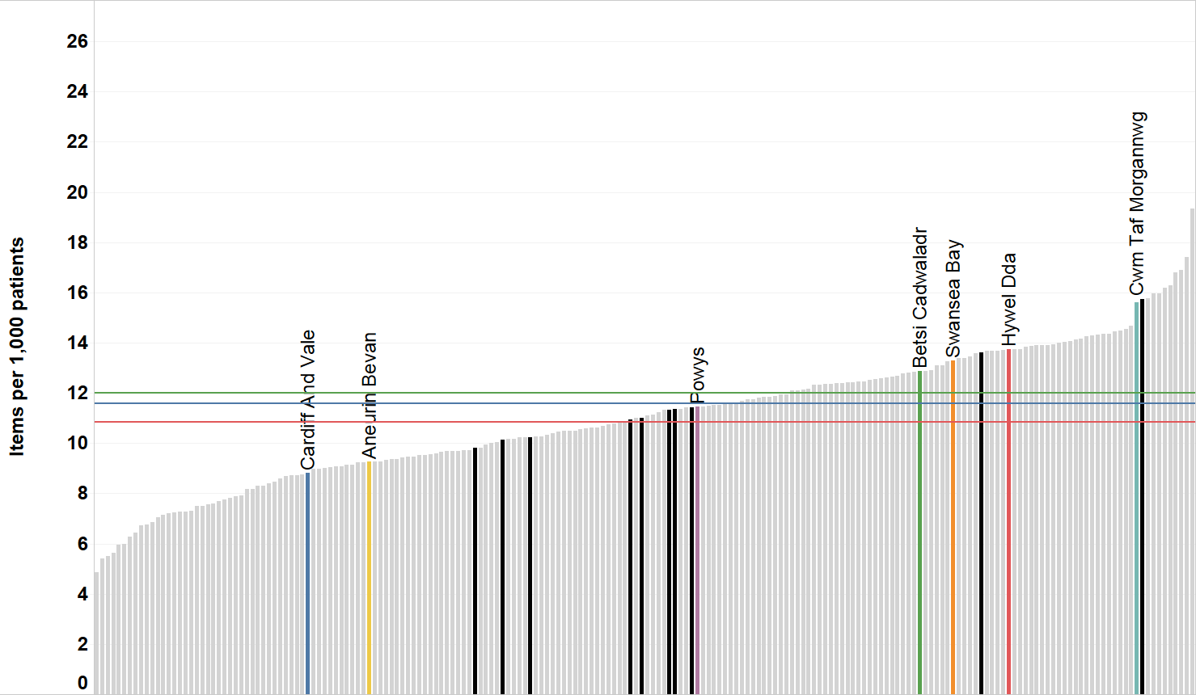
Total 4C antibacterial items per 1,000 patients – Quarter ending September 2019
PRIORITY
4C ANTIMICROBIALS
Wales average
NE England CCGs
England average
Other CCGs
North East England average
CCG/HB

Slide 36
How can changes be made?
PRIORITY
4C ANTIMICROBIALS
?
Where an antimicrobial is indicated, follow local or national guidelines, prescribing antibiotics for the shortest effective course at the most appropriate dose.
Consider the risk of antimicrobial resistance for individual patients and the population as a whole.
Document and code the clinical diagnosis and reason for prescribing, or not prescribing, an antimicrobial.
Consider a delayed/back up prescription.
Provide patients with leaflets/resources so they are aware of how long they can expect their condition to last and how they can self-care. Resources are available in the TARGET Antibiotics toolkit.
Carry out the AWMSG National Audit: Focus on Antibiotic Prescribing.

Slide 37
National Prescribing Indicators (NPIs)
SUPPORTING DOMAIN:
SAFETY

Slide 38
NPIs
SAFETY
National Prescribing Indicator | Applicable to: | Unit of measure | Target for 2020–2021
Prescribing Safety Indicators | Primary care | Number of patients identified | No target set
Proton pump inhibitors | Primary care | PPI DDDs per 1,000 PUs | Maintain performance levels within the lower quartile, or show a reduction towards the quartile below
Hypnotics and anxiolytics | Primary care | Hypnotic and anxiolytic UDG ADQs per 1,000 STAR-PUs | Maintain performance levels within the lower quartile, or show a reduction towards the quartile below
Yellow Cards | Primary care | Number of Yellow Cards submitted | One Yellow Card per 2,000 GP practice population
 | Health board |  | One Yellow Card per 2,000 health board population 20% or greater increase from baseline (2019–2020) for Yellow Cards submitted by secondary care 50% or greater increase from baseline (2019–2020) for Yellow Cards submitted by members of the public
 | Community pharmacy |  | No target set. Reported as the number of Yellow Cards submitted by health board

Slide 39
SAFETY
PRESCRIBING SAFETY INDICATORS
Purpose | To identify patients at high risk of ADRs and medicines-related harm in primary care.
Unit of measure | Number of patients identified
Aim | To review patients identified as being at high risk of ADRs and reduce inappropriate prescribing.
It is estimated that within the UK around 6.5% of hospital admissions are related to ADRs.
ADRs can often be predictable, making it possible to identify and address them before patient harm occurs.
A process of identifying patients electronically could enable intervention and help to avoid harm.

Slide 40
SAFETY
PRESCRIBING SAFETY INDICATORS
PSIs related to acute kidney injury (AKI)
• | Number of patients on the CKD register (CKD stage 3–5) who have received a repeat prescription for an NSAID within the last 3 months
• | Number of patients who are not on the CKD register but have an eGFR of < 59 ml/min and have received a repeat prescription for an NSAID within the last 3 months
• | Number of patients with concurrent prescriptions of an NSAID, renin-angiotensin system (RAS) drug and a diuretic
• | Number of patients aged 75 and over with a current prescription for an ACE Inhibitor or loop diuretic without a check of renal function and electrolytes in the previous 15 months
PSIs related to bleeds
• | Number of patients with a peptic ulcer who have been prescribed NSAIDs without a PPI
• | Number of patients with concurrent prescriptions of warfarin and an oral NSAID
• | Number of patients with concurrent prescriptions for a DOAC and an oral NSAID
• | Number of patients aged 65 years or over prescribed an NSAID plus aspirin and/or clopidogrel but without gastroprotection (PPI or H2-receptor antagonist)
• | Number of patients with concurrent prescriptions of an oral anticoagulant (warfarin or DOAC) and an SSRI
PSIs related to cognition
• | Number of patients aged 65 years or over prescribed an antipsychotic
• | Number of patients aged 75 and over with an Anticholinergic Effect on Cognition (AEC) score of 3 or more for items on active repeat

Slide 41
SAFETY
PRESCRIBING SAFETY INDICATORS
PSIs specific to females
• | Number of female patients with a current prescription of oestrogen-only hormone replacement therapy (HRT) without any hysterectomy READ/SNOMED codes.
• | Number of female patients with a past medical history of venous or arterial thrombosis who have been prescribed combined hormonal contraceptives
• | Number of female patients aged 14–45 with a prescription for sodium valproate
• | Number of female patients aged 14–45 with a prescription for oral retinoids
PSIs related to ‘other’
• | Number of patients under 16 with a current prescription of aspirin
• | Number of patients with asthma who have been prescribed a beta-blocker
• | Number of patients with concurrent prescriptions of verapamil and a beta-blocker

Slide 42
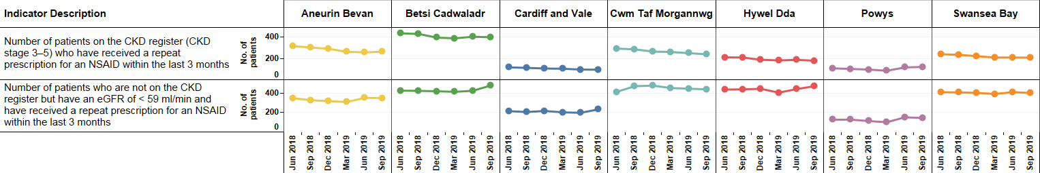
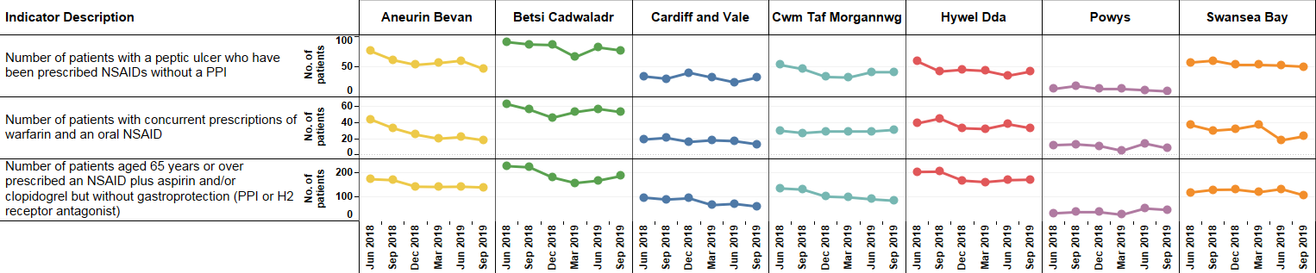
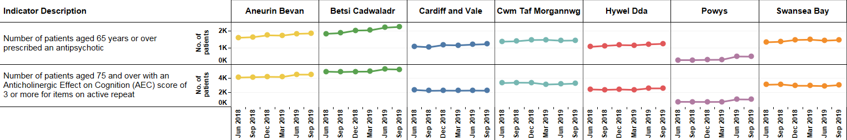
Prescribing Safety Indicator data – June 2018 to September 2019
SAFETY
PRESCRIBING SAFETY INDICATORS
PSIs related to acute kidney injury (AKI)
PSIs related to bleeds
PSIs related to cognition

Slide 43
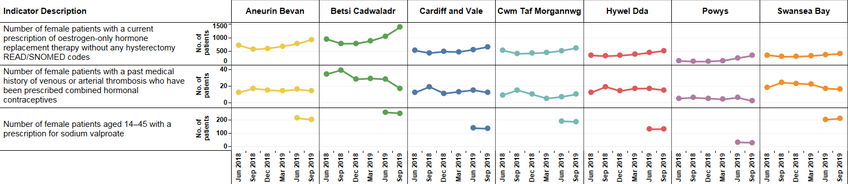
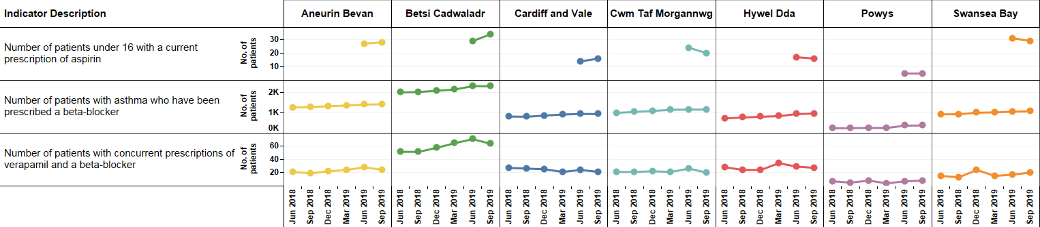
Prescribing Safety Indicator data – June 2018 to September 2019
SAFETY
PRESCRIBING SAFETY INDICATORS
PSIs specific to females
PSIs related to ‘other’
Please note: A number of Prescribing Safety Indicators are new for 2020–2021, and therefore no baseline data is currently available.

Slide 44
How can changes be made?
SAFETY
PRESCRIBING SAFETY INDICATORS
?
Review patients identified as being at high risk of ADRs and medicines-related harm
Ensure that action taken is clearly documented and coded appropriately.

Slide 45
SAFETY
PROTON PUMP INHIBITORS
Purpose | To encourage appropriate use of proton pump inhibitors (PPIs) in primary care.
Unit of measure | PPI DDDs per 1,000 PUs.
Aim | To reduce prescribing.
In the financial year 2018–2019, over 4.3 million prescriptions for PPIs were dispensed in Wales, this equates to approximately 10.7% of the population.
There is increasing evidence regarding the potential consequences of long-term treatment with PPIs, including C. difficile infection, fractures and hypomagnesaemia.
Other possible serious adverse effects include acute interstitial nephritis, vitamin B₁₂ deficiency and rebound acid hypersecretion.
When the potential adverse effects are taken into consideration, the possible risks of treatment may outweigh the potential benefits, particularly in patients without a clear indication for a PPI, or when the patient is at increased risk of medicine-related adverse effects.
Ranitidine supply disruption
Due to the disruption to the supply of ranitidine from October 2019 and the recommendation to switch to omeprazole, rather than an alternative H₂-receptor antagonist where ongoing treatment is still required and the patient cannot be stepped down to an antacid or alginate, there may be a resultant increase in PPI prescribing.

Slide 46
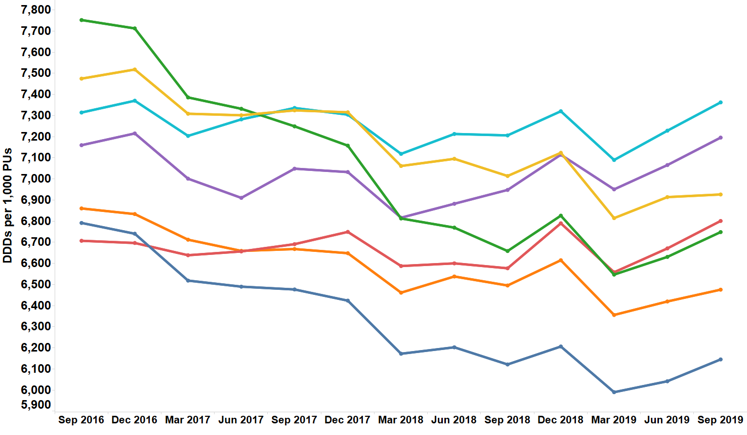
Trend in proton pump inhibitor prescribing
SAFETY
PROTON PUMP INHIBITORS

Slide 47
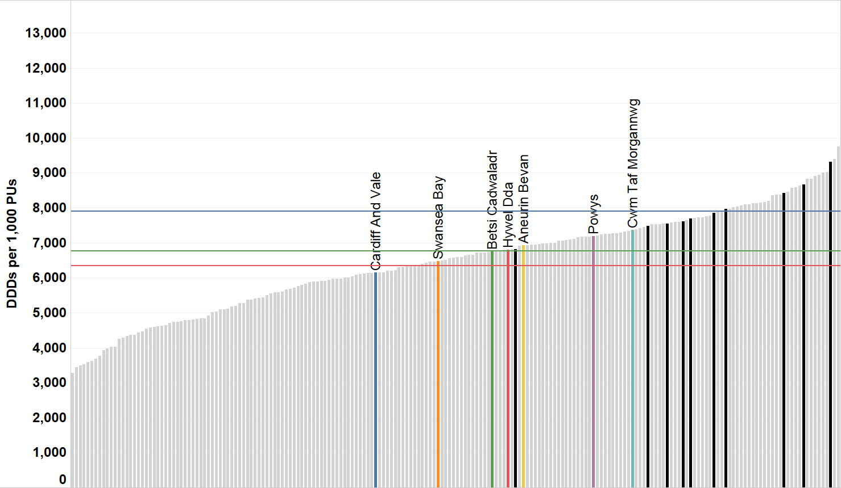
Proton pump inhibitor DDDs per 1,000 PUs –
Quarter ending September 2019
SAFETY
PROTON PUMP INHIBITORS
Wales average
NE England CCGs
England average
Other CCGs
North East England average
CCG/HB

Slide 48
How can changes be made?
SAFETY
PROTON PUMP INHIBITORS
?
When initiating a PPI, only consider for short courses (4 weeks) where needed, using acute, rather than repeat, prescriptions.
Review long-term PPI prescriptions at least annually, and advise patients that it may be appropriate for them to return to self-treatment with antacid and/or alginate therapy.
Inform patients of the potential long-term effects of PPIs as this may result in them being more willing to try self-care to improve their symptoms.
Use the AWMSG patient information leaflet ‘Stopping Your PPI’ when initiating; reducing and stopping PPIs.
Use the PPI audit and review toolkit in AWMSG Safe Use of Proton Pump Inhibitors resource pack.

Slide 49
SAFETY
HYPNOTICS AND ANXIOLYTICS
Purpose | To encourage a reduction in the inappropriate prescribing of hypnotics and anxiolytics in primary care.
Unit of measure | Hypnotic and anxiolytic UDG ADQs per 1,000 STAR-PUs
Aim | To reduce prescribing.
There is a high level of hypnotic and anxiolytic prescribing in NHS Wales, compared with England.
The problems associated with benzodiazepines (e.g. tolerance, dependence, withdrawal causing rebound insomnia) are well known, and the number of deaths associated with benzodiazepines has increased.
Hypnotics and anxiolytics are known to significantly increase the risk of falls.

Slide 50
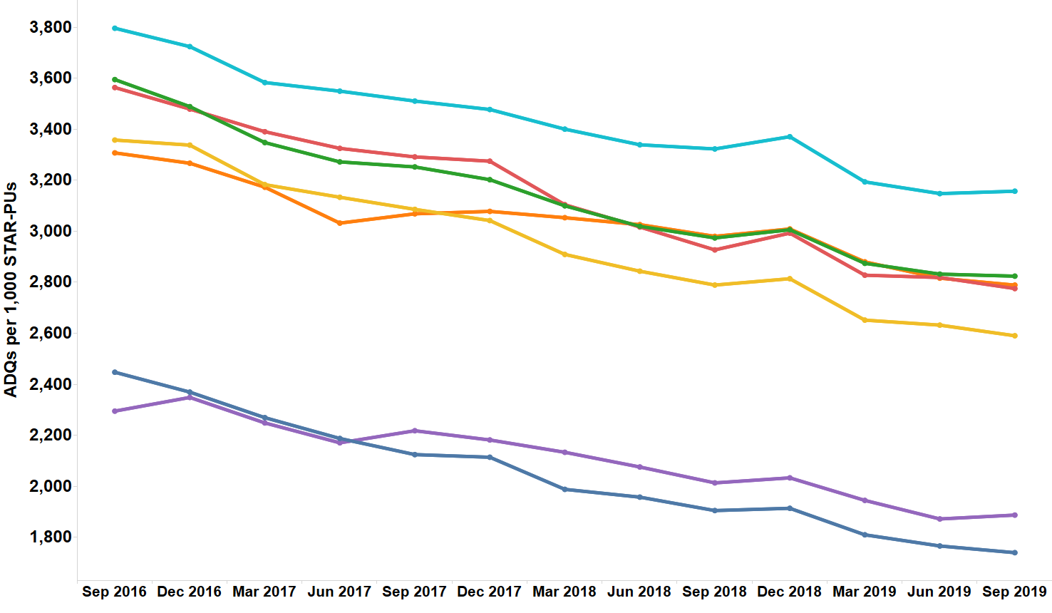
Trend in hypnotic and anxiolytic prescribing
SAFETY
HYPNOTICS AND ANXIOLYTICS

Slide 51
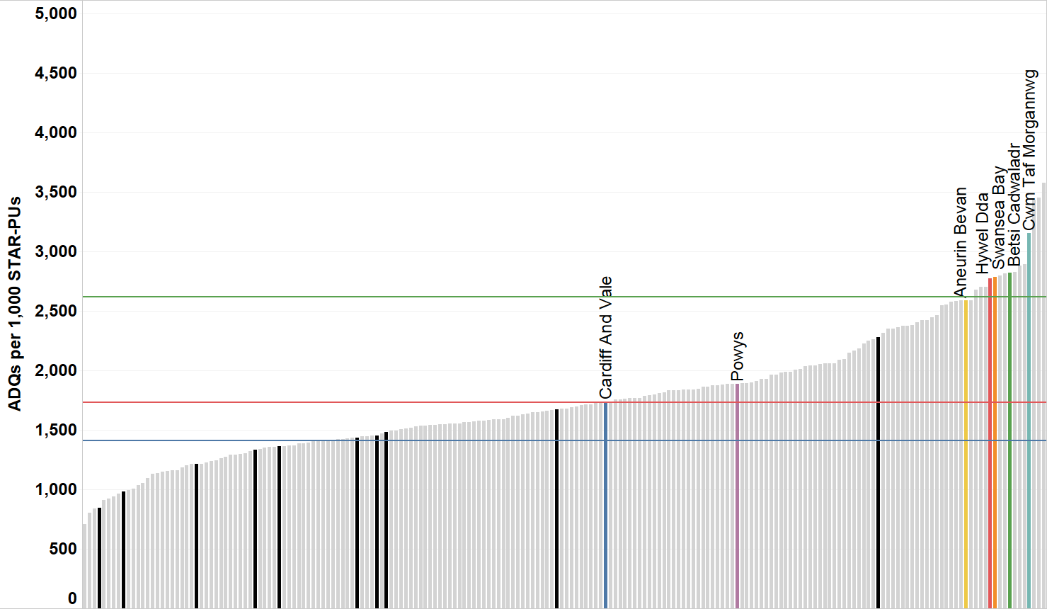
Hypnotic and anxiolytic ADQs per 1,000 STAR-PUs – Quarter ending September 2019
SAFETY
HYPNOTICS AND ANXIOLYTICS
Wales average
NE England CCGs
England average
Other CCGs
North East England average
CCG/HB

Slide 52
How can changes be made?
SAFETY
HYPNOTICS AND ANXIOLYTICS
?
Consider hypnotics only after non-drug therapies have been explored.
When prescribing hypnotics, use the lowest dose possible, for the shortest duration possible and in strict accordance with their licensed indications; no more than four weeks.
Do not offer benzodiazepines for the treatment of generalised anxiety disorder (GAD), except as a short-term measure during crises.
Always consider reducing hypnotics and anxiolytics where appropriate.
Carry out the hypnotic and anxiolytic audit from the AWMSG Educational Pack: Materials to Support Appropriate Prescribing of Hypnotics and Anxiolytics across Wales.
Use the hypnotic and anxiolytic reduction/withdrawal resources in the AWMSG Educational Pack: Materials to Support Appropriate Prescribing of Hypnotics and Anxiolytics across Wales.

Slide 53
SAFETY
YELLOW CARDS
Purpose | To encourage an increase in the number of Yellow Cards submitted in Wales.
Unit of measure | Number of Yellow Cards submitted per GP practice, per health board and per hospital. Number of Yellow Cards submitted by Community Pharmacies, per health board.
Aim | To increase reporting.
ADRs are a significant clinical problem, increasing morbidity and mortality.
The Yellow Card Scheme is vital in helping the MHRA monitor the safety of all healthcare products in the UK to ensure they are acceptably safe for those that use them.
Yellow Card reporting supports the identification and collation of ADRs which might not have been known about before.

Slide 54
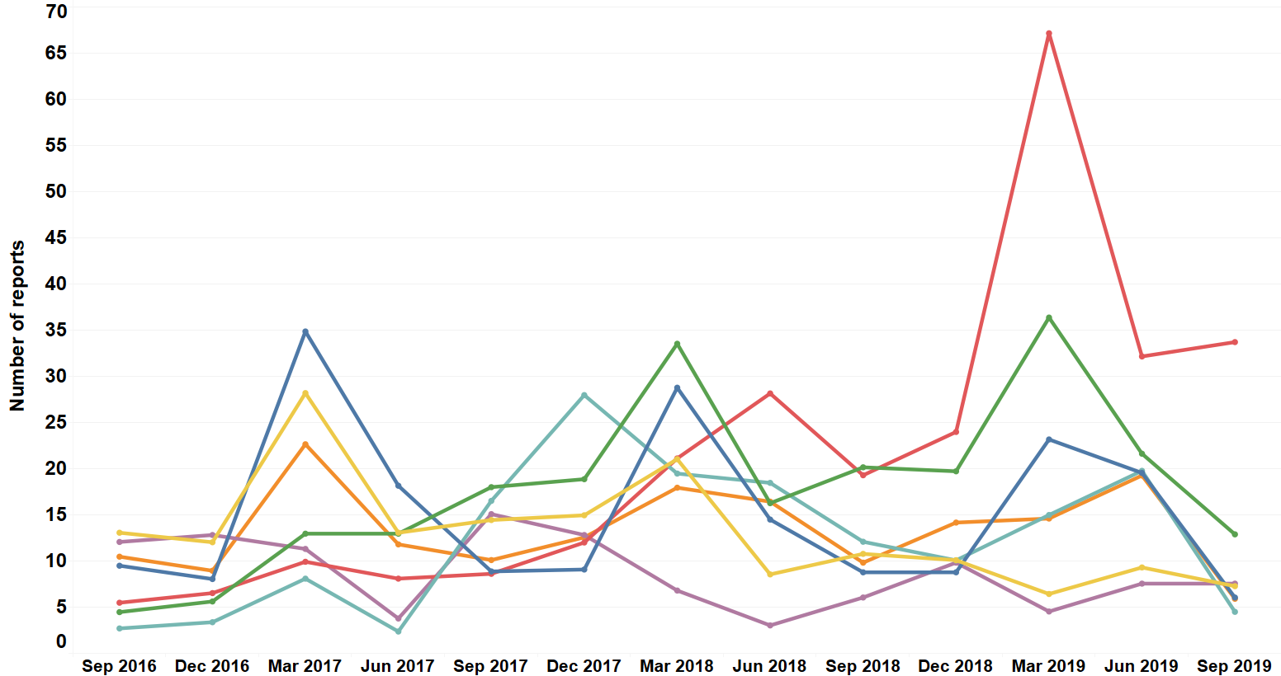
Trend in GP Yellow Card Reporting
SAFETY
YELLOW CARDS

Slide 55
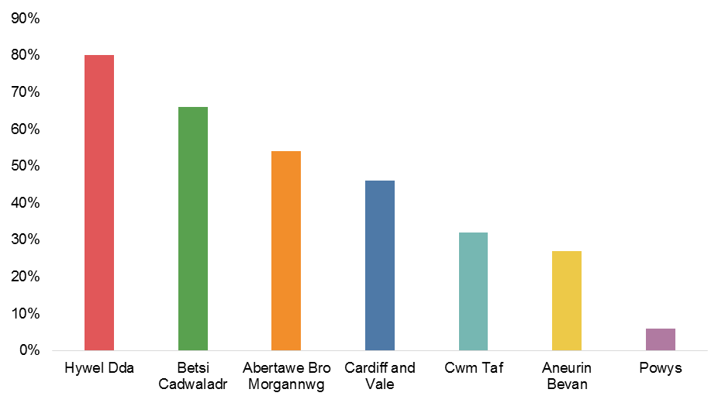
Percentage of GP practices meeting the target of one Yellow Card per 2,000 practice population 2018–2019
SAFETY
YELLOW CARDS

Slide 56
Total number of reports, secondary care reports, and public reports in 2018–2019
SAFETY
YELLOW CARDS
Health board | Total number of reports | Secondary care reports | Number of public reports
Aneurin Bevan | 375 | 84 | 56
Betsi Cadwaladr | 929 | 188 | 77
Cardiff and Vale | 479 | 106 | 73
Cwm Taf | 315 | 47 | 40
Hywel Dda | 704 | 95 | 59
Powys | 57 | 8 | 15
Swansea Bay | 346 | 52 | 34
Velindre | 17 | 17 | N/A

Slide 57
How can changes be made?
SAFETY
YELLOW CARDS
?
Yellow Card reports can be completed:
  Online: www.mhra.gov.uk/yellowcard
  Using the free Yellow Card app
  Through the Vision prescribing system
  By writing to FREEPOST YELLOW CARD
  By emailing: yellowcard@mhra.gov.uk
  By downloading forms from the website
You only need to suspect that an adverse drug reaction was caused by a medicine to report it.
Don’t assume someone else will report an adverse drug reaction you witness.
Reports can be made for all medicines including vaccines, blood factors and immunoglobulins, herbal medicines and homeopathic remedies, and all medical devices available on the UK market.

Slide 58
National Prescribing Indicators (NPIs)
SUPPORTING DOMAIN: EFFICIENCY

Slide 59
NPIs
EFFICIENCY
National Prescribing Indicator | Applicable to: | Unit of measure | Target for 2020–2021
Best value biological medicines | Primary care + secondary care | Quantity of best value biological medicines prescribed as a percentage of total ‘biosimilar’ plus ‘reference’ product | Increase the appropriate use of cost-efficient biological medicines, including biosimilar medicines
Insulin | Primary care + secondary care | Items/number of long-acting insulin analogues expressed as a percentage of total long- and intermediate-acting insulin prescribed | Reduce prescribing of long-acting insulin analogues and achieve prescribing levels below the Welsh average.
Low value for prescribing | Primary care | Low value for prescribing UDG spend per 1,000 patients | Maintain performance levels within the lower quartile or show a reduction towards the quartile below

Slide 60
EFFICIENCY
BEST VALUE BIOLOGICAL MEDICINES
Purpose | To ensure prescribing of best value biological medicines supports cost-efficient prescribing in primary and secondary care in Wales.
Unit of measure | Quantity of best value biological medicines prescribed as a percentage of total ‘biosimilar’ plus ‘reference’ product.
Aim | Increase the appropriate use of cost-efficient biological medicines, including biosimilar medicines.
A biosimilar medicine is “a biological medicine that is developed to be highly similar and clinically equivalent to an existing biological medicine”.
A target has been set to increase the appropriate use of cost-efficient biological medicines, including biosimilar medicines, in line with guidance.
Biological medicines including all biosimilars must be prescribed by brand name.
Within the next five years a number of biological medicines will lose their patent protection thus increasing the potential opportunity of prescribing biosimilar medicines.
There are a number of biosimilar medicines available within NHS Wales; those currently being reported on within the NPI are:
  infliximab – Inflectra®
  etanercept – Benepali®, Erelzi ®
  rituximab – Truxima®
  trastuzumab – Ontruzant®
  adalimumab – Amgevita®, Hulio®, Hyrimoz®, Imraldi®
  teriparatide – Movymia ®, Terrosa ®

Slide 61
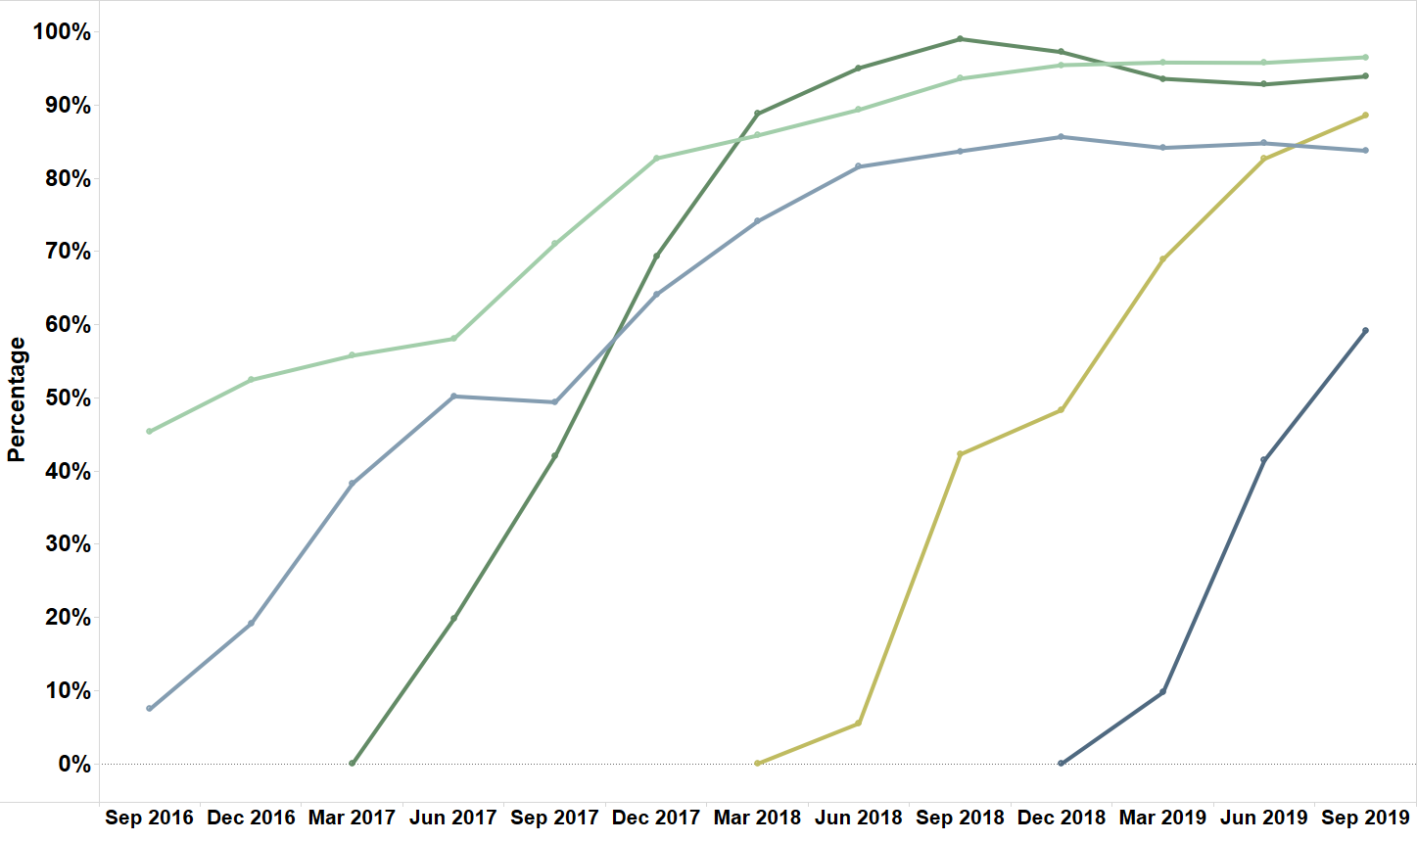
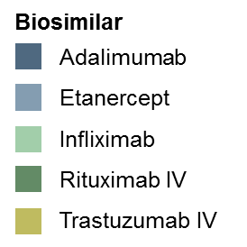
Trend in biosimilar percentage
EFFICIENCY
BEST VALUE BIOLOGICAL MEDICINES

Slide 62
How can changes be made?
EFFICIENCY
BEST VALUE BIOLOGICAL MEDICINES
?
Where AWMSG or NICE has recommended the reference medicine, the same guidance will normally apply to the biosimilar.
At the time of dispensing there must not be automatic substitution of the reference product with a biosimilar medicine. Therefore, the clinician in consultation with the patient should make the decision on whether the reference or biosimilar biological medicine will be prescribed.
All biological medicines, including biosimilars, must be prescribed by brand name.

Slide 63
EFFICIENCY
INSULIN
Purpose | To encourage a reduction in the prescribing of long-acting insulin analogues in primary and secondary care in line with NICE guidance to maximise cost-effectiveness in Wales.
Unit of measure | Items/number of long-acting insulin analogues as a percentage of total long- and intermediate-acting insulin prescribed.
Aim | To reduce prescribing.
There is an absence of evidence to suggest the superiority of the long-acting insulin analogues versus neutral protamine Hagedorn (NPH) insulin.
NICE recommends NPH as first choice regimen before long-acting insulin analogues for the majority of people (NG28, 2019).

Slide 64
Long-acting insulin analogues as a percentage of total long- and intermediate-acting insulin prescribing in primary and secondary care
EFFICIENCY
INSULIN
 | 2017–2018 |  |  |  | 2018–2019
 | Q1 | Q2 | Q3 | Q4 | Q1 | Q2 | Q3 | Q4
Percentage of long-acting insulin analogues (primary care) | 88.9 | 88.5 | 88.3 | 88.1 | 88.1 | 87.9 | 88.0 | 88.1
Percentage of long-acting insulin analogues (secondary care) | 79.2 | 80.1 | 81.8 | 82.0 | 81.2 | 81.9 | 81.3 | 81.8

Slide 65
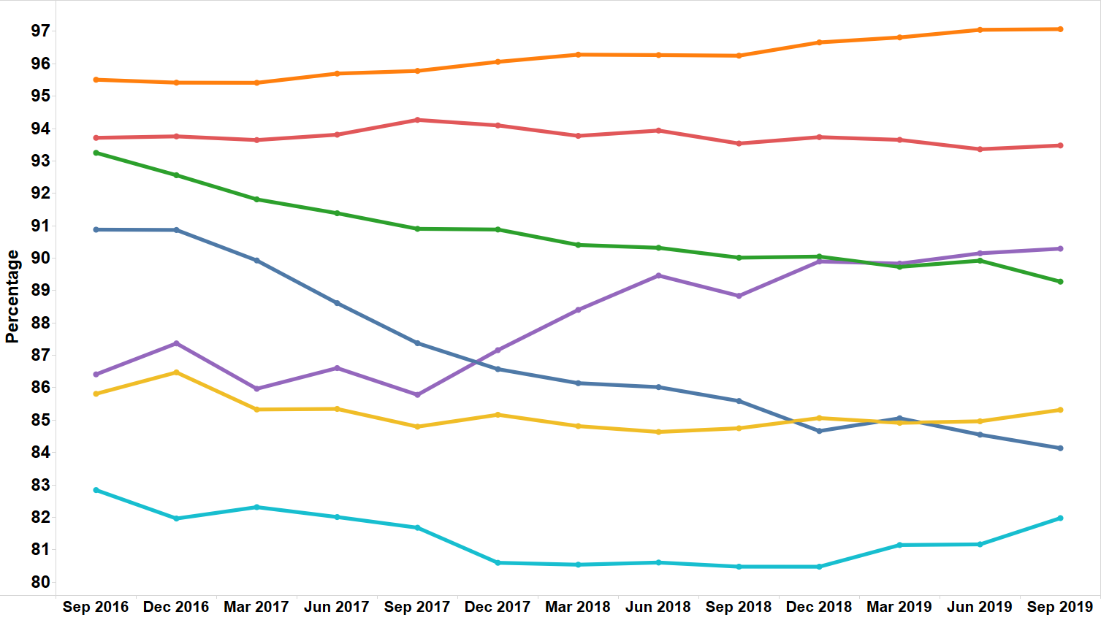
Trend in long-acting analogue prescribing as a percentage of total long- and intermediate-acting insulin prescribed in primary care
EFFICIENCY
INSULIN

Slide 66
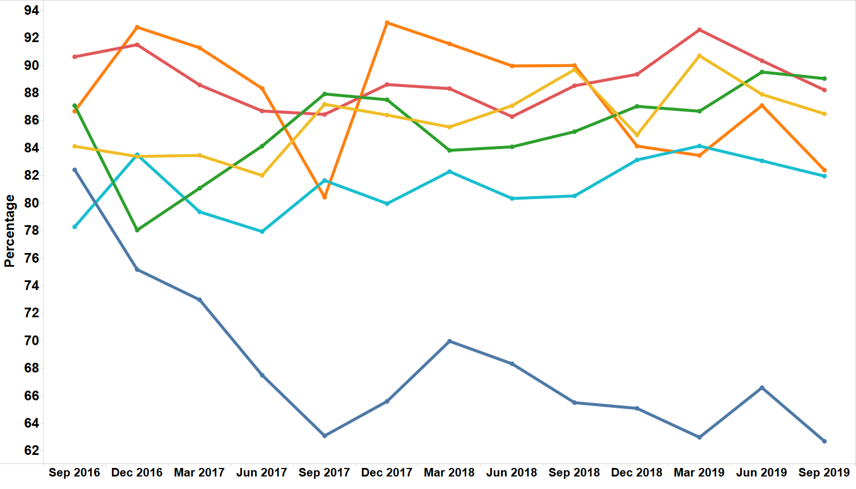
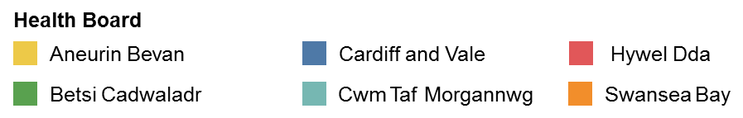
Trend in long-acting analogue prescribing as a percentage of total long- and intermediate-acting insulin prescribed in secondary care
EFFICIENCY
INSULIN
Please note: Data for Velindre have not been included due to very low usage.

Slide 67
How can changes be made?
EFFICIENCY
INSULIN
?
Patients should have the opportunity to make informed decisions about their care and treatment, in partnership with their healthcare professionals.
Discuss with the patient the comparative effectiveness of the specific insulin types and ascertain any preference.
When patients are started on an insulin therapy, a structured programme of active dose titration should be employed. In addition, this programme should also cover injection technique, continuing telephone support, self-monitoring, dietary understanding, DVLA guidance, management of hypoglycaemia, management of acute changes in plasma glucose control, and support from an appropriately trained and experienced healthcare professional.

Slide 68
EFFICIENCY
LOW VALUE FOR PRESCRIBING
Purpose | To drive a reduction in the prescribing of items considered as not suitable for routine prescribing in Wales.
Unit of measure | Low value for prescribing UDG spend per 1,000 patients.
Aim | To reduce prescribing.
The aim of the Low Value for Prescribing in NHS Wales initiative is to minimise the prescribing of items that offer a limited clinical benefit to patients and where more cost-effective treatments may be available.
Five items/item groups were identified for the purposes of the first phase of this initiative, with an additional four included in the second phase. The paper detailing the items included in the third phase of this initiative was endorsed by AWMSG and published in February 2020.

Slide 69
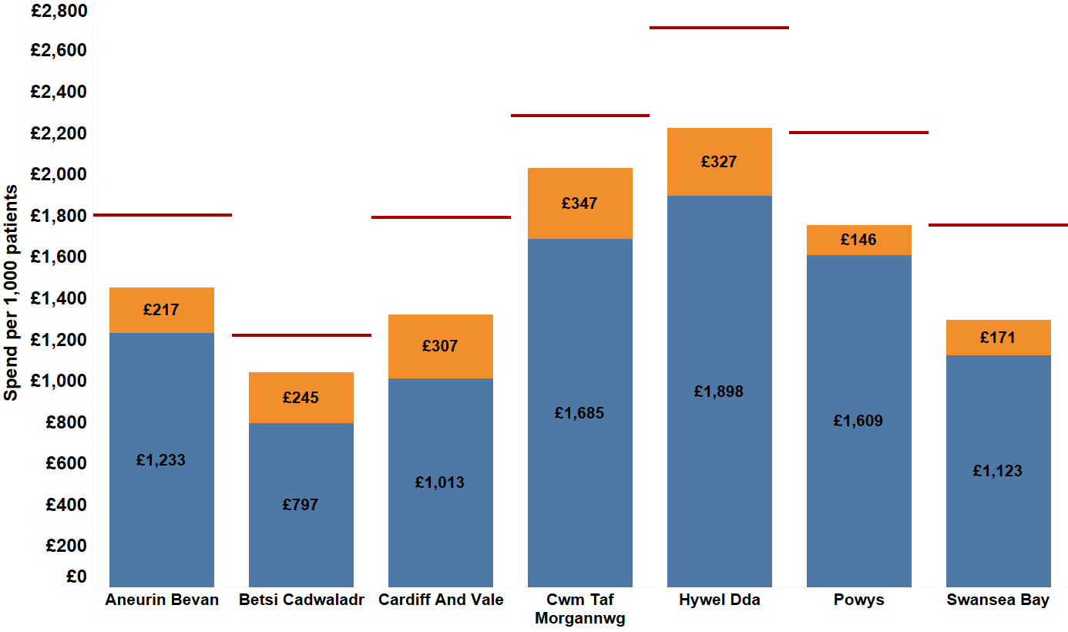
Spend per 1,000 patients on the medicines identified as low value for prescribing by health boards in 2018–2019, compared to 2017–2018
EFFICIENCY
LOW VALUE FOR PRESCRIBING
Spend on items within phase 1 in 2018–2019
Spend on items within phase 2 in 2018–2019
Spend in 2017–2018

Slide 70
How can changes be made?
EFFICIENCY
LOW VALUE FOR PRESCRIBING
?
Prescribers should consider the Low Priority for Funding initiative when deciding whether or not to prescribe any of the included items.
Changes to individual medication regimens should be in partnership with patients using a shared decision making model.

Slide 71
Thank you
For further information on the NPIs visit:
https://www.awttc.org/national-prescribing-indicators-2020-2021
NPI data are available on the Server for Prescribing Information Reporting and Analysis (SPIRA):
https://www.awttc.org/spira

