Slide 1
National Prescribing Indicators
2018–2019

Slide 2
National Prescribing Indicators (NPIs) development process
Developed by the All Wales Prescribing Advisory Group (AWPAG):
May 2017: AWPAG NPI Task and Finish Group review and develop NPIs.
June 2017: Recommendations for NPIs 2018–2019 discussed at AWPAG.
September 2017: Draft consultation paper discussed at AWPAG.
October 2017: Consultation with industry and stakeholders.
December 2017: Final version presented to AWPAG.
February 2018: Final document endorsed by the All Wales Medicines Strategy Group (AWMSG).

Slide 3
Prescribing measures – volume measures
Items
Single item prescribed by a prescriber on a prescription form.
Number of items is a measure of how often a prescriber has decided to write a prescription.
For vaccines and acute treatment such as antibiotics it can be used as a volume measure.
However, a single item can be any quantity or duration (e.g. 1 item = lansoprazole 15 mg od 28 tablets).
Defined daily doses (DDDs)
Developed and maintained by WHO based on international prescribing habits.
Each medicine is given a value, within its recognised dosage range, that represents the assumed average maintenance dose per day when used for its main indication in adults (DDD lansoprazole = 30 mg).
Unit of measurement – not a recommended dose and may not be a real dose. DDD of one medicine is assumed to be functionally equivalent to DDD of any other medicine used for a similar indication; therefore the number of DDDs for two or more such medicines can be added together.
Average daily quantities (ADQs)
Work undertaken in England showed that prescribing in primary care can differ from the international standard.
Measure of prescribing volume that accurately reflects primary care prescribing behaviour in England.
Assumed average maintenance dose/day for a medicine used for its main indication in adults.
Not a recommended dose, but an analytical unit to compare prescribing activity of primary care practitioners (ADQ lansoprazole = 20 mg).
Many ADQs are the same as the corresponding DDD; however, values may differ e.g. when DDD is influenced by use of higher doses in hospital setting.

Slide 4
Prescribing measures – denominators
To allow comparison between health boards, clusters and practices of different sizes, there needs to be a way of weighting prescribing data.
Patients
  Data can be presented per 1,000 patients.
  Only useful if monitoring something that is not influenced by age and gender.
Prescribing units (PUs)
  Introduced in 1983 to take into account the greater need of the elderly population.
  Age < 65 years weighted as 1; age 65 and over weighted as 3.
Specific therapeutic group age-sex related prescribing units (STAR-PUs)
  Introduced in England in 1995.
  Designed to weight individual health board or practice populations based on the age and sex distribution of their practice, for specific therapeutic group for which a particular medicine/group of medicines is prescribed.
  Reviewed regularly (most recently 2013) to take into account changes in prescribing practice: some are cost based, some item based, and ADQ based prescribing units now being introduced.
Analysis has been undertaken to ensure correlation between PUs and STAR-PUs to determine that these measures are relevant to the Welsh population.
Advantage that comparison can also be undertaken with English Clinical Commissioning Groups (CCGs).

Slide 5
National Prescribing Indicators (NPIs)
SAFETY

Slide 6
NPIs
SAFETY
National Prescribing Indicator | Applicable to: | Unit of measure | Target for 2018–2019
Prescribing Safety Indicators | Primary care | Number of patients identified as a percentage of the practice population | No target set
Hypnotics and anxiolytics | Primary care | Hypnotic and anxiolytic ADQs per 1,000 STAR-PUs | Maintain performance levels within the lower quartile, or show a reduction towards the quartile below
Analgesics | Primary care | Tramadol DDDs per 1,000 patients | Maintain performance levels within the lower quartile, or show a reduction towards the quartile below
 |  | Opioid patch items as a percentage of all opioid prescribing | Maintain performance levels within the lower quartile, or show a reduction towards the quartile below
 |  | Gabapentin and pregabalin DDDs per 1,000 patients | Maintain performance levels within the lower quartile, or show a reduction towards the quartile below
Yellow Card Reporting | Primary care | Number of Yellow Cards submitted | One Yellow Card per 2,000 GP practice population
 | Secondary care |  | In excess of a 20% increase from baseline
 | Health board |  | In excess of one Yellow Card per 2,000 health board population In excess of a 50% increase from baseline for Yellow Cards submitted by members of the public
 | Community pharmacy |  | No target set. Reported as the number of Yellow Cards submitted by health board.

Slide 7
Prescribing safety indicators
SAFETY
The aim of this NPI is to identify patients at high risk of adverse drug reactions (ADRs) and medicines-related harm in primary care.
It is estimated that within the UK around 6.5% of hospital admissions are related to ADRs.
ADRs can often be predictable, making it possible to identify and address them before patient harm occurs.
A process of identifying patients electronically could enable intervention and help to avoid harm.

Slide 8
Prescribing safety indicators
SAFETY
1 | Number of patients with a peptic ulcer who have been prescribed NSAIDs without a PPI as a percentage of all patients.
2 | Number of patients with asthma who have been prescribed a beta-blocker as a percentage of all patients.
3 | Number of patients with concurrent prescriptions of verapamil and a beta-blocker as a percentage of all patients.
4 | Number of female patients with a past medical history of venous or arterial thrombosis who have been prescribed combined hormonal contraceptives, as a percentage of all female patients.
5 | Number of female patients with a current prescription of oestrogen-only hormone replacement therapy without any hysterectomy READ/SNOMED codes, as a percentage of all female patients.
6 | Number of patients with concurrent prescriptions of warfarin and an oral NSAID as a percentage of all patients.
7 | Number of patients under 12 with a current prescription of aspirin, unless due to a specialist recommendation, as a percentage of all patients.
8 | Number of patients aged 65 years or over prescribed an NSAID plus aspirin and/or clopidogrel but without gastroprotection (PPI or H₂ receptor antagonist), as a percentage of all patients aged 65 years or over.
9 | Number of patients aged 65 years or over prescribed an antipsychotic, as a percentage of all patients aged 65 years or over.
10 | Number of patients aged 75 and over with an Anticholinergic Effect on Cognition (AEC) score of 3 or more for items on active repeat, as a percentage of all patients aged 75 and over.
11 | Number of patients on the CKD register (CKD stage 3–5) who have received a repeat prescription for an NSAID within the last 3 months, as a percentage of all patients on the CKD register.
12 | Number of patients who are not on the CKD register but have an eGFR of < 59 ml/min and have received a repeat prescription for an NSAID within the last 3 months, as a percentage of all patients who are not on the CKD register but have an eGFR of < 59 ml/min.

Slide 9
Hypnotics and anxiolytics
SAFETY
Aims to encourage a reduction in the inappropriate prescribing of hypnotics and anxiolytics in primary care.
There is a high level of prescribing within Wales, in comparison to England.
Hypnotics and anxiolytics are known to significantly increase the risk of falls.
Hypnotics should only be considered after non-drug therapies have been explored, and should be used at the lowest dose possible, for the shortest duration possible and for no more than 4 weeks.
Benzodiazepines should not be offered for the treatment of generalised anxiety disorder (GAD), except as a short-term measure during crises.
AWMSG Material to Support Appropriate Prescribing of Hypnotics and Anxiolytics provides:
  examples of practice protocols to allow clinicians to agree a consistent approach for the prescribing and review of hypnotics and anxiolytics.
  materials to support the review and discontinuation of hypnotic and anxiolytic treatment.

Slide 10
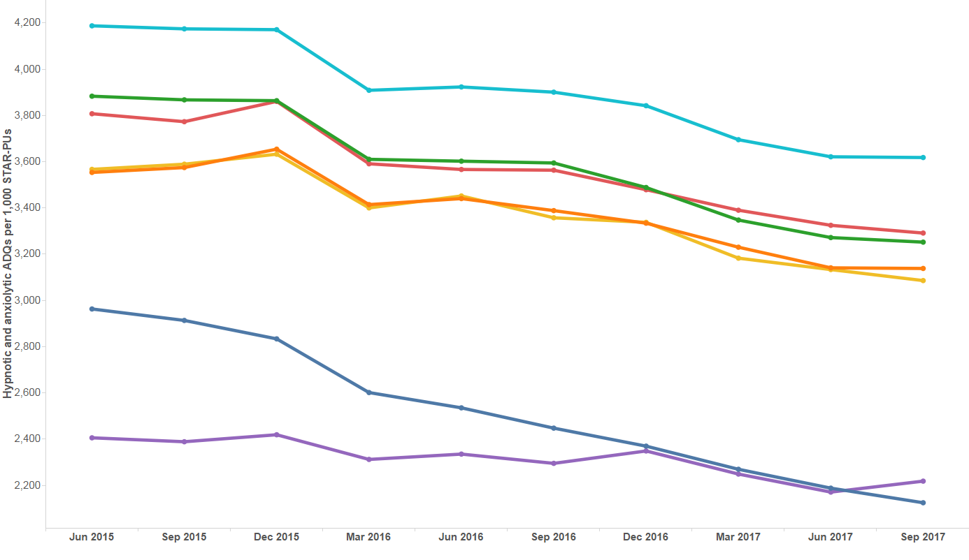
Trend in hypnotic and anxiolytic prescribing
SAFETY

Slide 11
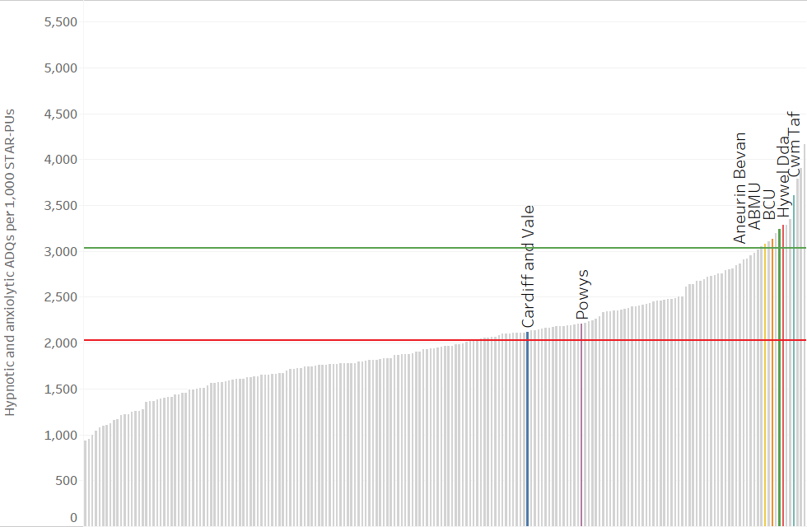
Hypnotic and anxiolytic ADQs per 1,000 STAR-PUs – Quarter ending September 2017
SAFETY
Wales average
England average
CCG/HB

Slide 12
Analgesics – Tramadol
SAFETY
Aims to encourage the appropriate use and review of tramadol in primary care, minimising the potential for dependence, diversion, misuse and ADRs.
There are concerns regarding abuse, dependence and deaths involving tramadol.
Side effects include hallucinations, confusion and convulsions. Rare cases of dependence and withdrawal symptoms have been reported with tramadol at therapeutic doses.
Tramadol should be used with caution in patients taking concomitant medicines that can lower the seizure threshold, such as tricyclic antidepressants (TCAs) and selective serotonin reuptake inhibitors (SSRIs).
Where appropriate, consider stepping down or stopping, reducing the dose slowly to minimise the risk of withdrawal symptoms and/or adverse reactions.

Slide 13
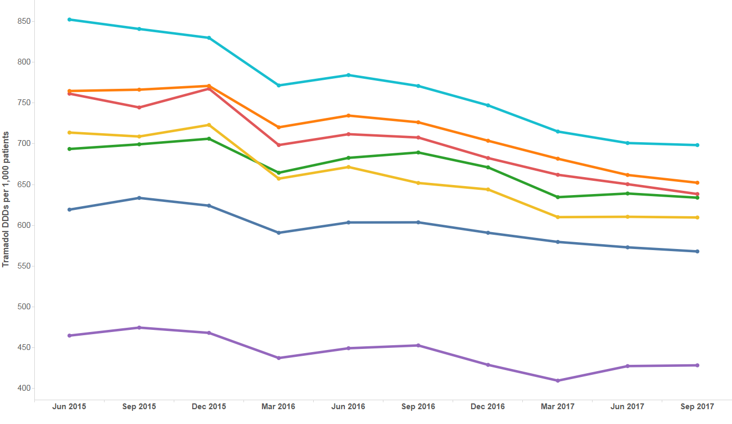
Trend in tramadol prescribing
SAFETY

Slide 14
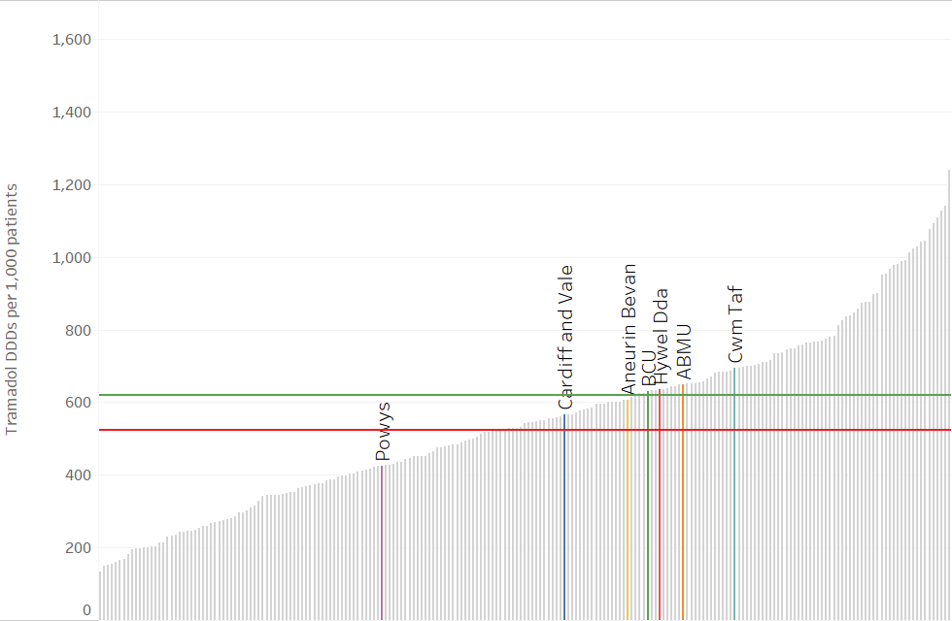
Tramadol DDDs per 1,000 patients -
Quarter ending September 2017
SAFETY
Wales average
England average
CCG/HB

Slide 15
Analgesics – Opioid patches
SAFETY
Aims to encourage the appropriate use and review of opioid patches in primary care, minimising the potential for diversion, misuse and ADRs.
There have been reports of life-threatening reactions and fatalities from fentanyl overdose, with a number of incidents occurring as a result of inappropriate strength of fentanyl patches prescribed in opioid naive patients
Fentanyl and buprenorphine patches are not suitable for acute pain, or for patients whose analgesic requirements are changing rapidly.
Reserve the use of opioid patches for patients in whom oral opioids are unsuitable and whose analgesic requirements are stable.
Fentanyl patches should only be used in patients who have previously tolerated opioids because of the risk of significant respiratory depression in opioid naive patients.
Ensure the initial dose of opioid patch is based on a patient’s opioid history.

Slide 16
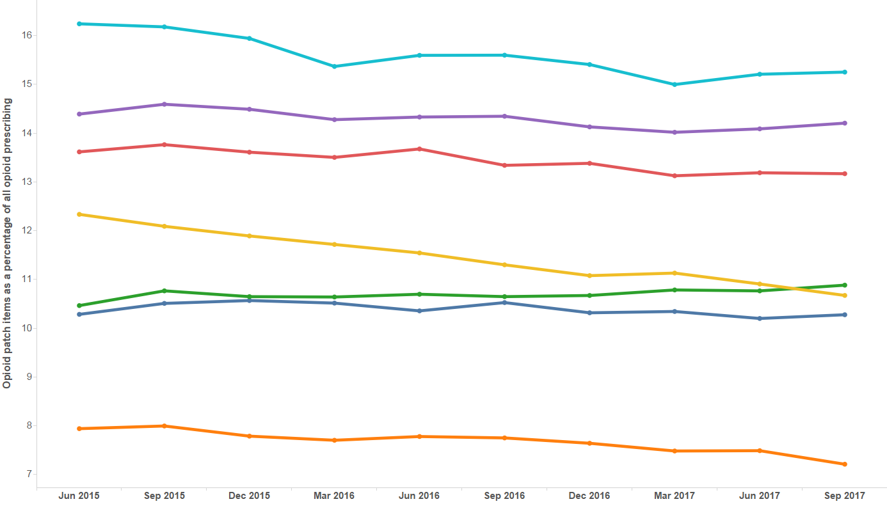
Trend in opioid patch prescribing
SAFETY

Slide 17
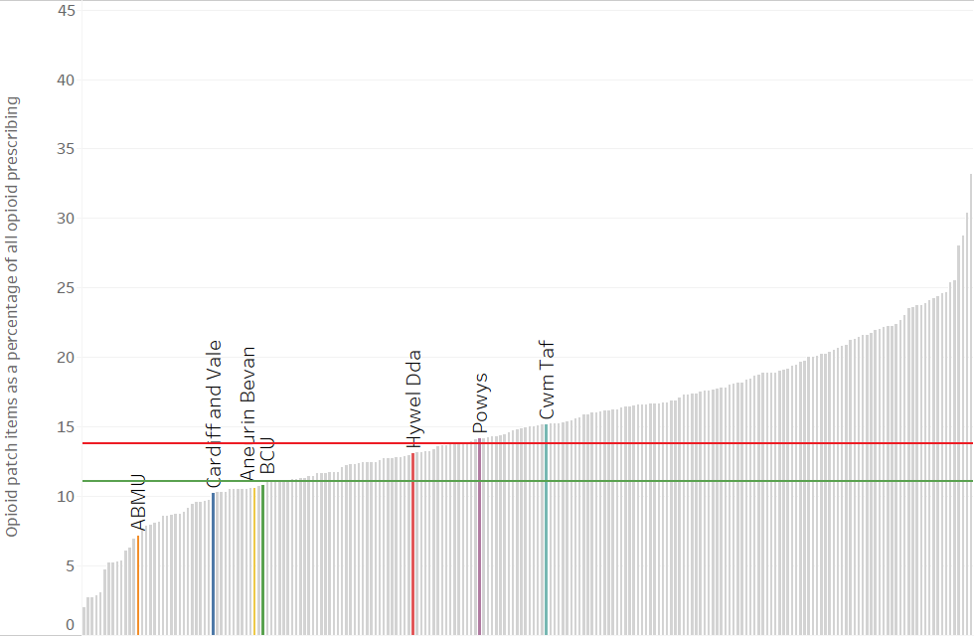
Opioid patch items as a percentage of all opioid analgesics – Quarter ending September 2017
SAFETY
Wales average
England average
CCG/HB

Slide 18
Analgesics – Gabapentin and pregabalin
SAFETY
Aims to encourage the appropriate use and review of gabapentin and pregabalin in primary care, minimising the potential for dependence, diversion, misuse and ADRs.
The number of deaths involving gabapentin or pregabalin is increasing, from 12 deaths registered in England and Wales in 2012 to 170 deaths registered in 2016.
If the patient has not shown sufficient benefit within eight weeks of reaching the maximum tolerated dose, drug treatment should be reduced and stopped.
Caution should be exercised in prescribing either drug for patients with a history of substance abuse.

Slide 19
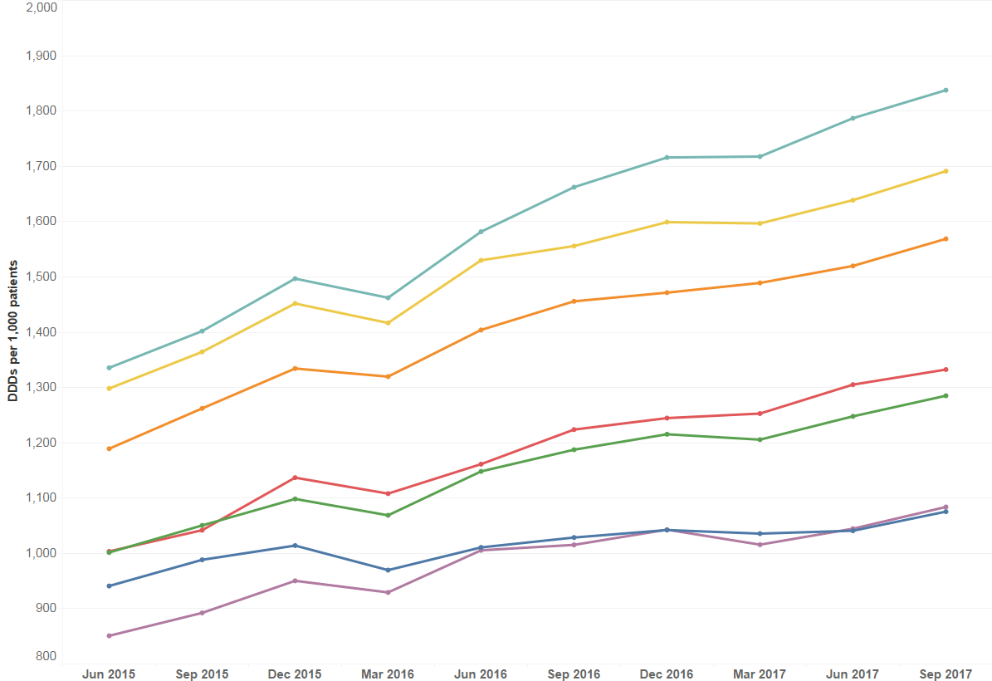
Trend in gabapentin and pregabalin prescribing
SAFETY

Slide 20
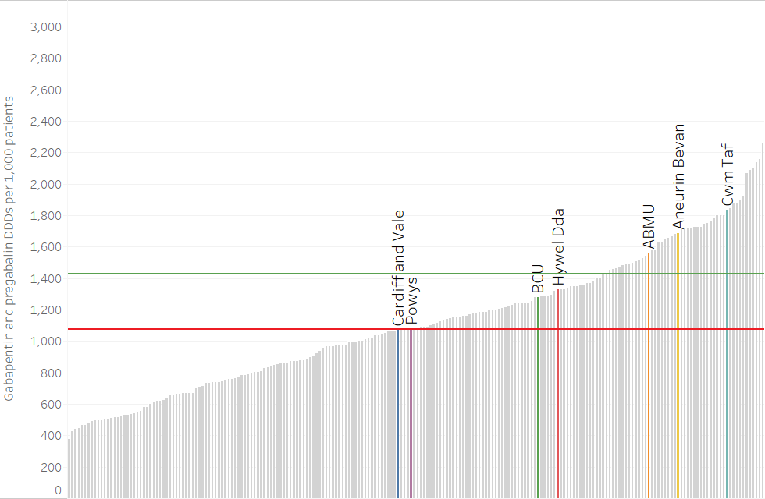
Gabapentin and pregabalin DDDs per 1,000 patients – Quarter ending September 2017
SAFETY
Wales average
England average
CCG/HB

Slide 21
Yellow Cards
SAFETY
Aims to encourage an increase in the number of Yellow Cards submitted in Wales, per GP practice, per health board and per hospital.
ADRs are a significant clinical problem, increasing morbidity and mortality.
The Yellow Card Scheme is vital in helping the MHRA monitor the safety of all healthcare products in the UK to ensure they are acceptably safe for those that use them.
Yellow Card reporting supports the identification and collation of ADRs which might not have been known about before.
A strong safety culture requires good reporting of adverse events from all healthcare professionals and patients.

Slide 22
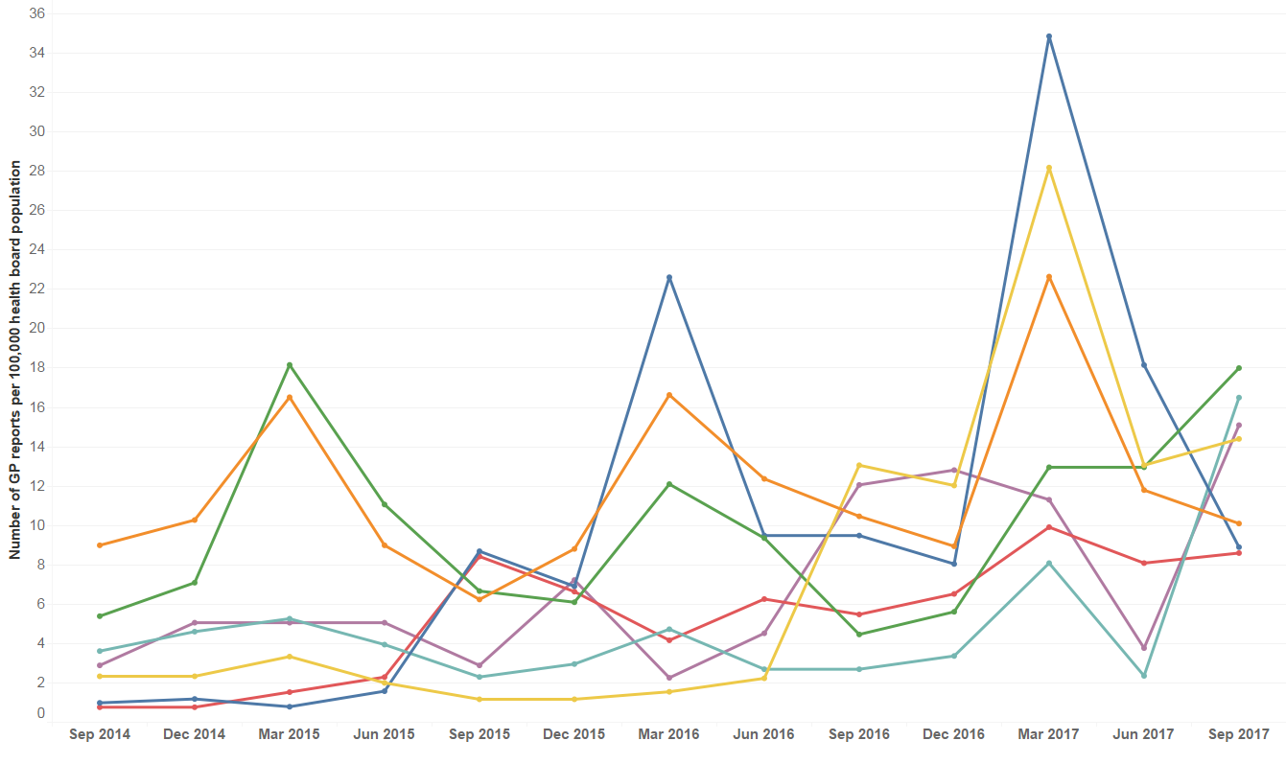
Trend in GP Yellow Card Reporting
SAFETY

Slide 23
Total number of reports, secondary care reports, and public reports in 2016–2017
SAFETY
Health board | Total number of reports | Secondary care reports | Member of public reports
Abertawe Bro Morgannwg | 465 | 74 | 59
Aneurin Bevan | 452 | 47 | 60
Betsi Cadwaladr | 486 | 172 | 66
Cardiff and Vale | 466 | 111 | 38
Cwm Taf | 106 | 22 | 22
Hywel Dda | 278 | 112 | 44
Powys | 82 | 8 | 11

Slide 24
National Prescribing Indicators (NPIs)
STEWARDSHIP

Slide 25
NPIs
STEWARDSHIP
National Prescribing Indicator | Applicable to: | Unit of measure | Target for 2018–2019
Antimicrobial stewardship | Primary care | Total antibacterial items per 1,000 STAR-PUs | Health board target: a reduction of 5% against a baseline of April 2016–March 2017
 | Primary care | 4C antimicrobials (co-amoxiclav, cephalosporins, fluoroquinolones and clindamycin): the number of 4C items as a percentage of total antibacterial prescribing. the number of 4C items per 1,000 patients | Absolute measure ≤7% or a proportional reduction of 10% against a baseline of April 2016–March 2017
 | Secondary care | Prophylaxis in colorectal surgery: Proportion of elective colorectal patients receiving a single dose of antimicrobial for surgical prophylaxis | Absolute measure ≥90% or a proportional increase of 20% against performance for 2017–2018

Slide 26
Total antibacterial items
STEWARDSHIP
Aims to encourage the appropriate prescribing of all antibiotics in primary care.
Over prescribing of antibiotics leads to resistance.
If there is evidence of bacterial infection, prescribe according to national or local guidelines.
Where an antibiotic is indicated, prescribe the shortest effective course at the most appropriate dose.
Consider the risk of antimicrobial resistance for individual patients and the population as a whole.
Document the clinical diagnosis with the reason for prescribing, or not prescribing, an antimicrobial.

Slide 27
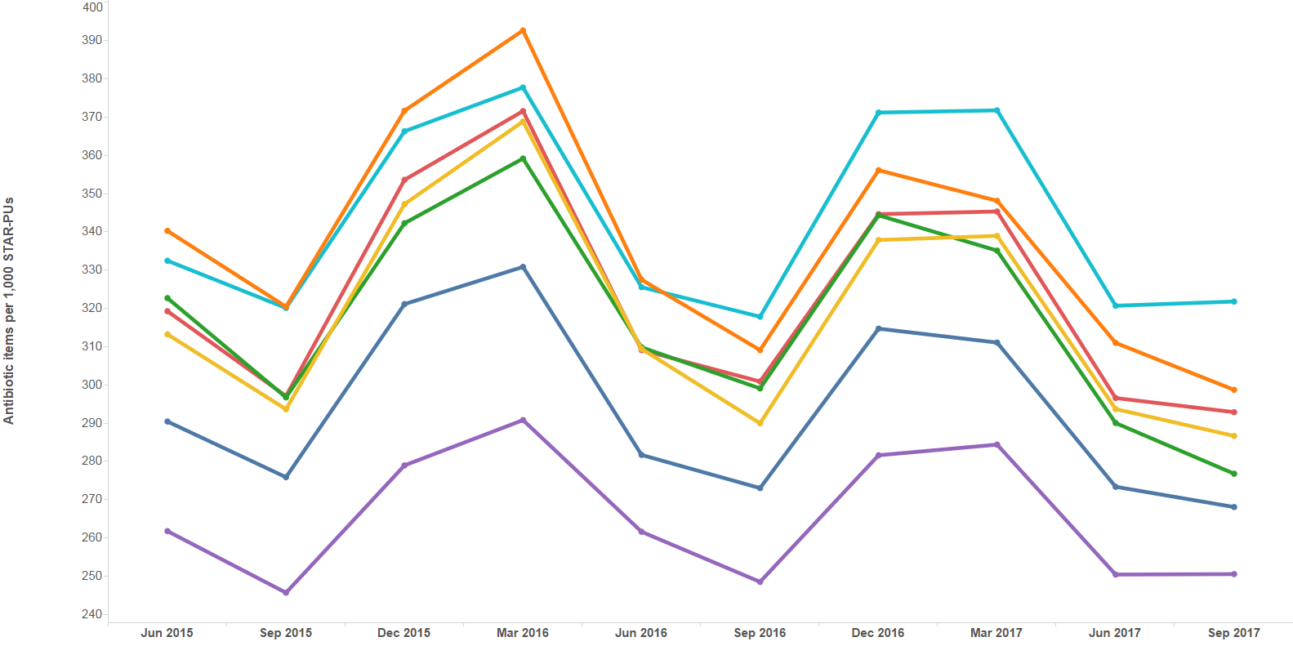
Trend in total antibacterial prescribing
STEWARDSHIP

Slide 28
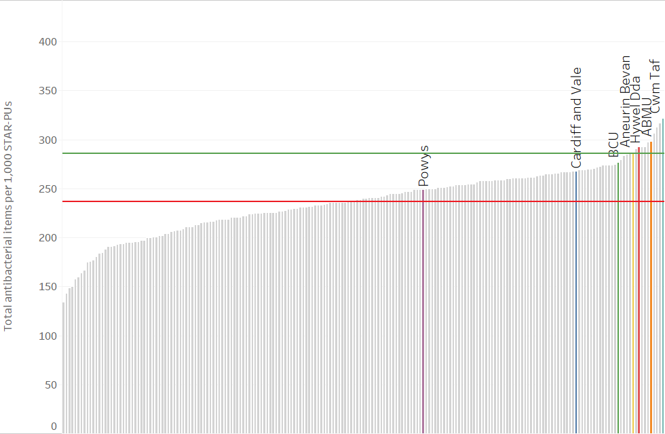
Total antibacterial items per 1,000 STAR-PUs – Quarter ending September 2017
STEWARDSHIP
Wales average
England average
CCG/HB

Slide 29
4C antimicrobials
STEWARDSHIP
Aims to encourage a reduction in variation and reduce overall prescribing of the 4C antimicrobials.
The term ‘4C antimicrobials’ refers to four broad-spectrum antibiotics, or groups of antibiotics: co-amoxiclav, cephalosporins, fluoroquinolones and clindamycin.
Broad-spectrum antibiotics are more likely to significantly change the gut flora, potentially allowing other bacteria, such as C. difficile, to become established.
The use of simple generic antibiotics and the avoidance of broad-spectrum antibiotics preserve these from resistance and reduce the risk of C. difficile, MRSA and resistant UTIs.
These antimicrobials have a very useful role in specific clinical situations and should be reserved for use as per local guidelines.

Slide 30
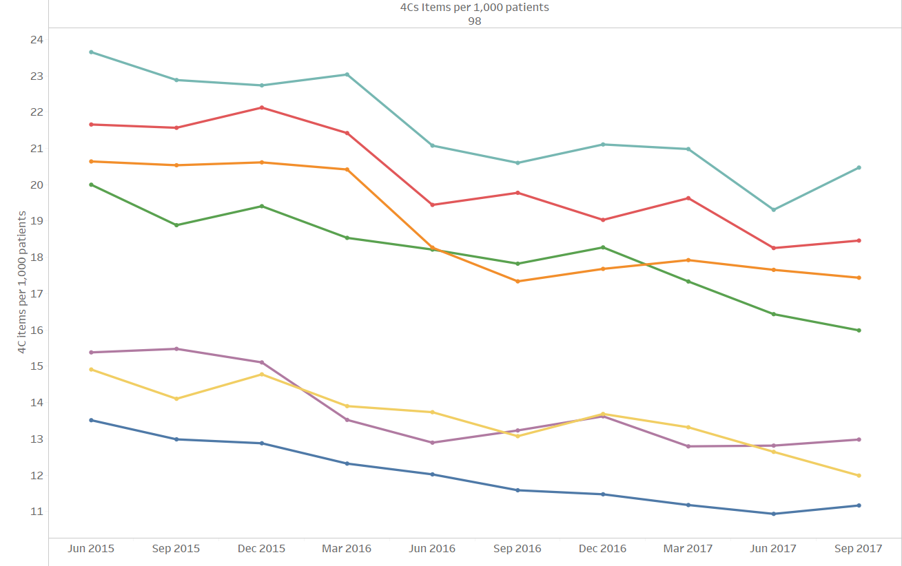
Trend in 4C items per 1,000 patients
STEWARDSHIP

Slide 31
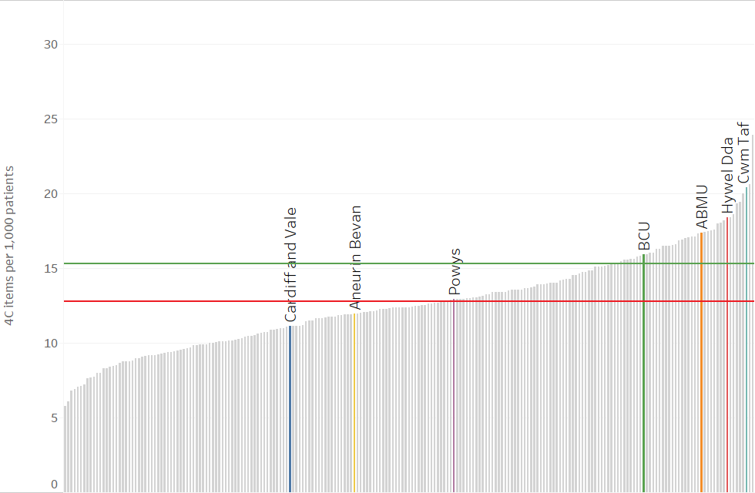
Total 4C antibacterial items per 1,000 patients – Quarter ending September 2017
STEWARDSHIP
Wales average
England average
CCG/HB

Slide 32
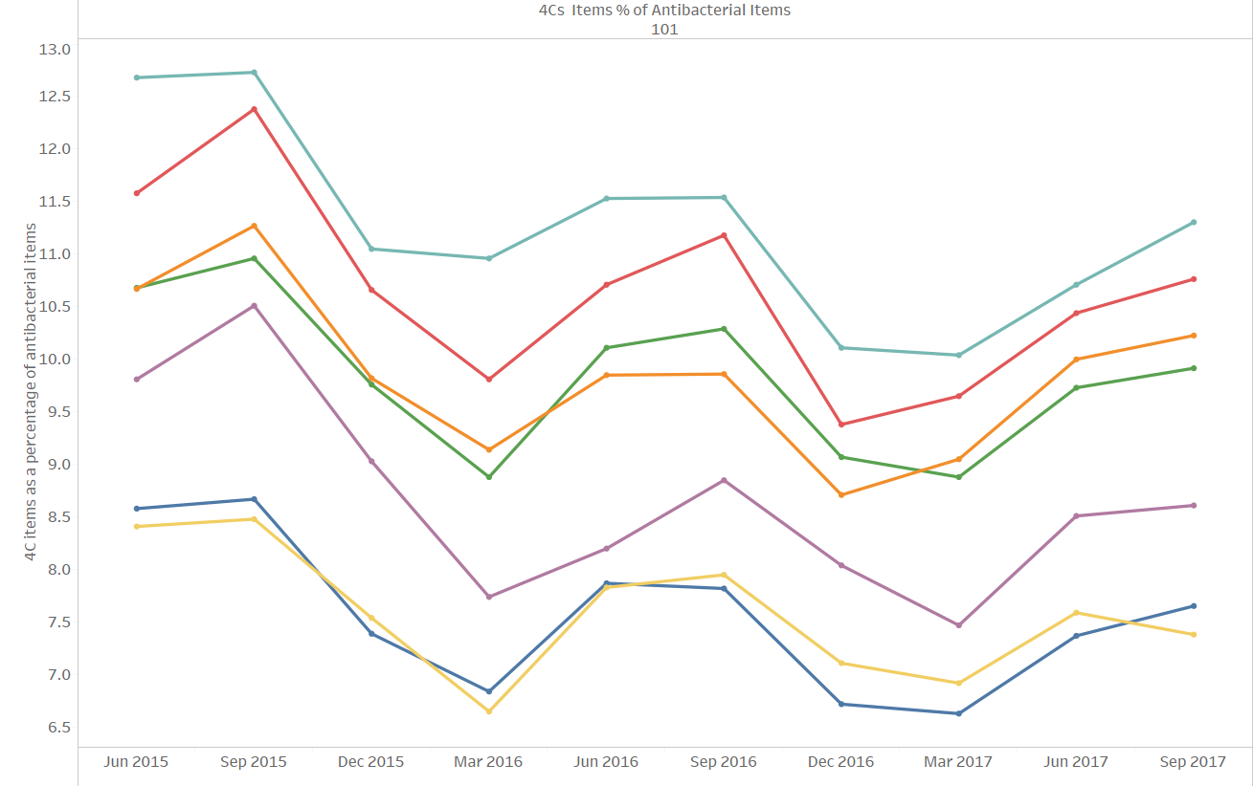
Trend in 4C items as a percentage of total antibacterial items
STEWARDSHIP

Slide 33
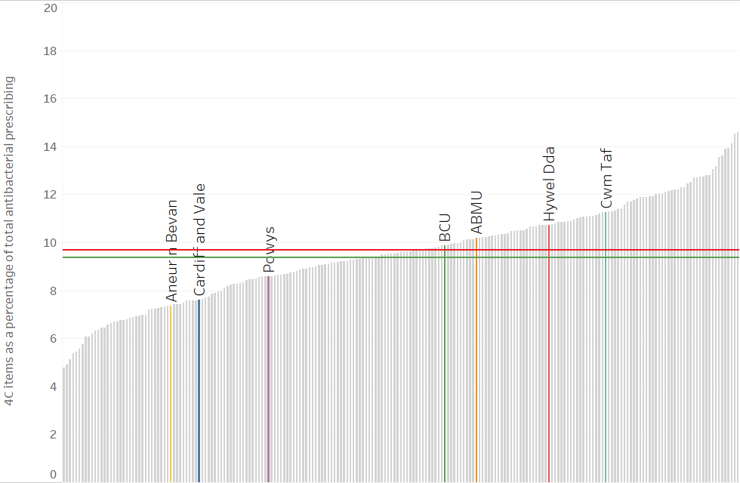
Total 4C antibacterial items as a percentage of total antibacterial items – Quarter ending September 2017
STEWARDSHIP
Wales average
England average
CCG/HB

Slide 34
Prophylactic antibiotics in colorectal surgery
STEWARDSHIP
Aims to encourage appropriate antimicrobial prophylaxis for colorectal surgical patients in secondary care.
Administration of antibiotic prophylaxis to surgical patients is intended to reduce the incidence of surgical site infection and minimise adverse effects to the patient.
Antibiotic prophylaxis should be given to patients before:
  clean surgery involving the placement of a prosthesis or implant
  clean-contaminated surgery
  contaminated surgery.
Antibiotic prophylaxis is not routinely recommended for clean non-prosthetic uncomplicated surgery.
National organisations recommend that antibiotic prophylaxis for surgical patients should be a single therapeutic (stat) dose of intravenous antibiotics in the majority of cases.
Antibiotic choice should minimise C. difficile risk whilst ensuring adequate coverage of the expected pathogens for the operative site.
Antibiotic choice should reflect local, disease-specific information about the common pathogens and their antimicrobial susceptibility.
Narrow-spectrum, less expensive antibiotics should be the first choice.

Slide 35
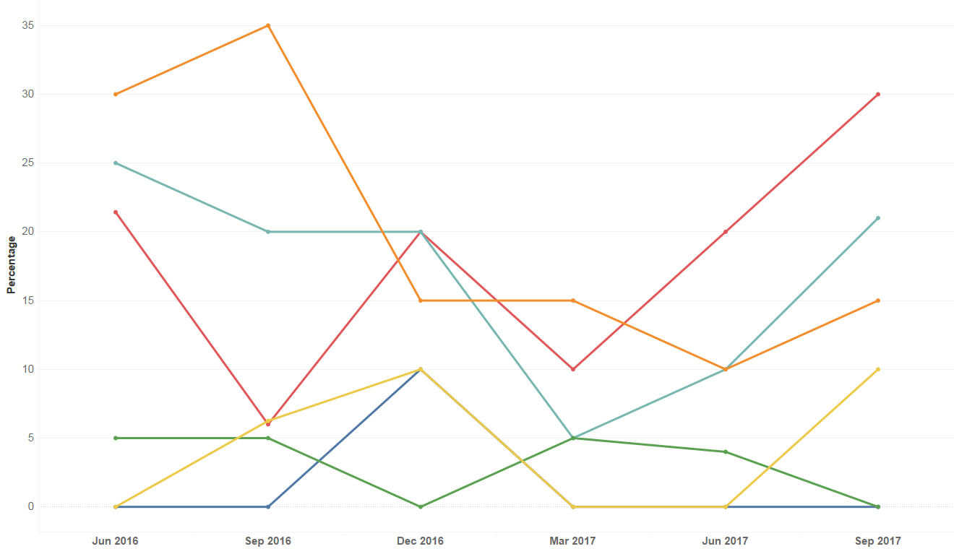
Trend in the percentage of colorectal patients receiving a static dose of antimicrobial for surgical prophylaxis
STEWARDSHIP

Slide 36
National Prescribing Indicators (NPIs)
EFFICIENCY

Slide 37
NPIs
EFFICIENCY
National Prescribing Indicator | Applicable to: | Unit of measure | Target for 2018–2019
Proton pump inhibitors | Primary care | PPI DDDs per 1,000 PUs | Maintain performance levels within the lower quartile, or show a reduction towards the quartile below.
Biosimilars | Primary care + secondary care | Quantity of biosimilar medicines prescribed as a percentage of total ‘reference’ product plus biosimilar | Increase the appropriate use of cost-effective biological medicines, including biosimilar medicines.
Long-acting insulin analogues | Primary care + secondary care | Items/number of long-acting insulin analogues expressed as a percentage of total insulin prescribed | Reduce prescribing of long-acting insulin analogues and achieve prescribing levels below the Welsh average.

Slide 38
Proton pump inhibitors (PPIs)
EFFICIENCY
Aims to encourage appropriate use of PPIs in primary care.
There is increasing evidence on potential consequences of long-term use e.g.
  C. difficile infection
  increased risk of bone fractures
  hypomagnesaemia.
People with dyspepsia should initially be offered lifestyle advice and medications should be reviewed for possible causes of dyspepsia.
PPIs should only be considered for short courses (4 weeks) where needed.
If symptoms continue or recur, a PPI can be continued at the lowest possible dose or on an ‘as required’ basis.
Offer annual review to patients receiving PPIs and step down from treatment doses where appropriate.

Slide 39
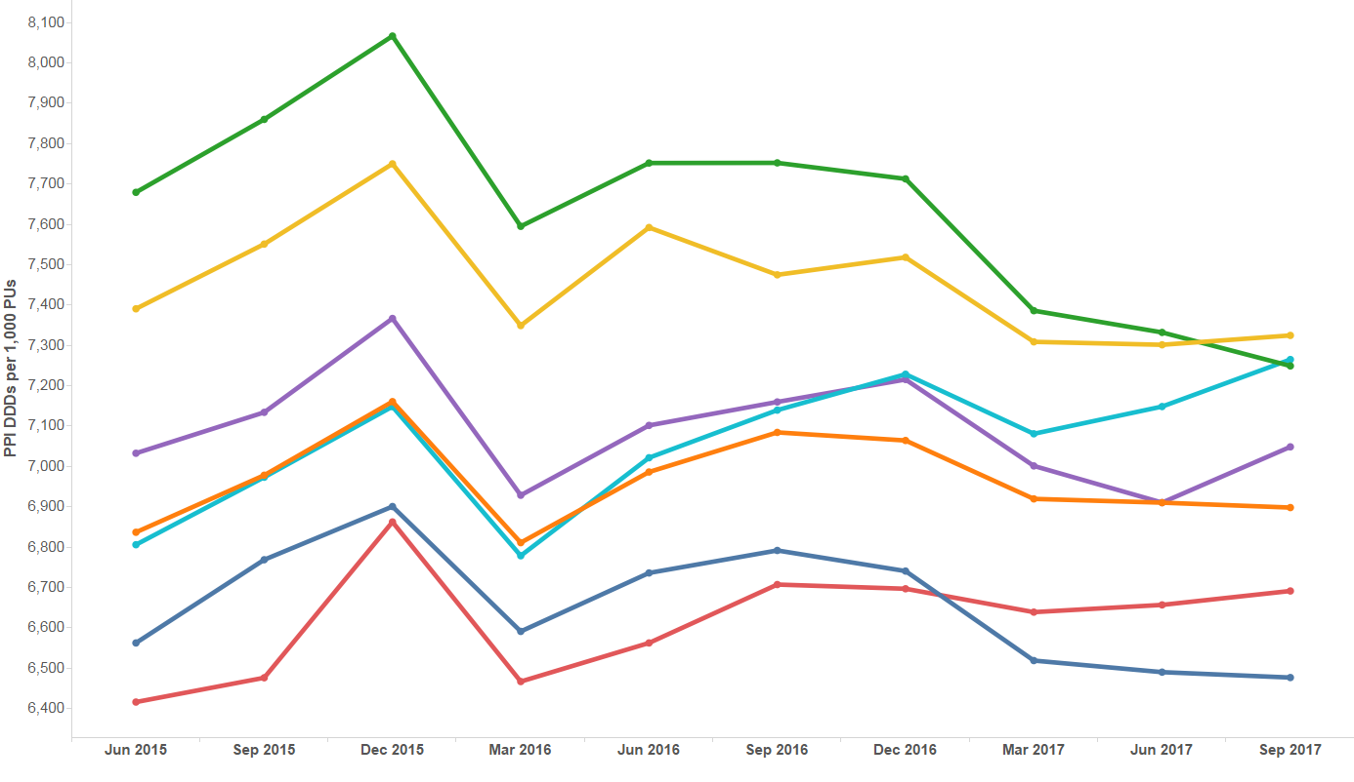
Trend in PPI prescribing
EFFICIENCY

Slide 40
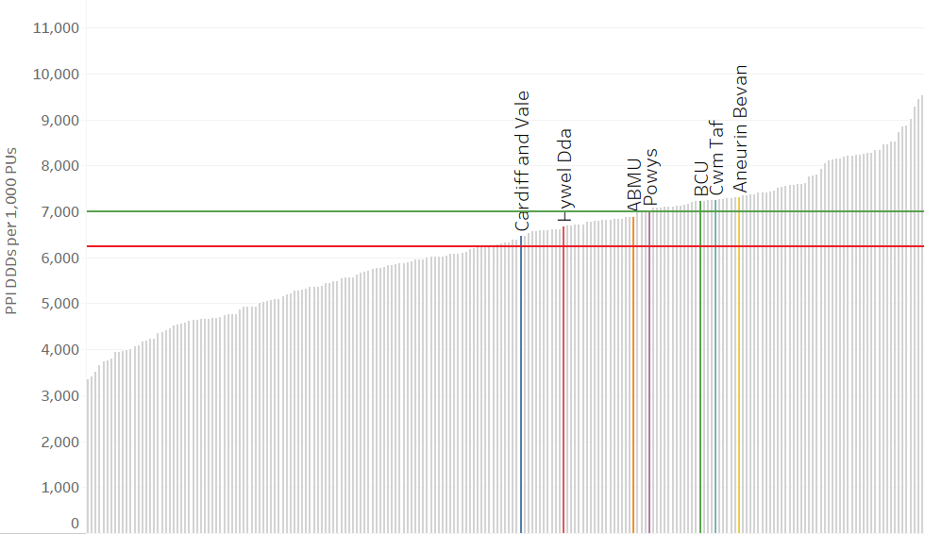
PPI DDDs per 1,000 PUs -
Quarter ending September 2017
EFFICIENCY
Wales average
England average
CCG/HB

Slide 41
Prescribing of biosimilars
EFFICIENCY
Aims to ensure prescribing of biological medicines supports cost-effective prescribing in Wales.
A biosimilar medicine is “a biological medicine that is developed to be highly similar and clinically equivalent to an existing biological medicine”.
A target has been set to increase the appropriate use of cost-effective biological medicines, including biosimilar medicines, in line with guidance.
Biological medicines including all biosimilars must be prescribed by brand name.
Within the next five years a number of biological medicines will lose their patent protection thus increasing the potential opportunity of prescribing biosimilar medicines.
There are a number of biosimilar medicines available within NHS Wales; those currently being monitored are infliximab – Inflectra®, insulin glargine – Abasaglar®, etanercept – Benepali® and rituximab – Truxima®.

Slide 42
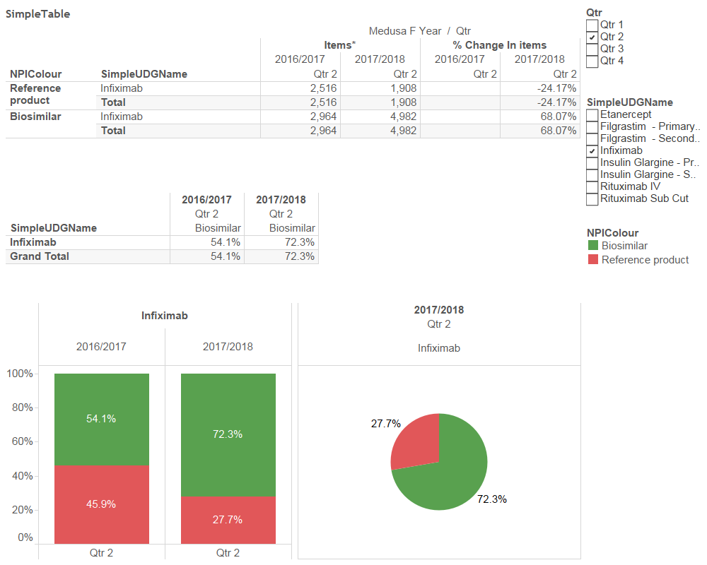
Prescribing of biosimilars – infliximab
EFFICIENCY
Change in the use of infliximab biosimilar as a percentage of all infliximab within NHS Wales for quarter ending September 2017

Slide 43
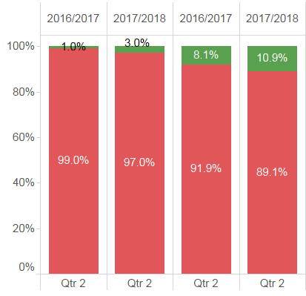
Prescribing of biosimilars – insulin glargine
EFFICIENCY
Change in the use of insulin glargine biosimilar as a percentage of all insulin glargine within NHS Wales for quarter ending September 2017

Slide 44
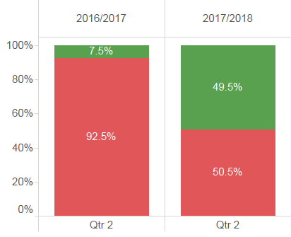
Prescribing of biosimilars – etanercept
EFFICIENCY
Change in the use of etanercept biosimilar as a percentage of all etanercept within NHS Wales for quarter ending September 2017

Slide 45
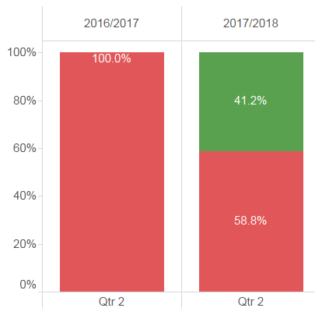
Prescribing of biosimilars – rituximab
EFFICIENCY
Change in the use of rituximab biosimilar as a percentage of all rituximab within NHS Wales for quarter ending September 2017

Slide 46
Insulin prescribing
EFFICIENCY
Aims to encourage a reduction in the prescribing of long-acting insulin analogues in line with NICE guidance to maximise cost-effectiveness in Wales.
There is an absence of evidence to suggest the superiority of the long-acting insulin analogues versus NPH insulin.
NICE recommends NPH as first choice regimen before long-acting insulin analogues for the majority of people (CG87, 2009; NG28, 2015).

Slide 47
Long-acting insulin analogues as a percentage of total long- and intermediate-acting insulin prescribing in secondary care
EFFICIENCY
 | 2016–2017 Qtr 2 | 2017–2018 Qtr 2 | % Change
Cardiff and Vale | 83.0 | 67.2 | -19.0
Velindre | 100 | 85.7 | -14.3
Cwm Taf | 56.2 | 52.8 | -5.99
Abertawe Bro Morgannwg | 85.8 | 83.6 | -2.53
Hywel Dda | 81.2 | 83.7 | 3.08
Aneurin Bevan | 73.0 | 75.7 | 3.68
Betsi Cadwaladr | 79.7 | 83.9 | 5.31
Wales | 77.7 | 76.0 | -2.22

Slide 48
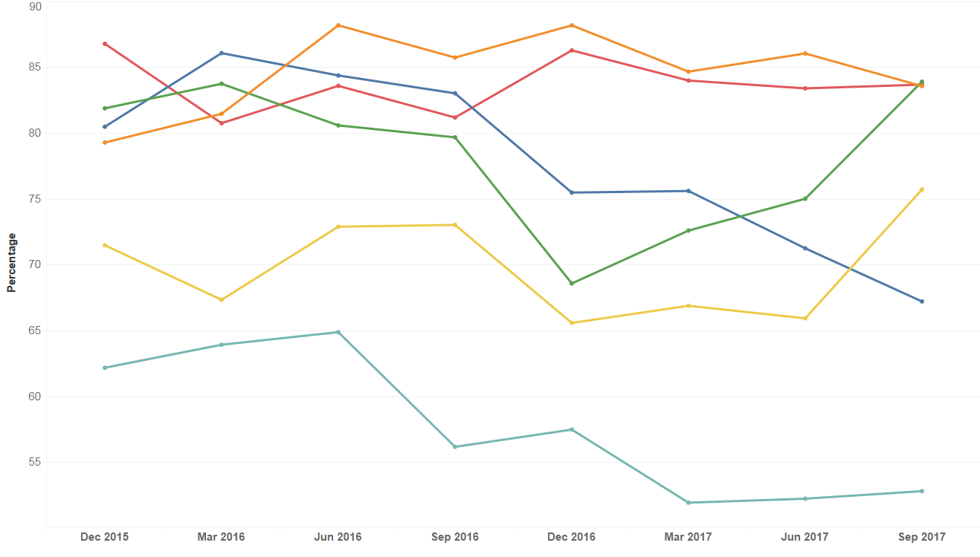
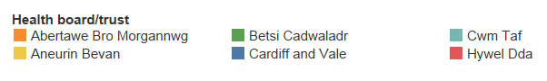
Trend in long-acting analogue prescribing as a percentage of total long- and intermediate-acting insulin prescribed in secondary care
EFFICIENCY
Please note: Data for Velindre have not been included due to very low usage.

Slide 49
Long-acting insulin analogues as a percentage of total long- and intermediate-acting insulin prescribing in primary care
EFFICIENCY
 | 2016–2017 Qtr 2 | 2017–2018 Qtr 2 | % Change
Cardiff and Vale | 90.9 | 87.4 | -3.85
Cwm Taf | 80.1 | 78.0 | -2.62
Betsi Cadwaladr | 93.3 | 90.9 | -2.57
Aneurin Bevan | 85.8 | 84.8 | -1.17
Powys | 86.4 | 85.8 | -0.69
Abertawe Bro Morgannwg | 93.6 | 94.1 | 0.53
Hywel Dda | 93.7 | 94.3 | 0.64
Wales | 89.8 | 88.5 | -1.45

Slide 50
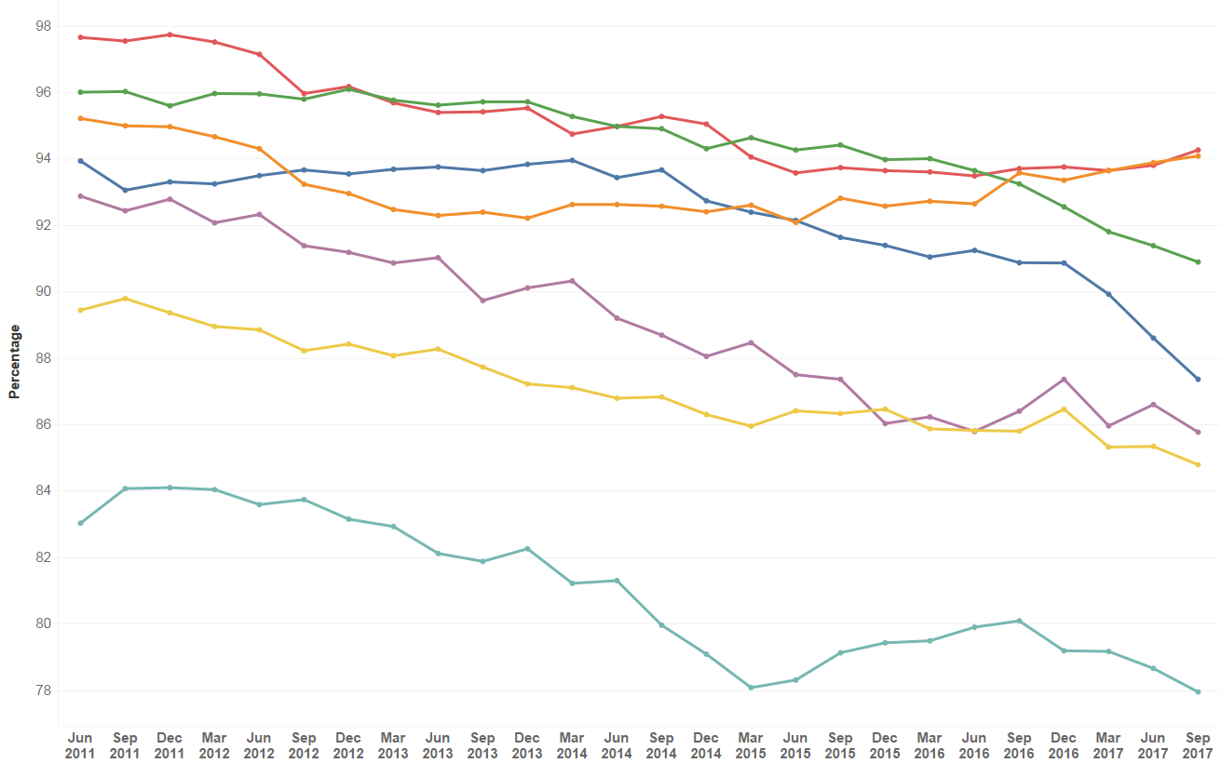
Trend in long-acting analogue prescribing as a percentage of total long- and intermediate-acting insulin prescribed in primary care
EFFICIENCY

Slide 51
Thank you

