Slide 1

National Prescribing Indicators 2015–2016

Slide 2
National Prescribing Indicators (NPIs) development process
Developed by the All Wales Prescribing Advisory Group (AWPAG):
June 2014: Consultation and feedback on current NPIs.
July 2014: Task and Finish Group review and develop NPIs.
September 2014: Document discussed at AWPAG.
October–November 2014: Consultation with industry and stakeholders.
February 2015: Final document endorsed by the All Wales Medicines Strategy Group (AWMSG).

Slide 3
Prescribing measures – volume measures
Items – single item prescribed by a prescriber on a prescription form
  The number of items is a measure of how often a prescriber has decided to write a prescription.
  For vaccines and acute treatment such as antibiotics it can be used as a volume measure.
  However, a single item can be any quantity or duration (e.g. 1 item = lansoprazole 15 mg od 28 tablets).
DDDs – defined daily doses
  Developed and maintained by WHO based on international prescribing habits.
  Each medicine is given a value, within its recognised dosage range, that represents the assumed average maintenance dose per day when used for its main indication in adults (DDD lansoprazole = 30 mg).
  A DDD is a unit of measurement; it is not a recommended dose and may not be a real dose.
  A DDD of one medicine is assumed to be functionally equivalent to the DDD of any other medicine used for a similar indication; therefore the number of DDDs for two or more such medicines can be added together.
ADQs – average daily quantities
  Work undertaken in England showed that prescribing in primary care can differ from the international standard.
  ADQs provide a measure of prescribing volume that accurately reflects primary care prescribing behaviour in England.
  ADQs represent the assumed average maintenance dose/day for a medicine used for its main indication in adults.
  An ADQ is not a recommended dose, but an analytical unit to compare prescribing activity of primary care practitioners (ADQ lansoprazole = 20 mg).
  Many ADQs are the same as the corresponding DDD; however, the values may differ e.g. when a DDD value is influenced by use of higher doses in a hospital setting.

Slide 4
Prescribing measures – denominators
To allow comparison between health boards, clusters and practices of different sizes, there needs to be a way of weighting prescribing data.
Patients
  Data can be presented per 1,000 patients.
  Only useful if monitoring something that is not influenced by age and gender.
PUs – Prescribing Units
  Introduced in 1983 to take into account the greater need of the elderly population.
  Age < 65 years weighted as 1; age 65 and over weighted as 3.
STAR-PUs – Specific Therapeutic group Age-sex Related Prescribing Units
  Introduced in England in 1995.
  Designed to weight individual health board or practice populations based on the age and sex distribution of their practice, for specific therapeutic group for which a particular medicine/group of medicines is prescribed.
  Reviewed regularly (most recently 2013) to take into account changes in prescribing practice: some are cost based, some item based, and ADQ based prescribing units now being introduced.
Analysis has been undertaken to ensure correlation between PUs and STAR-PUs to determine that these measures are relevant to the Welsh population.
Advantage that comparison can also be undertaken with English Clinical Commissioning Groups (CCGs).

Slide 5
Indicator | BNF chapter | Unit of measure
Proton pump inhibitors (PPIs) | 1.3.5 | PPI DDDs per 1,000 PUs
Lipid-modifying drugs | 2.12 | Low acquisition cost (LAC) statin items as a percentage of all statin, ezetimibe and simvastatin/ezetimibe combination prescribing
Inhaled corticosteroids (ICS) | 3.2 | Low strength ICS items as a percentage of all ICS prescribing
Hypnotics and anxiolytics | 4.1 | Hypnotic and anxiolytic ADQs per 1,000 STAR-PUs
Opioid analgesics | 4.7.2 | Morphine items as a percentage of strong opioid prescribing
 | 4.7.2 | Tramadol DDDs per 1,000 patients
Antibiotics | 5.1 | Total antibacterial items per 1,000 STAR-PUs
 | 5.1.1 | Co-amoxiclav items per 1,000 patients Co-amoxiclav items as a percentage of total antibacterial items
 | 5.1.2 | Cephalosporin items per 1,000 patients Cephalosporin items as a percentage of total antibacterial items
 | 5.1.12 | Fluoroquinolone items per 1,000 patients Fluoroquinolone items as a percentage of total antibacterial items
Non-steroidal anti-inflammatory drugs (NSAIDs) | 10.1.1 | NSAID ADQs per 1,000 STAR-PUs
 | 10.1.1 | Ibuprofen and naproxen items as a percentage of NSAID prescribing
Yellow Cards |  | Number of Yellow Cards submitted per practice and per health board
ADQ = average daily quantity; DDD = defined daily dose; LAC = low acquisition cost; PU = prescribing unit; STAR-PU = specific therapeutic group age–sex related prescribing unit

Slide 6
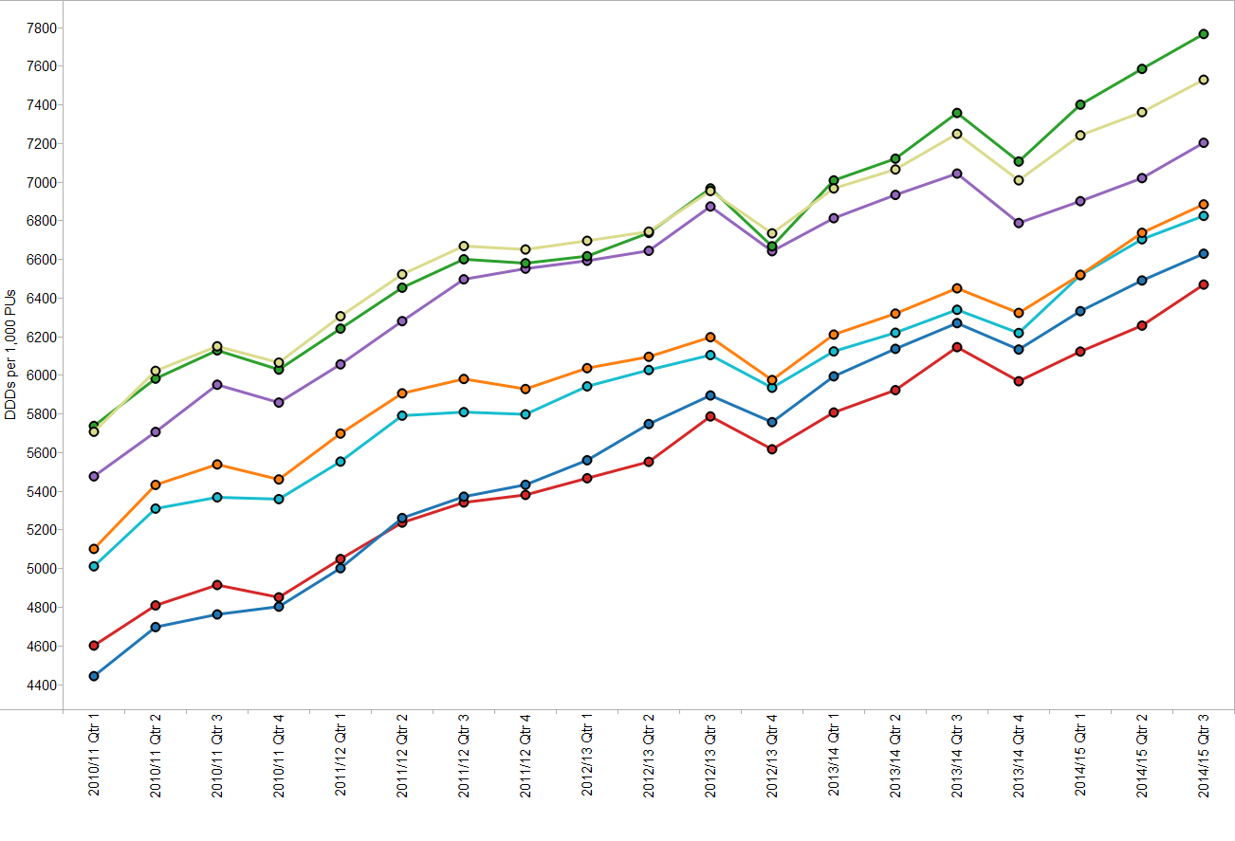
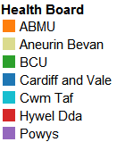
Trend in proton pump inhibitor (PPI) prescribing

Slide 7
PPI DDDs per 1,000 PUs
Quarter ending December 2014

Slide 8
Proton pump inhibitors (PPIs)
PPI use continues to increase across Wales at a rate of 6% per year.
Aims to encourage a reduction in PPI prescribing due to potentially serious adverse effects linked to long-term use e.g.
  Clostridium difficile infection,
  Hospital- and community-acquired pneumonia,
  Hypomagnesaemia,
  Fractures of the hip, wrist and spine.
NICE CG184 recommends offering people requiring long-term management of dyspepsia symptoms an annual review:
  Review medicines which may cause dyspepsia (e.g. calcium channel blockers, nitrates, theophyllines, bisphosphonates, corticosteroids and NSAIDs).
  Encourage people requiring long-term management of dyspepsia symptoms to reduce their use of prescribed medication stepwise: by using the lowest effective dose, by trying 'as-needed' use when appropriate, and by returning to self-treatment with antacid and/or alginate therapy.
Gastro-protection should be considered for people taking high-risk medicines e.g. NSAIDs in osteoarthritis and rheumatoid arthritis.

Slide 9
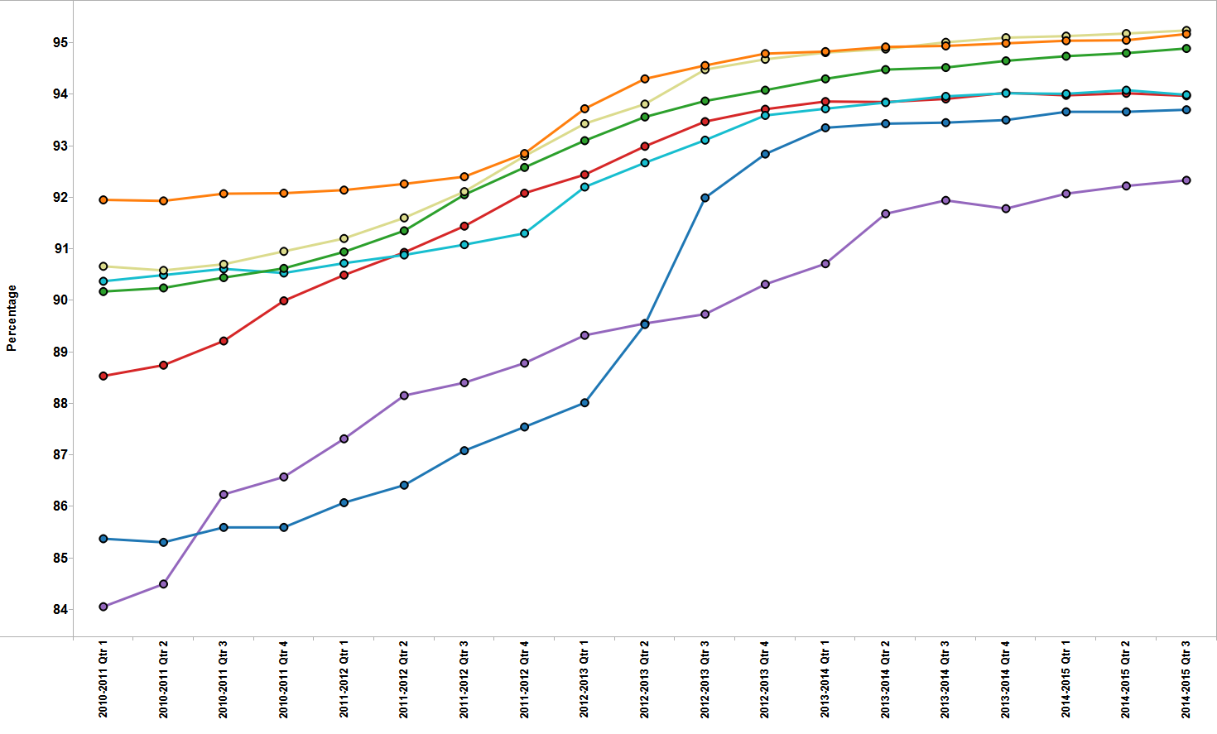
Trend in low acquisition cost (LAC) statin items as a percentage of all statin, ezetimibe and simvastatin/ ezetimibe combination prescribing

Slide 10
LAC statin items as a percentage of all statin, ezetimibe and simvastatin/ezetimibe combination prescribing – Quarter ending December 2014

Slide 11
Lipid modifying drugs
Aims to increase the prescribing of statins with a low acquisition cost (LAC) over more expensive lipid lowering treatments in line with NICE guidance.
NICE CG181 was published in July 2014, which updates guidance relating to lipid modification in adults both with and without diabetes:
  Atorvastatin, simvastatin and pravastatin are LAC statins and remain the lipid-modifying drugs of choice.
  Use a statin of high intensity and low acquisition cost.
  Offer atorvastatin 20 mg for the primary prevention of cardiovascular disease (CVD) to patients with or without type 2 diabetes who have a 10% or greater 10-year risk of developing CVD and all patients with type 1 diabetes.
  If a high-intensity statin is not tolerated, aim to treat with the maximum tolerated dose; other strategies may include changing the statin to a lower intensity group.

Slide 12
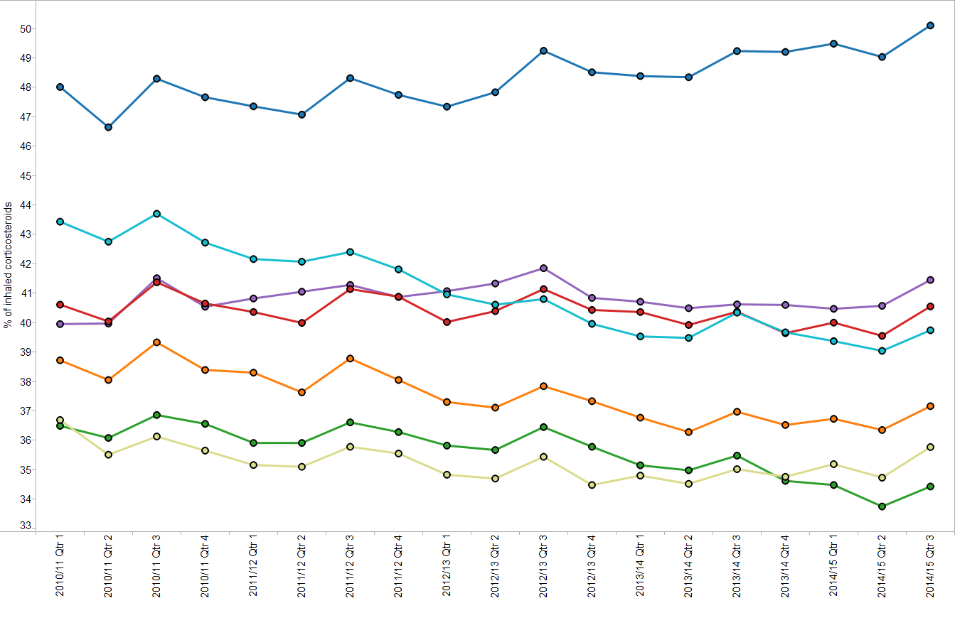
Trend in low strength inhaled corticosteroid (ICS) items as a percentage of all ICS prescribing

Slide 13
Low strength ICS items as a percentage of all ICS prescribing – Quarter ending December 2014

Slide 14
Inhaled corticosteroids (ICS)
Aims to encourage the routine review of ICS in people with asthma, particularly those on high doses, encouraging step down of the dose when clinically appropriate.
ICS (particularly at high doses) associated with side effects: adrenal suppression, growth failure, decrease in bone mineral density, cataracts and glaucoma.
The British guideline on the management of asthma recommends:
  a stepwise approach for the treatment of asthma with ICS as the first-choice regular preventer therapy for adults and children with asthma.
  dose of ICS should be titrated to the lowest dose at which effective control of asthma is maintained.
  ICS dose reduction should be considered every three months, decreasing the dose by approximately 25–50% each time.

Slide 15
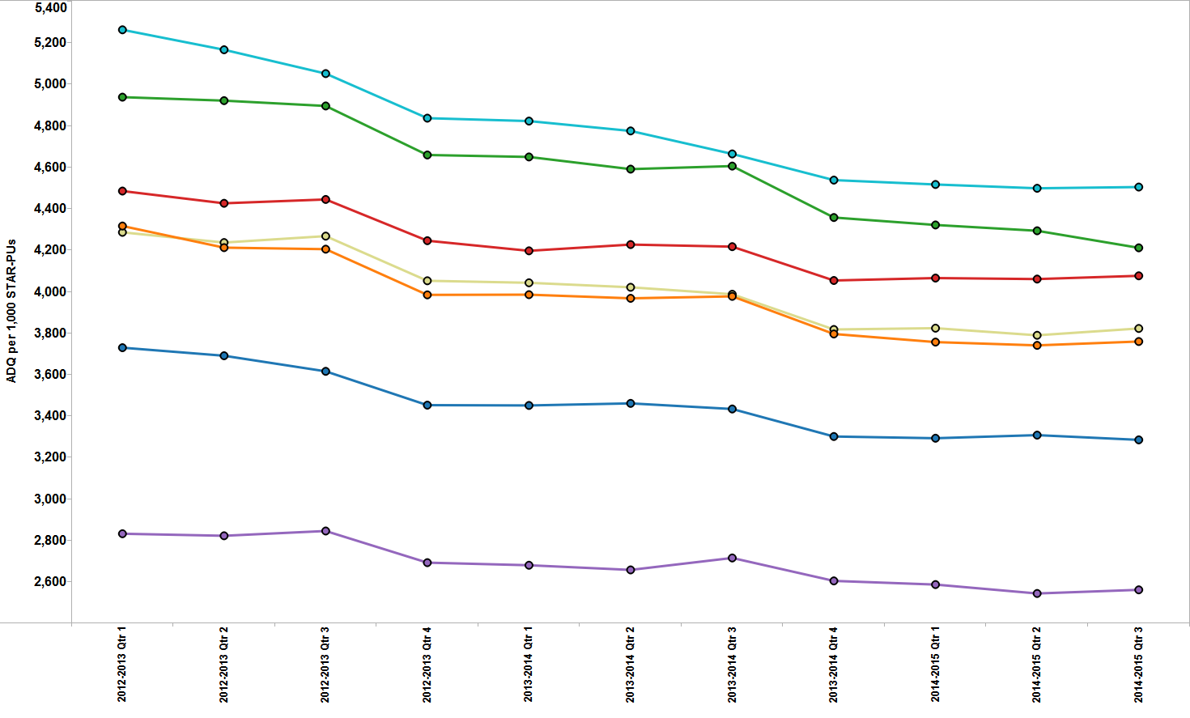
Trend in hypnotic and anxiolytic prescribing

Slide 16
Hypnotic and anxiolytic ADQs per 1,000 STAR-PUs – Quarter ending December 2014

Slide 17
Hypnotics and anxiolytics
Aims to encourage a reduction in the prescribing of hypnotics and anxiolytics in Wales.
Variation in prescribing rates across health boards in Wales.
Prescribing in Wales is still high compared to England: six health boards in Wales within the highest prescribing quartile when compared to CCGs in England.
Long-term use of benzodiazepine hypnotics and anxiolytics is associated with increased risk of Alzheimer’s disease and falls.
AWMSG hypnotics and anxiolytic educational pack provides:
  examples of practice protocols to allow clinicians to agree a consistent approach for the prescribing and review of hypnotics and anxiolytics.
  materials to support the review and discontinuation of hypnotic and anxiolytic treatment.

Slide 18
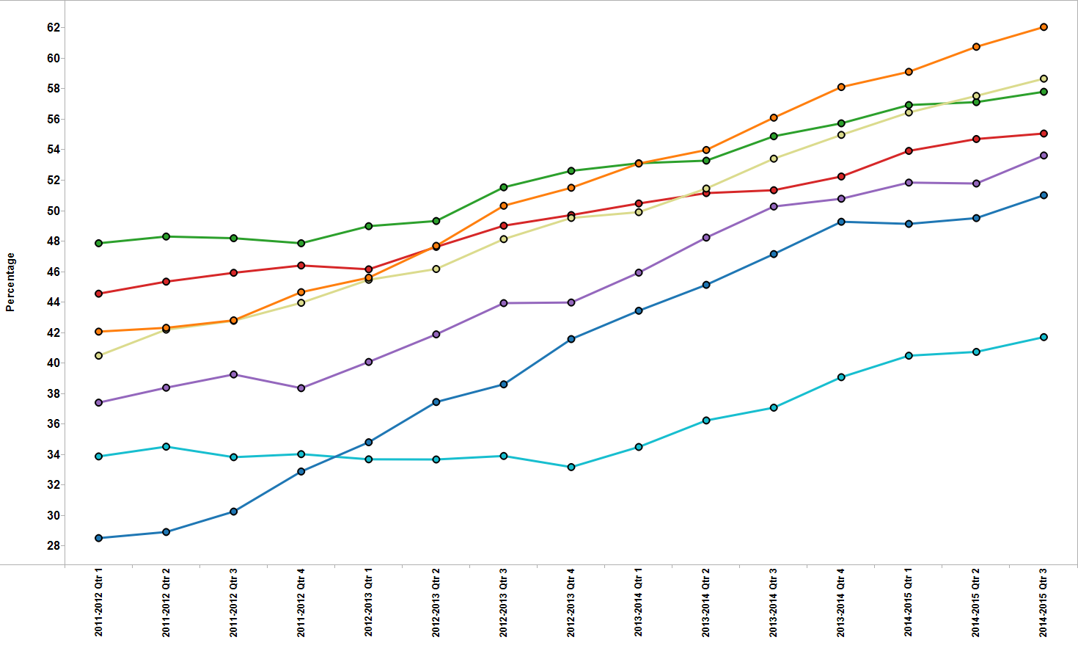
Trend in morphine items as a percentage of strong opioid prescribing

Slide 19
Morphine items as a percentage of strong opioid prescribing – Quarter ending December 2014

Slide 20
Opioid analgesics – Morphine
Aims to encourage the appropriate prescribing of all opioid analgesics.
NICE CG140 states:
  When starting treatment with strong opioids, offer patients with advanced and progressive disease regular oral modified-release or oral immediate-release morphine (depending on patient preference), with rescue doses of oral immediate-release morphine for breakthrough pain.
  Do not routinely offer transdermal patch formulations as first-line maintenance treatment to palliative care patients in whom oral opioids are suitable.
Transdermal fentanyl safety issues:
  Significant levels of the medicine persist in the blood for 24 hours or more after the patch has been removed.
  Inappropriate use of transdermal preparations has caused fatalities.

Slide 21
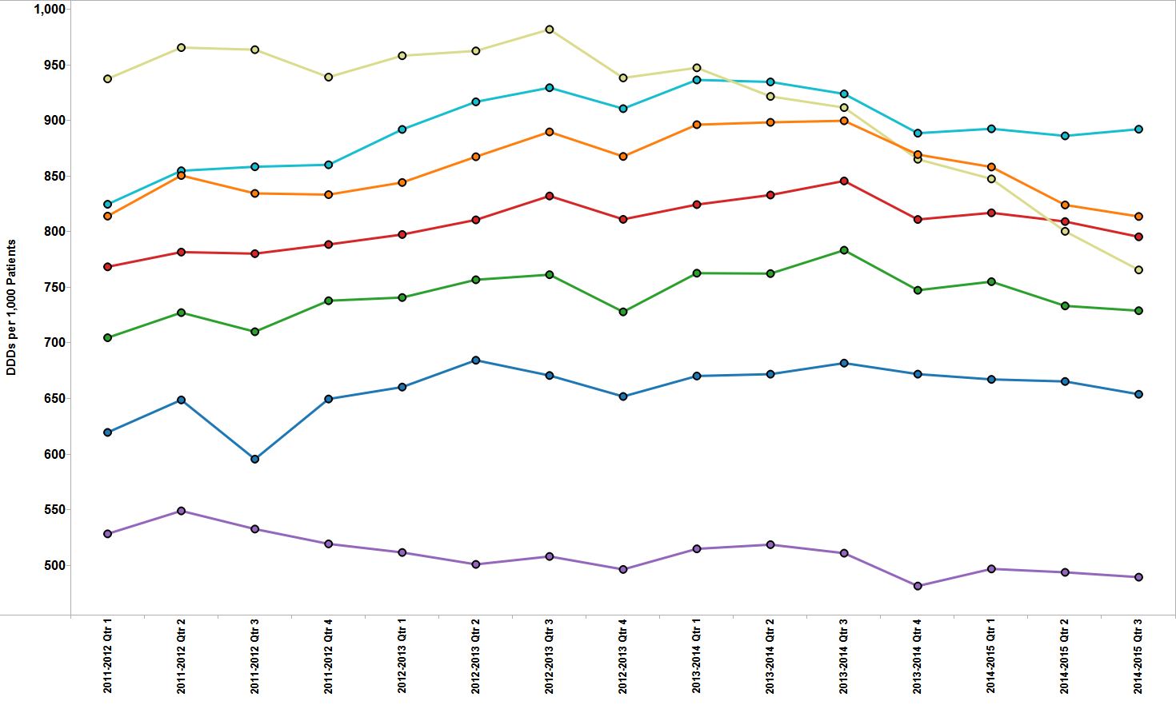
Trend in tramadol prescribing

Slide 22
Tramadol DDDs per 1,000 patients
Quarter ending December 2014

Slide 23
Opioid analgesics – Tramadol
Aims to encourage the appropriate prescribing of tramadol.
Deaths related to tramadol misuse in England and Wales increased from 83 in 2008 to 220 in 2013.
In June 2014, tramadol was placed within Schedule III to the Misuse of Drugs Regulations, requiring prescriptions to be written as for other controlled drugs, including a maximum supply of 28 days.
Avoid abrupt withdrawal after long-term tramadol treatment.
Tramadol reduces seizure threshold.
Side effects include: dizziness, constipation, hallucinations, confusion and convulsions. Drug dependence and withdrawal have been reported at therapeutic doses.
Multiple drug interactions: warfarin, antidepressants (SSRIs, SNRIs, TCAs)

Slide 24
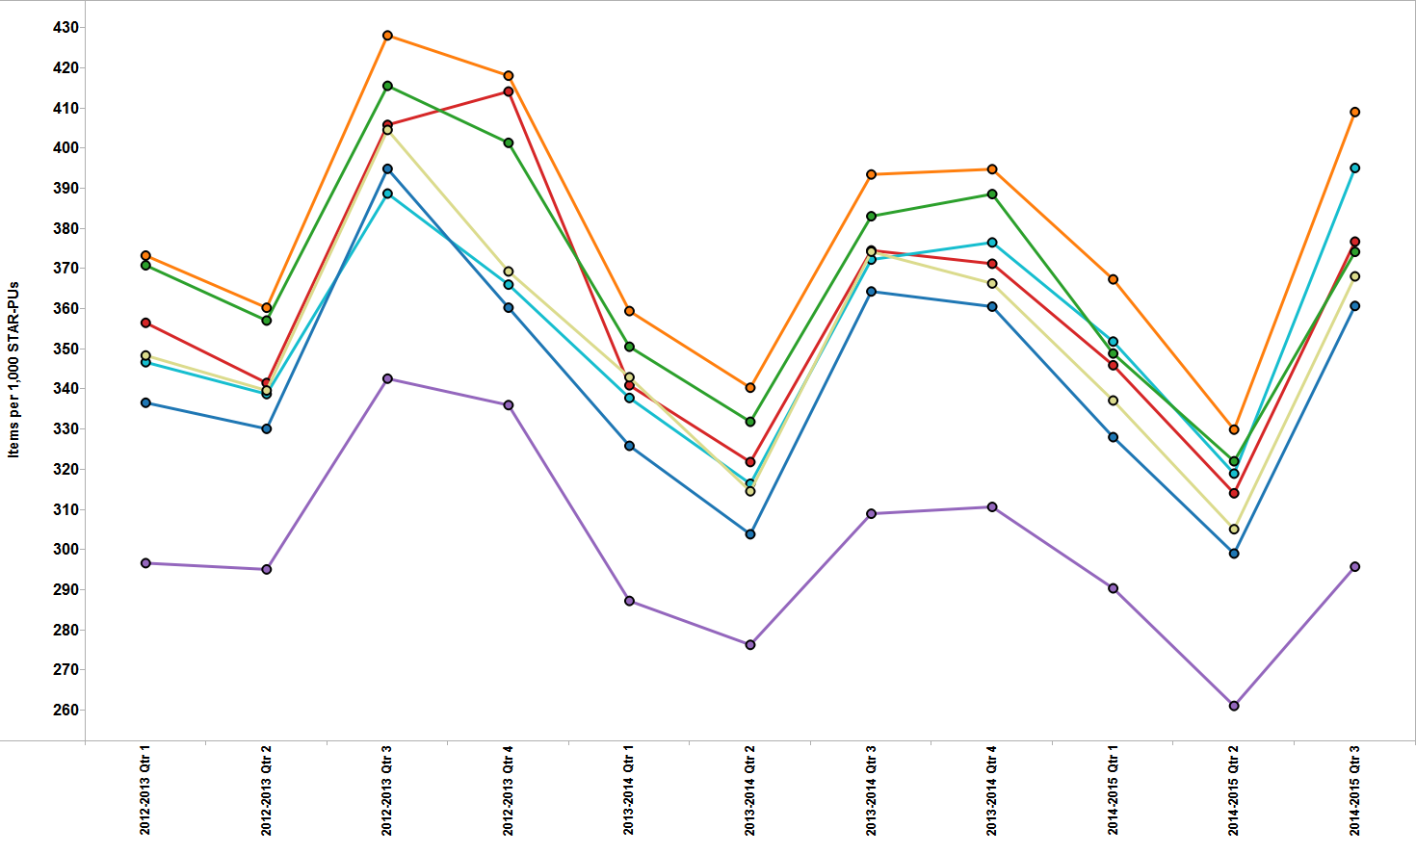
Trend in total antibacterial prescribing

Slide 25
Total antibacterial items per 1,000 STAR-PUs Quarter ending December 2014

Slide 26
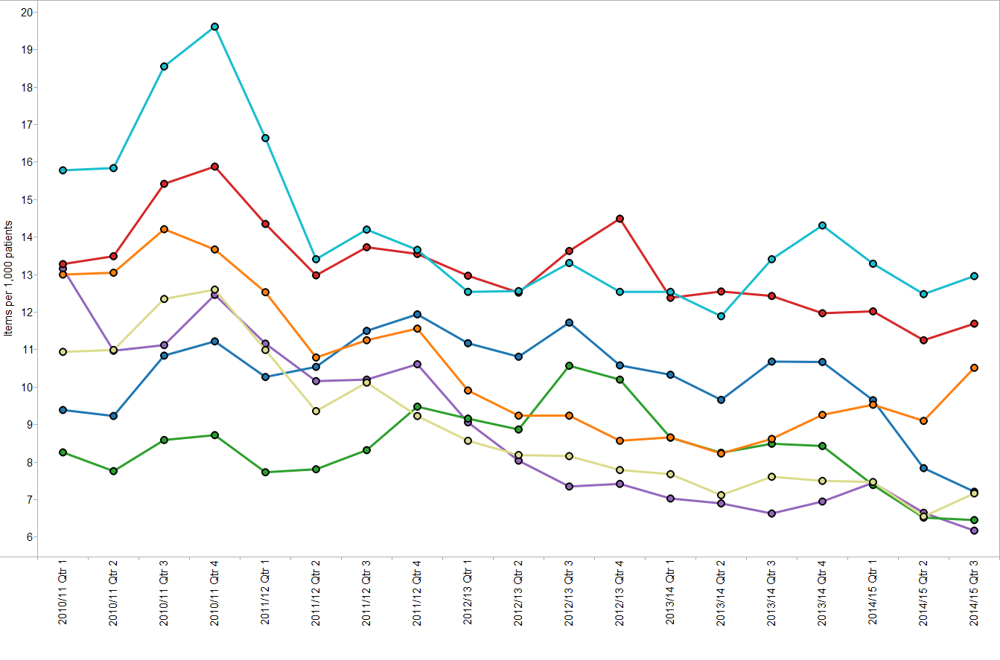
Trend in co-amoxiclav items per 1,000 patients

Slide 27
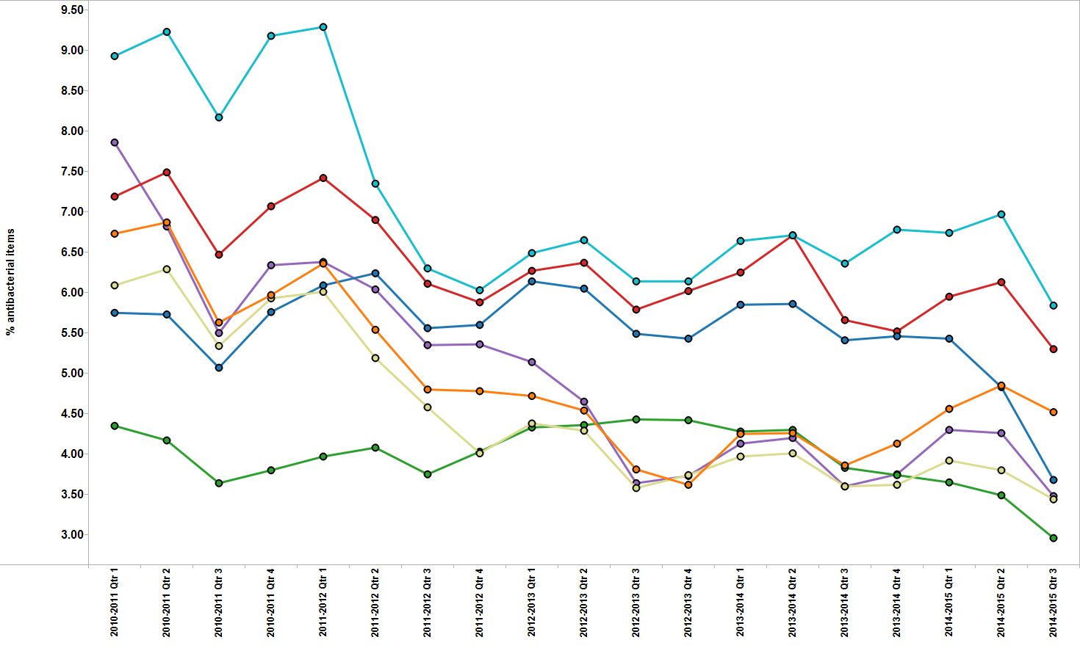
Trend in co-amoxiclav items as a percentage of total antibacterial items

Slide 28
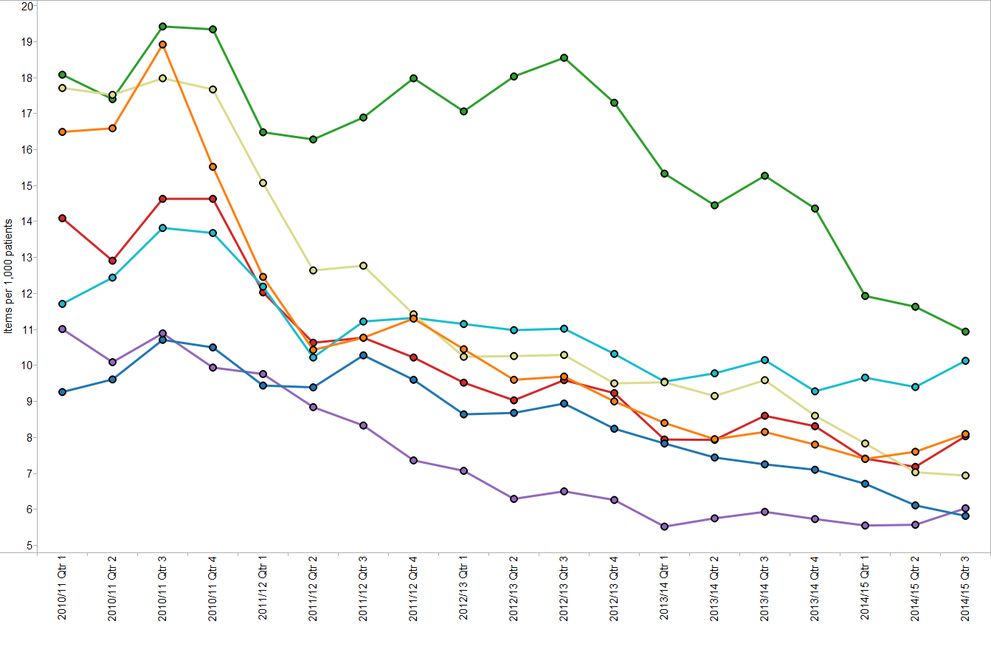
Trend in cephalosporin items per 1,000 patients

Slide 29
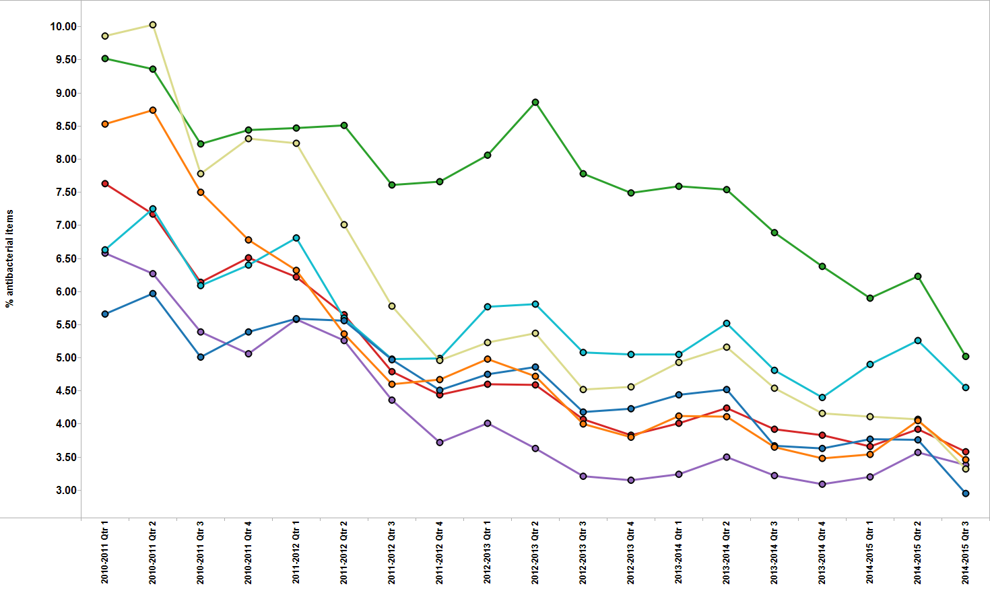
Trend in cephalosporin items as a percentage of total antibacterial items

Slide 30
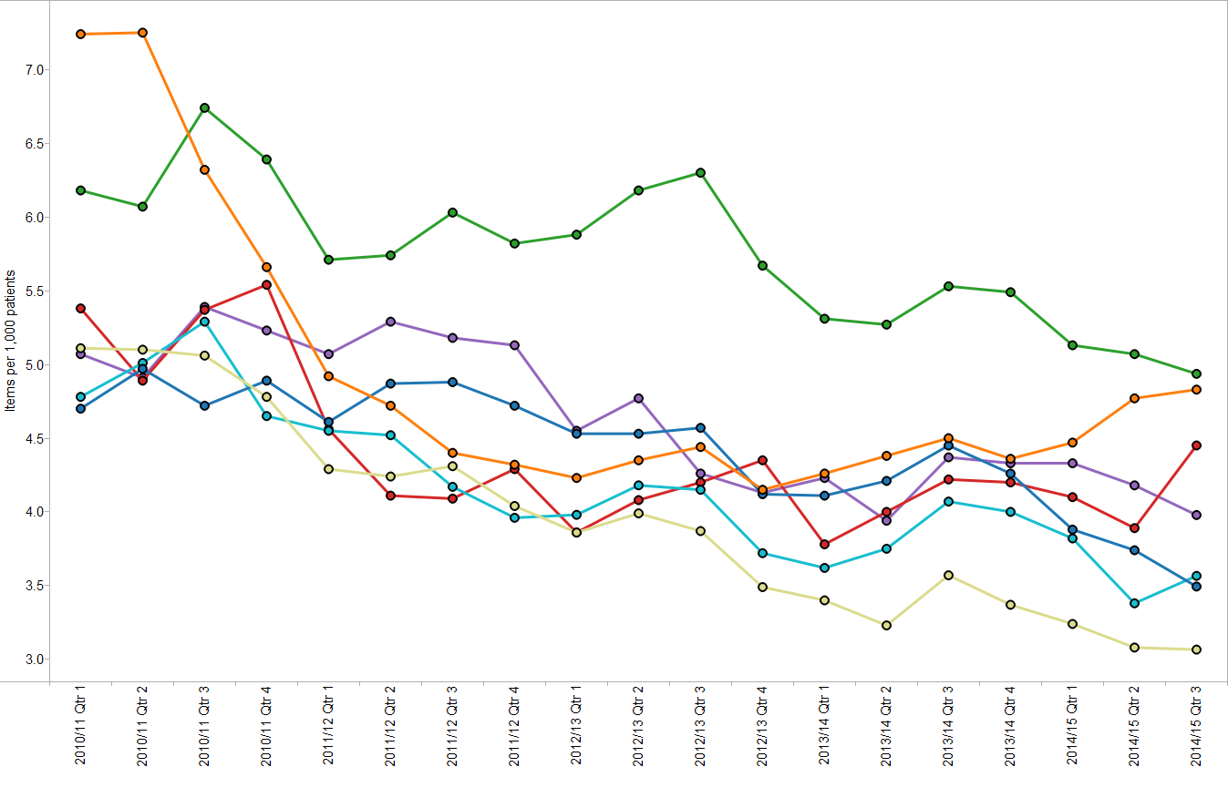
Trend in fluoroquinolone items per 1,000 patients

Slide 31
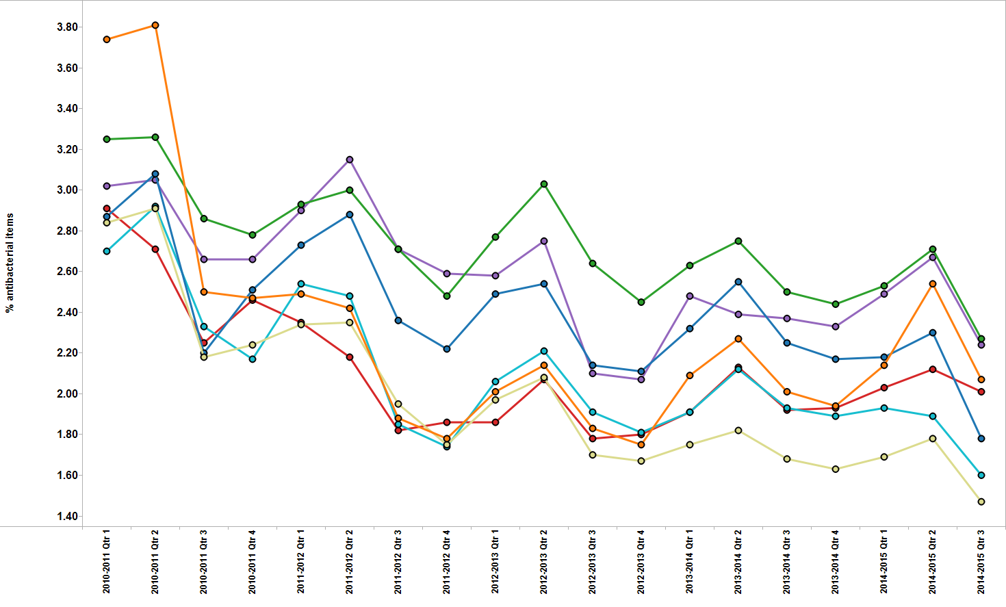
Trend in fluoroquinolone items as a percentage of total antibacterial items

Slide 32
Antibiotics
These indicators support one of the core elements of the Welsh Antimicrobial Resistance Programme: to inform, support and promote the prudent use of antimicrobials. They also aim to reduce the prescribing of medicines associated with an increased risk of C. difficile, MRSA and resistant UTIs.
AWMSG CEPP National Audit: Focus on antibiotic prescribing – consists of stand-alone bite-size components
    sore throat,
    acute rhinosinusitis,
    UTI in females,
    acute cough or bronchitis,
    quinolone prescribing,
    cephalosporin prescribing,
    co-amoxiclav prescribing,
    hospital prescribing of antibiotics,
    delayed prescriptions,
    read coding to identify healthcare-acquired infections.

Slide 33
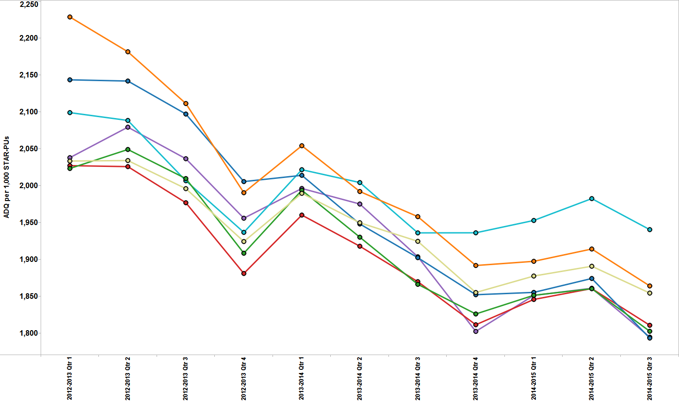
Trend in NSAID prescribing

Slide 34
NSAID ADQs per 1,000 STAR-PUs
Quarter ending December 2014

Slide 35
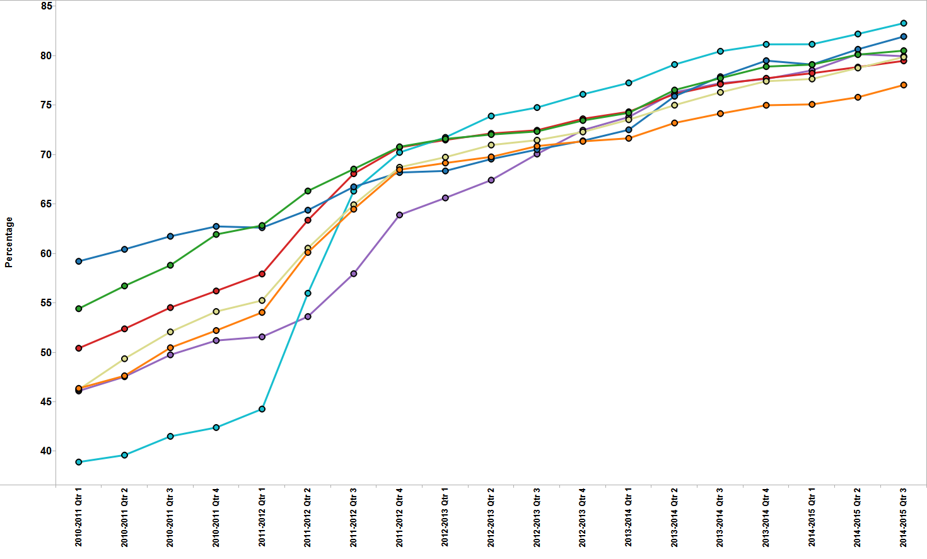
Trend in ibuprofen and naproxen items as a percentage of NSAID prescribing

Slide 36
Ibuprofen and naproxen items as a percentage of NSAID prescribing – Quarter ending December 2014

Slide 37
NSAIDs
Aims
  to encourage a reduction in total NSAID prescribing, which is consistently higher than in England,
  to increase the prescribing of ibuprofen and naproxen, because these drugs are associated with a lower risk of cardiovascular adverse events than other NSAIDs.
It is recommended that prescribers should:
  Review their NSAID prescribing using the AWMSG CEPP National Audit: Towards Appropriate NSAID Prescribing.
  Use acute rather than repeat prescriptions for NSAIDs.
  Set the default to small quantities (e.g. 1–2 weeks supply) per script.
  Provide the AWMSG Patient Information Leaflet: Medicines for Mild to Moderate Pain Relief.
  Prescribe naproxen 250 mg rather than 500 mg to allow patients to make dose adjustments.

Slide 38
Yellow Cards
Aim to increase the number of Yellow Cards submitted by GPs.
The Yellow Card Scheme is vital in helping the Medicines and Healthcare Regulatory Agency monitor the safety of medicines and vaccines and supports the identification and collation of adverse drug reactions, which might not have been known about before.
What to report
  Established medicines and vaccines: report all suspected ADRs considered to be serious (i.e. fatal, life-threatening, congenital abnormality, disabling or incapacitating, or resulting in prolonged hospitalisation).
  New medicines and vaccines (black triangle): report all suspected ADRs.
Yellow Card reporting can be used to report suspected ADRs to medicines, vaccines, homeopathic or herbal remedies, medical device incidents, defective or suspected counterfeit medicines.
Yellow Card reports can be completed on-line.

Slide 39
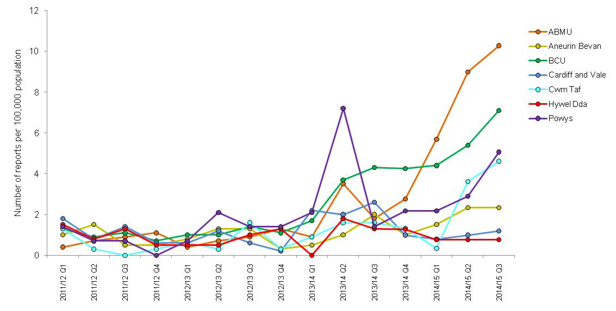
Trend in GP Yellow Card reporting

Slide 40

For more information on the National Prescribing Indicators for 2015–2016, please visit the AWMSG website at www.awmsg.org or contact AWTTC on awttc@wales.nhs.uk.

