Slide 1

WHSSC IPFR Judicial Review
Welsh Health Specialised Services Committee

Slide 2
Individual Patient Funding Request: What is it?
It’s a process which allows patients to access treatments which are not routinely available because:
  New
  Not considered cost-effective
  The condition is rare and treatments not fully evaluated
  Evidence of clinical effectiveness is weak
Criteria (very similar across UK):
  Patients are significantly clinically different (no social factors)
  Likely to benefit more than other patients
  Likely to be cost effective
Described in the All Wales (AW) IPFR Policy

Slide 3
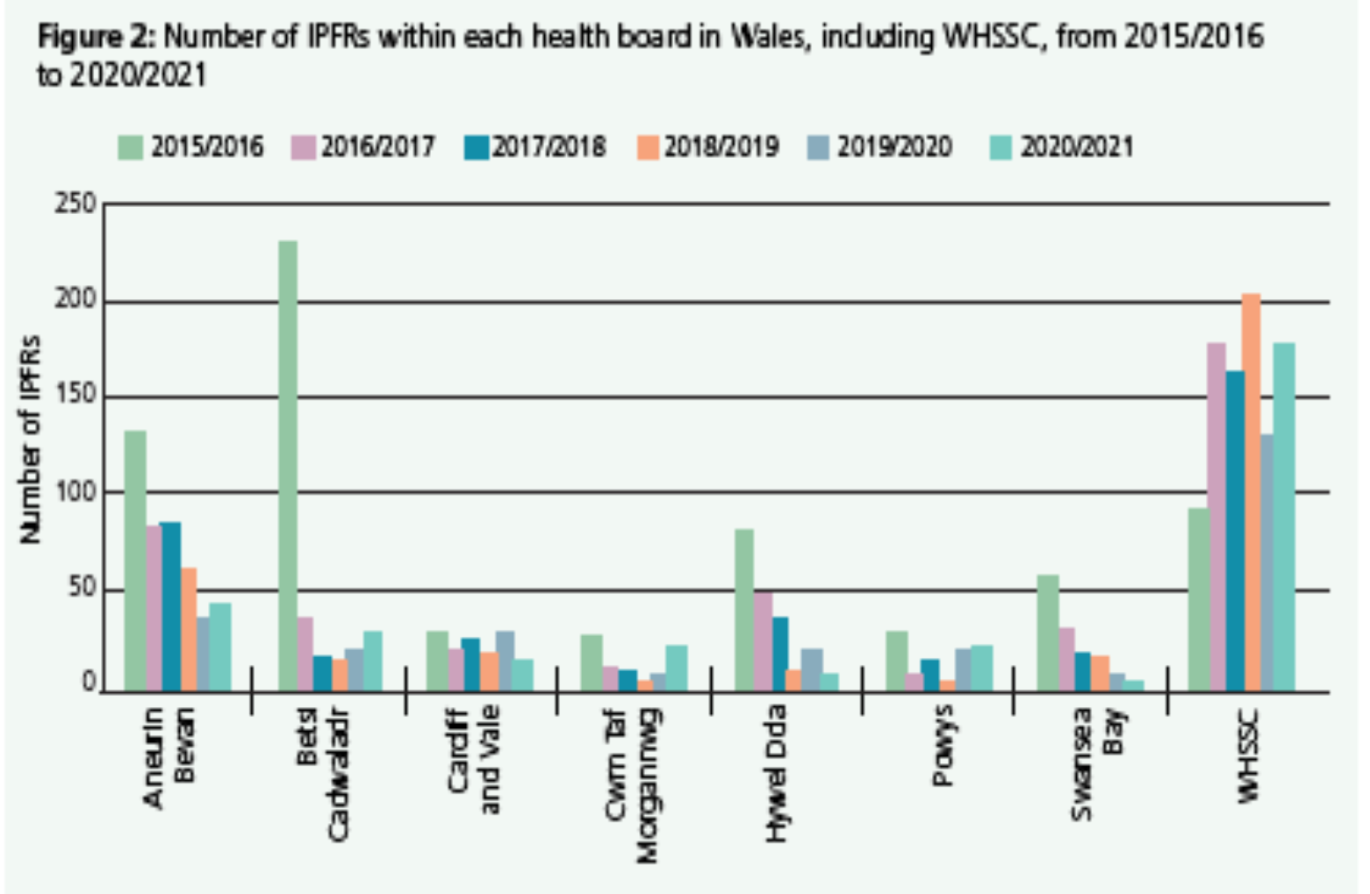
Scale of IPFR requests seen by WHSSC and HBs

Slide 4
Judicial Review Dec 2021
JR is a frequent threat
Judicial Review of IPFR decision in Dec 2021
Found that WHSSC IPFR Panel had ‘not acted legally’
Not used the correct comparator group
  Not documented the decision making adequately
  Not interpreted the NICE Interventional Procedure Guidance properly
Learning: Legal advice from QC, Barrister from Wales and WLR. Further advice IPFR Chair and WHSSC MD

Slide 5
Comparator Group - Walpott Case
Comparator Group or ‘Significantly different test’
  IPFR Panel compared the patient to other patients with operable disease for whom surgery is not an option because of the policy
  The judge said the patient should be compared to the whole patient group – even those with inoperable disease
This means that all patients with operable disease are now “significantly different”

Slide 6
Solutions…
Training from KC on lessons fro JR- focus on comparator group
Use of the language TEST i.e.
  Part 9A
  Is the patient significantly different? YES/NO
  Will they get significantly more benefit? YES/NO
  Does it represent reasonable value for money? YES/NO
  Part 9B
  Is the patient likely to get significantly more benefit? YES/NO
  Does it represent reasonable value for money? YES/NO

Slide 7
Running of IPFR Panel
Feedback from Barrister observing Panel:
  Currently large (Note- complex decision making)
  Currently large number of cases per meeting
  Strong informed chairing is of key importance
  Quasi legal standard of documentation needed
  Need clarity on use of references

Slide 8
Solutions…
Increased frequency of meetings
Changing TORs
Corporate Governance Manager in attendance
  Community of support?
Clarified how references are to be used
Strengthened our documentation- huge challenge!
Strengthened our economic evaluation
  Difficult area despite our expertise
  Develop a specific information sheet for procedure related to JR
  Example…..

Slide 9
Cost effectiveness
Often no published evidence on cost effectiveness
Cost - £73K (hardly any offset costs)
ICER (cost of procedure compared with years of good quality life -QALY) to be cost effective in UK is £20-30K
  US data $166K ICER
  Aus data $21K ICER
Health Technology Wales – evidence low quality
  ICER $91K (US) (range of conditions with diff. ICERs)
Cancer ICER higher; probability that is above accepted threshold to pay

Slide 10
Solutions….
Ensure the wording in the Policy…
“reflects the correct intention”

