Slide 1
Value for money
Health Technology Wales
Sophie Hughes
IPFR Workshop 2023

Slide 2
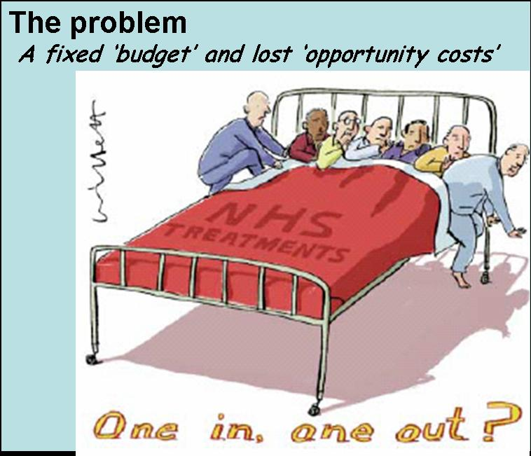
Why consider health economics?
NHS faces a limited budget
Difficult spending decisions must be made across different disease areas
Spending more in one area necessitates spending less somewhere else
Economic analysis estimates whether the gains from the new spending outweighs the losses from what has been displaced (i.e. the ‘opportunity cost’)

Slide 3

HE Mythbusting
Health economics is NOT about saving money and spending less
  Money is never really ‘saved’ in the NHS budget as it would always be spent on something else
Health economists are concerned with maximising benefits NOT minimising costs
This means that it is possible for costly treatments to be cost-effective if they are more effective than the available treatments
Also means that treatments may not be cost-effective just because they are cheaper. Effectiveness matters

Slide 4
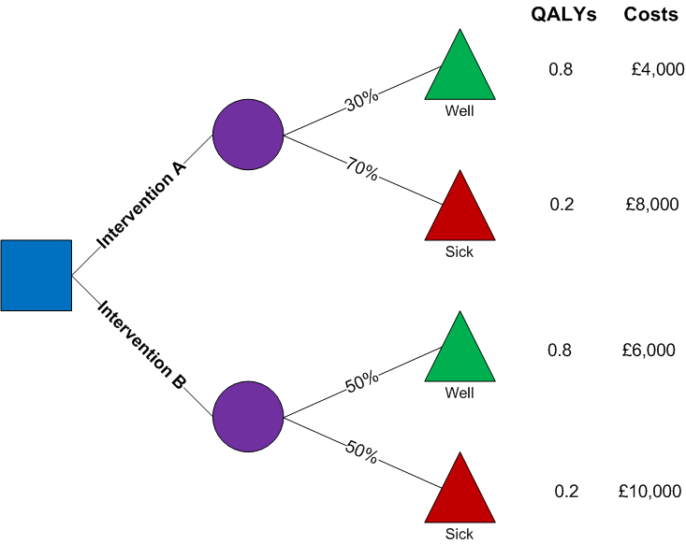
Decision tree model
Outcome | Expected cost | Expected QALYs
Intervention A | £6,800 (30%*£4,000+70%*£8,000) | 0.38 (30%*0.8+70%*0.2)
Intervention B | £8,000 (50%*£6,000+50%*£10,000) | 0.50 (50%*0.8+50%*0.2)

Slide 5
Cost-effectiveness thresholds
Δ Cost
+
£30,000 per QALY
Less effective and more costly
Not cost-effective
£20,000 per QALY
_
Cost-effective
+
Δ QALYs
Not cost-effective
More effective and less costly
Cost-effective
_

Slide 6

Health economics in decision-making for IPFRs
Why is the patient likely to gain a significant clinical benefit from the proposed intervention?
Does the intervention for that particular patient represent value for money, compared with the alternative if the IPFR is declined? (i.e. is the incremental cost justified by the expected clinical benefits?)

Slide 7

Making an economic case in IPFR applications
No alternative? The up-front cost of the alternative is £0
Intervention cost - £0 =
Intervention cost -£300= smaller!
If the patient is receiving any type of care, list these costs.
No offset costs? Less likely that the intervention will save money

Slide 8
Communicating decisions
Do you have economic evidence?
Over the long term, is the intervention likely to increase costs to the health board, compared with usual care for the patient?
Over the long term, how much benefit (e.g. length of life and quality of life) is the patient likely to derive compared with usual care for the patient?
Δ Cost
+
£30,000 per QALY
Less effective and more costly
Not cost-effective
£20,000 per QALY
_
Cost-effective
+
Δ QALYs
Not cost-effective
More effective and less costly
Cost-effective
_

Slide 9
Communicating decisions: Yes
+
Δ Cost
Less effective and more costly
Not cost-effective
Where does the intervention fit?
_
Cost-effective
+
Not cost-effective
More effective and less costly
Δ QALYs
Cost-effective
_

Slide 10
Communicating decisions: Yes
Economic evidence | No economic evidence
The NICE guideline recommendation was based on an economic model which included a scenario considering patients with X. In this scenario, drug A was cost effective. | Over the patient’s lifetime, the intervention is expected to be more effective and less costly than the care the patient would receive as part of usual care. This is because substantial cost savings are expected from the reduction in hospitalisations shown in (X. et al 2018)
The published economic study showed that drug A could be cost effective compared with standard care for patients with X. | The additional cost of the intervention compared with the patient’s usual care is justified by the expected gains in life expectancy
+
Δ Cost
Less effective and more costly
Not cost-effective
Where does the intervention fit?
_
Cost-effective
+
Not cost-effective
More effective and less costly
Δ QALYs
Cost-effective
_

Slide 11
Communicating decisions: No
Where does the intervention fit?
Δ Cost
+
Less effective and more costly
Not cost-effective
_
Cost-effective
+
Not cost-effective
More effective and less costly
Δ QALYs
Cost-effective
_

Slide 12
Communicating decisions: No
Got economic evidence | No economic evidence
The NICE guideline recommendation was based on an economic model which included a scenario considering patients with X. In this scenario, drug A was not cost effective. | Over the patient’s lifetime, the intervention is expected to be similarly effective but more costly than the care the patient would receive as part of usual care. Drug A is not expected to be cost effective because the gains in quality of life expected from the reduced toxicity of drug A are not likely to justify the additional costs of the intervention
The published economic study showed that drug A was not cost effective compared with standard care for patients with X. | TIPS: Be specific! Consider what would need to change for the IPFR to be approved?
Where does the intervention fit?
Δ Cost
+
Less effective and more costly
Not cost-effective
_
Cost-effective
+
Not cost-effective
More effective and less costly
Δ QALYs
Cost-effective
_

Slide 13
How could we improve?
“As there is evidence of benefit to the patient, the panel can make an assumption that there is good cost benefit for the intervention.”
“Due to continued clinical benefit, this treatment is deemed good value for money”
The IPFR Panel considered that this request would decrease costs compared with the alternative for this patient, and that quality of life/length of life is likely to increase. Therefore, the Panel expects that the request would be cost effective.
OR
The IPFR Panel considered that this request is likely to lead to a small increase in costs compared with the alternative for this patient, and that the expected benefits (e.g. increased quality of life/length of life) are sufficient to justify these costs. Therefore, the Panel expects that the request would be cost effective.
Δ Cost
+
Less effective and more costly
Not cost-effective
Evidence of benefit is not enough to judge that something is cost effective.
Where do we sit in terms of costs?
_
Cost-effective
+
Not cost-effective
More effective and less costly
Δ QALYs
Cost-effective
_

Slide 14
How could we improve?
“The IPFR Panel considered that this request would place a financial burden on the Health Board that on balance, was not an appropriate use of the limited resource currently available”
“Members of the panel considered the cost of this treatment but based on the information provided could not identify any good cost benefit”
The IPFR Panel considered that this request would increase costs compared with the alternative for this patient, and that the expected benefits (e.g. decreased adverse events) are not sufficient to justify these costs. Therefore, the Panel does not expect that the request would be cost effective.
Δ Cost
+
”Financial burden”… suggests the panel thinks that the intervention is more costly than usual care
But something can be more expensive but still cost effective
Less effective and more costly
Not cost-effective
_
Cost-effective
+
Not cost-effective
More effective and less costly
Δ QALYs
Cost-effective
_

Slide 15
Tips: if you have health economic studies
Do we have any health economic evidence? How well does it match the PICO for this case?
What type of health economic study is it? Does it present just costs, or cost per QALY?
Check scenario analyses in health economic studies, which may match your case more closely than the population in the base case
Is the study setting applicable to the UK? Are there any obvious limitations?
Be specific in your rationale

Slide 16
Tips: if you don’t!
Full cost-utility analysis not likely to be feasible; try to have a qualitative discussion on value
Try to find the costs of the intervention and the correct comparator
Consider the effectiveness evidence, and think about what the implications are for costs and QALYs. For example, does the intervention group have fewer recurrences than the comparator?
Quality of life: Do people who receive the intervention have a better quality of life than people who receive the comparator? This may justify additional costs
Be specific in your rationale

Slide 17
Thank you!
Sophie Hughes
IPFR Workshop 2023

