Slide 1
Patient outcomes
Ann-Marie Matthews
Lead for Clinical Commissioning/ IPFR
Aneurin Bevan University Health Board

Slide 2
Why do we collect outcome data?
The IPFR panel needs to understand how and when the patient will be monitored and what key outcome parameters will be used to assess response to treatment.
It enables panel members to receive feedback on the impact of their decision made.
As part of the follow up process the clinician will be sent an outcome questionnaire. If the intervention is funded the measures included in this section will be used to assess response.

Slide 3
Outcome data received

Slide 4
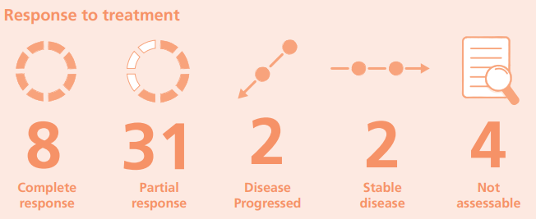
Data Collection -21/22
Outcome data was provided for 49 patients who had an IPFR approved
34 of the outcomes were for continued funding for medicines – the remainder were for new medicines requests and non-medicines.

Slide 5
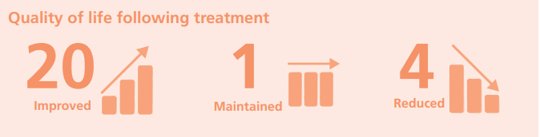
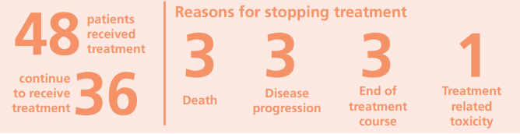
Data collection 21/22 cont.
The majority of IPFRs approved in 20/21 for which we have outcome data were associated with evidence of clinical benefit and a maintained or improved quality of life.

Slide 6
IPFR Outcome Questionnaire
The number of cases for which outcome data was available is low.
What further information, if any, should we collect?
How can we encourage clinicians to provide outcome data?

Slide 7
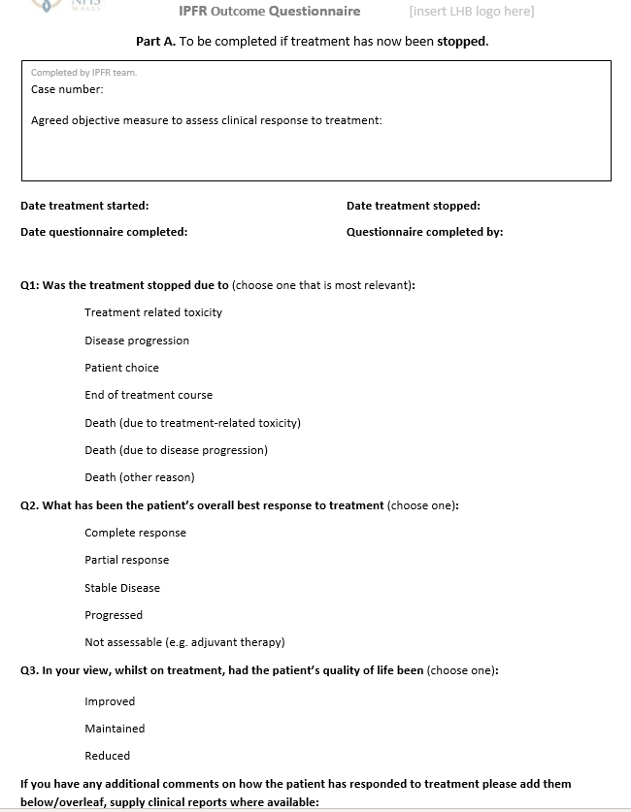

Slide 8
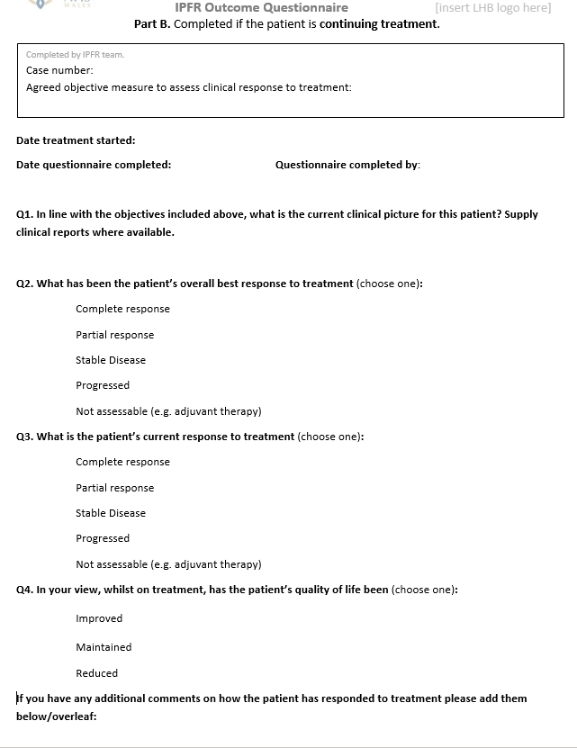

Slide 9
Thanks for listening

