Slide 1
IPFR QA – lessons learnt
James Coulson, Chair of IPFR QA group

Slide 2
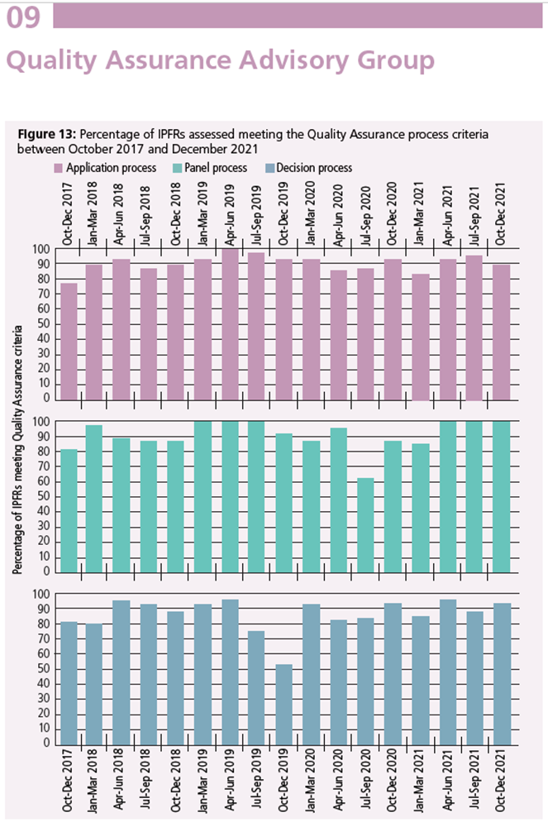
2017-2021
In 2020 the exceptional circumstances of the pandemic resulted in a dip in improvements due to short term local adaptions which meant some processes fell outside of the assessment criteria.
From April to December 2021 the percentage of criteria met recovered to 90% and above with the exception of the decision process.

Slide 3
Key themes in the past 12 months
Documentation (application, minutes, decision letter)
Value for money considerations and documentation
Exceptionality and rarity*
Lay representation vacancies*
Role of other groups on decision making*
Panel quoracy – clarification of who is attending and their role, panel members providing comments to the meeting but not being present
Voting vs. collective decision
Removal of patient identifiable data

Slide 4
Exceptionality and rarity
Term exceptionality removed following the last review
  Not clearly defined term
  Difficult to apply
  Misinterpreted by some patients as being very good compared with others and considered by some to be a smokescreen for HBs to deny treatment
  Confused with rarity
  Legal term arise from case law - no public service can have a blanket ban on providing a specific service
  Only makes sense when there is a rule (guideline, policy)
  Difficult to apply for rare diseases

Slide 5
Significant clinical benefit
An individual patient might be sufficiently different from the cohort of patients that a reasonable judgement can be made whether an individual patient is so different from the others that they are likely obtain an significant clinical benefit from the treatment, at reasonable cost, by comparison with the cohort of patients falling outside the treatment guideline.
Keep reminding/educating your clinicians

Slide 6
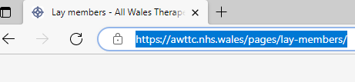
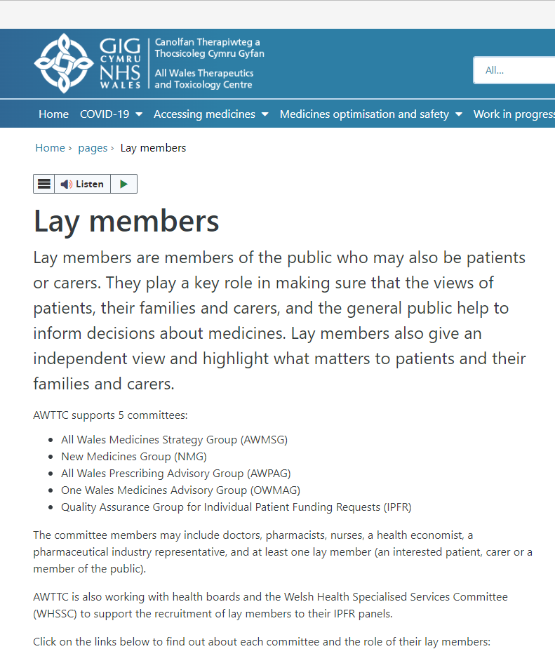
Lay representation
Presentation to PAPIG
Campaign over Volunteers week
Compiling an information pack for IPFR Co-ordinators
Information section on AWTTC website with option to submit interest to become a lay

Slide 7
Role of other groups
Medicines and Therapeutics Groups, Oncology groups providing recommendations to panel
  Consider how this may impact on decision making (timeliness, use of decision making guide, bias)
  Ok to provide a professional view but should not be a recommendation

Slide 8
Interactive part!

Slide 9
Documentation Questions/scenarios
Maximum 5 minutes reading time, then 15 minute discussion, 10 minutes to feedback
Example of a poor application
  how do we communicate the changes needed to the clinician?
  What can we do to improve applications in the future?
Example of poor minutes
  what extra information is needed?
  How can we improve minute taking?
Example of a poor decision letter
  what extra information is needed?
  How can we make our decision rationale more robust?

