Slide 1
IPFR E-SUBMISSION
Ann-Marie Matthews
Lead for Clinical Commissioning / IPFR
Aneurin Bevan University Health Board

Slide 2
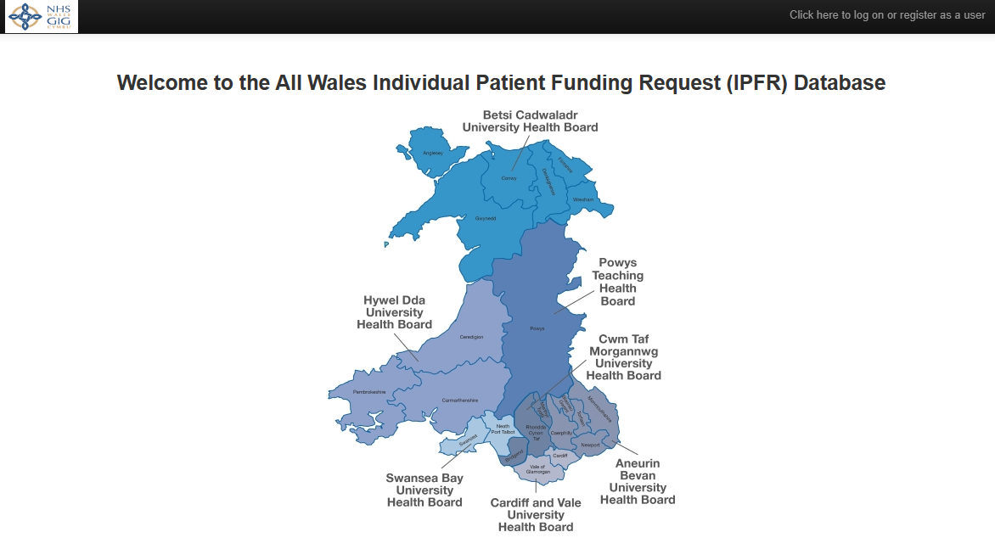
IPFR E-Submission

Slide 3
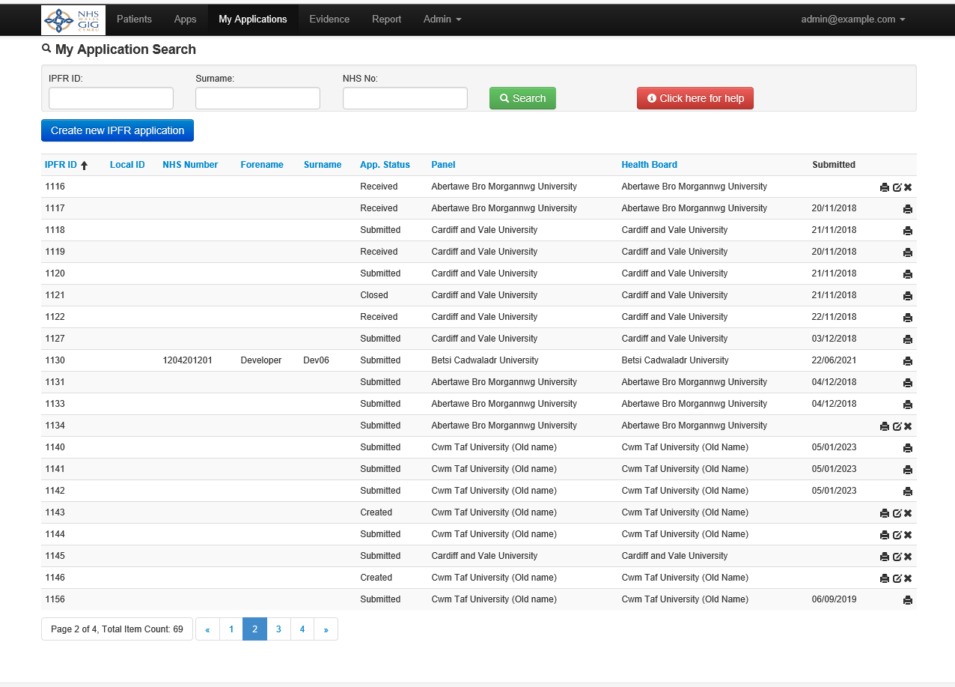
Application process

Slide 4
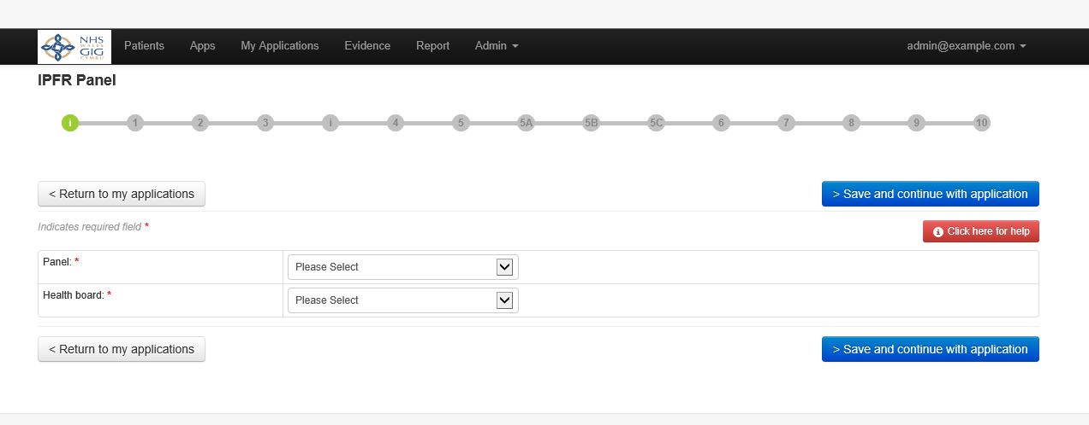
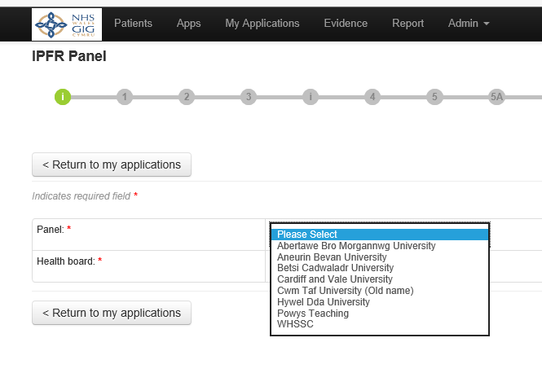

Slide 5
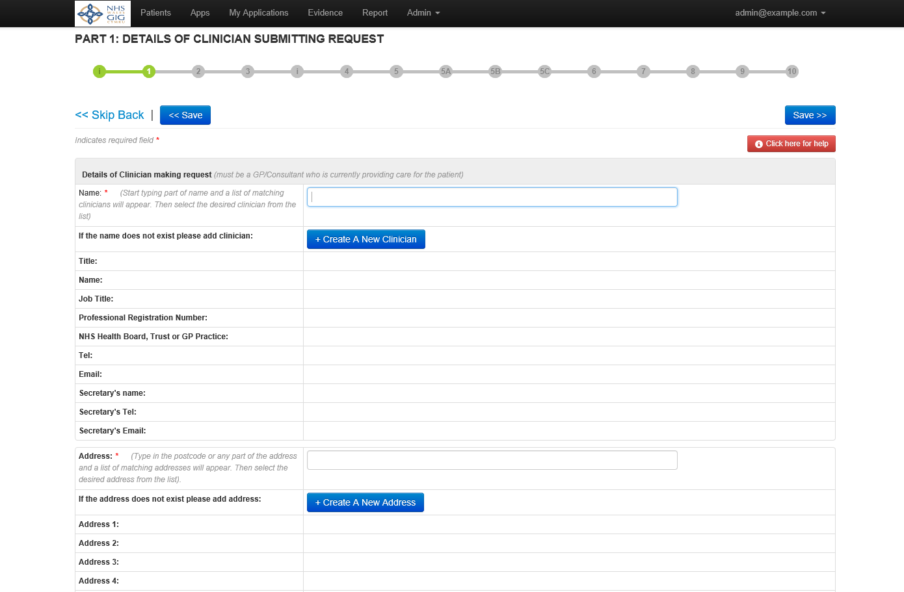

Slide 6
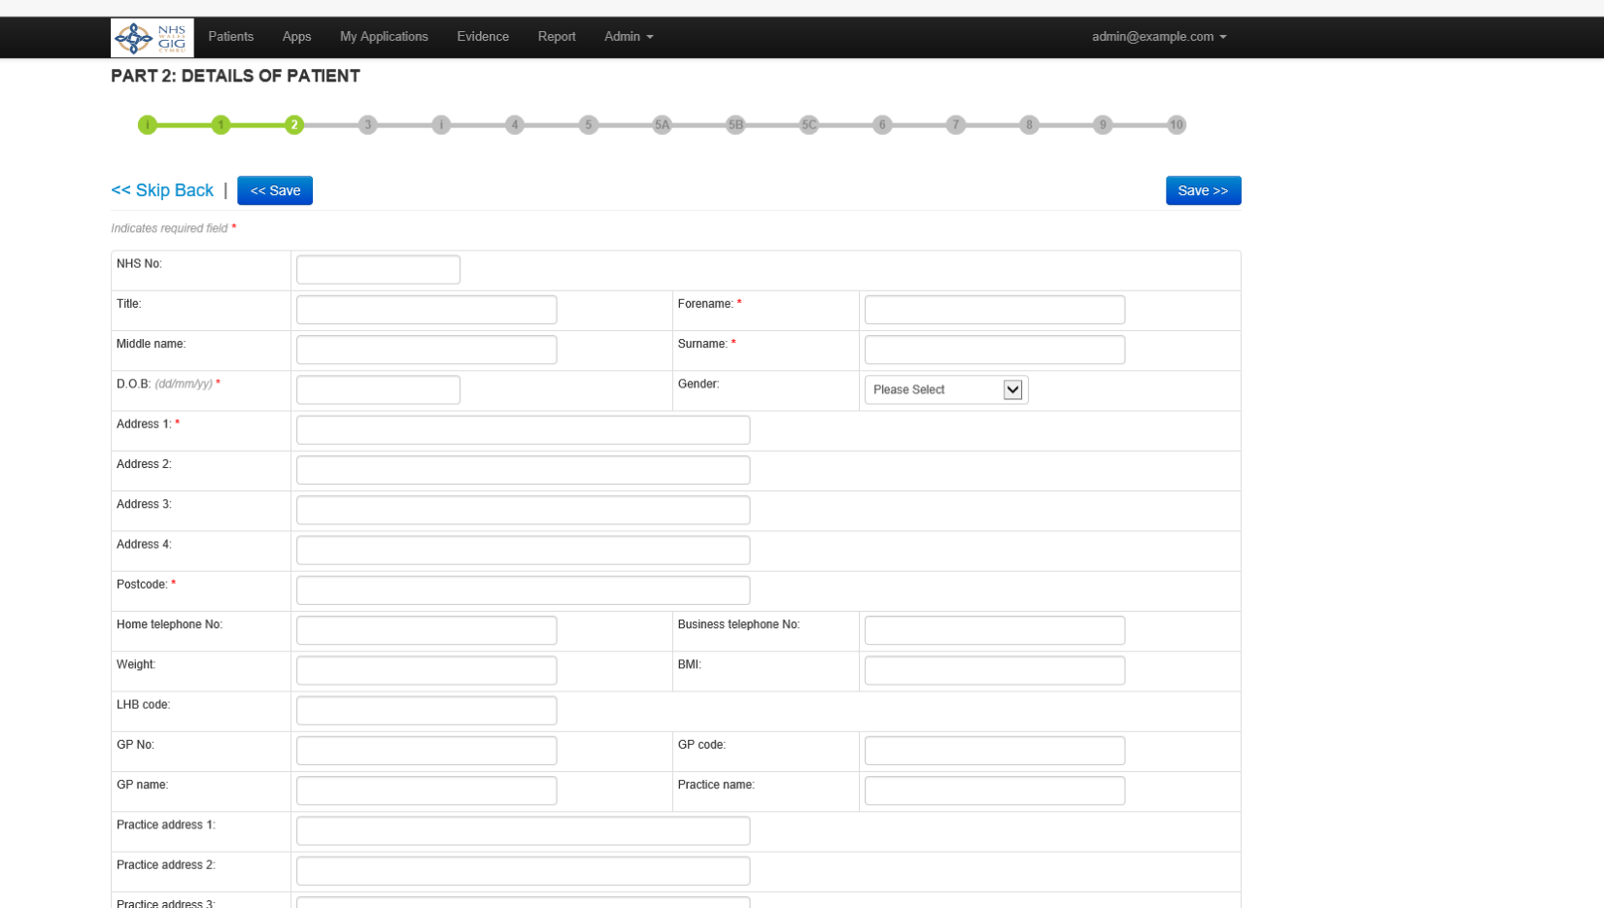

Slide 7
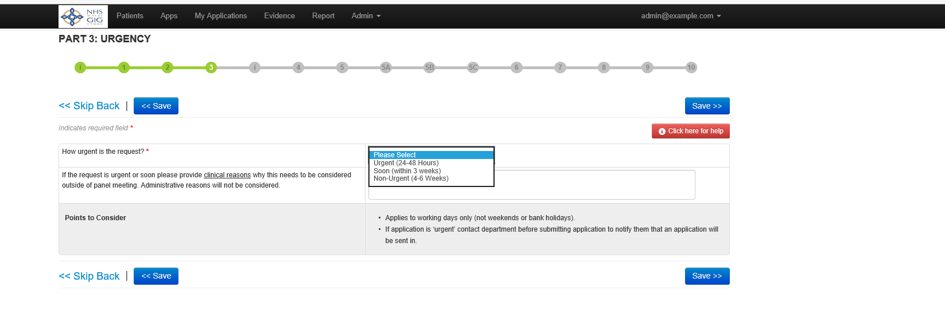

Slide 8
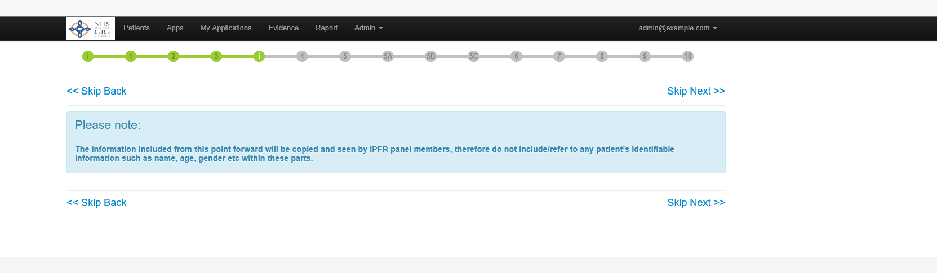

Slide 9
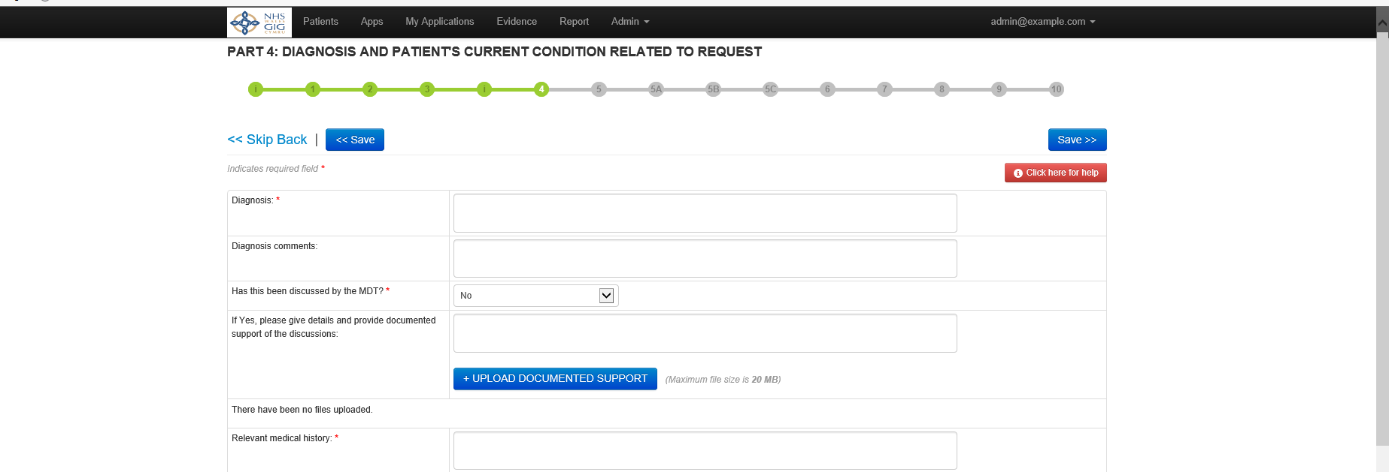

Slide 10
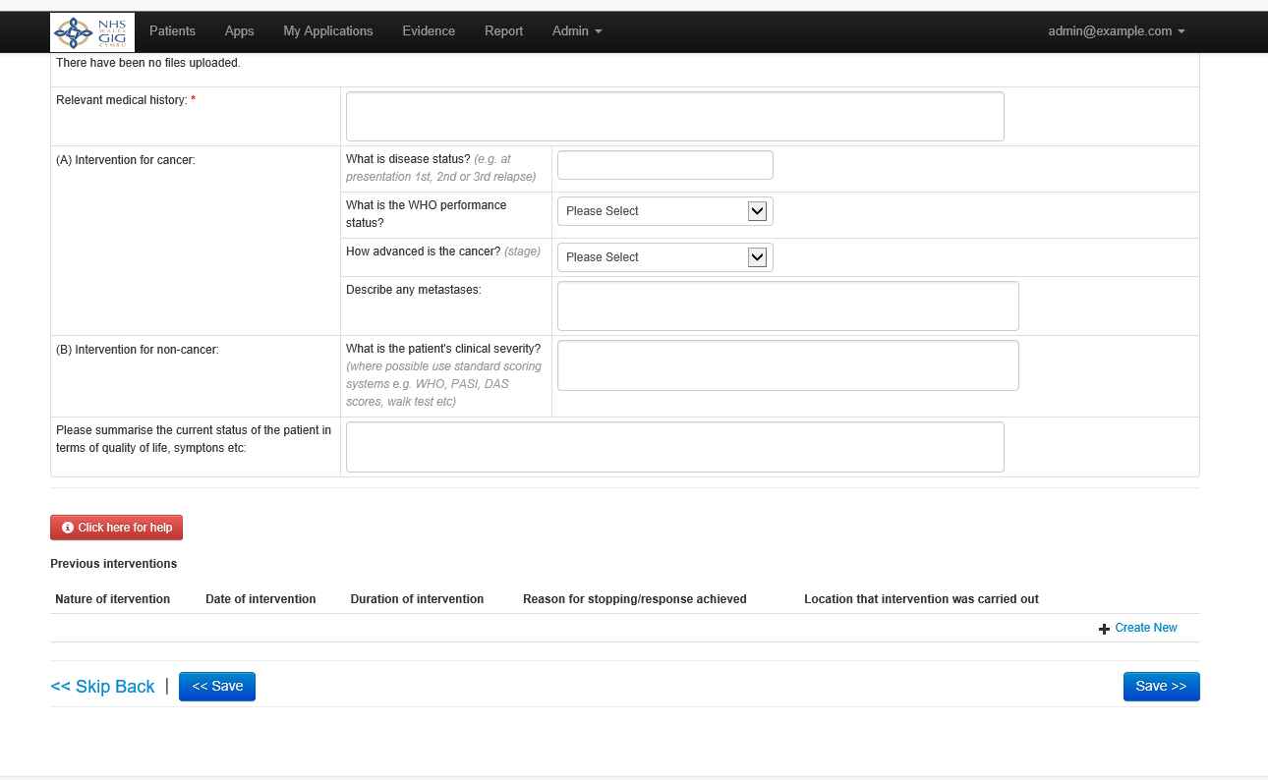
Part 4 cont.

Slide 11
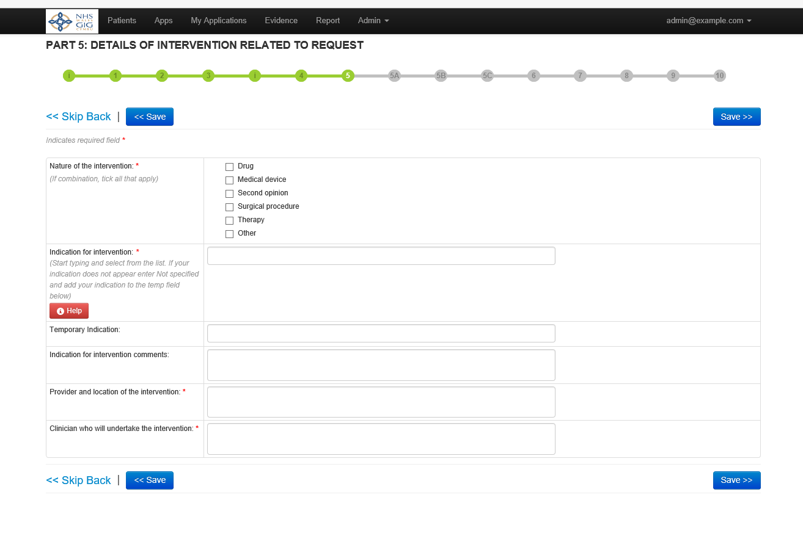

Slide 12
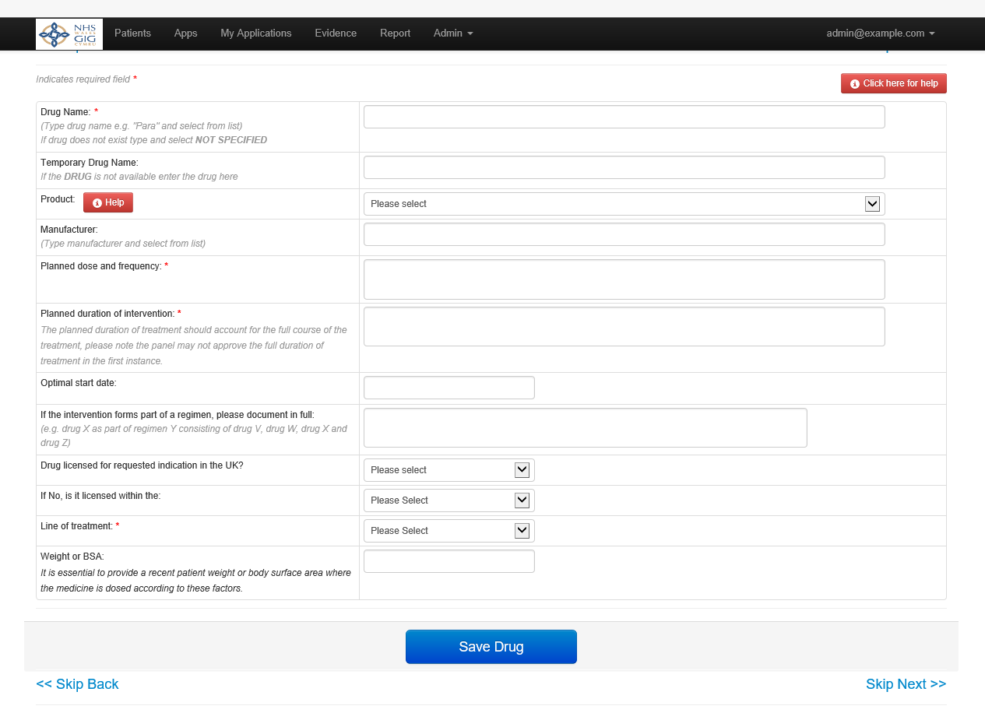

Slide 13
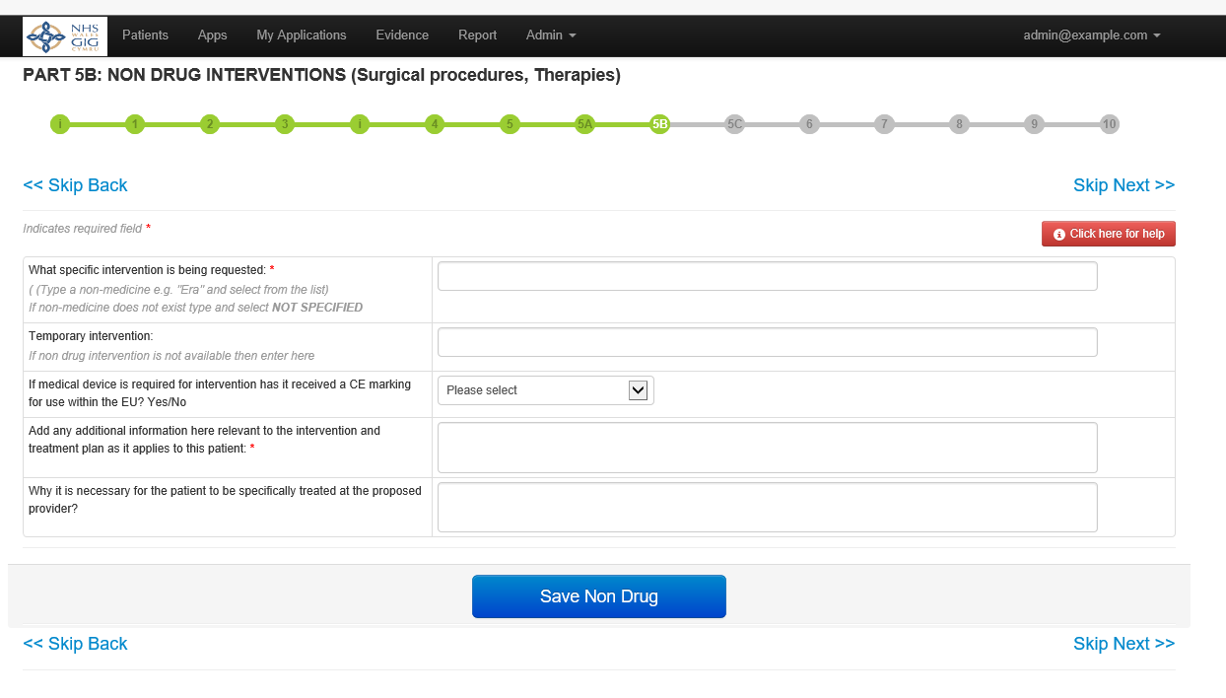

Slide 14
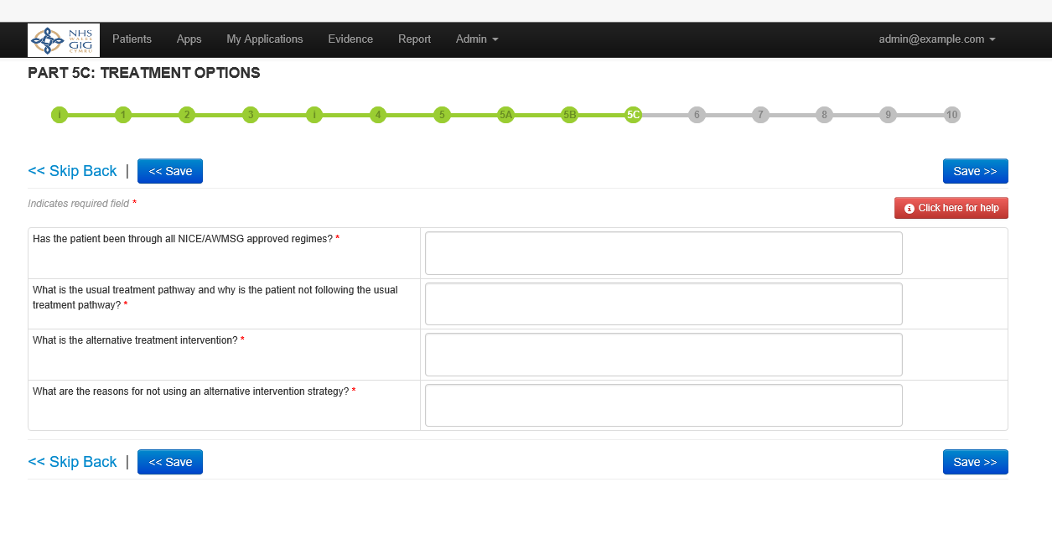

Slide 15
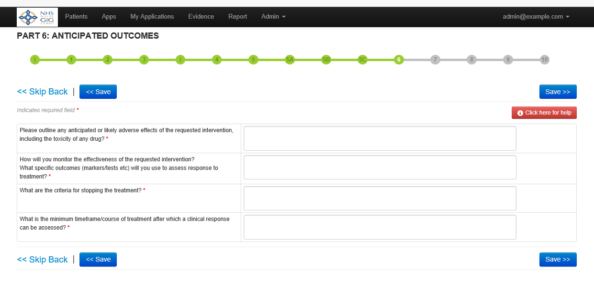

Slide 16
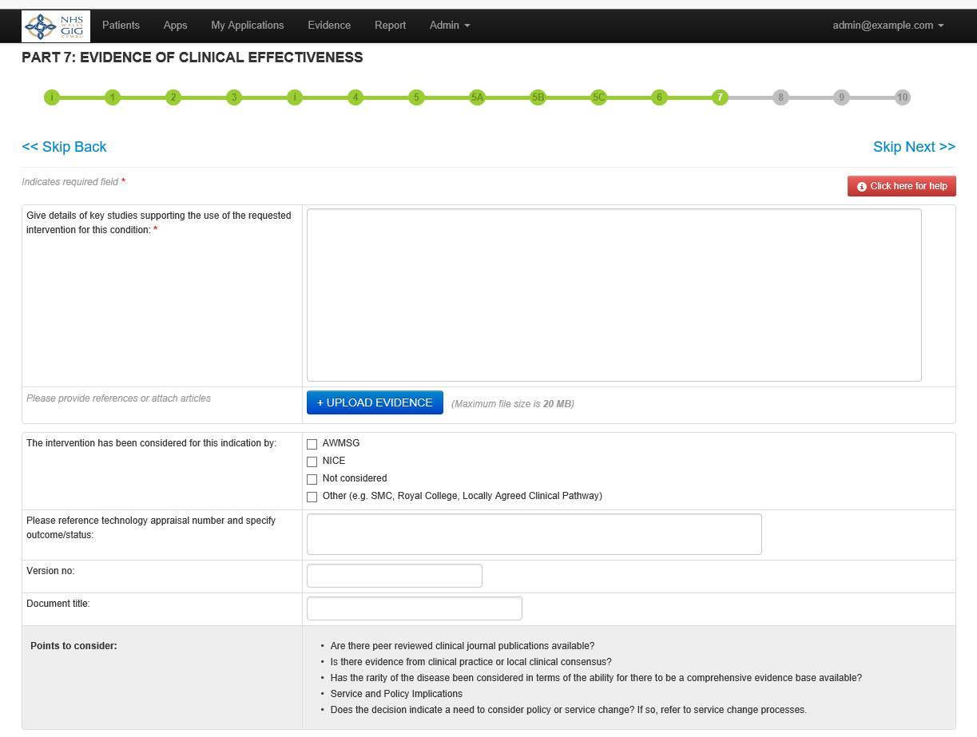

Slide 17
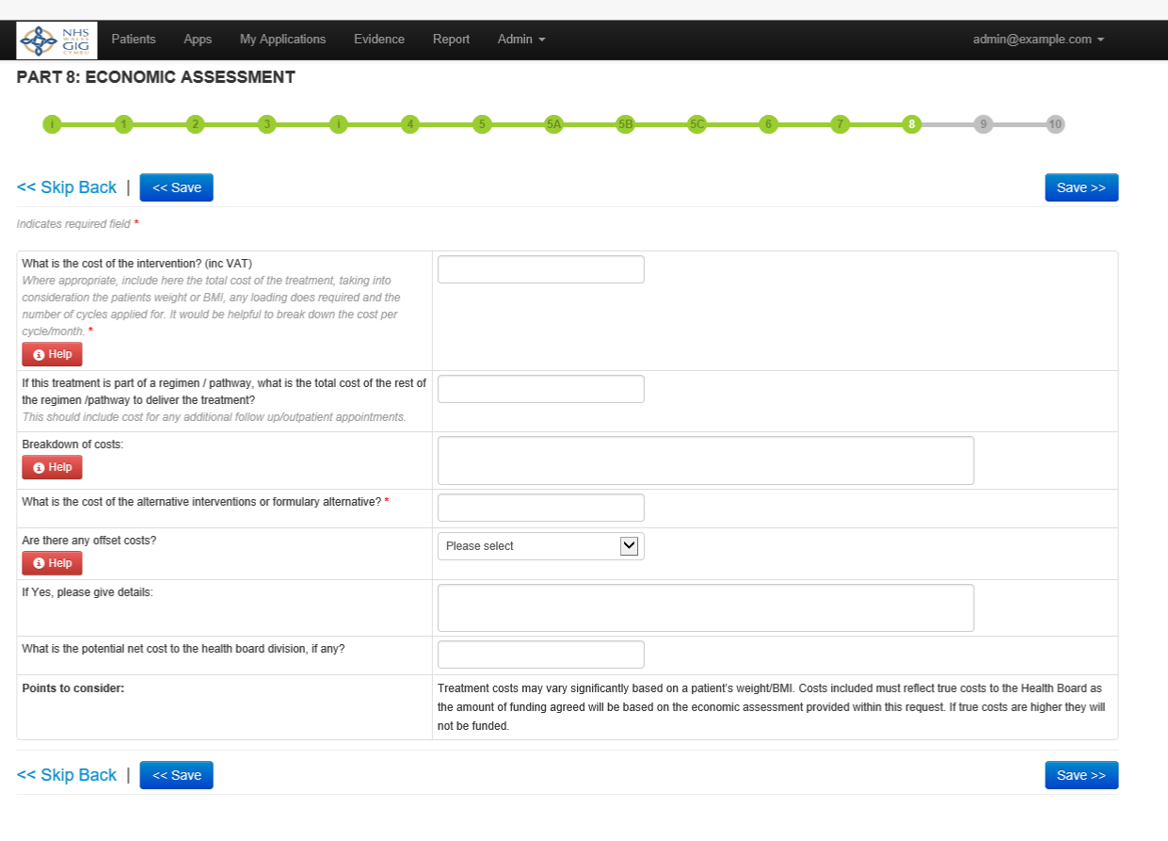

Slide 18
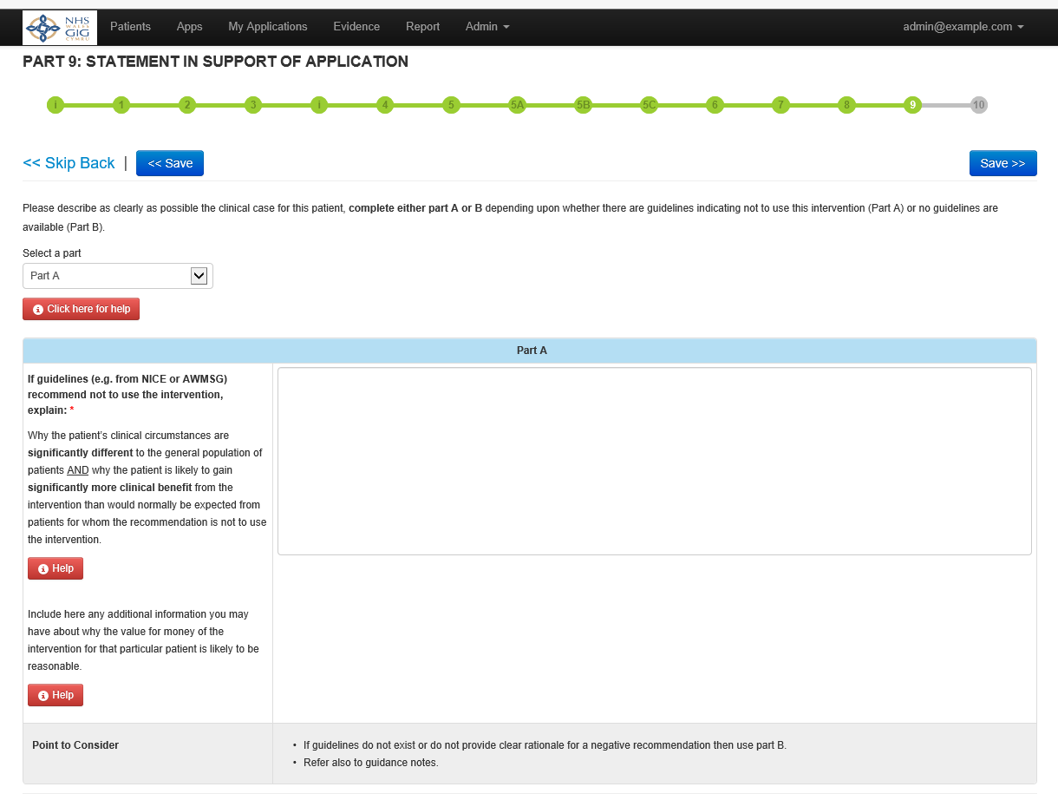

Slide 19
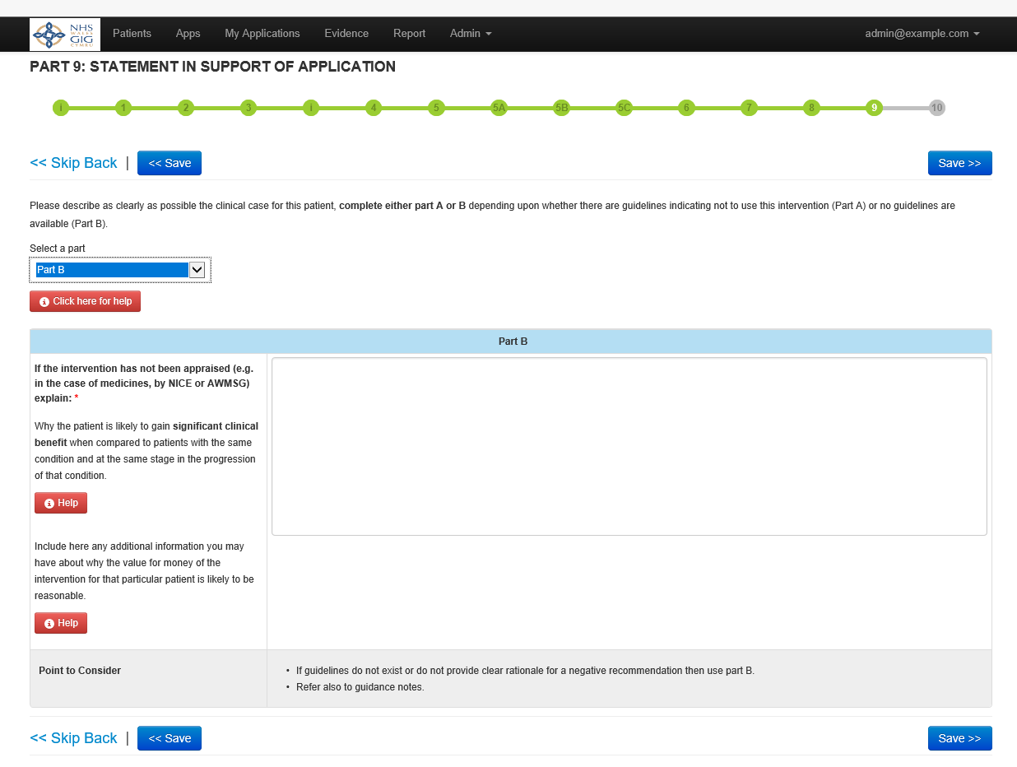

Slide 20
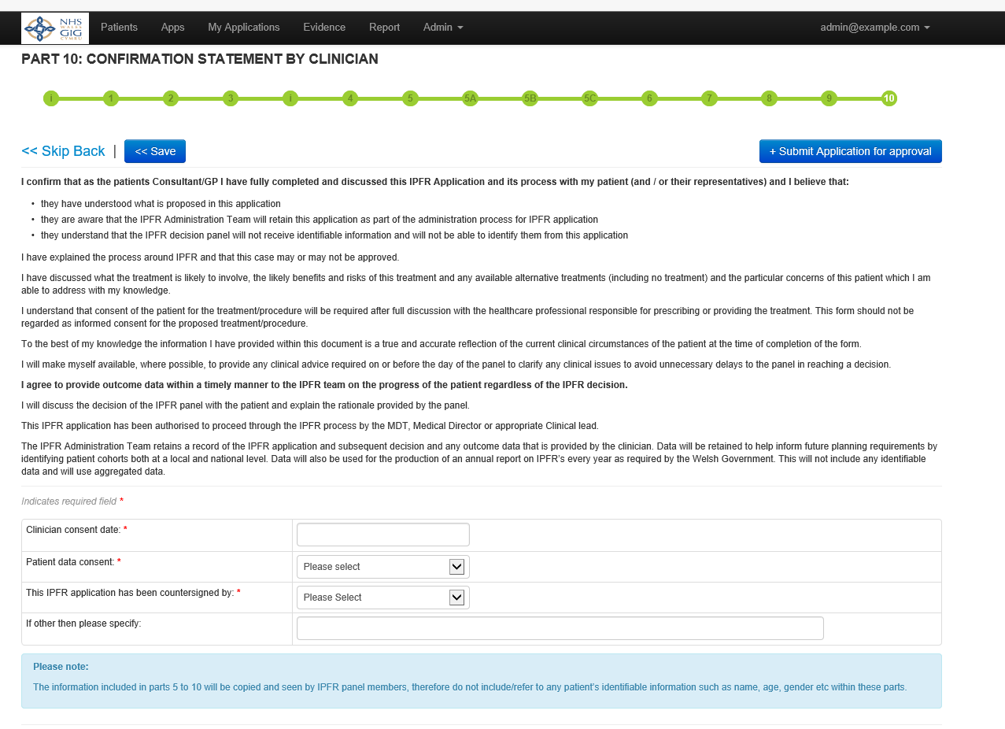

Slide 21
Advantages of E-submission
Clinician has a record of all application submitted.
Help guides are available throughout the document.
Reduction in administration time for clinicians and co-ordinators.
If further information is required the co-ordinator can unlock the submission to enable the clinician to add further detail.

Slide 22
Next Phase
Always looking at ways we can simplify the form.
Develop an E-user guide.
Add a function which triggers a request for outcome data.
Function for outcome data to be added to the e-submission.

