Slide 1
IPFR at HTW
Health Technology Wales
Sophie Hughes
IPFR Workshop 2023

Slide 2
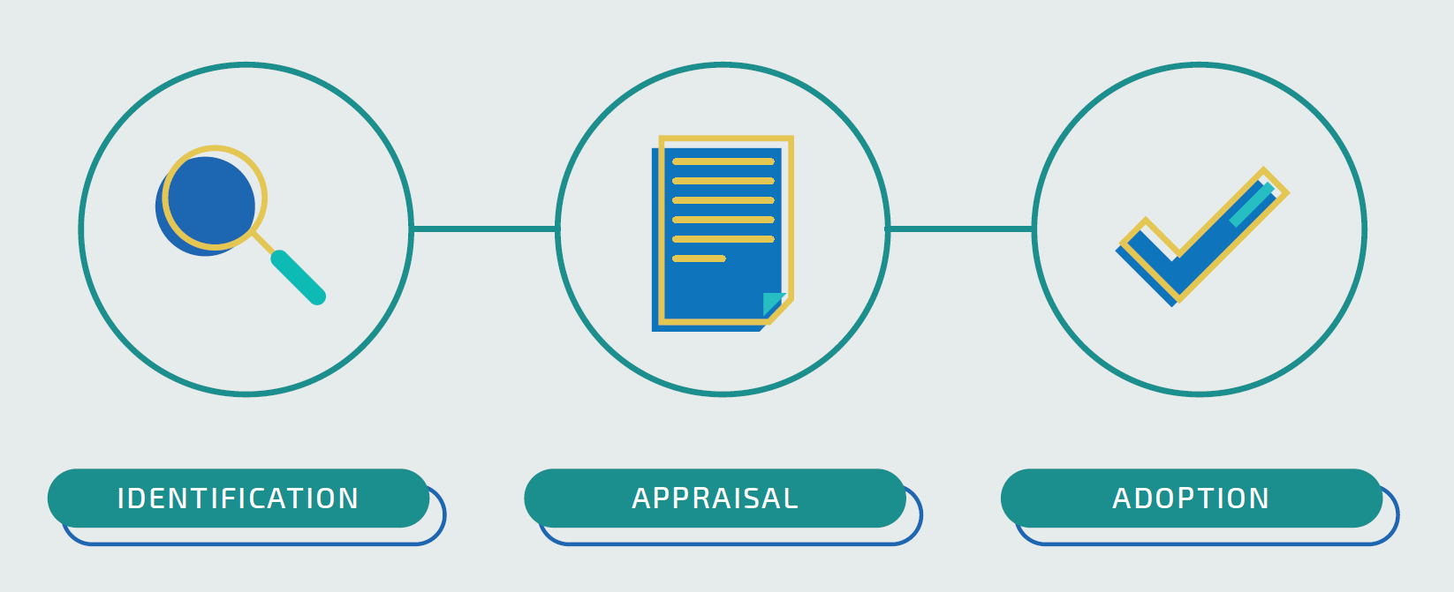
The purpose of HTW
To deliver a strategic, national approach to the identification, appraisal and adoption of new technologies into health and care settings

Slide 3
Background
2020/21 IPFR approval rates:
Overall: 74%, (same as 2019/2020)
Medicines: 77% (78% during 2019/2020)
Non-medicines: 73%, (72% during 2019/2020)

Slide 4

HTW Rapid Evidence Summaries
Assist panels by outlining:
Brief summary of request and patient details and background
Clinical effectiveness
Economic evidence and considerations
Conclusions
Summary of search results, terms and dates

Slide 5
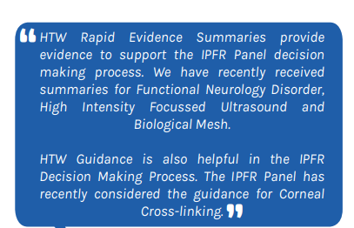
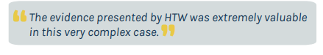
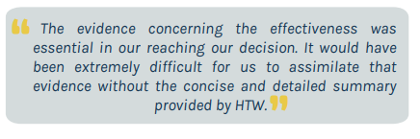
HTW Rapid Evidence Summaries
Assist panels by outlining:
Brief summary of request and patient details and background
Clinical effectiveness
Economic evidence and considerations
Conclusions
Summary of search results, terms and dates

Slide 6
HTW Rapid Evidence Summaries
Autologous serum eye drops for Sjögren’s syndrome with dry eyes
Argon plasma coagulation for the treatment of gastrointestinal angiodysplasia
Specialist inpatient/multidisciplinary treatment/cognitive behavioural therapy for Functional Neurological Disorder
Low energy contact X-ray brachytherapy (the Papillon technique) for recurrent early rectal cancer after primary treatment
Biological mesh (Strattice) as part of complex abdominal wall reconstruction for incisional hernia
Gasoelectrical stimulator insertion for gastroparesis
High-intensity focused ultrasound for a local recurrence of prostate cancer
Autologous chondrocyte implantation for left knee ligament injury with significant chondral injury
Diagnostic bronchoscopy navigation for primary or metastatic lung nodule
Ketogenic diet for tumour-related epilepsy
33 IPFR Rapid Evidence Summaries (37 requests) since early 2020
~1-2 weeks turnaround

Slide 7
How can you support HTW?
Identification of priority topics for appraisal
  Target HTW evidence support to realise most value
Participate in expert review processes
  Share expertise to inform HTW appraisals
Dissemination of HTW guidance
  Support dissemination, implementation & audit of HTW guidance

Slide 8
Thank you!
Sophie Hughes
IPFR Workshop 2023

