Slide 1


WHSSC and the IPFR process
Iolo Doull
Executive Medical Director WHSS

Slide 2
What does WHSSC do?
WHSSC is responsible for the planning of Specialised and Highly Specialised Services on behalf of the 7 health boards in Wales
Commissioning policies define the specialised services commissioned by WHSSC and the criteria that must be met for Welsh patients to access the treatment
Service specifications define what WHSSC expects to be in place for providers to offer, and must be:
  Evidence-based
  Safe
  Effective
  Equitable access to services

Slide 3
How does WHSSC commission new services
WHSSC must ensure that any new investment decisions are affordable, offer value for money and are supported by convincing evidence of safety and effectiveness
WHSSC runs an annual prioritisation process to determine the relative prioritisation of new interventions within specialised services
The process is facilitated by the WHSSC Prioritisation Panel and Clinical Impact Assessment Group (CIAG) and their recommendations (or priorities) are subsequently presented in the WHSSC Integrated Commissioning Plan ICP

Slide 4
WHSSC aims
To ensure … equitable access to safe, effective and sustainable specialised services for the people of Wales ……..within available resources

Slide 5
What are specialised services?
Services for a range of rare and complex conditions includes rare cancers, genetic disorders or complex medical or surgical conditions
Typically deliver cutting-edge care and often innovative
Defined by:
  The number who require the service (Pop’n of 1 million)
  The cost of the service or facility (Ave. £20,000 per patient)
  The number of people able to provide the service or facility; and
  The financial implications for HBs if they were required to arrange for provision of the service themselves

Slide 6
What are highly specialised services?
Highly specialised services are provided to a smaller number of patients compared to specialised services
Usually no more than 500 patients per year (UK)
Best delivered nationally through a very small number of centres of excellence
Examples include liver transplant services, enzyme replacement therapy, and proton beam therapy for specific cancer treatments
Typically 2-3 UK centres

Slide 7
WHSSC Commissioning HB Contribution 21/22 £715m
The average Welsh HB contribution is 14.3%
Notes:
Integrated Commissioning Plan investment 22/23 circa £28.5m
Total WHSSC budget 22/23 circa £742 m
Percentage uplift approx. 4%

Slide 8
WHSSC Governance
Joint Committee
  Independent Chair
  All 7 Health Board CEOs
  3 Independent Members (from HBs)
  WHSS Managing Director, Director of Finance, Director of Nursing, Medical Director
Management Group
  Representative from each HB usually 2, usually a Planning/Commissioning and Finance but determined by each HB. Membership has to be agreed by JC

Slide 9
Who does it?
63 wte Staff
6 Commissioning Teams (inc. Renal Network)
5 Functional Teams
£4m
Direct running costs
45 Contracts
(7 Welsh/38 English)

Slide 10
WHSSC Commissioning Teams
Women and Children
Cancer and Blood
Cardiac
Mental Health
Neurosciences and chronic conditions
Renal Network

Slide 11
Mental Health and Vulnerable Groups
High Security Psychiatric Services
Medium Secure Psychiatric Services
Traumatic Stress Wales
Gender Identity Services for Adults
Gender Identity Development Service for Children and Young People
Specialised Eating Disorder Services (Tier 4)
Mental Health Services for Deaf People (Tier 4)
Specialised Perinatal Services
CAMHS (Child and Adolescent Mental Health Services) Tier 4
Forensic Adolescent Consultation and Treatment Service (FACTS)

Slide 12
Cancer and Blood
PET scanning
All Wales Lymphoma Panel
Specialist services for Sarcoma
Haematopoietic Stem Cell Transplantation (BMT)
CAR-T therapy for lymphoma and acute lymphoblastic leukaemia
Thoracic surgery
Hepatobiliary cancer surgery
Brachytherapy (prostate and gynaecological cancers)
Proton Beam Therapy
Stereotactic Ablative Body Radiotherapy
Specialist service for Neuroendocrine Tumours

Slide 13
Cancer and Blood
All Wales Medical Genomics Service
Burns and Plastics
Inherited Bleeding Disorders
Welsh Blood Service
Hereditary Anaemias specialist service
ECMO
Long Term Ventilation
Immunology

Slide 14
Horizon scanning and prioritisation of new interventions
NHS Wales and WHSSC must ensure that new investment decisions are:
affordable and offer value for money
supported by convincing evidence of safety and effectiveness
made using a process that is consistent and transparent
This requires the dual processes of horizon scanning and prioritisation
  Horizon scanning identifies new interventions
  Prioritisation allows them to be ‘scored’ and ranked in terms of clinical and cost effectiveness and other key criteria
  This information when combined with information around demands underpins the development of the Integrated Commissioning Plan (ICP)

Slide 15
Horizon scanning
Horizon scanning requires a systematic examination of all relevant information sources in order to identify new and emerging technologies, including:
NHS England policy propositions
AWTTC horizon scanning
IPFR - provides early indications of clinical demand for new treatments
Provider Health Boards and Trusts
WHSSC Commissioning Teams
Clinicians with a special interest in a clinical condition
Welsh Government strategic priorities
NICE HST and TA guidance and AWMSG guidance are mandatory

Slide 16
WHSSC Prioritisation Process
Process originally described in All Wales Prioritisation Framework (2011)
WHSSC Prioritisation Panel established in 2016
Broad expertise – Medical, Nursing, HB, Public Health, Lay, Ethics, Legal, Equalities, Finance, Health Economics
Open and transparent process – clear methodology, minutes available and results published in our ICP
Process unique to NHS Wales – commended by Welsh Government and Joint Committee

Slide 17
Prioritisation – assessment and scoring
Each intervention is supported by a package of information including a full evidence review – presented to the panel
Interventions are ‘scored’ against the following six criteria:
  Quality and strength of the evidence of clinical effectiveness
  Patient benefit (clinical impact)
  Potential for improving/reducing inequalities of access
  Economic assessment
  Burden of disease – nature (severity) of the condition
  Burden of disease – population impact

Slide 18

CIAG PROCESS
Commissioning Intent
Proposals
Sift CIAG appropriate route
Panel agreed
Prioritisation
Direct through alternate mechanism
Inclusion in plan
Reject/ manage alternate

Slide 19
CIAG SCHEMES 2022
50 schemes received (C&VUHB, SBUHB, BCUHB, MTN, WRCN, Velindre)
30 sifted with providers (ie strategic work, contract discussions etc)
CIAG day held 03 August 2021 - Microsoft teams for voting
20 schemes considered against 3 criterion:
  Burden of disease
  Clinical impact
  Equity
10 signalled for inclusion in the plan
Notes:
Members will be aware, and will predominantly have contributed to the CIAG day held on the 3rd August 2021.
All Health Boards were represented, however Hywel Dda abstained from vote due to difficulty in securing membership that could do so.
50 schemes were received for consideration through the CIAG process, the schemes were submitted from Cardiff, Swansea, Betsi and also this year from the Welsh Renal Network, the Major Trauma Network, some joint work between Swansea and Cardiff, Velindre and one specific WHSSC scheme.
As usual, assessment was made against 3 key criterion of :
Equity
Clinical Impact
Burden of disease

Slide 20
The WHSSC Prioritisation Process

Slide 21


Slide 22
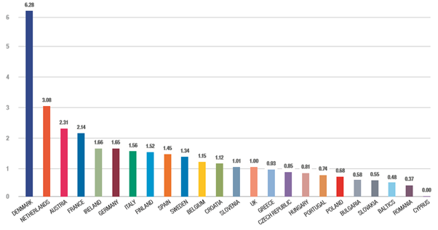
Density of PET-CT scanners in the EU (scanners per million population)
Notes:
In 2019 Wales was performing approximately 33% of the PET scans per head of population compared to England
NHS Wales list of indications for PET-CT which is limited compared to England and Scotland
UK compares unfavourably with Europe

Slide 23
Increase in PET Scanning in Wales
WHSSC has led the All Wales PET Programme
Imaging Statement of Intent (Welsh Government, 2018)
All Wales PET Advisory Group (AWPET) and the Welsh Scientific Advisory Committee (WSAC) Positron Emission Tomography (PET) in Wales – Overview and Strategic Recommendations
PET-CT indications have been selected based on careful assessment of the evidence base. Behind each overarching indication, specific criteria have been agreed to define the clinical circumstances in which patients should be referred
In the rest of the UK, PET-CT has moved out of specialist commissioning and tertiary centres to become a routine part of the equipment available in large District General Hospitals

Slide 24
New indications that AWPET has recommended for inclusion within the revised WHSSC commissioning policy from May 2021
WHSSC ICP 2020-23 prioritised 20 new or updated PET indications
Colorectal cancer 40
Cholangiocarcinoma 24
Dementia 250
Gastrointestinal stromal tumours (GIST) 45
Lymphoma 40
Prostate cancer 280
Total 679

Slide 25
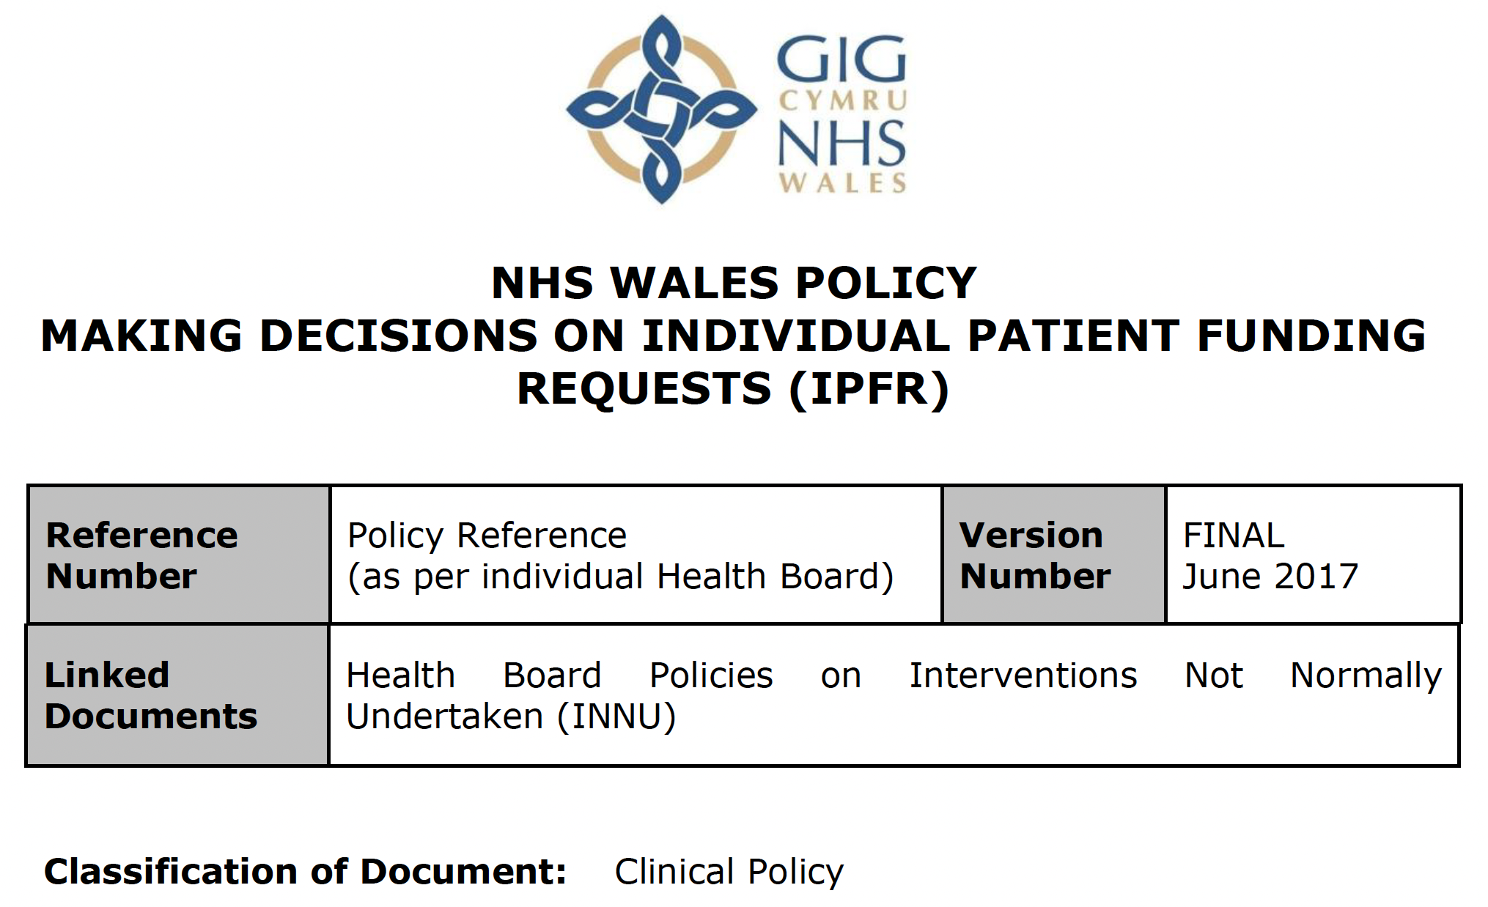

Slide 26
All Wales IPFR Panel
Funding requests for WHSSC commissioned services are considered by the all Wales IPFR Panel
Acts as a Sub Committee of WHSSC and holds delegated Joint Committee authority
Considers and makes decisions on requests to fund NHS healthcare for patients who fall outside the range of services and treatments that a Health Board has agreed to routinely provide
At all times acts in accordance with the all Wales IPFR Policy
At all times takes account of funding policies agreed by WHSSC
Reaches its decision on the basis of the written evidence
  the request form itself
  supportive documentary evidence

Slide 27
The WHSSC IPFR panel
Independent Chair ( from members of the NHS organisations Boards)
Two Lay representatives
Nomination at Director level from each of the LHBs
A named deputy of appropriate seniority and experience who can operate in the capacity of the primary representative
A further two panel members may be appointed at the discretion of the Chair of the panel
In attendance from WHSSC
  Medical Director or Deputy
  Director of Nursing or Deputy
  IPFR Co-ordinator

Slide 28
Quoracy and Urgent requests
The Chair or Vice-Chair and representation from five of the seven Health Boards, three of which must be clinical representatives
Meet at least once a month
Video conferencing facilities will be available for all meetings
For urgent cases a “virtual panel” will be held
For very urgent requests the Chair with the Managing Director and the Medical Director or Director of Nursing are authorised to make a decision outside of a full meeting of the Panel

Slide 29
Number of IPFR submissions in Wales 2015-2021

Slide 30
Number medicine IPFR submissions in Wales 2015-2021

Slide 31
Number of non-medicine IPFR submissions in Wales 2015-2021

Slide 32
The three tests
The clinician must demonstrate that the patient’s clinical circumstances are significantly different to the general population of patients for whom the recommendation is not to use the intervention, such that,
The clinician can demonstrate that the patient is likely to gain significantly more clinical benefit from the intervention than would normally be expected from patients for whom the recommendation is not to use the intervention, and
The IPFR panel must be satisfied that the value for money of the intervention for that particular patient is likely to be reasonable

Slide 33
The three tests
The clinician must demonstrate that the patient’s clinical circumstances are significantly different to the general population of patients for whom the recommendation is not to use the intervention, such that,
The clinician can demonstrate that the patient is likely to gain significantly more clinical benefit from the intervention than would normally be expected from patients for whom the recommendation is not to use the intervention, and
The IPFR panel must be satisfied that the value for money of the intervention for that particular patient is likely to be reasonable

Slide 34
The three tests
The clinician must demonstrate that the patient’s clinical circumstances are significantly different to the general population of patients for whom the recommendation is not to use the intervention, such that,
The clinician can demonstrate that the patient is likely to gain significantly more clinical benefit from the intervention than would normally be expected from patients for whom the recommendation is not to use the intervention, and
The IPFR panel must be satisfied that the value for money of the intervention for that particular patient is likely to be reasonable

Slide 35
The three tests
The clinician must demonstrate that the patient’s clinical circumstances are significantly different to the general population of patients for whom the recommendation is not to use the intervention, such that,
The clinician can demonstrate that the patient is likely to gain significantly more clinical benefit from the intervention than would normally be expected from patients for whom the recommendation is not to use the intervention, and
The IPFR panel must be satisfied that the value for money of the intervention for that particular patient is likely to be reasonable

Slide 36
Diolch

