Slide 1
Online submissions, outcomes and continued funding
Session B. Gail Woodland, AWTTC

Slide 2
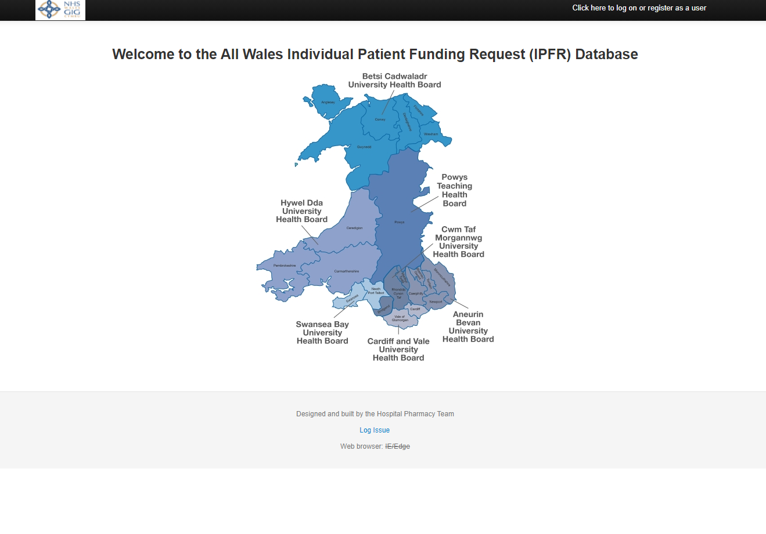
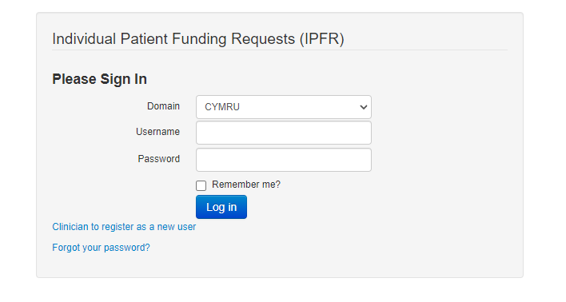
Register

Slide 3
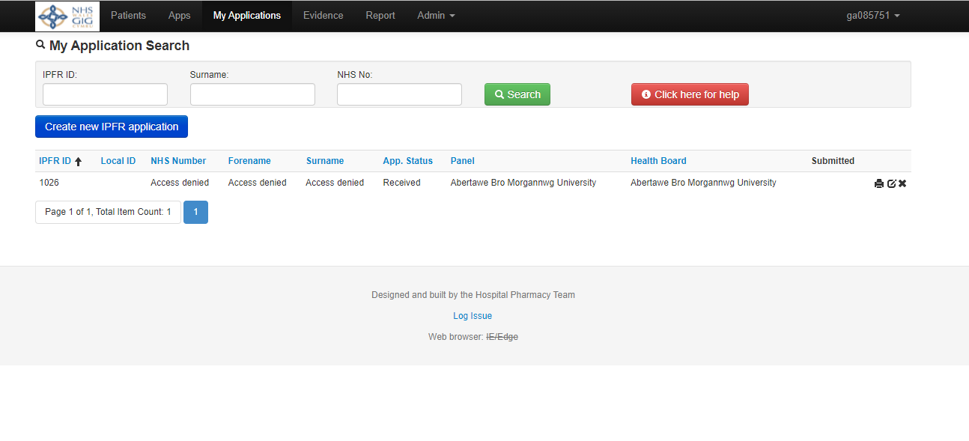
Creating a new application
Go to ‘My Applications’

Slide 4
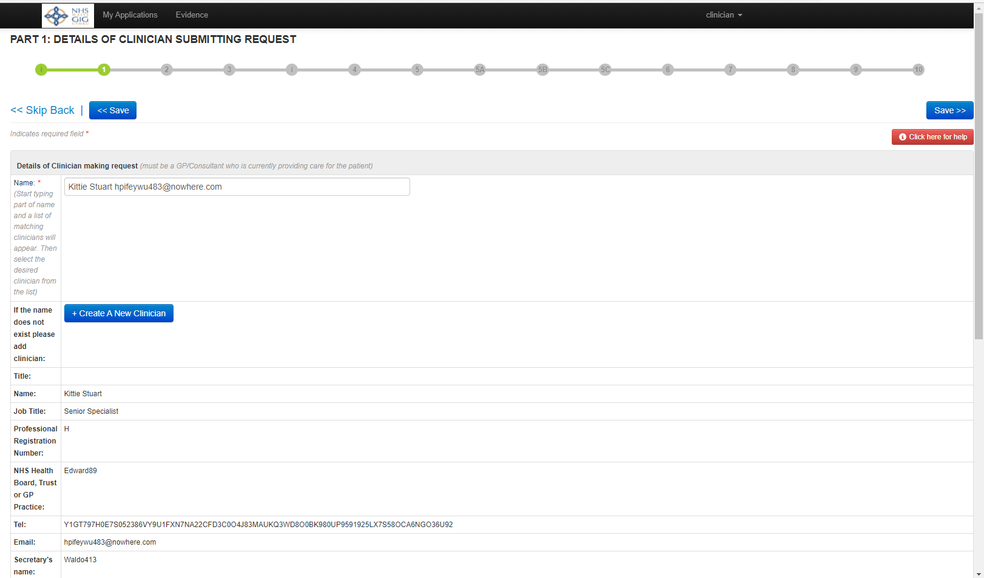
PART 1: DETAILS OF CLINICIAN SUBMITTING REQUEST

Slide 5
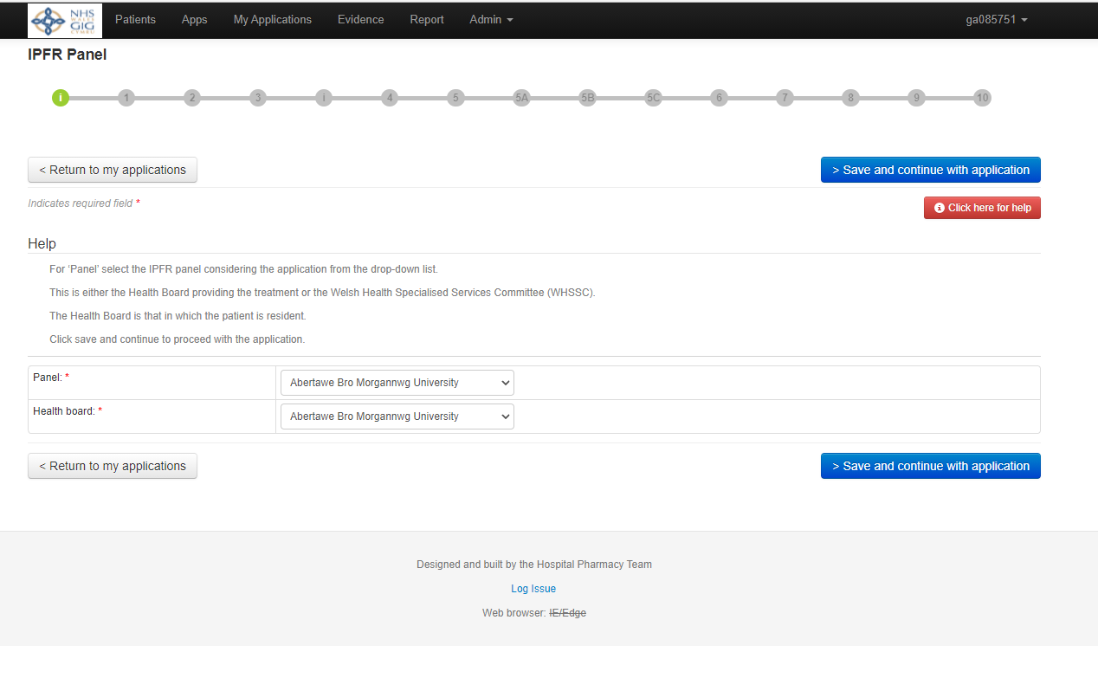
Select the panel the application is going to and the patient’s health board
There is a help function to advise on how to complete the form
Red asterisk = compulsory

Slide 6
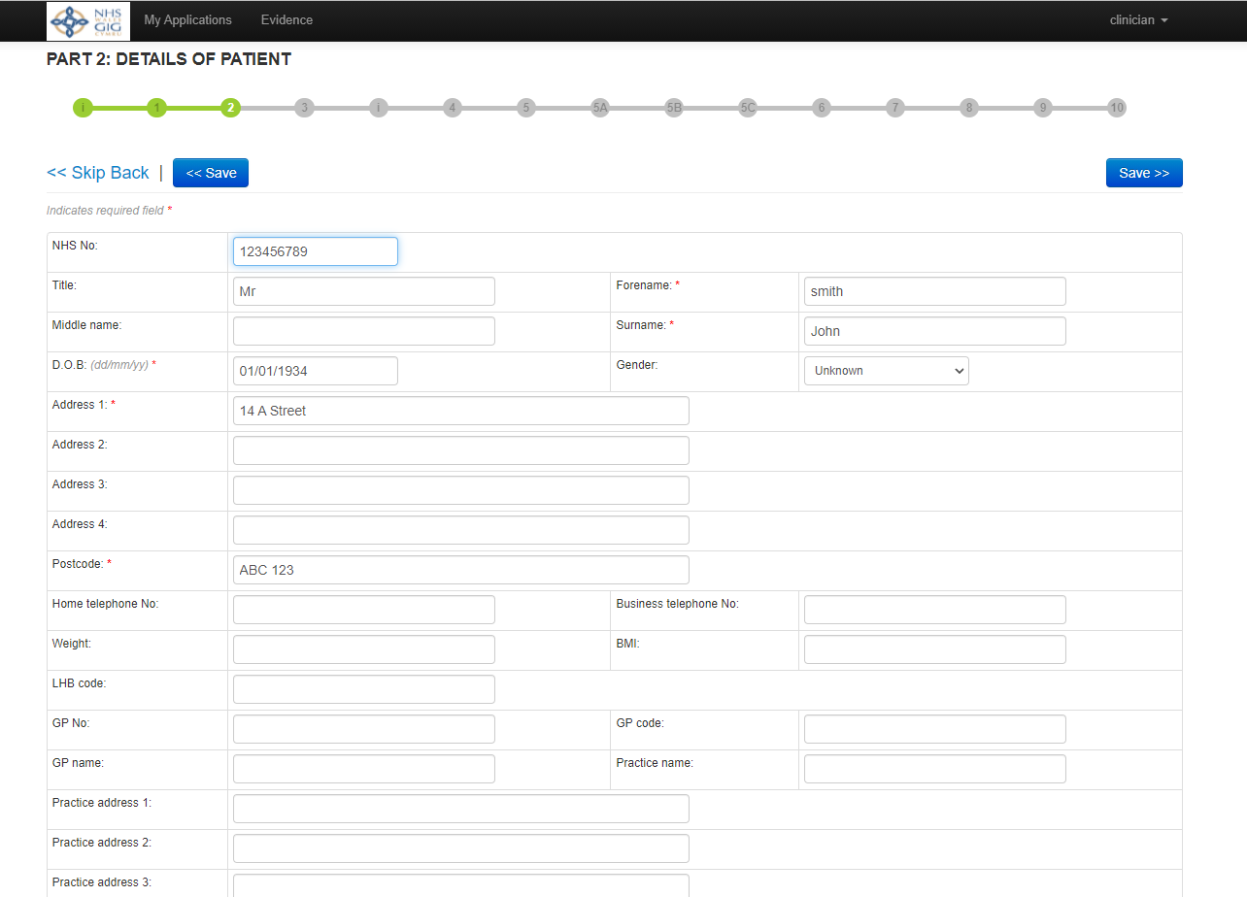
PART 2: DETAILS OF PATIENT
Notes:
Moves on to urgency

Slide 7
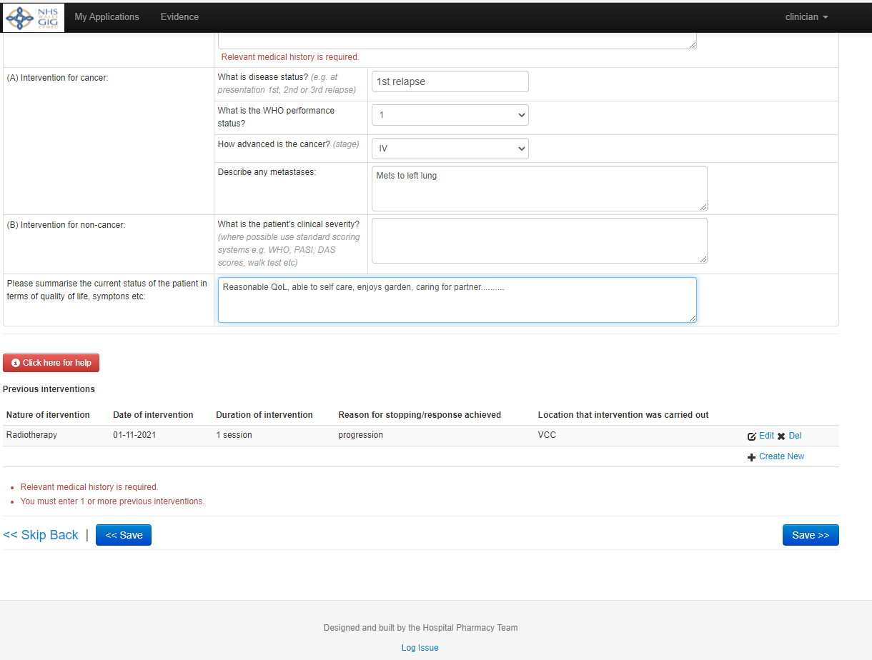
PART 4: DIAGNOSIS AND PATIENT'S CURRENT CONDITION RELATED TO REQUEST

Slide 8
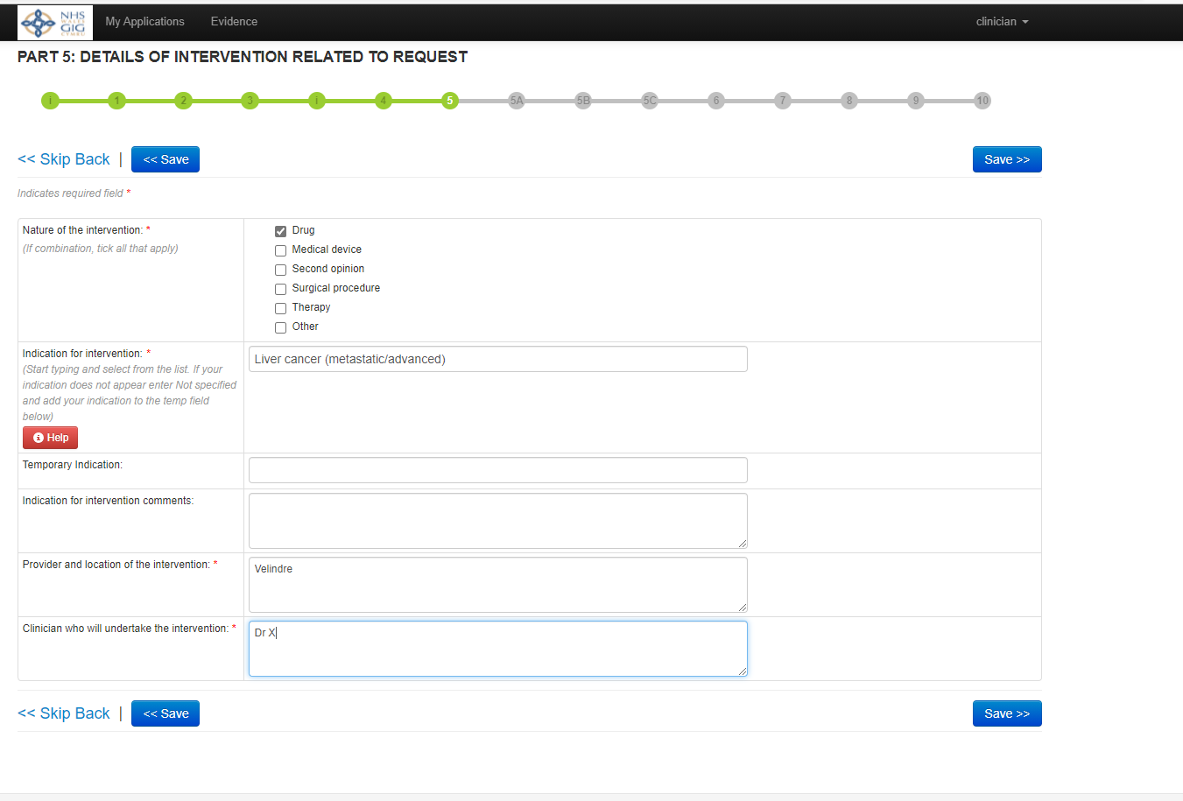
Intervention details

Slide 9
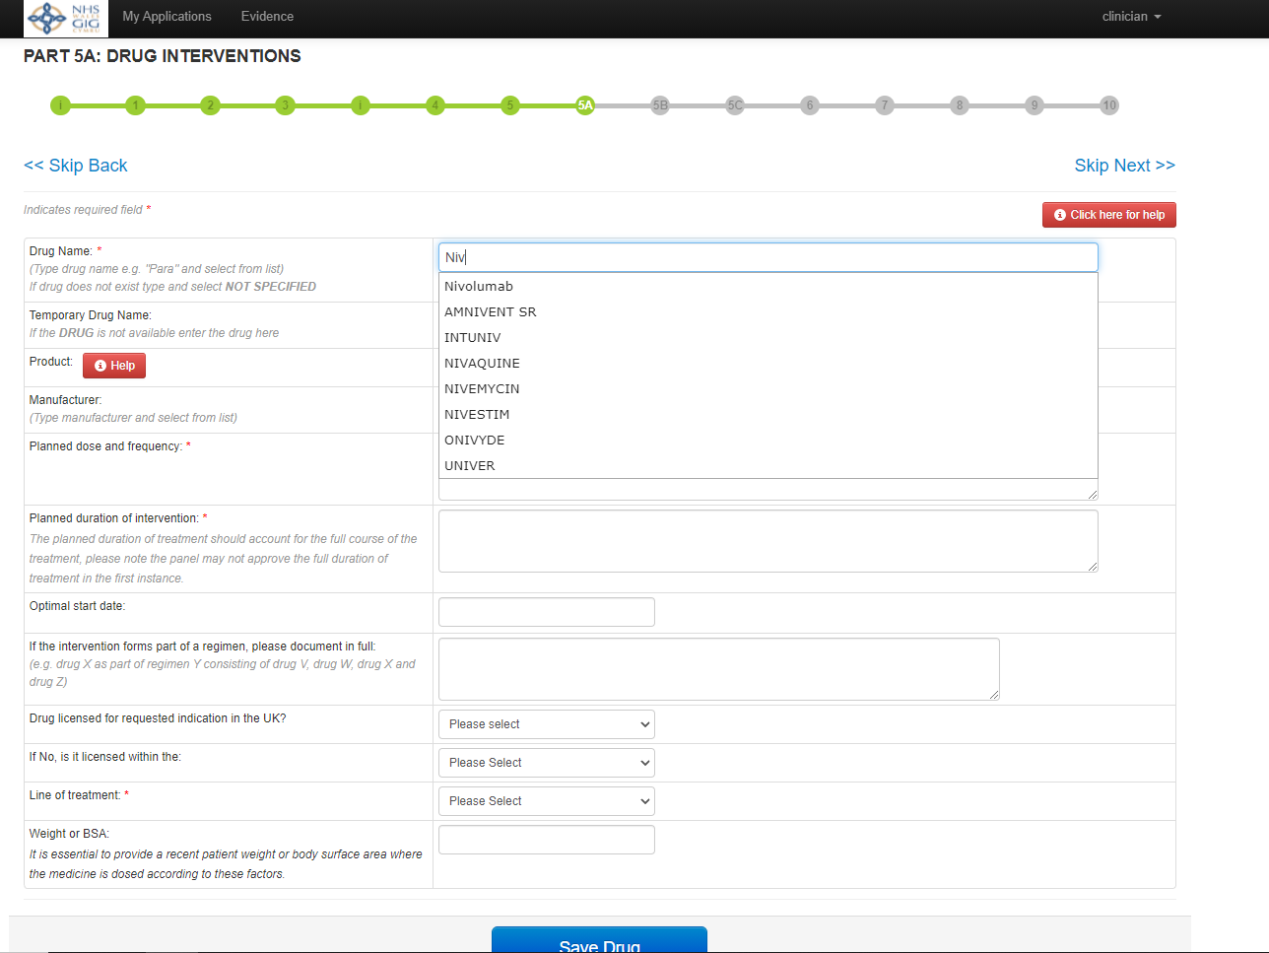
PART 5A: DRUG INTERVENTIONS

Slide 10
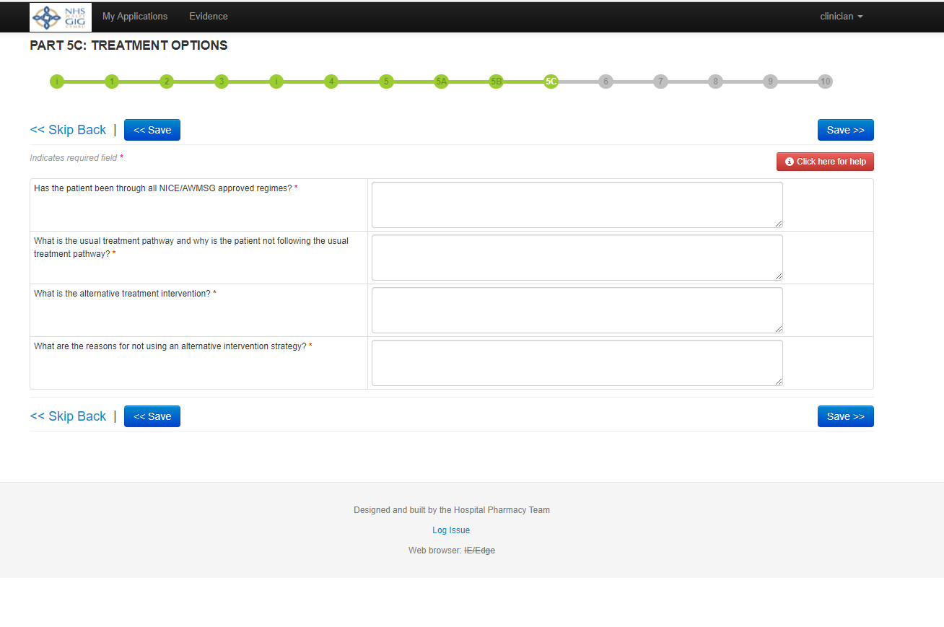
PART 5C: TREATMENT OPTIONS

Slide 11
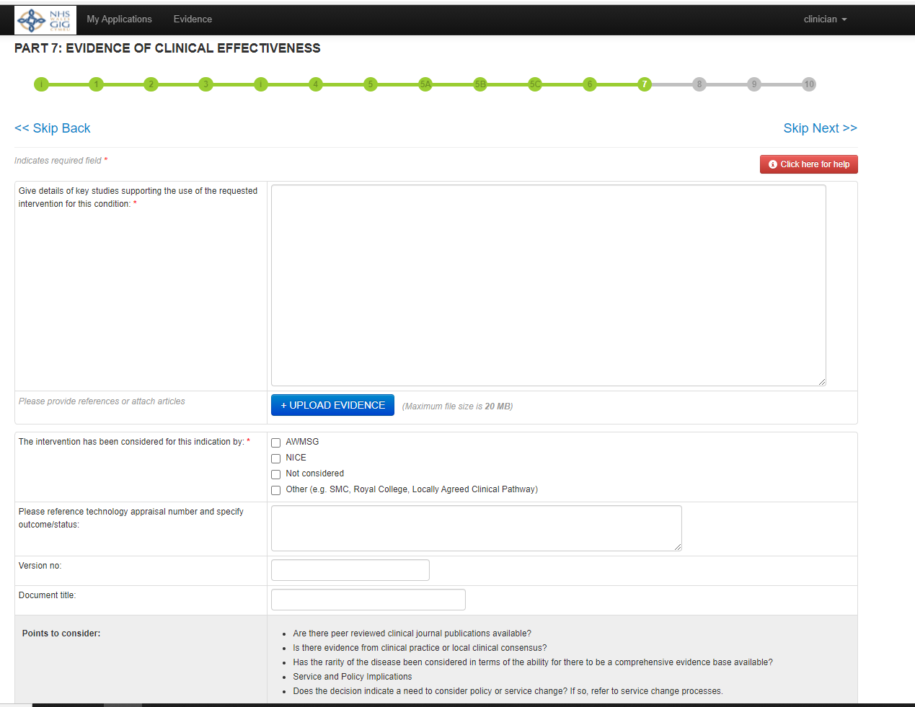
PART 7: EVIDENCE OF CLINICAL EFFECTIVENESS

Slide 12
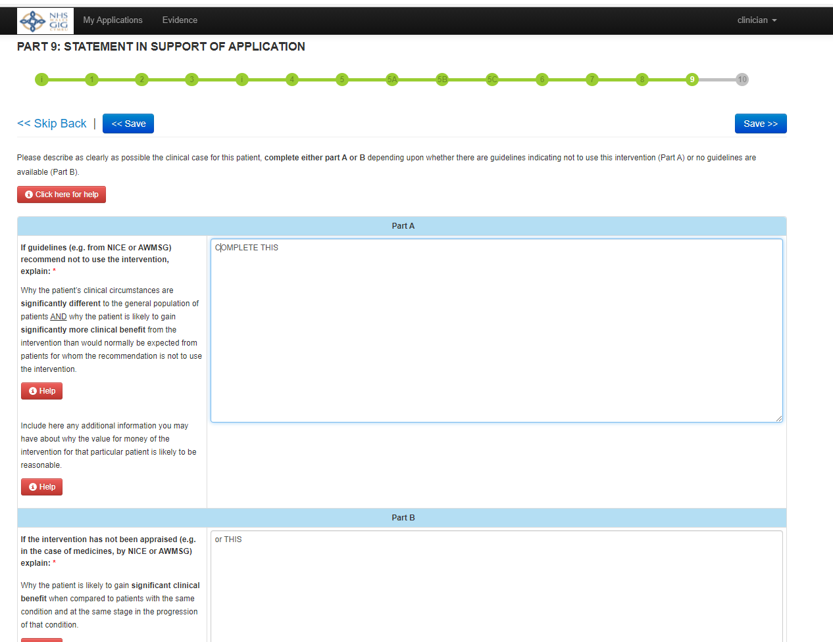
PART 9: STATEMENT IN SUPPORT OF APPLICATION

Slide 13
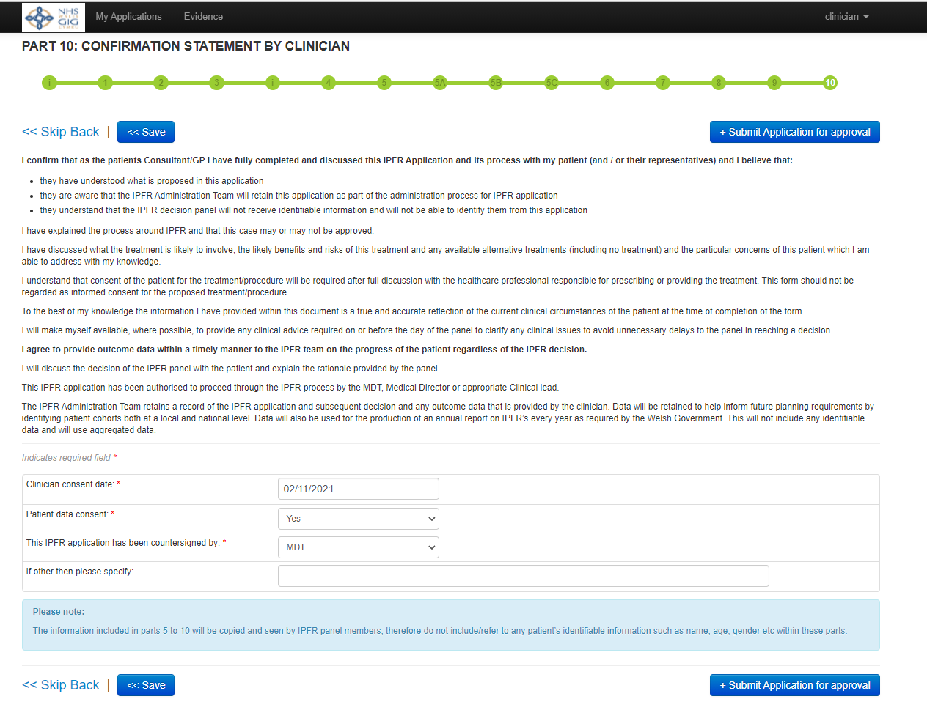
PART 10: CONFIRMATION STATEMENT BY CLINICIAN

Slide 14
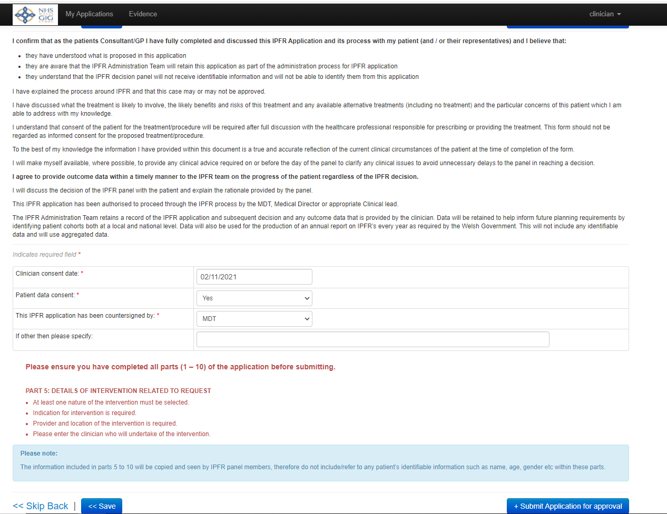
Missed a bit!

Slide 15
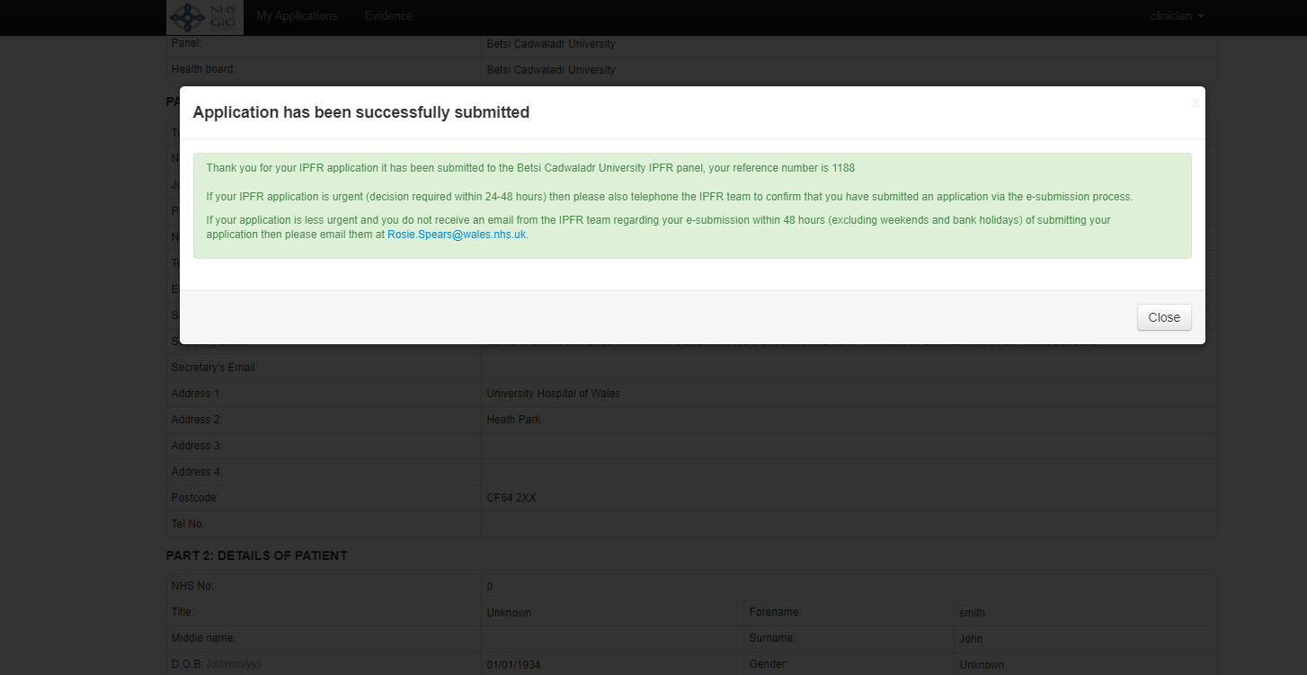
Notice

Slide 16
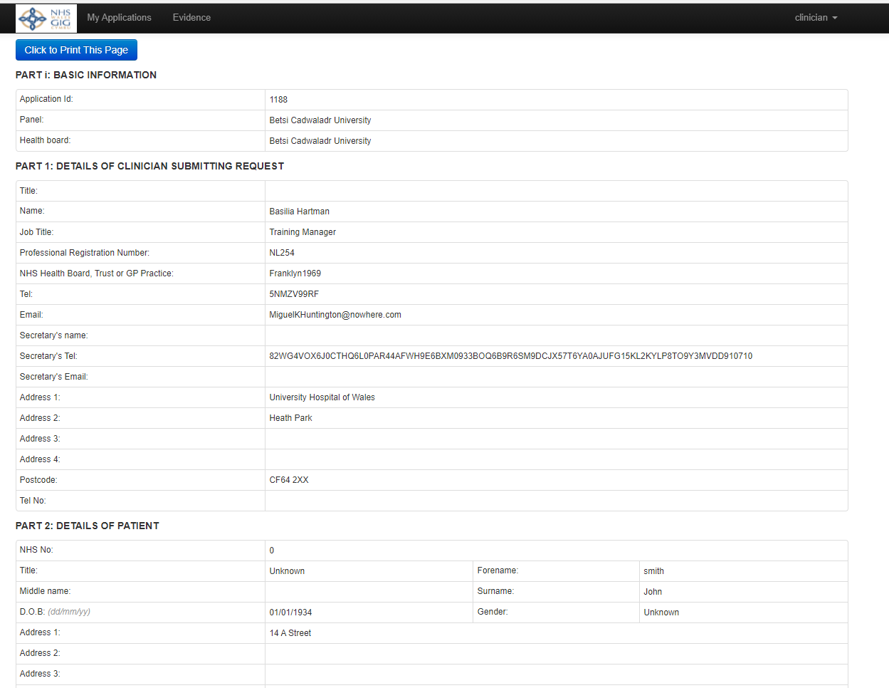
Print/PDF option

Slide 17
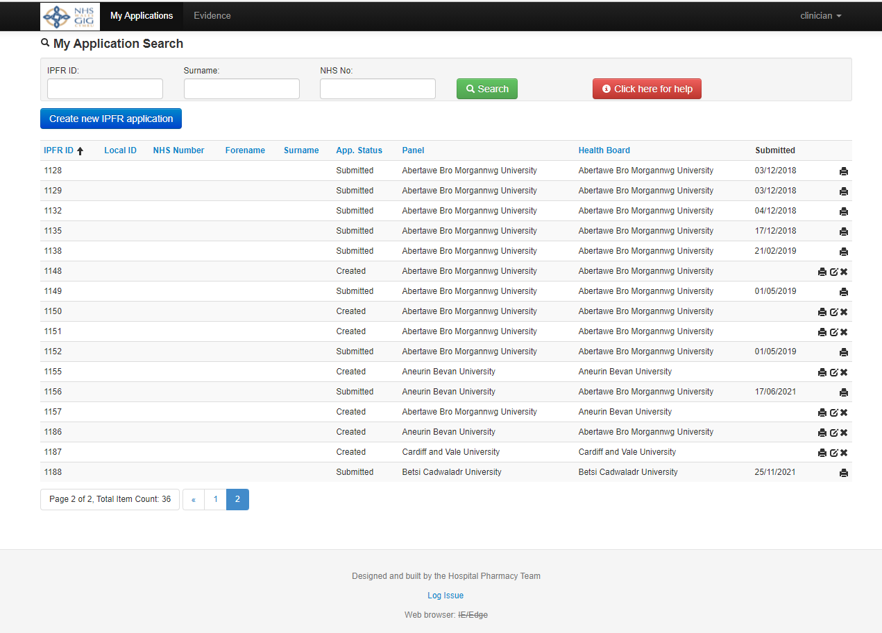
Finding your application

Slide 18

Outcomes
IPFR outcome form
Part A – treatment stopped
Part B – treatment continuing
With confirmation letter and/or at end of treatment/point of review
Overview of response to treatment and QoL
Provide form alongside clinic letters
On-line version

Slide 20
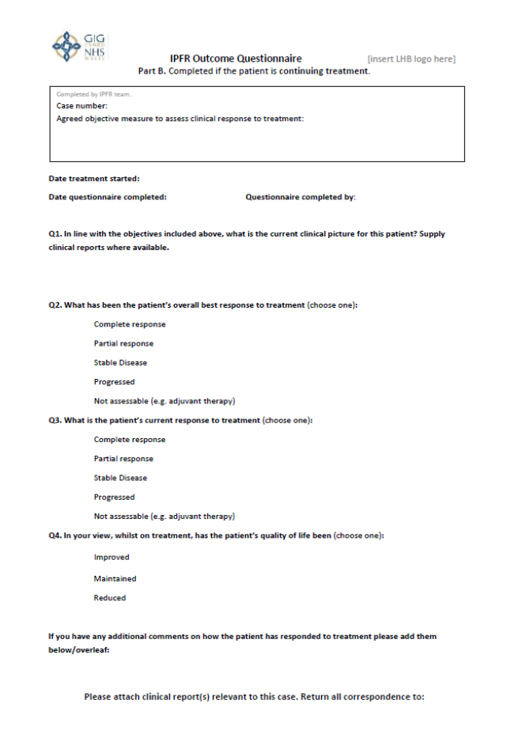

Slide 21

Continued funding
<12 months (3-6 months)
Clinic letter outlining patient response to treatment and request to approve further supply for a discrete period of time
In line with approval of original request (scans, tests)
≥12 months
Submit a new IPFR application form
Impact on new financial year
Do check with local HB IPFR team

Slide 22
Thank you

