Slide 1
Making a case and reviews
Session B. Ann-Marie Matthews, Aneurin Bevan University Health board

Slide 2

Background
What is an Individual Patient Funding Request?
The role of the Health Board and Welsh Health Specialised Services Committee.
IPFR determining factors.

Slide 3
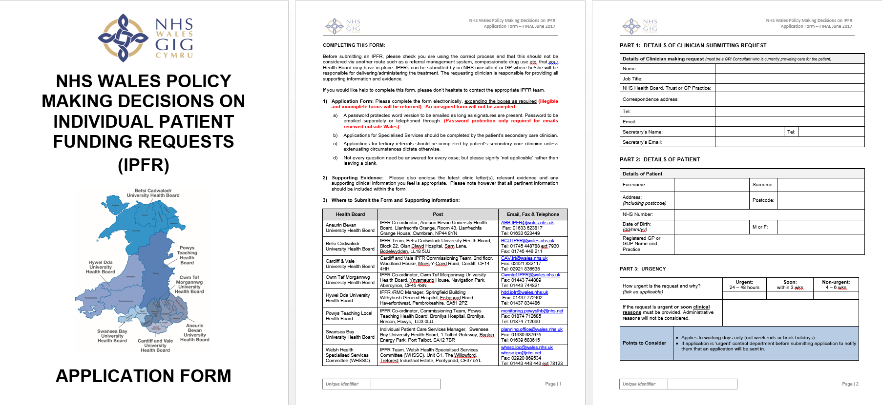

Slide 4
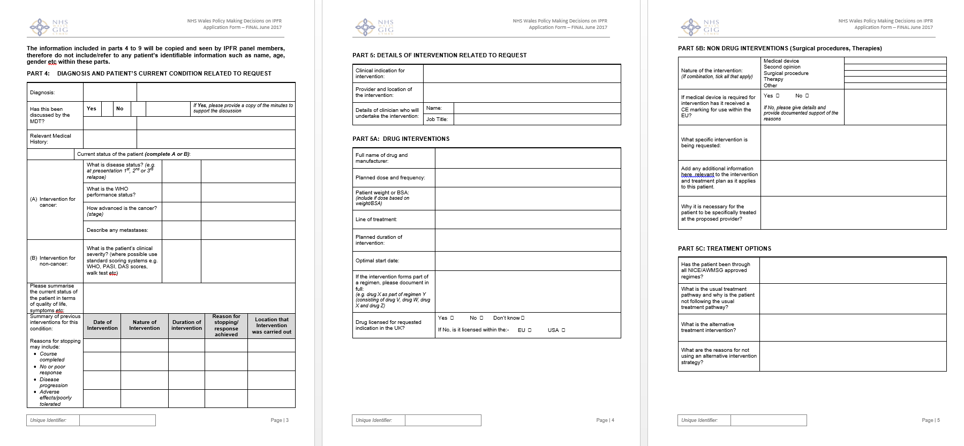

Slide 5
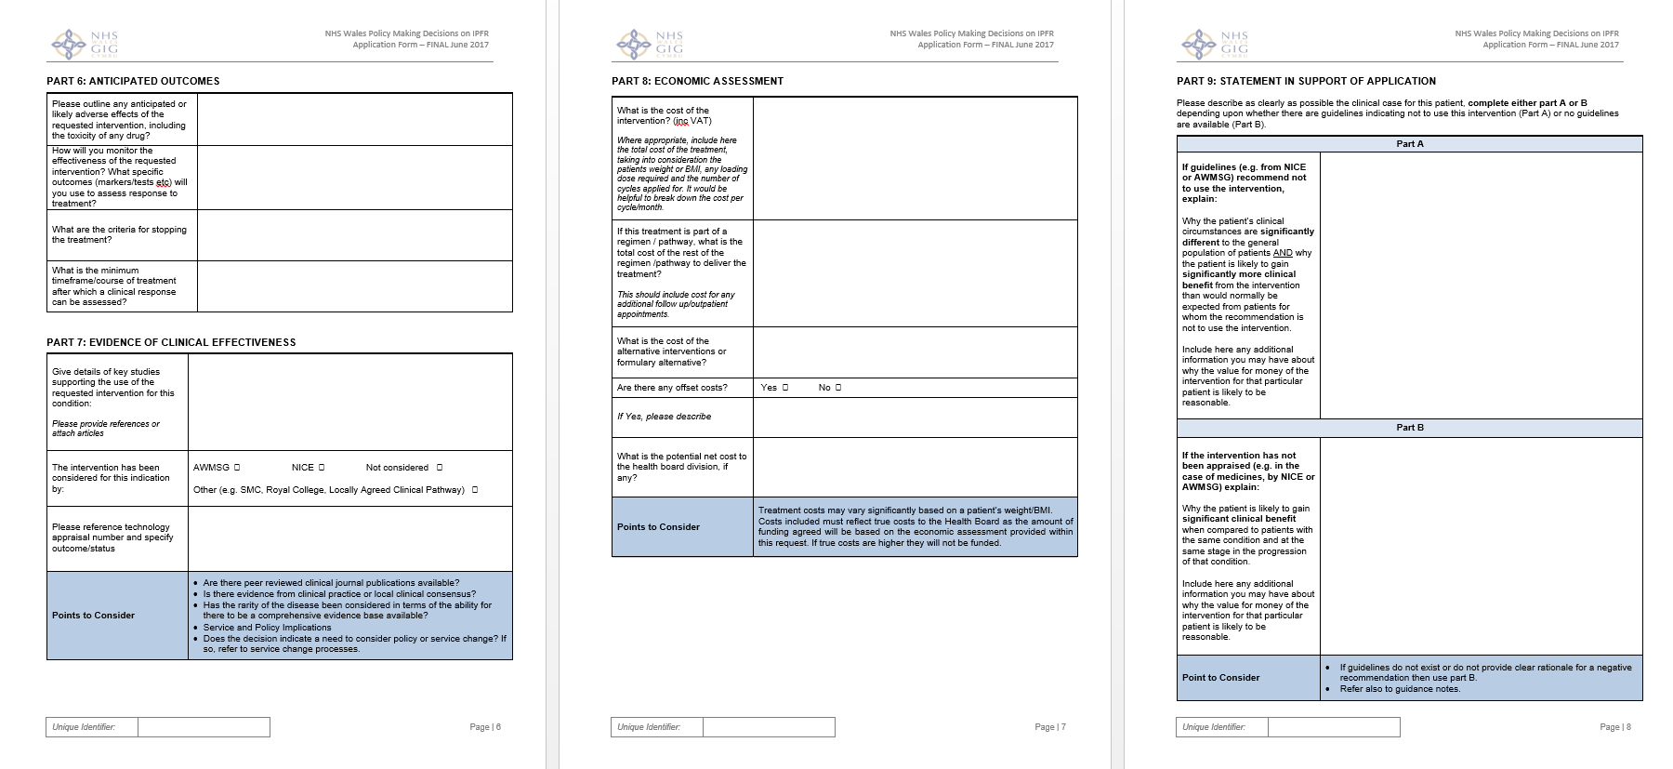

Slide 6
Part 5C: Treatment Options
 | Example of poorly complete application | Example of good practice
Has the patient been through all NICE/AWMSG approved regimes? | Yes | Yes. Provide detail on the treatments received No. Explain the reasons why.
What is the usual treatment pathway and why is the patient not following the usual treatment pathway? | Patient has followed the usual pathway. | Provide details on any treatment(s) tried by the patient as part of the usual pathway. Explain why the patient is no longer following this, for example, the usual treatment interacts with other medications.
What is the alternative treatment intervention? | No alternative | Provide details of alternative treatments even if this no treatment, or a treatment that would also require an IPFR.
What are the reasons for not using an alternative intervention strategy? | None available | It has a higher cost. The patient is unable to tolerate it The alternative treatment has higher side effects for this patient’s condition.

Slide 7
Part 7: Evidence of Clinical Effectiveness
 | Example of poorly complete application | Example of good practice
Give details of key studies supporting the use of the requested intervention for this condition: Please provide references or attach articles | Will often include a link to a journal if the IPFR is in relation to a request for a medicine. No information contained if not a drug request. | Provide or reference any available journals or trial data, even if this is not drug related.
The intervention has been considered for this indication by: AWMSG NICE Not considered Other (e.g. SMC, Royal College, Locally Agreed Clinical Pathway) | Usually ticked or left blank | If there is any guidance available, include or reference it. Provide or reference any available journals or trial data
Please reference technology appraisal number and specify outcome/status | Usually left blank | Need the reference number for any guidance Are there any peer reviews or clinical journals available Is this a rare disease? If so, is there any comprehensive evidence base studies available? How does the patient’s clinical circumstances fit with the evidence submitted.

Slide 8
Part 8: Economic Assessment
 | Example of poorly complete application | Example of good practice
What is the cost of the intervention? (inc VAT) | £2,970 cost of the medication per 28 days. Other forms of treatment - usually marked unknown | Include here the total cost of the treatment, taking into consideration the patients weight or BMI, any loading dose required and the number of cycles applied for. It would be helpful to break down the cost per cycle/month. If your unsure, help is always available from your local pharmacy team. Surgical costs can be obtained from your finance teams, or by checking the NHSE PBR tariff. Please include the cost of any assessment, any additional surgery and follow up that may also be required.
If this treatment is part of a regimen / pathway, what is the total cost of the rest of the regimen /pathway to deliver the treatment? | n/a | Please include the cost of any assessment and follow up that may also be required.
What is the cost of the alternative interventions or formulary alternative? | Usually left blank | Provide details on the alternative treatment, including any additional costs they may incur. For example, the alternative treatment would necessitate the need for additional bed days.
Are there any offset costs? Yes No
If Yes, please describe | Usually left blank | If yes, include details such as savings that could be delivered. If the treatment requested is being provided orally, inpatient/outpatient savings could be made
What is the potential net cost to the health board division, if any? | Usually left blank | Please provide the cost details of any potential savings that could be made.
Points to Consider: Treatment costs may vary significantly based on a patient’s weight/BMI. Costs included must reflect true costs to the Health Board as the amount of funding agreed will be based on the economic assessment provided within this request. If true costs are higher they will not be funded.

Slide 9
Part 9: Statement in Support of Application
PART A:
If guidelines (e.g. from NICE or AWMSG) recommend not to use the intervention, explain: Why the patient’s clinical circumstances are significantly different to the general population of patients AND why the patient is likely to gain significantly more clinical benefit from the intervention than would normally be expected from patients for whom the recommendation is not to use the intervention. Include here any additional information you may have about why the value for money of the intervention for that particular patient is likely to be reasonable.
PART B:
If the intervention has not been appraised (e.g. in the case of medicines, by NICE or AWMSG) explain: Why the patient is likely to gain significant clinical benefit when compared to patients with the same condition and at the same stage in the progression of that condition. Include here any additional information you may have about why the value for money of the intervention for that particular patient is likely to be reasonable.

Slide 10
Being Mortal (full film) | FRONTLINE - YouTube
Section 18:20 to 21:55

Slide 11

What should I discuss with my patient?
Treatment options
Risks and benefits of treatment
Realistic goals
Why an IPFR is required
Social factors
What happens if funding is declined
Confirmation statement
Resources
Patient leaflet
Video

Slide 12
The review process
Who can request a review?
How long does a request for a review take?
The grounds for review;
The Health Board has failed to act fairly and in accordance with the All Wales IPFR policy
The Health Board has prepared a decision which is irrational in light of the evidence submitted
The Health Board has not exercised its powers correctly
The WHSSC review process
Review form completed by the requesting clinician
Screened by the HB IPFR officer to see if it meets the grounds for review
Review heard by the independent review panel within 25 working days
Decision communicated to the patient and clinician within 5 working days

Slide 13
Thank you

