Slide 1


Health Economics 101
For Health Technology Assessment
For Individual Patient Funding Requests (IPFR)

Slide 2

What is Health Economics?
And why do we need it?

Slide 3
Economic Evaluation is not “choosing the cheapest”
“The pursuit of efficient practice is not merely about reducing costs. If it were, the most efficient procedure would be to do nothing as that pushes costs to zero.”
Alan Maynard

Slide 4
What is Health Economics?
The study of attempts to allocate limited healthcare resources among unlimited wants and needs to achieve the maximum health benefit for society.

Slide 5

The root of all choice
Choices, decisions and prioritisation need to be made because resources are scarce.
Resources (human, financial, capital, environmental) are LIMITED
Wants, needs and desires are UNLIMITED

Slide 6


The reasons for increasing unmet need…
Higher demand of an aging population with increasing life expectancy
Decreasing health of the population (e.g. obesity, low activity levels, stress)
Staffing levels
Changes in NHS budgets
Expensive technologies
Increasing expectations

Slide 7
Opportunity cost
    When resources are limited it is necessary to give up one thing in order to be able to acquire another thing.
    Every action and every resource use has an opportunity cost – which does not necessarily mean monetary implications.

Slide 8
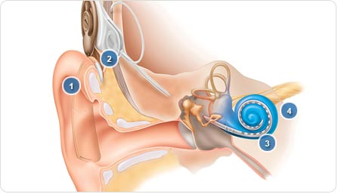

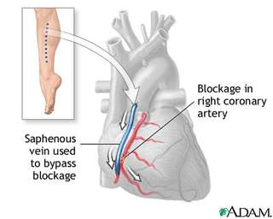
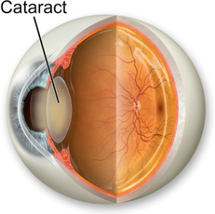

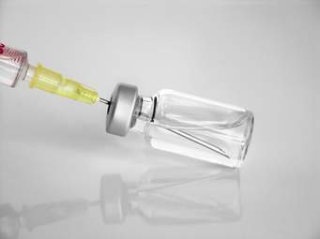
The opportunity cost of IVF
(from Morris, Devlin and Parker, 2007)
In the NHS sector
Outside the NHS sector
One-third of a cochlear implant
One heart bypass operation
Half a junior teaching assistant
11 cataract removals
150 MMR vaccinations
2000 school dinners

Slide 9
Addressing the 3 E’s
Good health is a necessary condition for a happy life.
Good healthcare, accessed and used fairly (equity) and equally according to equal needs (equality) is often a necessary condition for good (or better) health.
Appropriate use of available resources to maximise health outcomes (efficiency) is required for good healthcare.

Slide 10

Equality vs equity

Slide 11
Efficiency is about allocation
The term efficiency is used to assess the extent to which the allocation of limited resources maximises the benefits for society.
It is the relationship between the inputs to a service and the outputs and outcomes generated.
The most efficient solution to a health care problem is the one which makes the best use of the resources available.

Slide 12



Types of efficiency
Allocative efficiency
Technical efficiency

Slide 13
The overarching aim
To get the best value (in terms of outcomes and patient experience) from each programme as a whole for a specific amount of money.
Low Value
Low Value
High Value
High Value

Slide 14

And that’s where Health Economics comes in…

Slide 15
So, how do we make our choices?
We need evidence-based health care which combines:
Clinical expertise and judgement and…
The best available external evidence on clinical and cost-effectiveness to allow…
Healthcare professionals, with patients and other stakeholders to reach…
The best decision in any particular situation.

Slide 16
The Health Economic Evaluation Process

Slide 17

Health Economics
Uses economic evaluation to compare alternative courses of action in terms of both their costs and consequences.
To provide high quality evidence on which to base decisions.
The aim is to improve efficiency (but not forgetting about equity, equality and quality of care).

Slide 18
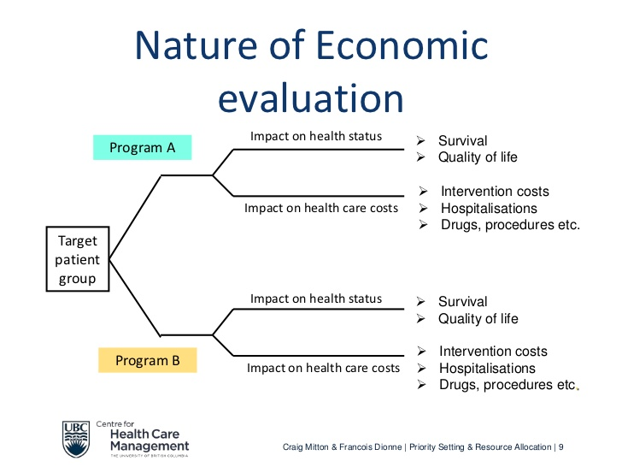

Slide 19
Methods of Health Economic Evaluation

Slide 20
Cost-minimisation analysis
Cost-benefit analysis
Cost-effectiveness analysis
Cost-consequences analysis
Cost-utility analysis

Slide 21
Cost-Utility Analysis (CUA)
An alternative measure of value to that of a monetary approach is one of utility.
Utility is the benefit derived from consuming a resource.
Cost-utility analysis considers the impact of a policy/intervention/programme upon an individual’s and society’s welfare, typically expressed in quality adjusted life years (QALYs).

Slide 22
What is a QALY ?

Slide 23
So, what is a QALY?
The Quality-Adjusted Life Year (QALY) is a common currency to assess the benefits/outcomes gained from a variety of interventions
We obtain the Quality weight usually from established measures such as the EQ-5D
A QALY combines in a single unit of benefit:
  health-related quality of life (quality)
  Life expectancy (quantity)

Slide 24
What is a QALY? by Alan Williams
"The essence of a QALY is that it takes a year of healthy life expectancy to be worth 1, but regards a year of unhealthy life expectancy as worth less than 1. Its precise value is lower the worse the quality of life of the unhealthy person (which is what the 'quality adjusted' bit is all about)."
A. Williams, 'The Value of QALYs', Health and Social Service Journal July (1985)

Slide 25
Considering the Cost of Health Care

Slide 26
The 2 components to consider
Resource use changes related to implementation of intervention/programme/treatment/medicine
  New equipment
  Training
  Resource use associated with delivery
Changes to healthcare resource use as a consequence of intervention/programme/treatment/medicine
  Primary care
  Secondary care
  Social care

Slide 27


A matter of perspective
Healthcare provider perspective
  NHS and personal social services (PSS) perspective
Societal perspective
Other perspective

Slide 28
Undertaking the Analysis

Slide 29
Possible outcomes
Compared with the ‘old’ intervention, the ‘new intervention can be:
More costly, less effective (dominated)
Less costly, more effective (dominating)
Less costly, less effective
More costly, more effective

Slide 30
Incremental cost-effectiveness ratios
ICER =
Total cost of new intervention – total cost of old intervention
Outcome of new intervention – outcome of old intervention
The higher the ICER of an intervention, the less cost-effective the intervention relative to the comparator.

Slide 31
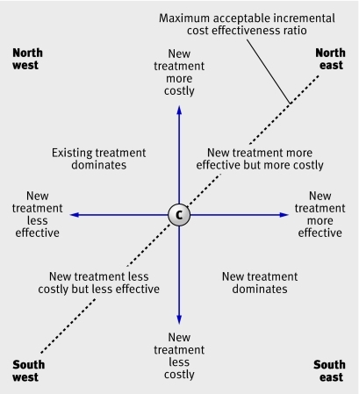
How do we know whether something is cost-effective?
Reject
Questionable
Questionable
Accept

Slide 32
Addressing Uncertainty

Slide 33
Sensitivity analysis
The nature and extent of the sensitivity analysis determines the quality of an economic evaluation.
Main question: Do plausible changes in the values of the main variables affect the results of the analysis?
  NO – results are robust
  Yes – results are not robust
    Consider how likely scenario is in practice

Slide 34
What if there is limited evidence?

Slide 35

Critically Assess…
The quality and appropriateness of the methods and analysis undertaken
The quality, appropriateness and relevance of the data inputs and assumptions
The accuracy of the findings (including appropriate account for uncertainty)
The quality of reporting

Slide 36
Consequences?
  The available evidence influences allocation decisions, i.e. there is a chance of making the wrong decision based on poor/misleading evidence
    Wasting scarce resource
    Reducing efficiency
    Potential to cause harm

Slide 37
Most Likely Scenario…
Cost-effectiveness
No relevant cost-effectiveness analyses were identified in the (repeat) literature search.

Slide 38

Most Likely Scenario…
Cost-effectiveness
No relevant cost-effectiveness analyses were identified in the (repeat) literature search.
High cost + little benefit = low value
Low cost + big benefit = high value
Low cost + little benefit = low value
High cost + big benefit = high value
Don’t just think budget, think value.

Slide 39
Any Questions?

