Slide 1

Application of the principles of health economics for IPFR
Sophie Hughes
Health Economist, Health Technology Wales

Slide 2

Contents
Introduction to health economics in IPFR
Case 1: Olaparib maintenance therapy for BRCA2 mutated metastatic adenocarcinoma of minor salivary duct
Case 2: Pembrolizumab (beyond 2 years) for metastatic squamous lung carcinoma
Key messages

Slide 3
Introduction: IPFRs and decision-making
Definition: requests to a Health Board or WHSSC to fund NHS healthcare for individual patients who fall outside the range of services and treatments that a Health Board has arranged to routinely provide, or commission.
Robust decision-making involves consideration of:
Evidence outlining the patient’s individual clinical circumstances.
Evidence demonstrating expected significant clinical benefit
Clinical and cost effectiveness evidence
Ethical considerations

Slide 4

Introduction: Health economics in decision-making for IPFRs
Why is the patient likely to gain a significant clinical benefit from the proposed intervention?
Does the intervention for that particular patient represent value for money, compared with the alternative if the IPFR is declined? (i.e. is the incremental cost justified by the expected clinical benefits?)

Slide 5

Case 1: Olaparib Maintenance therapy for BRCA2 mutated metastatic adenocarcinoma of minor salivary duct
Population: Salivary gland tumour/cancer (BRCA positive), demonstrated platinum sensitive
Intervention: Olaparib maintenance therapy
Comparator [What will this patient receive if the request is denied?]: Rucaparib? Niraparib? Best supportive care?

Slide 6
IPFR Policy Considerations
If the intervention has not been appraised (e.g. in the case of medicines, by AWMSG or NICE);
Is the patient likely to gain significant clinical benefit?
The IPFR panel must be satisfied that the intervention represents good value for money for that particular patient.

Slide 7

Outcome if successful
Olaparib
Outcome if not successful
Person with BRCA2-mutated metastatic adenocarcinoma of minor salivary duct
Outcome if successful
Alternative PARP inhibitor?
Other? Best supportive care?
Outcome if not successful

Slide 8
% ?
Non-Response
Olaparib
% ?
Response
% ?
Death
Person with BRCA2-mutated metastatic adenocarcinoma of minor salivary duct
% ?
Non-Response
Alternative PARP inhibitor
% ?
Response
% ?
Death

Slide 9
Amputation
Non-Response
No amputation
Olaparib
Response
Person with BRCA2-mutated metastatic adenocarcinoma of minor salivary duct
Death
Amputation
Non-Response
No amputation
Alternative PARP inhibitor
Response
Death

Slide 10
Amputation
Total costs | Total health benefit
Costs of olaparib, follow-up, management if relapse occurs, amputation surgery etc | Survival, quality of life QALYs
Non-Response
No amputation
% ?
Olaparib
Response
% ?
Person with BRCA2-mutated metastatic adenocarcinoma of minor salivary duct
Death
Total costs | Total health benefit
Cost of alternative, follow-up, management if relapse occurs, amputation surgery etc | Survival, quality of life QALYs
Amputation
Non-Response
No amputation
Alternative PARP inhibitor
% ?
Response
% ?
Death

Slide 11
Total costs | Total health benefit
Up-front costs of olaparib: £5562 per month Non-response: Similar between olaparib and alternative Toxicity: Lower toxicity | Non-response: Similar effectiveness therefore similar survival and quality of life Toxicity: Lower toxicity
Amputation
Non-Response
No amputation
% ?
Olaparib
Response
Person with BRCA2-mutated metastatic adenocarcinoma of minor salivary duct
Death
Total costs | Total health benefit
Up-front cost of alternative PARP inhibitor: £3420 rucaparib or £2916 niraparib (consider niraparib higher monitoring costs) Non-response: Similar between olaparib and alternative Toxicity: Higher toxicity. What are the costs of managing this? | Non-response: Similar effectiveness therefore similar survival and quality of life Toxicity: Higher toxicity. Does this have large implications for quality of life?
Amputation
Non-Response
No amputation
Alternative PARP inhibitor
Response
Death

Slide 12
Cost-effectiveness thresholds
Δ Cost
+
£30,000 per QALY
Less effective and more costly
Not cost-effective
£20,000 per QALY
_
Cost-effective
+
Δ QALYs
Not cost-effective
More effective and less costly
Cost-effective
_

Slide 13
Case 2: Pembrolizumab for metastatic squamous carcinoma of the lung, beyond 2 years
Patient with Non-Small-Cell Lung Cancer - Squamous Cell Carcinoma T4 N2 M0 PD-L1 – 60%
Two full years on first-line Pembrolizumab monotherapy
Currently in clinical remission. Pembrolizumab has been very well tolerated with negligible side effects.
NICE TA447 states that treatment is provided on the NHS up to a maximum of two years.
The request is to continue treatment with Pembrolizumab monotherapy until disease progression or intolerable toxicity

Slide 14
Case 2: Pembrolizumab for metastatic squamous carcinoma of the lung, beyond 2 years
Population: metastatic squamous carcinoma of the lung, 60% positive for PD-L1, previously treated with Pembrolizumab
Intervention: Pembrolizumab beyond 2 years
Comparator [What will this patient receive if the request is denied?]: Platinum-based combination chemotherapy

Slide 15
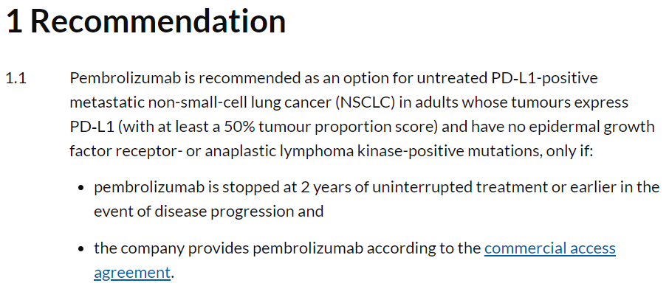
NICE Technology Appraisal 531

Slide 16
IPFR Policy Considerations
If guidelines (e.g. from NICE or AWMSG) recommend not to use the intervention/drug;
Are the patient’s clinical circumstances significantly different to the general population of patients for whom the recommendation was made?
Is the patient therefore likely to gain significantly more clinical benefit from the intervention than the patients for whom the recommendation was made?
Is the intervention likely to represent good value for money for this particular patient?

Slide 17

Evidence informing NICE’s decision
Clinical evidence for the manufacturer-submitted health economic model came from the KEYNOTE-024 RCT, which found a statistically significant survival benefit for pembrolizumab compared with standard care.
The maximum possible treatment duration with pembrolizumab in KEYNOTE‑024 was 2 years (35 cycles). No patients in the pembrolizumab arm of the trial completed 2 years' therapy.
The heath economic model included an assumption that, at 2 years, all patients (including those whose disease had not progressed) would stop treatment.
There were no scenarios modelled where people who did not progress continued treatment.
Is there any other evidence not considered in the NICE model?

Slide 18
Decision problem: Post-2 years
Costs | QALYs
Pembrolizumab acquisition, administration, monitoring, costs in people in whom treatment is successful, costs if treatment unsuccessful | QALYs (a measure of quality and length of life) if successful, QALYs if unsuccessful
% ?
Outcome if successful
Pembrolizumab after 2 years
Person with metastatic squamous carcinoma of the lung, previously treated with pembrolizumab
Outcome if not successful
% ?
% ?
Costs | QALYs
Platinum-based chemotherapy acquisition, administration, monitoring, costs in people successfully managed with platinum-based chemotherapy, costs if treatment unsuccessful | QALYs if successful, QALYs if unsuccessful
Outcome if successful
Stopping and receiving platinum-based chemotherapy
Outcome if not successful
% ?

Slide 19
Cost-effectiveness thresholds
Δ Cost
+
£30,000 per QALY
Less effective and more costly
Not cost-effective
£20,000 per QALY
_
Cost-effective
+
Δ QALYs
Not cost-effective
More effective and less costly
Cost-effective
_

Slide 20
Tips: if you have health economic studies
Start with a very clear PICO for your case
Do we have any health economic evidence? How well does it match the PICO for this case?
What type of health economic study is it? Does it present just costs, or cost per QALY?
Check scenario analyses in health economic studies, which may match your case more closely than the population in the base case
Is the study setting applicable to the UK? Are there any obvious limitations?

Slide 21
Tips: if you don’t!
Start with a very clear PICO
Try to find the costs of the intervention and the correct comparator
Consider the effectiveness evidence, and think about what the implications are for costs and QALYs. For example, does the intervention group have fewer recurrences than the comparator?
Quality of life: Do people who receive the intervention have a better quality of life than people who receive the comparator? This may justify additional costs

Slide 22

Summary
We started with a discussion of the consideration of health economics in IPFR
We first considered a case in which there was extant negative NICE Guidance, including an economic model
Next we considered a case with no HTA advice
What to think about when we do and do not have health economic evidence

Slide 23
Diolch | Thank you www.healthtechnology.wales info@healthtechnology.wales
@HealthTechWales

Slide 24



