Slide 1


Propranolol
A Regional PERSPECTIVE
Emma Morrison
July 2025

Slide 2
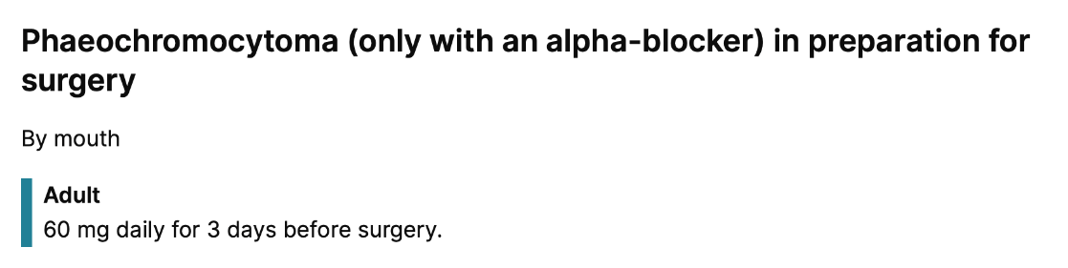
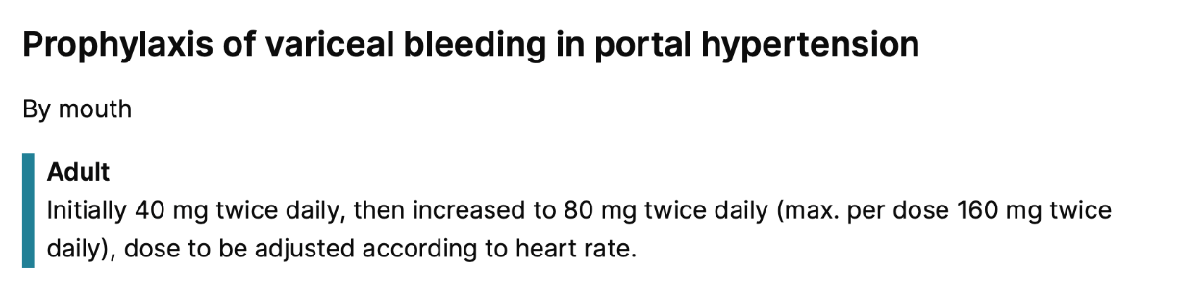
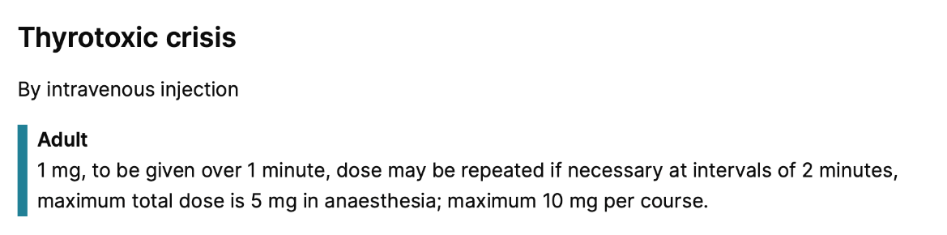
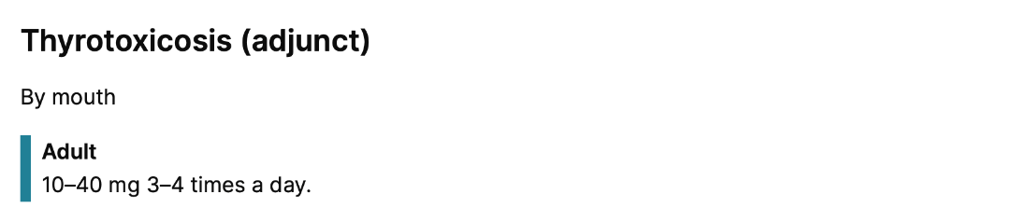
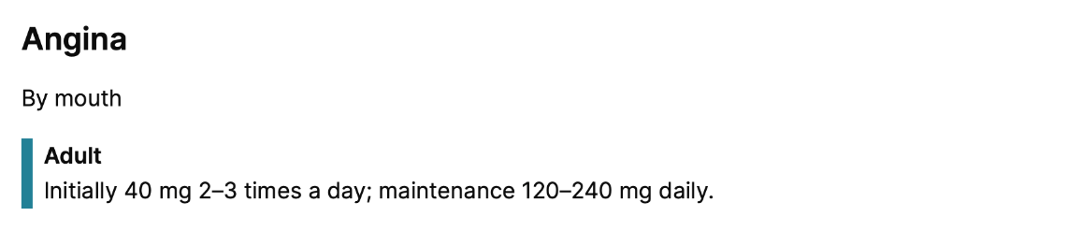
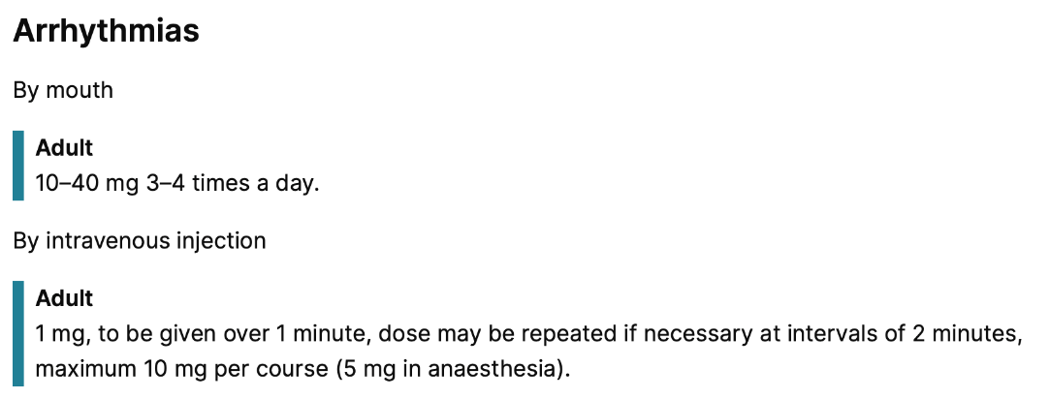
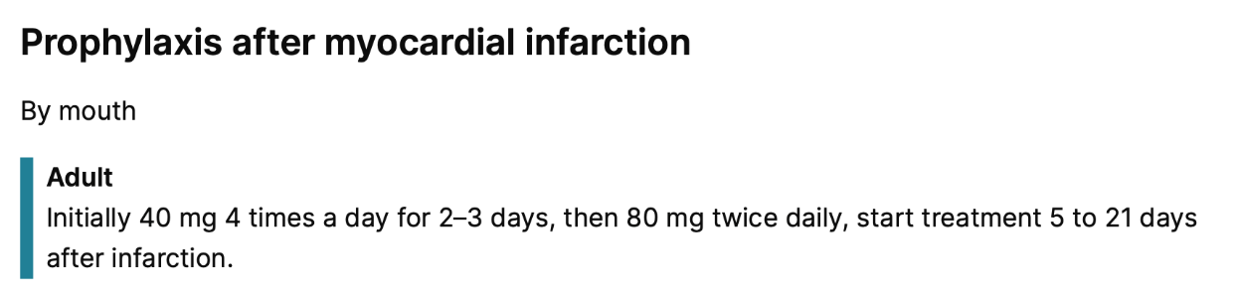
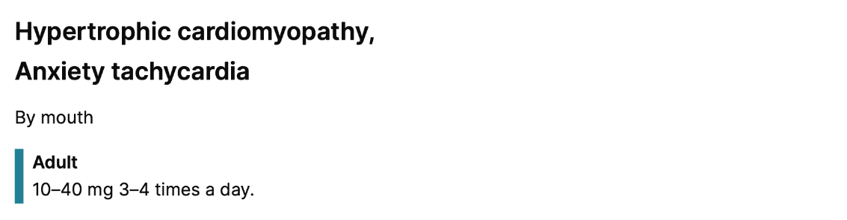
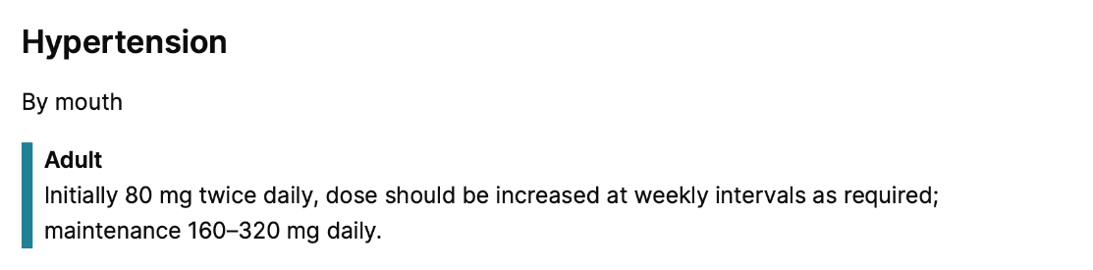
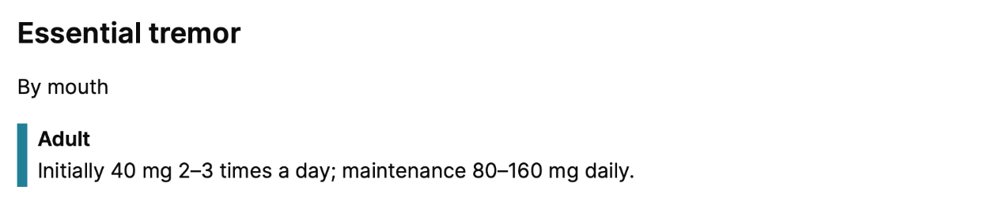
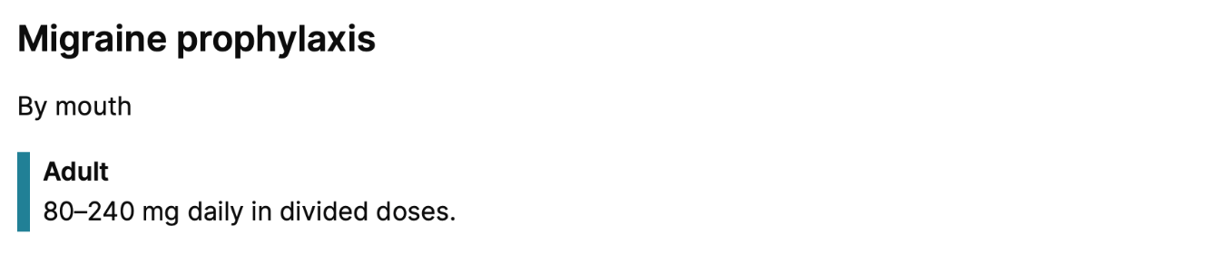
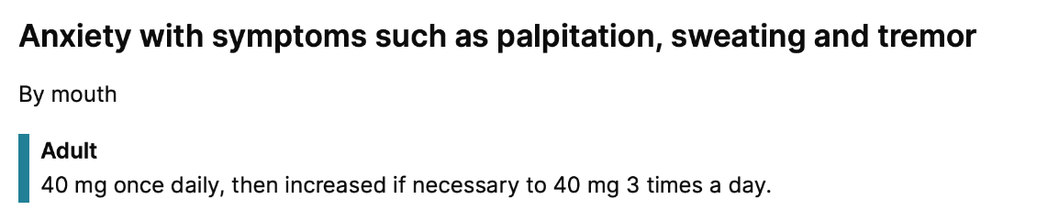


Slide 6
Anxiety in the UK
In 2021, those aged 16 to 29 years highest incidence of reported anxiety (28%)¹
Decreasing through the age groups, least likely aged 70 and over (5%)¹
In 2022/23, 37.1% of women and 29.9% of men reported high levels of anxiety ²
2012 to 2015, 21.8% of women and 18.3% of men³
Increased reported anxiety during the pandemic, but now decreasing.
19.8% reported anxiety during 2018/19
24.2% during 2020/21
22.5% during 2021/22 ²
Increasing incidence of anxiety recording in primary care since 2013⁴
1. ONS. (2021). Depression or anxiety in adults6
2. ONS. (2023). Public opinions and social trends, Great Britain: personal well-being and loneliness.
3. ONS. (2017). Measuring National Well-being: Anxiety.
4. Archer C et al. Trends in the recording of anxiety in UK primary care. Soc Psychiatry Psychiatr Epidemiol. 2022;57:375-38

Slide 7
Anxiety Management
NICE CG113 Generalised anxiety disorder and panic disorder in adults: management
Stepped approach:
1.Treat everything that may be contributing
2. Psychotherapies,
3. Pharmacotherapy
4. MDT
Therapeutics:
SSRI – SNRI – Pregablin
Benzos not indicated outside short term management of crisis
No mention of propranolol
Migraine prophylaxis (CG150) includes HSIB warning

Slide 8
Propranolol in Anxiety Management
Poor evidence base for long-term use
Not endorsed by national guidance
No more effective than benzos in Anxiety and PTSD¹
Evidence for short term use in preop², performance anxiety^{3, 4} and phobic behaviours⁵
?Prescription of desperation
Poor access to psychological therapies⁵
Relieve physical manifestations of anxiety¹
Increased awareness of benzo SEs vs propranolol SEs by prescribers
Prescriber bias
Local experience: more commonly used in primary care not secondary
Steenen SA, et al.. Propranolol for the treatment of anxiety disorders: Systematic review and meta-analysis. J Psychopharmacol. 2016;30:128-39. Dyck JB, Chung F. A comparison of propranolol and diazepam for preoperative anxiolysis. Can J Anaesth. 1991;38:704-9.
Brantigan CO, Brantigan TA, Joseph N. Effect of beta blockade and beta stimulation on stage fright. Am J Med. 1982 ;72:88-94..
Clark DB, Agras WS. The assessment and treatment of performance anxiety in musicians. Am J Psychiatry. 1991;148:598-605..
Soeter M, Kindt M. An Abrupt Transformation of Phobic Behavior After a Post-Retrieval Amnesic Agent. Biol Psychiatry. 2015;78:880-6.
National Audit Office: Progress in improving mental health service in England (Press Release). Feb 2023

Slide 9
Propranolol OD
ED presentation data pulled from the Royal Infirmary of Edinburgh
ED department serves population of Central, East and Midlothian, population ~800,000.
Toxicology Database
ED triage note reviewed for ‘overdose’ (not coding)
Caldicott approval as surveillance programme
Basic information and outcome available
Not linked to pharmacy data
Data collect 2019 onwards, presented 6 monthly

Slide 10
Propranolol OD

Slide 11
Propranolol OD
 | jan-jun 2019 | jul -dec 2019 | jan - jun 2020 | jul-dec 2020 | jan-jun 2021 | jul - dec 2021 | jan-jun 2022 | jul-dec 2022
Total N | 46 | 46 | 70 | 70 | 93 | 62 | 48 | 42
Discharged from ED (n, %total) | 27 (59%) | 24 (52%) | 26 (37%) | 31 (44%) | 56 (60%) | 47 (76%) | 35 (73%) | 35 (83%)
Ward (n, %total) | 18(39%) | 17 (37%) | 37 (53%) | 33 (47%) | 26 (28%) | 13 (21%) | 10 (21%) | 5 (12%)
Critical care (n, %total) | 1 (2%) | 5 (11%) | 7 (10%) | 6 (9%) | 11 (12%) | 2 (3%) | 1 (2%) | 2 (5%)

Slide 12
Propranolol OD
 |  | jan-jun 2019 |  | jul -dec 2019 |  | jan - jun 2020 |  | jul-dec 2020 |  | jan-jun 2021 |  | jul - dec 2021 |  | jan-jun 2022 |  | jul-dec 2022
 |  | N | % | N | % | N | % | N | % | N | % | N | % | N | % | N | %
Age | Years (median, Q1-Q3) | 29 (21-41) |  | 30(22-44) |  | 30(23-44) |  | 31 (24-37) |  | 29 (22-36) |  | 23(22-36) |  | 28(23-45) |  | 31 (23 -39)
Nº of agents | Single | 8 (17%) |  | 14 (30%) |  | 25 (36%) |  | 27 (39%) |  | 37 (40%) |  | 22 (36%) |  | 20 (42%) |  | 10 (24%)
 | Multiple | 38 (83%) |  | 31 (67%) |  | 45 (64%) |  | 43 (61%) |  | 55 (59%) |  | 40 (64%) |  | 28 (58%) |  | 32 (76%)
 | Unknown | 0 |  | 1 (2%) |  | 0 |  | 0 |  | 1 (1%) |  | 0 |  | 0 |  | 0
Intent | Self-harm (n, %total) | 42 (91%) |  | 38 (83%) |  | 63 (90%) |  | 65 (93%) |  | 78 (84%) |  | 57 (92%) |  | 39 (81%) |  | 36 (86%)
 | Accidental (n, %total) | 3 (7%) |  | 3 (7%) |  | 2 (3%) |  | 1 (1%) |  | 2 (2%) |  | 2 (3%) |  | 4 (8%) |  | 1 (2%)
 | Recreational (n, %total) | 0 |  | 1 (2%) |  | 2(3%) |  | 2 (3%) |  | 2 (2%) |  | 0 |  | 1 (2%) |  | 2 (5%)
 | Unknown (n, %total) | 1 (2%) |  | 4 (9%) |  | 3 (4%) |  | 2 (3%) |  | 11 (12%) |  | 3 (5%) |  | 5 (10%) |  | 3 (7%)
Deaths | Total number (n) | 1 |  |  |  | 1 |  |  |  | 5 |  |  |  | 3

Slide 13
Propranolol Prescriptions
Prescription data pulled from the Lothians (City, East, West and Mid)
Annual data considered (Jan-Jan)
 |  | Year
 |  | 2018 | 2019 | 2020 | 2021
Total Nº Prescription |  | 73823 | 81403 (+10.8%) | 85338 (+4.8%) | 91899 (+7.7%)
 | Male | 23733 (32.1%) | 25927 (31.8%) | 26225 (30.7%) | 27932 (30.9%)
 | Female | 50090 (67.8%) | 55476 (68.1%) | 58165 (68.2%) | 63967 (69.6%)

Slide 14
Propranolol Prescriptions

Slide 15
Propranolol Prescriptions
e.g. Propranolol 160 mg tablet = 1 DDD, 28 tablets = 28 DDD per prescription

Slide 16
Propranolol Prescriptions
Prescription data pulled from the Lothians (City, East, West and Mid)
Annual data considered (Jan-Jan)
 |  | Year
 |  | 2018 | 2019 | 2020 | 2021
Total Nº Prescription |  | 73823 | 81403 (+10.8%) | 85338 (+4.8%) | 91899 (+7.7%)
 | Male | 23733 (32.1%) | 25927 (31.8%) | 26225 (30.7%) | 27932 (30.9%)
 | Female | 50090 (67.8%) | 55476 (68.1%) | 58165 (68.2%) | 63967 (69.6%)

Slide 17
Propranolol Prescriptions
Prescription data pulled from the Lothians (City, East, West and Mid)
Annual data considered (Jan-Jan)
 |  | Year
 |  | 2018 | 2019 | 2020 | 2021
Total Nº Prescription |  | 73823 | 81403 (+10.8%) | 85338 (+4.8%) | 91899 (+7.7%)
 | Male | 23733 (32.1%) | 25927 (31.8%) | 26225 (30.7%) | 27932 (30.9%)
 | Female | 50090 (67.8%) | 55476 (68.1%) | 58165 (68.2%) | 63967 (69.6%)
Modified Release | MR 80 mg | 21913 (29.7%) | 22911 (28.1%) | 23393 (27.4%) | 24261 (26.4%)
 | MR 160 mg | 4330 (5.9%) | 4527 (5.6%) | 4587 (5.3%) | 4726 (5.1%)
 | MR Total | 26243 (35.6%) | 27438 (33.7%) | 27980 (32.8%) | 28987 (31.5%)

Slide 18
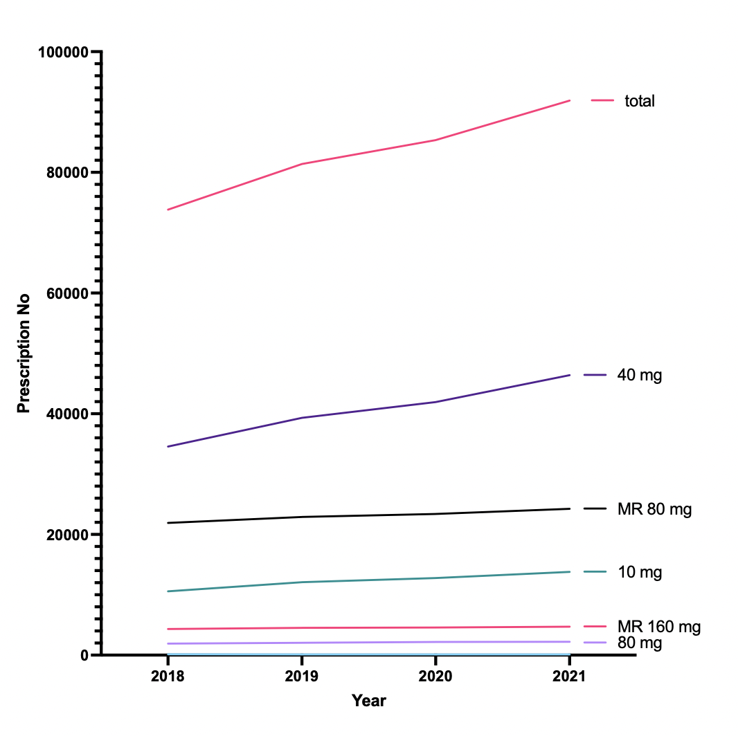
Propranolol Prescriptions

Slide 19
Interventions
October 2022
Publication about propranolol (evidence and risks) in regional prescribing bulletin
  Principally used as resource in primary care (GP practices and primary care pharmacy)
Alert added to GP prescribing systems for all propranolol prescriptions
  ‘Severe overdosages with propranolol may cause cardiovascular collapse, CNS depression, and convulsions. There is increasing incidence of severe overdose nationally’
May 2023
Spearheaded by Primary Care Pharmacy (Central and East Clusters)
  MR to IR
  ‘Daylight’ app link on script
    Digital therapeutic app that uses Cognitive Behavioural Therapy (CBT) techniques to help individuals manage and reduce anxiety and worry

Slide 20
Summary
Increased propranolol OD presentations since Sept 2019
Mainly young women
More admissions to critical care
More deaths in 2021
Overdose admissions down-trending since Sept 2021
Increased prescribing of propranolol since 2018
Majority immediate release and prescribed to female patients
More being prescribed to aged 30 -39 age group
More prescriptions, not more propranolol per prescription
Ongoing investigation of prescribing interventions

Slide 21
Summary
Increased propranolol OD presentations since Sept 2019
Mainly young women
More admissions to critical care
More deaths in 2021
Overdose admissions down-trending since Sept 2021
Increased prescribing of propranolol since 2018
Majority immediate release and prescribed to female patients
More being prescribed to aged 30 -39 age group
More prescriptions, not more propranolol per prescription
Ongoing investigation of prescribing interventions

Slide 22


Acknowledgements
National Poisons Information Service (Edinburgh)
Michal Klatka
Gill Jackson
Aravindan Veiraiah
Medicines Governance and Guidance NHS Lothian
Lesley Macher
Jane Browning
Primary Care Pharmacy NHS Lothian
Hazel Garven
Primary care in NHS Lothian

Slide 23
Propranolol OD
 |  | jan-jun 2019 |  | jul -dec 2019 |  | jan - jun 2020 |  | jul-dec 2020 |  | jan-jun 2021 |  | jul - dec 2021 |  | jan-jun 2022 |  | jul-dec 2022
 |  | N | % | N | % | N | % | N | % | N | % | N | % | N | % | N | %
Emergency Department (ED)present. | N | 46 |  | 46 |  | 70 |  | 70 |  | 93 |  | 62 |  | 48 |  | 42
 | Male (n, %total) | 16 (35%) |  | 12 (26%) |  | 14 (20%) |  | 20 (29%) |  | 19 (20%) |  | 14 (23%) |  | 1 (30%) |  | 15 (36%)
 | Female (n, %total) | 30 (65%) |  | 34 (74%) |  | 56 (80%) |  | 50 (71%) |  | 74 (80%) |  | 48 (77%) |  | 34 (70%) |  | 27 (64%)
Admissions | Discharged from ED (n, %total) | 27 (59%) |  | 24 (52.2%) |  | 26 (37%) |  | 31 (44%) |  | 56 (60%) |  | 47 (76%) |  | 35 (73%) |  | 35 (83%)
 | Ward (n, %total) | 18(39%) |  | 17 (37%) |  | 37 (53%) |  | 33 (47%) |  | 26 (28%) |  | 13 (21%) |  | 10 (21%) |  | 5 (12%)
 | Critical care (n, %total) | 1 (2%) |  | 5 (11%) |  | 7 (10%) |  | 6 (9%) |  | 11 (12%) |  | 2 (3%) |  | 1 (2%) |  | 2 (5%)
Age | Years (median, Q1-Q3) | 29 (21-41) |  | 30(22-44) |  | 30(23-44) |  | 31 (24-37) |  | 29 (22-36) |  | 23(22-36) |  | 28(23-45) |  | 31 (23 -39)
Nº of agents | Single | 8 (17%) |  | 14 (30%) |  | 25 (36%) |  | 27 (39%) |  | 37 (40%) |  | 22 (36%) |  | 20 (42%) |  | 10 (24%)
 | Multiple | 38 (83%) |  | 31 (67%) |  | 45 (64%) |  | 43 (61%) |  | 55 (59%) |  | 40 (64%) |  | 28 (58%) |  | 32 (76%)
 | Unknown | 0 |  | 1 (2%) |  | 0 |  | 0 |  | 1 (1%) |  | 0 |  | 0 |  | 0
Intent | Self-harm (n, %total) | 42 (91%) |  | 38 (83%) |  | 63 (90%) |  | 65 (93%) |  | 78 (84%) |  | 57 (92%) |  | 39 (81%) |  | 36 (86%)
 | Accidental (n, %total) | 3 (7%) |  | 3 (7%) |  | 2 (3%) |  | 1 (1%) |  | 2 (2%) |  | 2 (3%) |  | 4 (8%) |  | 1 (2%)
 | Recreational (n, %total) | 0 |  | 1 (2%) |  | 2(3%) |  | 2 (3%) |  | 2 (2%) |  | 0 |  | 1 (2%) |  | 2 (5%)
 | Unknown (n, %total) | 1 (2%) |  | 4 (9%) |  | 3 (4%) |  | 2 (3%) |  | 11 (12%) |  | 3 (5%) |  | 5 (10%) |  | 3 (7%)
Deaths | Total number (n) | 1 |  |  |  | 1 |  |  |  | 5 |  |  |  | 3

Slide 24
Extra
 | Sept 2018- Aug 2019 | Sept 2019- Aug 2020 | Sept 2020- Aug 2021 | Sept 2021- Aug 2022
Presented M (%) | 31 | 22 | 20 | 32
ITU M (%) | 67 | 42 | 13 | 33
Presented F(%) | 69 | 78 | 80 | 69
ITU F (%) | 33 | 58 | 88 | 67
Notes:
3 12 16 3

