Slide 1

Opening up the adherence can of worms: Ways of identifying and addressing treatment nonadherence
AWTTC, Cardiff
02/07/2024
Dr Sarah Chapman
Centre for Adherence Research and Education

Slide 2

The Adherence Challenge
  What have we known for a (reasonably) long time
  Estimated 30-50% patients nonadherent worldwide (Sabate, 2013)
  Nonadherence robustly linked to poorer patient outcomes & increased healthcare costs (e.g. Cutler et al., 2018 $5-52k per year per patient)
  Reasons for nonadherence complex e.g. Kardas et al. (2013) identified 771 different reasons
  Difficult to identify nonadherence in practice (e.g. Clyne et al., approx. 80 % HCPs said their patients more adherent than typical patient)

Slide 3
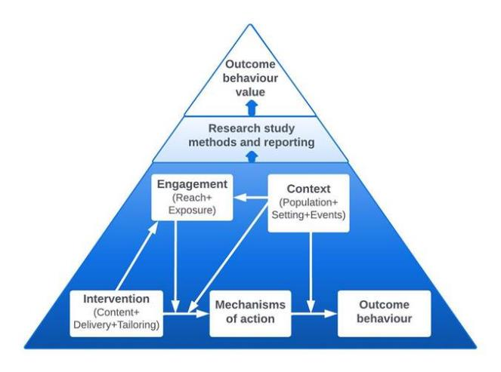
The Adherence Challenge
  What is new?
  Explosion in evidence about ‘what works for whom and when’
  Shared behavioural science language e.g. for describing interventions (HBCP, 2023)
  Focus on the process of nonadherence across contexts e.g. initiation, implementation and persistence (rather than patients being nonadherent/adherent)

Slide 4
CARE
CARE was set up around 6 years ago as a partnership between King's Health Partners and King's College London
Goal was to develop resources to enable healthcare practitioners to address the adherence challenge.
Two introductory training courses:
Online module available on KHP learning hub focused on theory/background to adherence support.
Half-day face-to-face course focused on delivery of adherence support.
Resources developed including adherence screening tool and video demonstrations.
Notes:
Prompt COM-B and barriers to talking about adherence

Slide 5
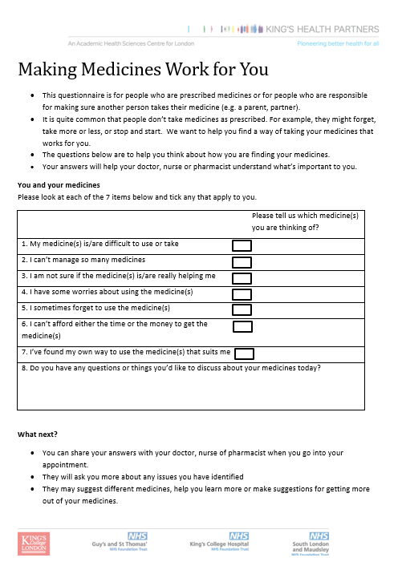
CARE approach
Clinicians are best placed to deliver adherence interventions
We target patient and clinician barriers
Train HCPs in:
Background to nonadherence challenge
SCREENER to open up conversation about risks of nonadherence
STYLE ‘switching off the righting reflex’
Mapped BEHAVIOUR CHANGE TECHNIQUES to address risks
AIM: To increase confidence and competence in IDENTIFYING and ADDRESSING nonadherence

Slide 6
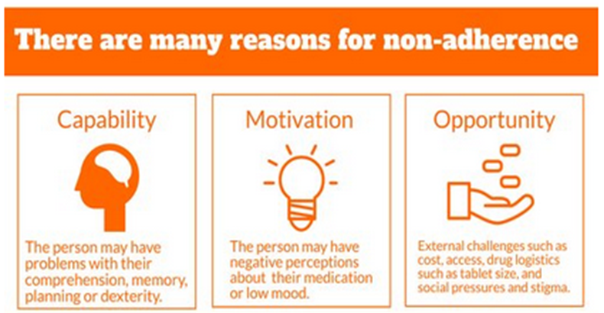
Reasons for nonadherence COM-B
Kardas (2013) review of reviews found 771 different reasons for nonadherence

Slide 7

HCP barriers to managing non-adherence in routine care
Outside their remit “Not my job”
Underestimate prevalence/sampling bias
Approach non-adherence in a “non-friendly” manner
Ill-equipped to manage the reasons underlying non-adherence
Lack of time in routine appointment
Failure to pick up patient cues
Feeling overwhelmed

Slide 8
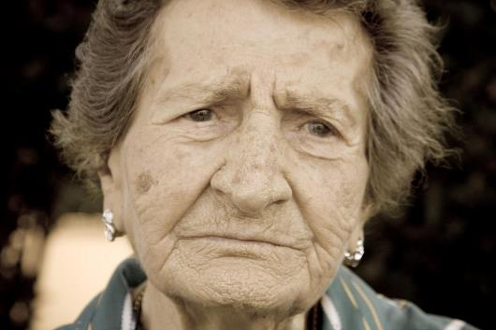
Patient barriers to talking about non-adherence in routine care
Hiding non-adherence from the clinician
Not wishing to disappoint or get “told-off”
Defensive - in response to direct questioning re adherence.
Motivational and opportunity factors rarely addressed

Slide 9

Healthcare system barriers
Role boundaries
Priorities and incentives
Time allocated in the system
Staffing (right staff and right place)
Record systems and sharing
Pathways not providing space for nonadherence
Service guidelines vague on adherence
Training for healthcare professionals
Barriers to engaging with system

Slide 10
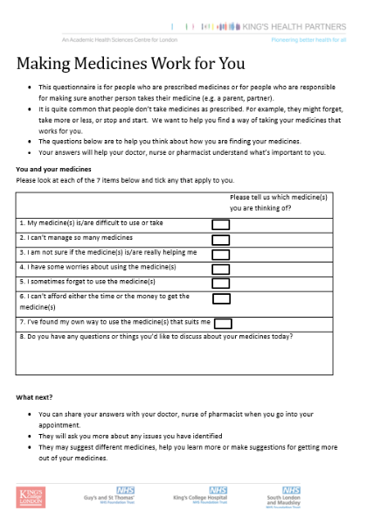

Tools for identifying nonadherence in clinical practice – CARE screener
Developed in conjunction with healthcare professionals and patients.
Aims to overcome some of the barriers to identifying nonadherence in practice
Evaluates potential for nonadherence (not nonadherence directly)
Pilot work (Weinman et al., 2019) validated against MMAS and BMQ. 88% of 145 patients with diabetes endorse one item.
Notes:
With support from KHP, CARE have developed a user-friendly way of identifying adherence challenges at an early stage, and a training package for HCPs in how best to help patients deal with these challenges to prevent non-adherence. Two key intervention elements are needed for optimising this support. First, it is necessary to identify the specific barriers and other reasons for adherence in each individual so that the HCP can focus on these. Second, HCPs will need training in basic behaviour change techniques in order to be able to offer individualised adherence support. To achieve this, our training is based on the use of a brief, patient-friendly adherence screener (Weinman, Imran, Hodgkinson, Canfield, & Jackon, In press) as well as focused training on the core adherence support techniques, which address all the issues which are identified by the screener.

Slide 11
Making treatments work for you
Patient to complete before the consultation (select which screener/s are relevant)
Intended to surface issues with treatment for discussion in consultation
Introductory statements: giving “permission”
7 questions (to raise issues relating to common adherence barriers from existing research)
Information about what happens next

Slide 12

Switch-off your “righting reflex”
Natural to wish to solve problems
You wish to use your expertise and give information
Facilitate the patient to find their own solutions
Advise not direct
Shift the balance of consultation
Enable the patient to hear their own reasons for adherence
Notes:
Release self from the responsibility to solve the adherence problem FOR the patient

Slide 13
Ways of switching off righting reflex in consultation
Ask for permission “Can we talk about your answers on the screener?”
Prioritise “Which answer is the most important to talk about today?”
Formulate the problem “Can you tell me more about why you chose that one?”

Slide 14

Examples of BCTs (support techniques)

Slide 15
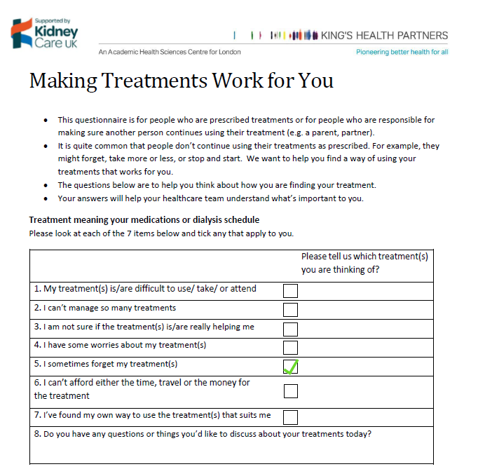
If-Then Action Plans (CAPABILITY)

Slide 16
IF-Then Action Plans (CAPABILITY)
Objective: Help the patient form an implementation intention for taking immunosuppressant medication
Making a specific plan about how to tie medication to an existing routine helps people remember
Ask the patient what they do once/twice daily within their routine…
The patient should think about the time, place and what they will be doing at the time that they need to take their medicine
  “Talk me through exactly how, when, where and what you will be doing when you take your immunosuppressants”
Record the If-Then plan on the reverse of the screener
“If it is 8am and I am in the kitchen and I have just boiled the kettle, then I will take my morning dose”

Slide 17
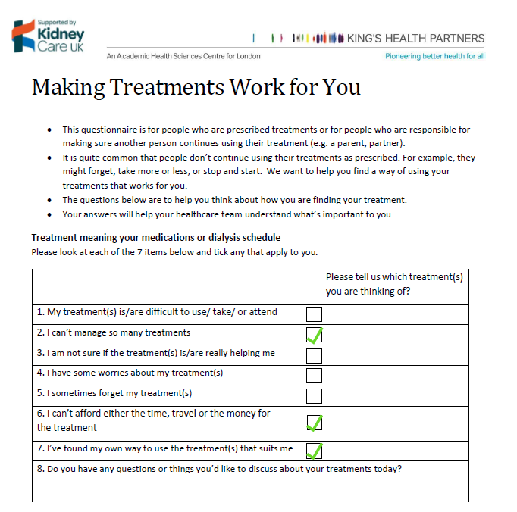
Problem Solving (OPPORTUNITY)

Slide 18
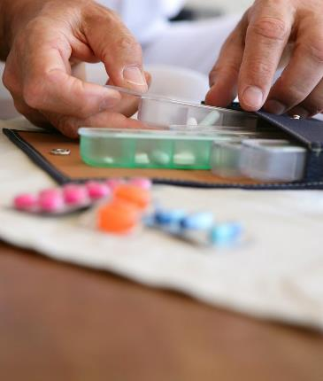
If you only have 1 minute to address: CAPABILITY/ OPPORTUNITY
Giving helpful aids to the patient to take home
BCT: Restructuring the physical environment (adding objects)
e.g. treatment diary / a pill box/ the screener/ low sodium recipe book/ reminder app/ dexterity supports
e.g. KCUK have Kidney Kitchen resources https://kidneycareuk.org/health-professionals/kidney-kitchen-dietitian-resources/

Slide 19
Problem Solving (OPPORTUNITY)
Objective: help the patient identify options and make a plan for overcoming obstacles to adherence
It is important that they generate and select options for solving the problem
You may need to help them break down the option/s selected into manageable steps
Section for patient to make notes on the back of Making Treatments Work for You screener questionnaire
Switch off your righting reflex

Slide 20
Motivation: Benefits and Risks
Objective: help the patient evaluate the benefits and risks of their medication
Acknowledge that it’s important that the patient makes their own decisions about their medication.
You, as the clinician, can advise and facilitate the decision-making process
It is important that it is PATIENT generated information
You can correct misinformation and suggest things the patient may not have thought of

Slide 21

Motivation: Information provision
Should include:
Health benefits of the medication
How medication works (mechanism)
How medication matches to patient understanding of their condition (may need to check this)
Good risk communication around adverse effects
Summarizing at end! And checking understanding/any remaining concerns.

Slide 22
Any questions for me?
Contact me sarah.chapman@kcl.ac.uk
Or care@kcl.ac.uk
Notes:
Prompt COM-B and barriers to talking about adherence

