Slide 1

Adherence and shared decision-making:
how beliefs influence behaviour
Dr Sarah Brown
Community Pharmacist
Research Associate in Applied Psychology and Population Health
School of Sport and Health Sciences
Cardiff Metropolitan University

Slide 2

Transdisciplinary working within Cardiff Metropolitan University
Colleagues with expertise in Pharmacy, Applied Psychology, Behavioural Science, Implementation Science, Health Psychology, Cardiovascular Physiology, Biomedical Sciences, Data Science and Art & Design.
Professor Delyth James
Dr Rhiannon Phillips
Dr Britt Hallingberg
Dr Heidi Seage
Professor Barry McDonnell
Dr Imtiaz Khan
Amelia Huw-Morgan

Slide 3
In this session:
A brief recap and overview of adherence
An introduction to behavioural science and health psychology theory
Practice points for reflection
Examples of projects in Cardiff Metropolitan University designed to support adherence and shared decision-making

Slide 4

X
X
X
X
Globally, medication adherence in long-term conditions is between 20 and 50%.
(Sabaté, 2003)
Sabaté E. Adherence to long-term therapies: Evidence for action. Sabaté E, editor. Geneva, Switzerland: Geneva : World Health Organization; 2003.

Slide 5
Definition of adherence
The extent to which a person’s behaviour
– taking medication, following a diet, and/or executing lifestyle changes,
corresponds with agreed recommendations from a health care provider.
Sabaté E. Adherence to long-term therapies: Evidence for action. Sabaté E, editor. Geneva, Switzerland: Geneva : World Health Organization; 2003.

Slide 6
Definition of adherence
The extent to which a person’s behaviour
– taking medication, following a diet, and/or executing lifestyle changes,
corresponds with agreed recommendations from a health care provider.
Sabaté E. Adherence to long-term therapies: Evidence for action. Sabaté E, editor. Geneva, Switzerland: Geneva : World Health Organization; 2003.

Slide 7
Definition of adherence
The extent to which a person’s behaviour
– taking medication, following a diet, and/or executing lifestyle changes,
corresponds with agreed recommendations from a health care provider.
Sabaté E. Adherence to long-term therapies: Evidence for action. Sabaté E, editor. Geneva, Switzerland: Geneva : World Health Organization; 2003.

Slide 8
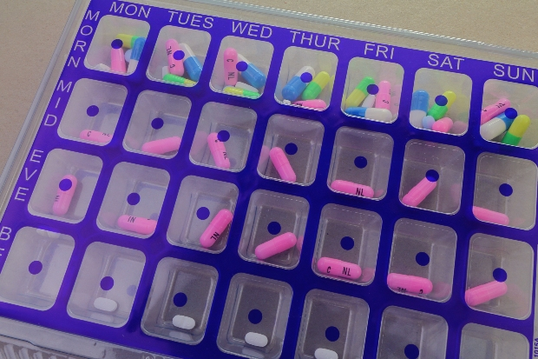
Dispelling myths
Monitored dosing systems are not the panacea for
non-adherence

Slide 9

Dispelling myths
A ‘typical’ non-adherent patient?

Slide 10



First prescription
First dose
Last dose
End of prescribing
Consultation
TIME

Slide 11


First prescription
First dose
Last dose
End of prescribing
Consultation
TIME
Persistence
Non-persistence
Implementation
Initiation
Discontinuation
Vrijens B, De Geest S, Hughes DA, Przemyslaw K, Demonceau J, Ruppar T, et al. A new taxonomy for describing and defining adherence to medications. Br J Clin Pharmacol. 2012;73(5):691–705.

Slide 12


Adherence to medication
First prescription
First dose
Last dose
End of prescribing
Consultation
TIME
Persistence
Non-persistence
Implementation
Initiation
Discontinuation

Slide 13
Supporting/ management of adherence
First prescription
First dose
Last dose
End of prescribing
Consultation
TIME
Persistence
Non-persistence
Implementation
Initiation
Discontinuation

Slide 14
Definition of adherence
The extent to which a person’s behaviour
– taking medication, following a diet, and/or executing lifestyle changes,
corresponds with agreed recommendations from a health care provider.
Sabaté E. Adherence to long-term therapies: Evidence for action. Sabaté E, editor. Geneva, Switzerland: Geneva : World Health Organization; 2003.

Slide 15
Shared decision-making ensures that individuals are supported to make decisions that are right for them. It is a collaborative process through which a clinician supports a patient to reach a decision about their treatment.
The conversation brings together:
the clinician’s expertise, such as treatment options, evidence, risks and benefits
what the patient knows best: their preferences, personal circumstances, goals, values and beliefs.
(NHS England, 2024)
NHS England, 2024. NHS England. Shared decision-making [Internet]. [cited 2024 May 1]. Available from: https://www.england.nhs.uk/personalisedcare/shared-decision-making/

Slide 16
Shared decision-making ensures that individuals are supported to make decisions that are right for them. It is a collaborative process through which a clinician supports a patient to reach a decision about their treatment.
The conversation brings together:
the clinician’s expertise, such as treatment options, evidence, risks and benefits
what the patient knows best: their preferences, personal circumstances, goals, values and beliefs.
(NHS England, 2024)
NHS England, 2024. NHS England. Shared decision-making [Internet]. [cited 2024 May 1]. Available from: https://www.england.nhs.uk/personalisedcare/shared-decision-making/

Slide 17



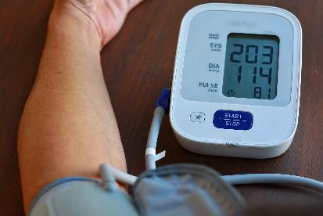

Following an agreed treatment plan involves enacting or changing behaviours:
Taking medication
Adjusting lifestyle: e.g. exercise or dietary changes
Monitoring their condition
Attending appointments

Slide 18
Why use behavioural science?
Our behaviour is complex and influenced by a range of internal and external factors.
Until we understand why behaviour occurs, we can’t identify the most appropriate methods/techniques to support behaviour change.
Practitioners and policymakers need a systematic and evidence-based method to understand behaviour and support behaviour change.
Notes:
Behaviour is often thought of as unpredictable. It’s less unpredictable than we might think, but often more complex. It’s that complexity we need to understand and unpack before we can start to build interventions and strategies to support behaviour change.

Slide 19
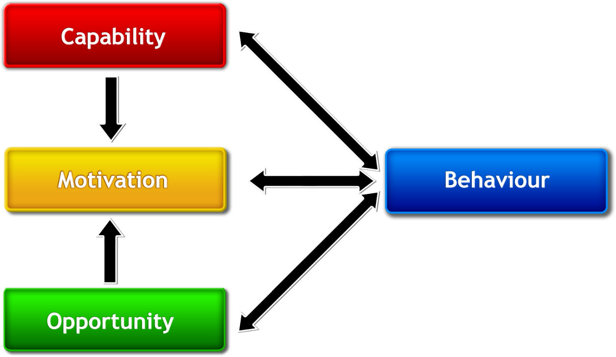
The COM-B Model (Michie et al, 2011)
Michie S, van Stralen MM, West R. The behaviour change wheel: A new method for characterising and designing behaviour change interventions. Implement Sci. 2011;6(1):42.
Notes:
A deceptively simple model. At its heart, it posits that to enact a behaviour one needs the capability, opportunity and motivation to do so.
Fans of American courtroom drama will perhaps recognise this reflected in the three aspects the jury needs to consider in order to make a conviction: the motive, the means and the opportunity.
This is a synthesis of multiple psychological frameworks that have been distilled down to their simplest moving parts.
Directional arrows…

Slide 20


Physical capability The physical skill, strength or stamina to engage in a behaviour.
e.g., strength, physique, physical skills.
Psychological capability Knowledge or psychological skills to engage in the necessary mental processes.
e.g., awareness of how to perform behaviour, reasoning ability and memory capacity, mental resilience, self-regulatory abilities.

Slide 21

Physical opportunity Physical environment that enables the behaviour.
e.g., time, resources, suitable location, physical cues that prompt behaviour.
Social opportunity Interpersonal influences, social cues and cultural norms that influence the behaviour.
e.g., social support, social norms, formal rules.

Slide 22

Reflective motivation Evaluations and intentions that influence the behaviour.
e.g., forming and enacting plans, making conscious decisions.
Automatic motivation Automatic processes involving emotional reactions, impulses and reflex responses.
e.g., habits and instinct, emotions.

Slide 23

The COM-B Model (Michie et al, 2011)
Psychological capability
Automatic motivation
Michie S, van Stralen MM, West R. The behaviour change wheel: A new method for characterising and designing behaviour change interventions. Implement Sci. 2011;6(1):42.
Notes:
A deceptively simple model. At its heart, it posits that to enact a behaviour one needs the capability, opportunity and motivation to do so.
Fans of American courtroom drama will perhaps recognise this reflected in the three aspects the jury needs to consider in order to make a conviction: the motive, the means and the opportunity.
This is a synthesis of multiple psychological frameworks that have been distilled down to their simplest moving parts.
Directional arrows…

Slide 24
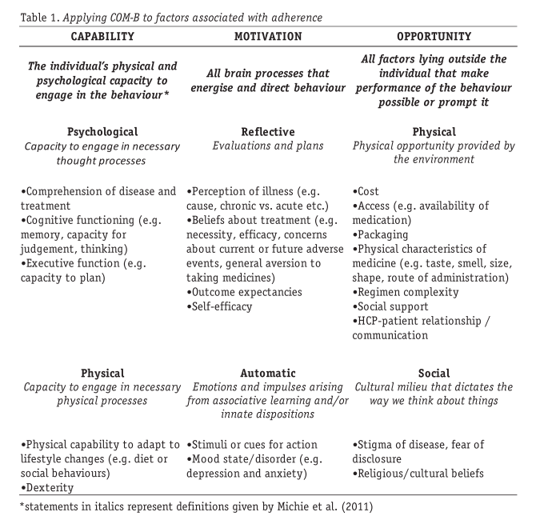
Applying the COM-B Model to medication adherence (Jackson, Eliasson & Weinman, 2014)
Jackson C, Eliasson L, Weinman J (2014). Applying COM-B to medication adherence. Bulletin of the European Health Psychology Society (EHP). Vol 16; 1. pp 7-17.
Notes:
A deceptively simple model. At its heart, it posits that to enact a behaviour one needs the capability, opportunity and motivation to do so.
Fans of American courtroom drama will perhaps recognise this reflected in the three aspects the jury needs to consider in order to make a conviction: the motive, the means and the opportunity.
This is a synthesis of multiple psychological frameworks that have been distilled down to their simplest moving parts.
Directional arrows…

Slide 25





Exploring motivation
Medication adherence can be influenced by:
our beliefs about the illness
our beliefs about the treatment
Misconceptions can lead to less desirable health behaviours

Slide 26
Health Psychology theory: beliefs about illness
Common-sense model of self-regulation (Leventhal, 1992)
Symptom or diagnosis
formation of illness representation
Identity
Cause
Timeline
Consequences
Cure/control
What is it? (symptoms, diagnosis)
What caused this?
How long will it last? (acute vs chronic, cyclical)
What will happen as a result?
What will make it better?
Leventhal H, Diefenbach M, Leventhal EA. Illness cognition: Using common sense to understand treatment adherence and affect cognition interactions. Cognit Ther Res. 1992;16(2):143–63.
Health-related coping behaviour

Slide 27
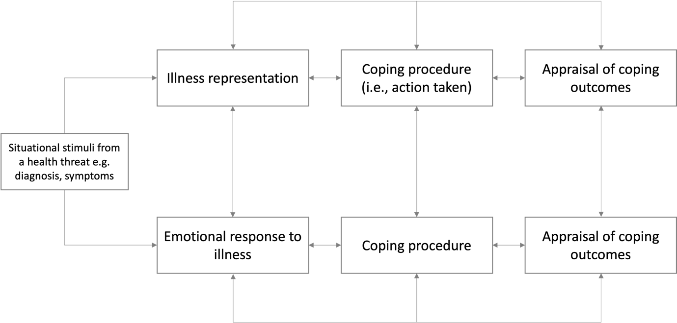
Health Psychology theory: beliefs about illness
Common-Sense Model of Self-Regulation (Leventhal, 1992)

Slide 28
Health Psychology theory: beliefs about illness
Common-Sense Model of Sepf-Regulation (Leventhal, 1992)
We appraise our chosen action (coping procedure) and may modify our behaviour based on that appraisal.

Slide 29


First prescription
First dose
Last dose
End of prescribing
Consultation
TIME
Non-persistence
Non-persistence
Persistence
Persistence
Drug ‘holidays’
may form part of the appraisal process
Implementation
Initiation
Discontinuation
Vrijens B, De Geest S, Hughes DA, Przemyslaw K, Demonceau J, Ruppar T, et al. A new taxonomy for describing and defining adherence to medications. Br J Clin Pharmacol. 2012;73(5):691–705.

Slide 30

Health Psychology theory: beliefs about medicines
Necessity-Concerns Framework (Horne et al, 1999)
The Necessity-Concerns Framework considers how our beliefs about medicines influence our medication-taking behaviour.
Our medicine-taking behaviour will be influenced by our beliefs about:
Medicines in general (beliefs that medicines are harmful, overprescribed etc)
The specific medicines we have been prescribed or are being offered
Horne R, Weinman J, Hankins M. The beliefs about medicines questionnaire: The development and evaluation of a new method for assessing the cognitive representation of medication. Psychol Heal. 1999;14(1):1–24.

Slide 31
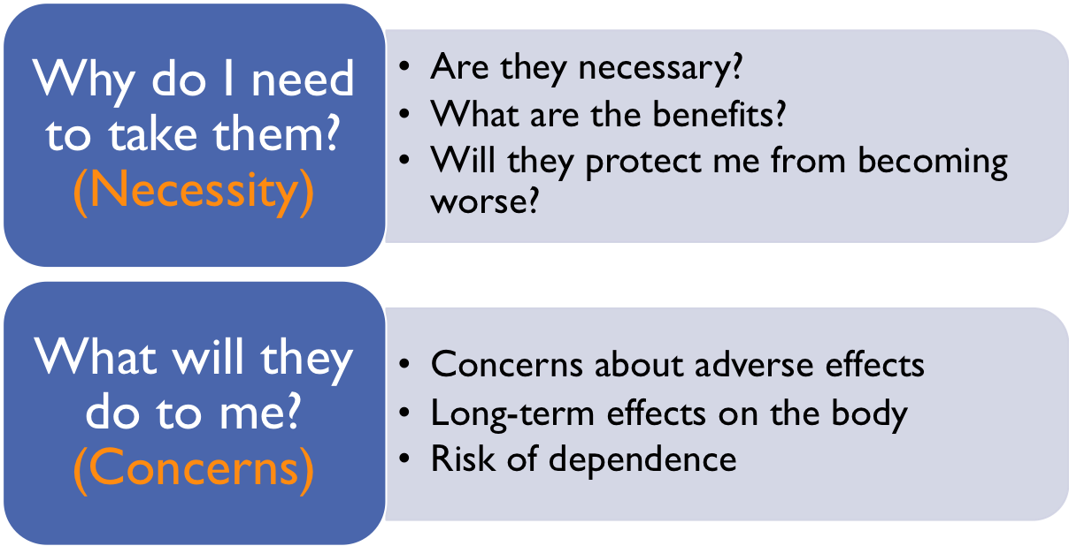
Health Psychology theory: beliefs about medicines
Necessity-Concerns Framework (Horne et al, 1999)
Specific beliefs about each medication: an individual may adhere to one medication but not another.
Specific to the individual: is this necessary for me?
Notes:
How do these beliefs relate to medication adherence?
Stronger beliefs about the necessity of medication will lead to greater medication adherence.
Greater concerns about medication will lead to worse adherence.

Slide 32
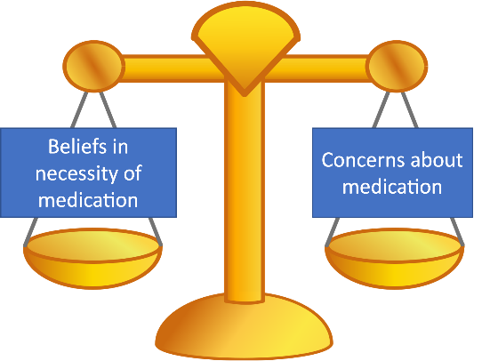
Health Psychology theory: beliefs about medicines
Necessity-Concerns Framework (Horne et al, 1999)
Beliefs in necessity of medication
adherence
=
Concerns about medication
adherence
=
Notes:
How do these beliefs relate to medication adherence?
Stronger beliefs about the necessity of medication will lead to greater medication adherence.
Greater concerns about medication will lead to worse adherence.

Slide 33
Supporting adherence starts at the first consultation
We need to understand the whole patient, not just their medical condition or their response to treatment
We need capability, opportunity and motivation for a behaviour to occur.
Do you know what their treatment goals are? They might have a different idea of what success looks like.
Exploring illness perceptions and beliefs about medication provides an understanding of the motivation to adhere.
Notes:
Misaligned goals: Inhaler use once a day vs one inhaler a year

Slide 34
Supporting adherence is a continuous process
People’s situations change. Their opportunity and/or capability to engage in the agreed behaviour might change too.
Motivation can change. People might gain new knowledge, need time to process the information you’ve given them etc.
Revisit the shared decision over the timeline of the condition. Is the original decision still the right one?
Keep the lines of communication open. If not you, who?

Slide 35
Consider non-adherence as a sign that the SDM
process needs to be revisited
Non-adherence suggests that one (or more) aspect(s) of their capability, opportunity or motivation to engage in the agreed behaviour has changed
… or maybe it wasn’t there in the first place.

Slide 36

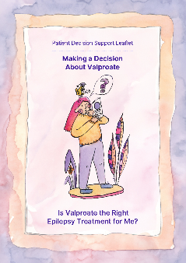
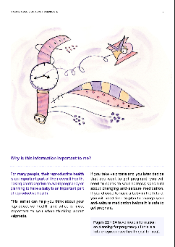
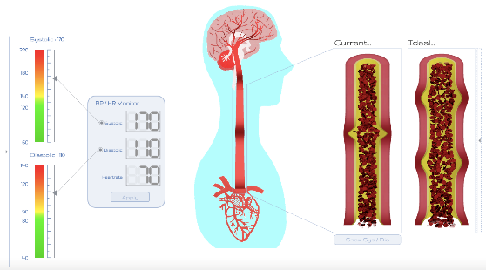
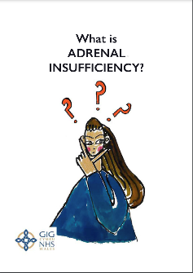
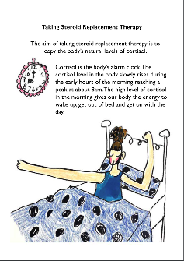
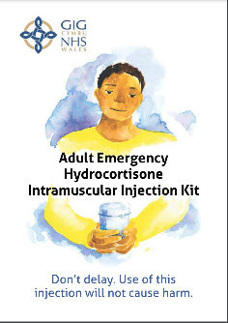
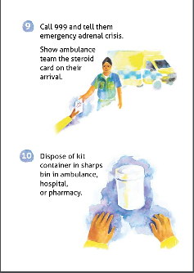
Tools to support adherence and shared decision-making
Co-designed with patients and stakeholders by a multidisciplinary team

Slide 37

ViSTA-BP: Visualisation to support treatment adherence in high blood pressure
An intervention comprising a digital visual platform and spoken narrative
Used within a consultation
Allows people with hypertension to visualise their blood pressure
Aims to support medication adherence by illustrating the necessity of medication and the consequences of nonadherence

Slide 38

Brown S, McDonnell B, McRae D, Hallingberg B, Angel P, Khan I, et al. Beliefs, behaviour, and blood pressure: preliminary analysis from a pharmacy-based hypertension visualisation intervention to support medication adherence. Int J Pharm Pract [Internet]. 2022 Dec 1;30(Supplement_2):ii8–9. Available from: https://doi.org/10.1093/ijpp/riac089.008
Brown S, Khan I, Angel P, Hallingberg B, McRae D, McDonnell B, et al. “I wasn’t interested until I actually had that consultation”: Exploring the acceptability of a community pharmacy-based hypertension visualisation intervention. Int J Pharm Pract. 2023;31(Supplement_2):ii11–2.

Slide 39
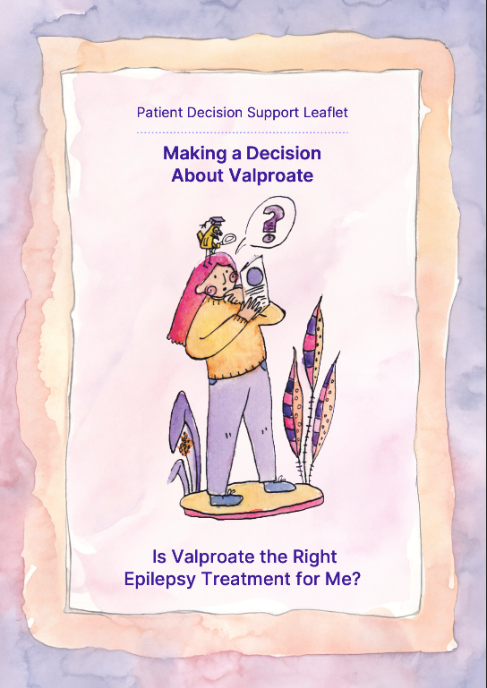
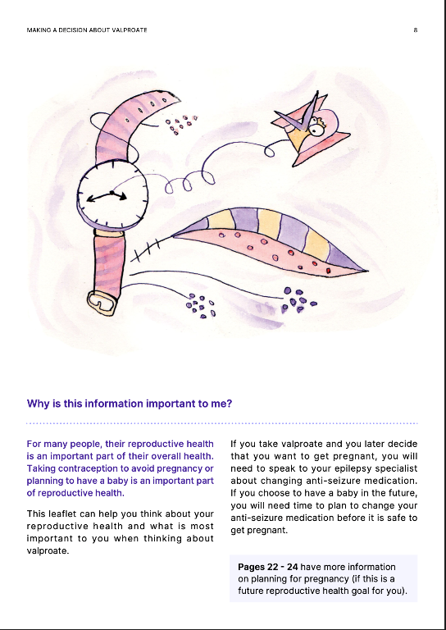
Valproate patient decision support leaflet

Slide 40

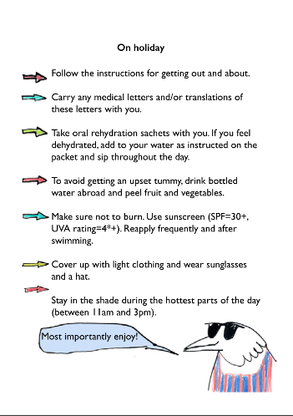
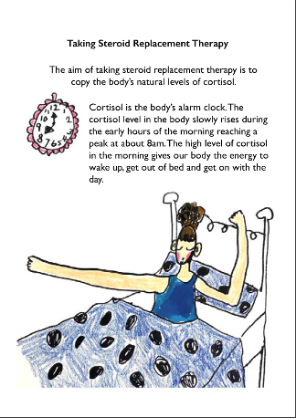
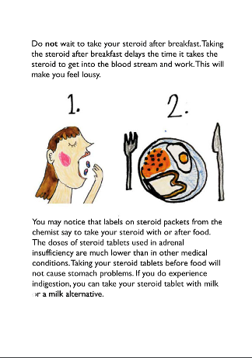
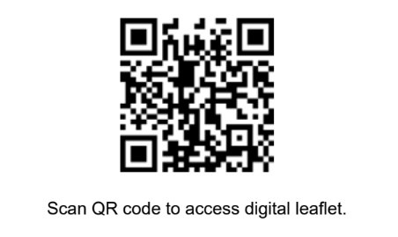
Adrenal insufficiency booklet
https://www.weds-wales.co.uk/wp-content/uploads/2022/08/ADRENAL_INSUFFICIENCY_ENGLISH.pdf

Slide 41
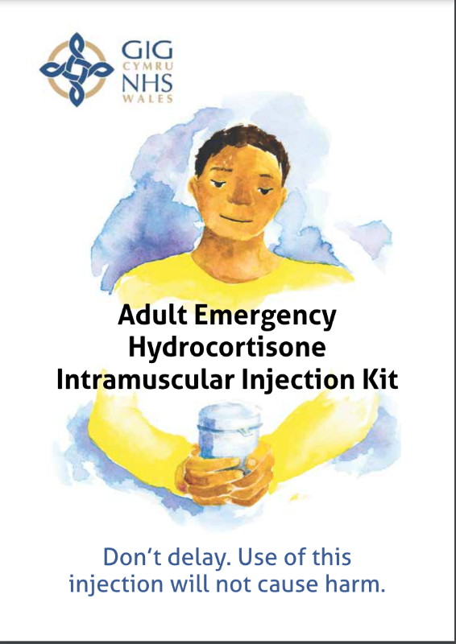
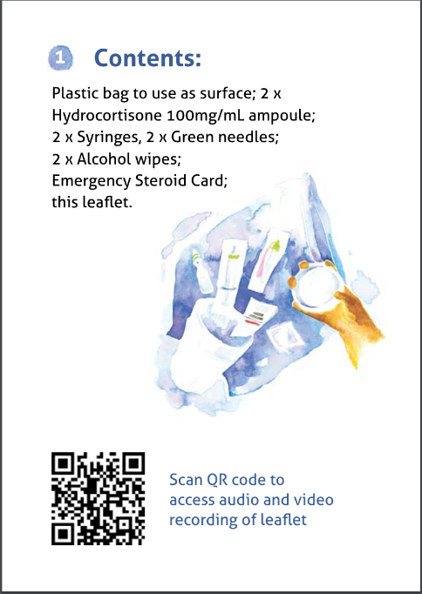
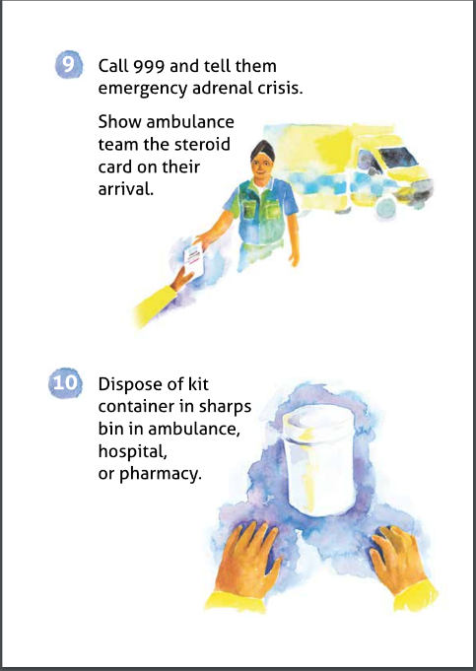
Emergency hydrocortisone injection
https://www.weds-wales.co.uk/wp-content/uploads/2022/08/HYDROCORTISONE_A5_ENGLISH_ADULT_INJECTION_BOOKLET.pdf

Slide 42


Thank you
Diolch
sabrown@cardiffmet.ac.uk

