Slide 1
Response to the Group A Strep demand surge in Wales
Dr Adam Mackridge
Strategic Lead for Community Pharmacy
Betsi Cadwaladr University Health Board

Slide 2

The problems
High demand for assessment and treatment of sore throats and respiratory problems following media reports of increases of Scarlet Fever and iGAS
Pressure to supply antibiotics on clinicians from patients/carers owing to media reports of the risks of iGAS
Demand for antibiotics exceeded usual levels, leading to depletion of stocks in community pharmacy and other settings
Supply-chain bandwidth insufficient to replenish stocks from manufacturer stockpiles quickly enough to meet ongoing demand
Patients presenting in multiple pharmacies to obtain supplies creating duplicate work
Prescription changes or multiple prescriptions being issued for 2nd line options to be used where 1st line was not available

Slide 3

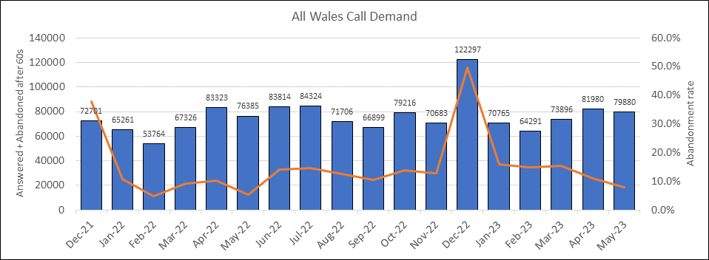
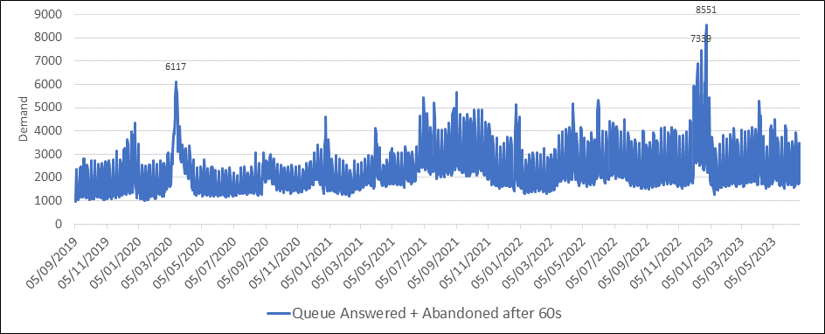
NHS 111 Demand

Slide 4
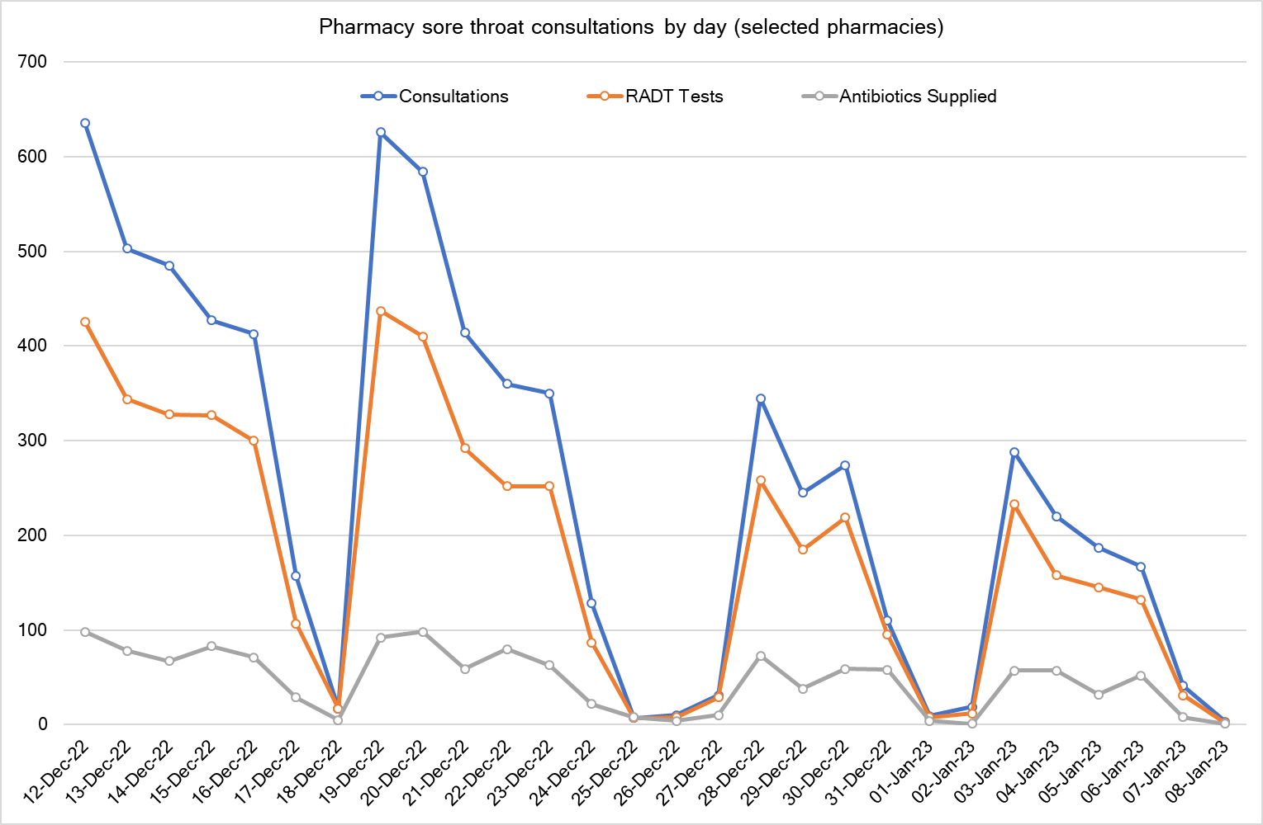
Sore Throat Test and Treat

Slide 5
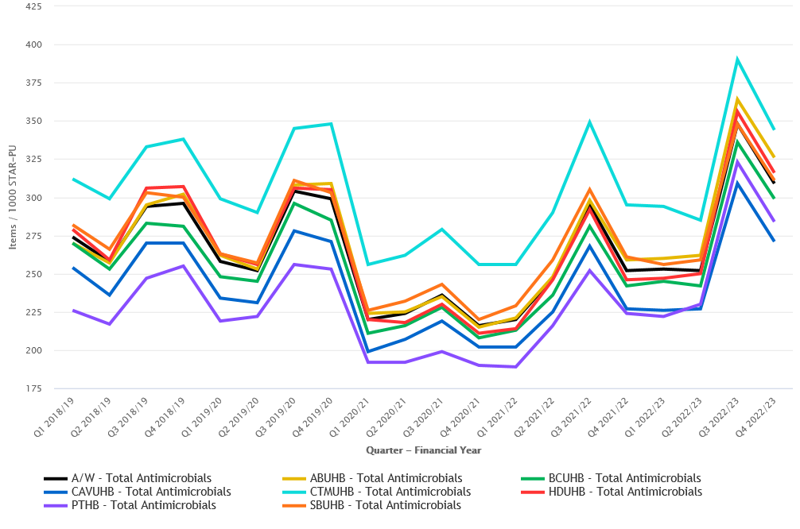
All antibiotics – Items / 1,000 STAR-PU

Slide 6
The response in Wales

Slide 7
Planning & information sharing
Multi-agency approach – Twice weekly national meetings
  Welsh Government
  Public Health Wales
  Wales Medicines Advice Service
  Local Health Boards (Community Pharmacy Lead/Secondary Care)
  NHS 111
  Shared Services (Procurement, Health Courier Service)
Information sharing with procurement teams
  Potential issues coming up
  Sources of medicines that were available
Liaison with wholesalers and manufacturers

Slide 8

Monitoring & surveillance
Health board stocks
  Assurance of availability across Wales
  Targeted support / tailored response
Sore Throat Test and Treat demand and delivery in Community pharmacy
  Consultations, tests completed, and antibiotic supplies
  Proxy marker of demand and level of acuity
Public Health Wales
  Twice weekly iGAS meetings - Health Protection, Microbiology, Pharmacy, Comms, and Welsh Government
  Tracking Scarlet Fever and iGAS cases, including mortality, and trying to identify high risk patients,
  Comms strategy and messaging to public and clinicians

Slide 9

Maximising supplies
Pre-packed antibiotics prepared centrally to help replenish pre-pack stocks in health boards
Central procurement of short dated stock for onward distribution to key sites
  Acute sites
  Community pharmacy ‘hubs’
Release of emergency stockpile medicines into health boards by Welsh Government

Slide 10
Care pathways - Prescribers
Clinical prescribing guidance for upper respiratory tract infection
  Issued by Public Health Wales as a supplement to current iGAS and Scarlet Fever guidance
  No change in pathogenicity:
    Typical strains involved
    The proportion of iGAS to scarlet fever not atypical
    The severity of disease no worse than usual
  Threshold for treatment (FeverPAIN or CENTOR) and treatment options unchanged
  Aimed to provide appropriate alternative treatment options when stock depleted
  Based on microbiology sensitivity and evidence of efficacy
  Co-amoxiclav excluded due to its implication in driving gram-negative resistance and risk of healthcare associated infections
Guidance on use of solid dosage forms
  Developed by Welsh Medicines Advice Service
  Support use of tablets in younger patients and those unable to swallow
  Protected liquid formulations for situations where no alternative

Slide 11
Care pathways – Community Pharmacy
Local WhatsApp groups between Community Pharmacies to support live understanding of stock and help patients locate medication
Serious Shortage Protocols
  Alternative formulations and alternative antibiotics for phenoxymethylpenicillin
  Guidance issued to prescribers to always prescriber Pen V unless clinically inappropriate (e.g. allergy)
Sore Throat Test and Treat - Patient Group Direction reviewed
  Addition of amoxicillin
  Supply of solid dosage forms for children who can't swallow
  Supply of clarithromycin and erythromycin where Pen V and amoxicillin not available

Slide 12
Communication
Community pharmacy stock availability tools
  Local > national
  National picture of stock availability
  Locally support healthcare professionals to guide patients to available supplies
Information and guidance issued locally to prescribers around availability of key antibiotics and how best to support patients to access
Guidance and advice issued to the public on when to seek help and how to do this
Local liaison and engagement
  Community Pharmacy Wales
  Local Medical Committee
  Independent contractors
  Local Health Board teams
  Understand issues / communicate information & plans

Slide 13
The Legacy

Slide 14
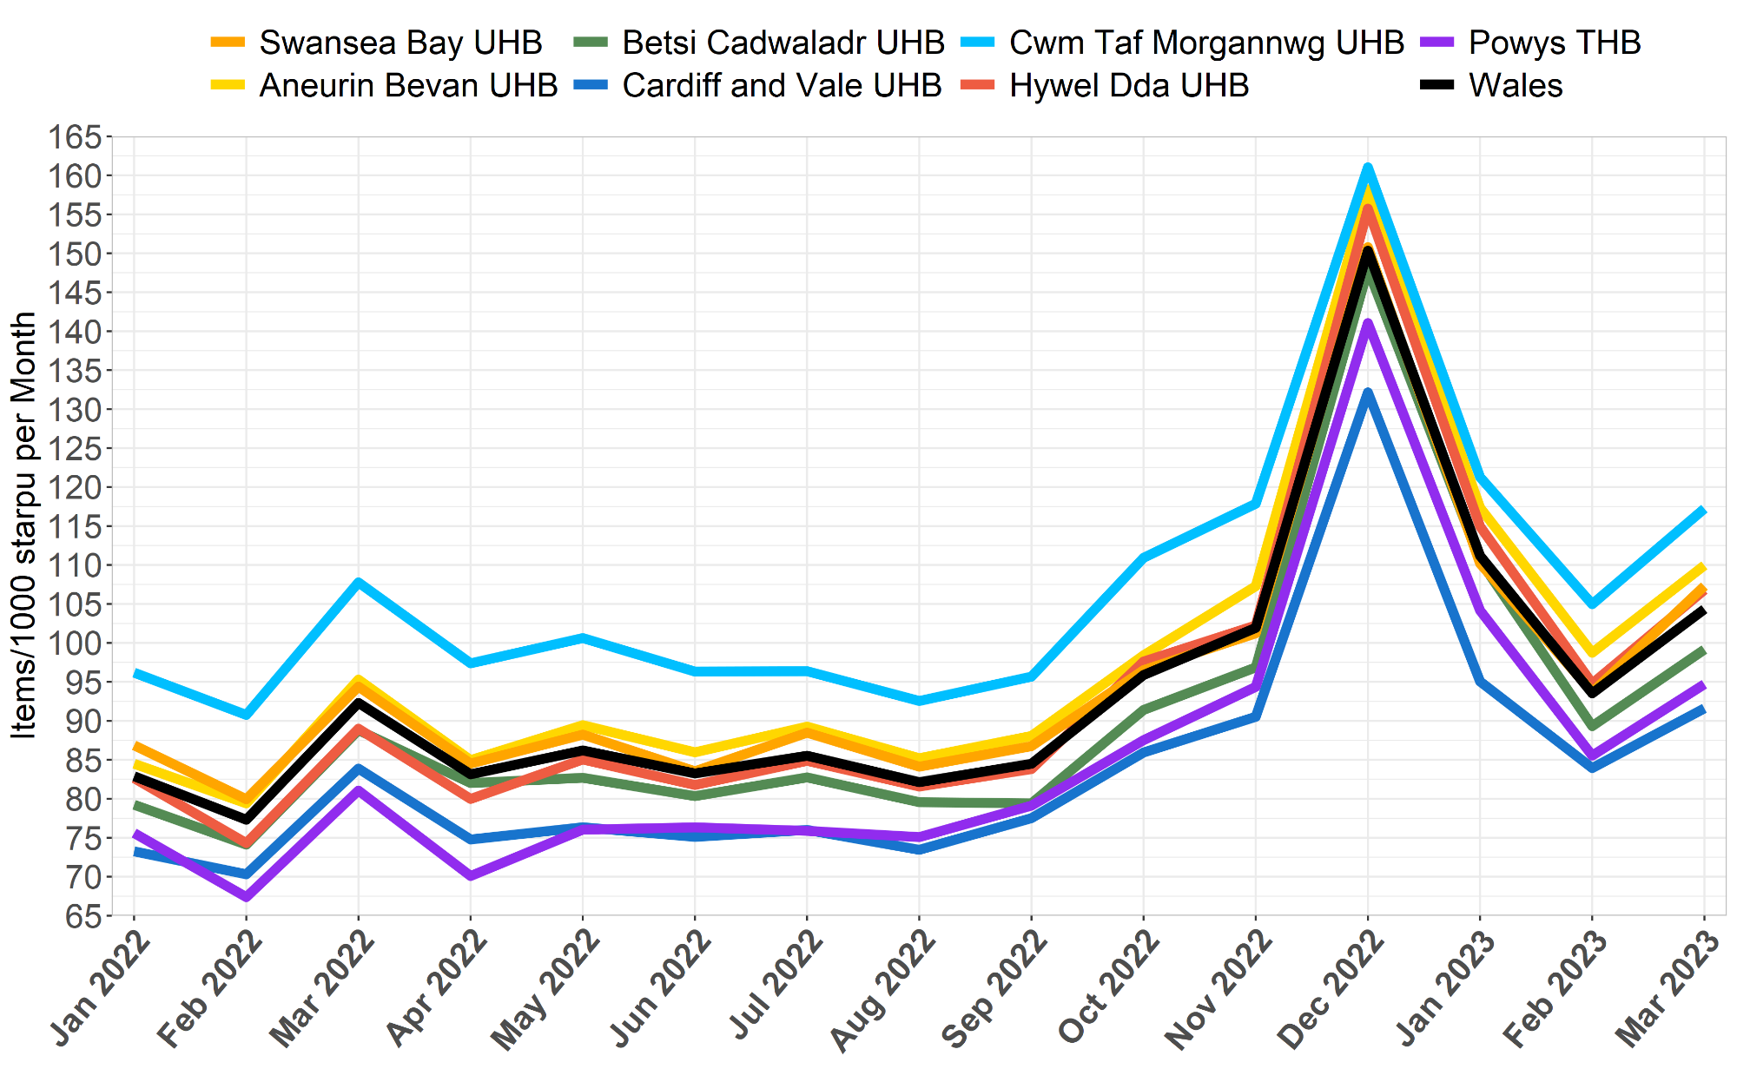
Spike in demand and legacy growth

Slide 15
Where now
Redouble efforts in AMR
  Raising awareness of the negatives of using antibiotics
  Realistic benefits
Influence public expectations
Influence clinician behaviours
Planning for future spikes in demand

Slide 16




Team Wales
Welsh Government
  Andrew.Evans – Chief Pharmaceutical Officer
  Lloyd Hambridge – Deputy Chief Pharmaceutical Officer
  Gavin Lewis - Pharmaceutical Services Officer
  Mark Welsby - Access to medicines policy lead
NWSSP Procurement & Production
  Anne Hinchliffe – All Wales Specialist Pharmacist- Contingency Planning
  Mark Francis – National Procurement Lead Pharmacist
  Laura-Jayne Keating – All Wales QA Pharmacist
  Gareth Tyrrell – Accountable Pharmacist
  Tracey Prothero – Commodity Manager
  Andrew Daniel – QA Lead
  Louise Lewis – Production Lead
Welsh Analytical Prescribing Support Unit
  Richard Boldero – WAPSU Pharmacist
  Kath Haines – HEAD OF WAPSU
Public Health Wales
  Nik Reid – Consultant Antimicrobial Pharmacist
  Meryl Davies – Lead Antimicrobial Pharmacist
  Robin Howe – National Clinical Lead for Microbiology Services
Local Health Boards
  Owain Williams Lead Pharmacist – Primary Care & Community Pharmacy, Hywel Dda UHB
  Adam Mackridge – Strategic Lead for Community Pharmacy, Betsi Cadwaladr UHB
NHS 111
  Alex Gibbins – Pharmacist Professional Lead
NWSSP Health Courier Service
  Gildas Griffiths – Deputy Head of Clinical Logistics
Welsh Medicines Advice Service
  Dianne Burnett – National Lead Medicines Information

