Slide 1

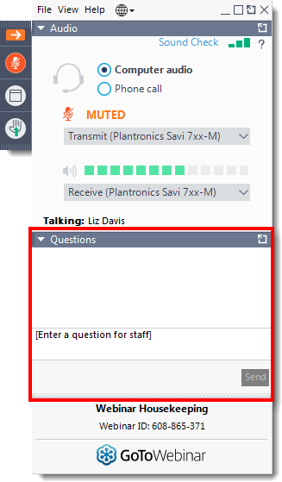
Today’s webinar
Questions
Please submit your questions to the speakers via the question function
Quiz
We will be hosting an interactive quiz on slido so please keep your mobile phone ready!
Slide 1

Slide 2
Appraisal Process I
‘How can you make a good appraisal submission?’
Slide 2

Slide 3
Overview
Appraisal process timelines – an overview
Steph Francis
Hints and tips on making a good submission
Stuart Keeping
Appraisal updates
Helen Adams
Slide 3

Slide 4
Appraisal process timelines
Steph Francis
Slide 4

Slide 5
Terminology
Form A – Initial appraisal submission
Form B – Full appraisal submission
Form C – Limited appraisal submission
CA – Commercial Arrangement
WPAS – Wales Patient Access Scheme
SOA – Statement of Advice
Slide 5

Slide 6

Timelines for Engagement
AWMSG Process for Industry engagement
Medicine Available for use in NHS Wales
Statement of advice
Marketing Authorisation
AWMSG/NICEApproval
PII/PIII trials
CHMP opinion
Horizon Scanning
Form A
Form B/C
Commercial
arrangements
Slide 6

Slide 7


Early Engagement
Initial appraisal submission (Form A)
Should be submitted on receipt of positive CHMP opinion
Assists AWTTC in determining whether a medicine meets the criteria for appraisal
Enables AWTTC to gather useful information to assist in horizon scanning
Ensures AWTTC identify which medicines are likely to have a WPAS/PAS
Provides AWTTC with information regarding NICE timelines.
Slide 7

Slide 8
Full Submission (Form B) ?
Limited Submission (Form C)?
Paediatric Licence extension?
Exclude?
Slide 8

Slide 9
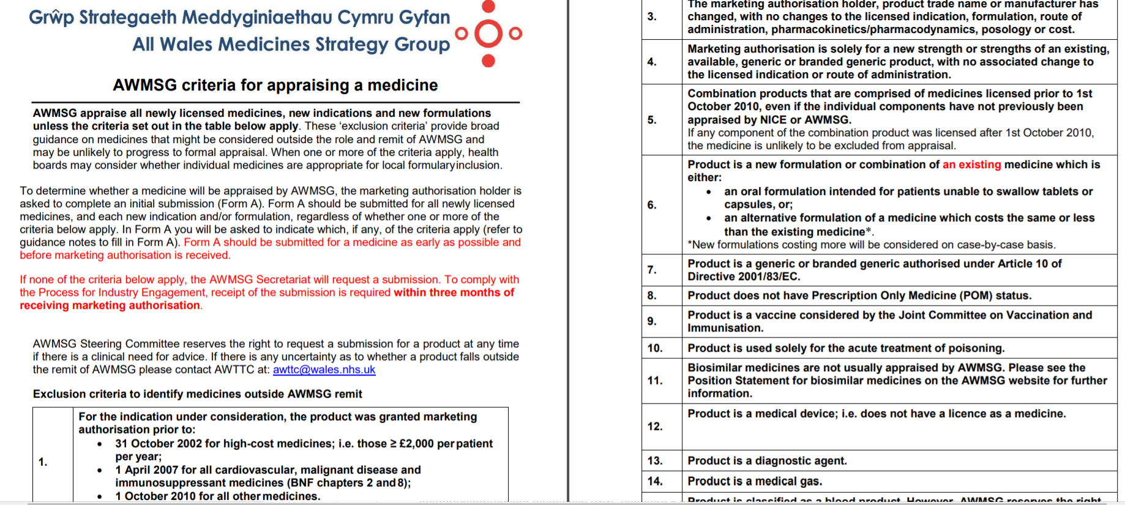
AWMSG exclusion criteria to identify medicines outside the remit of AWMSG appraisal
Slide 9

Slide 10
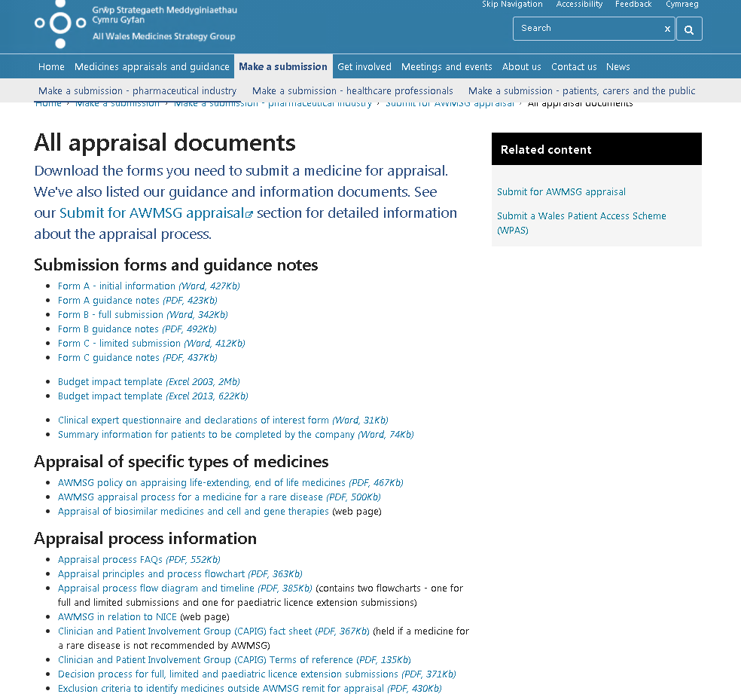
Decision process for full, limited and paediatric licence extension submissions
New medicine
(new chemical entity)
Yes
Full submission
No
New licensed therapeutic indication
(new target disease)
Yes
Full submission
No
Clear case for equivalence, superiority, or non-inferiority and
cost pro-rata is equivalent or lower than comparator, or the cost difference is deemed insignificant
Yes
Limited submission
New formulation of existing medicine
Yes
No
Full submission
No
Process for licence extensions for paediatric use
New minor licensed extension
to medicines previously recommended by NICE/AWMSG or medicines already in widespread use or licence predates AWMSG
Yes
Yes
Meets criteria for paediatric licence extension process
No
Yes
No
Impact deemed significant by AWMSG
Full submission
Full submission
No
Limited submission
AWMSG decision process
Slide 10
AWMSG reserves the right to request a full submission at any time and will provide a full explanation of its decision. If you intend on submitting a Wales Patient Access Scheme (WPAS) please refer to the WPAS section of the AWMSG website.

Slide 11

Join at slido.com
#9460
Slide 11

Slide 12
Timelines for Engagement
AWMSG Process for Industry engagement
Medicine Available for use in NHS Wales
Statement of advice
Marketing Authorisation
AWMSG/NICEApproval
PII/PIII trials
CHMP opinion
Horizon Scanning
Form A
Form B/C
Commercial
arrangements
Slide 12

Slide 13
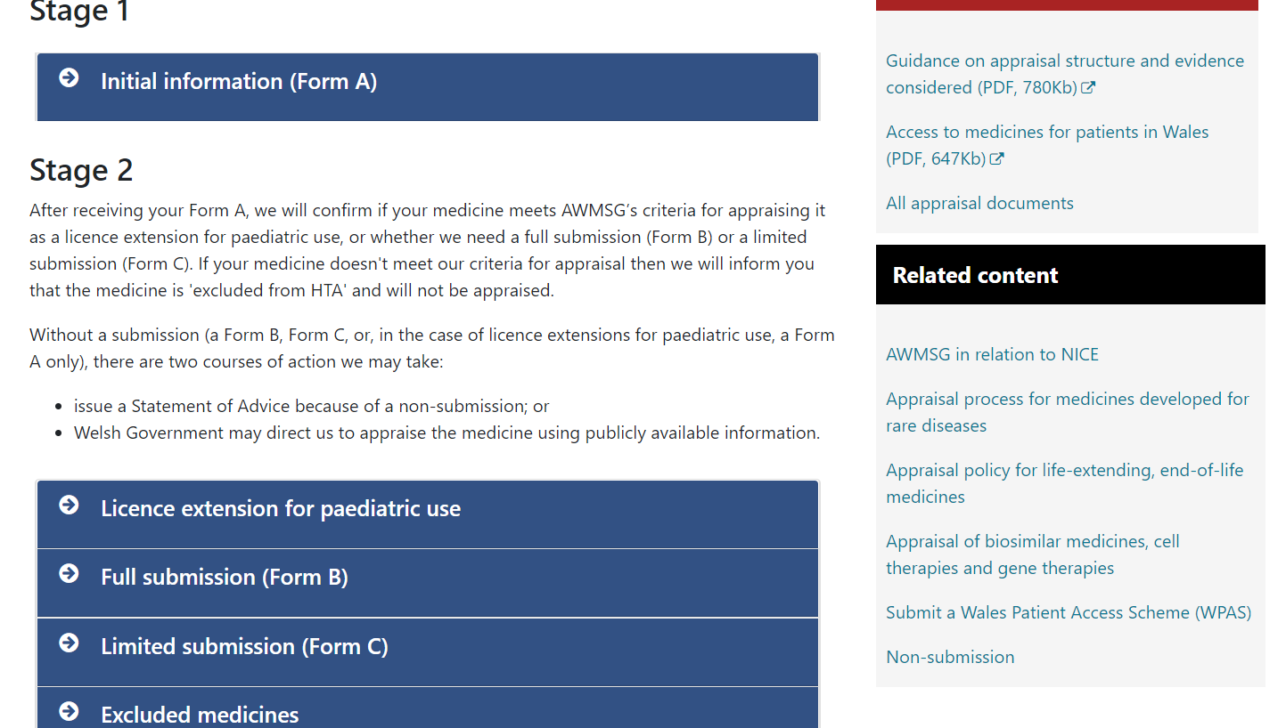
https://awmsg.nhs.wales/make-a-submission/make-a-submission-pharmaceutical-industry/submit-for-awmsg-appraisal/
Slide 13

Slide 14
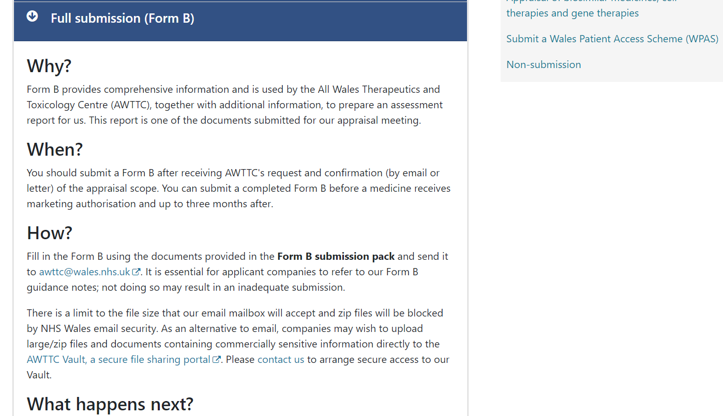
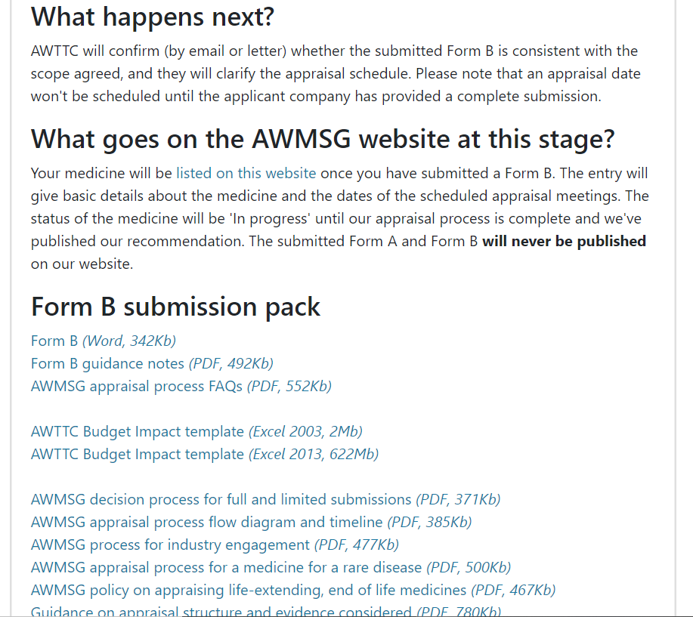
Slide 14

Slide 15
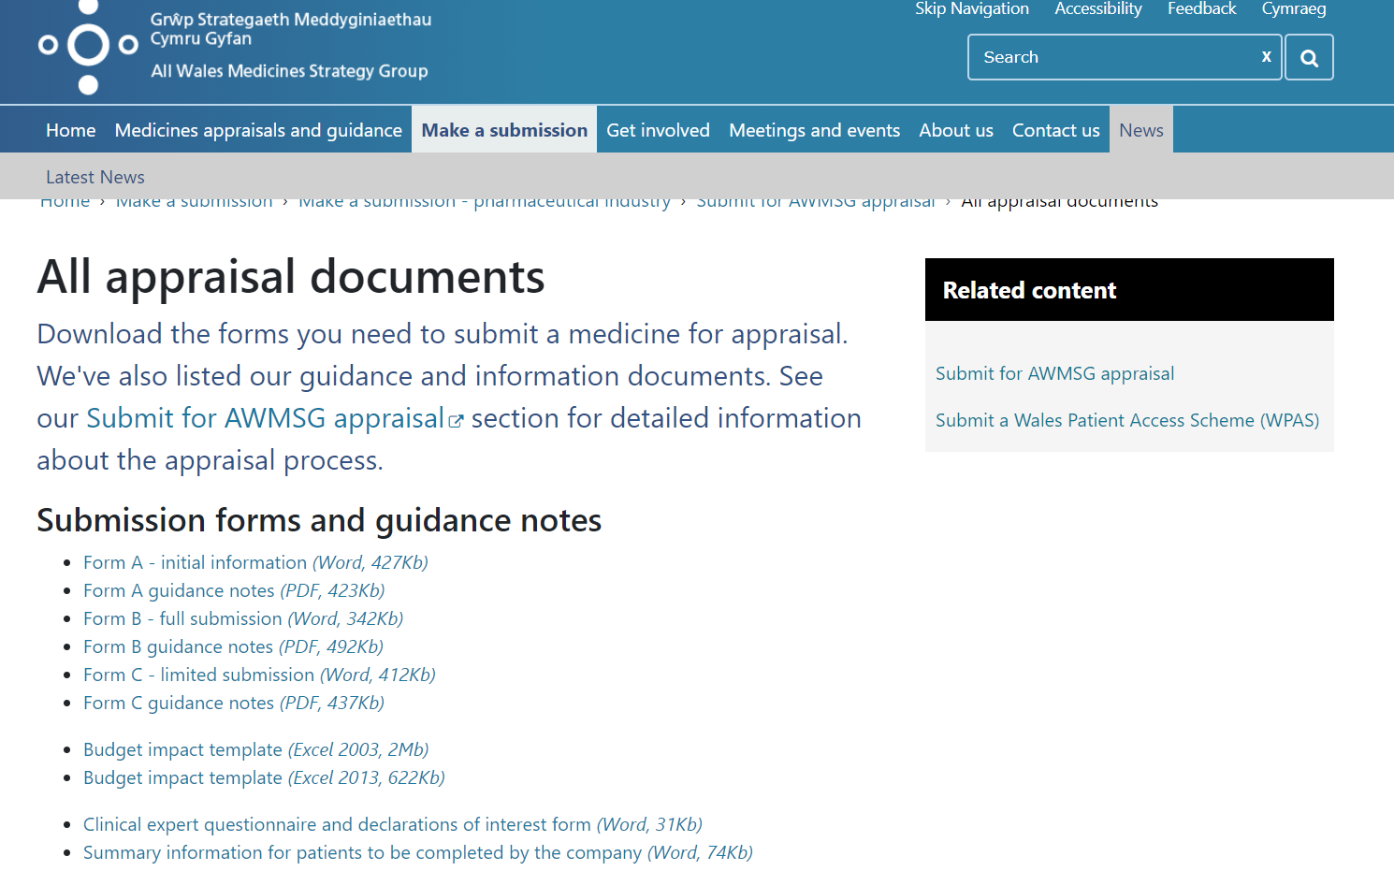
Slide 15

Slide 16
Terminology
Form A – Initial appraisal submission
Form B – Detailed appraisal submission
Form C – Limited appraisal submission
ASAR - AWMSG Secretariat Assessment Report
CR-ASAR - Company Response to AWMSG Secretariat Assessment Report (14 days)
PAR - Preliminary Appraisal Recommendation (7 days)
FAR - Final Appraisal Recommendation (14 days)
NMG – New Medicines Group
AWMSG – All Wales Medicines Strategy Group
WG – Welsh Government
Slide 16

Slide 17
Timelines for Appraisal
Clinical Expert
Clinical Expert
Patient Views
WG
Ratification
NMG
AWMSG
FAR to
Welsh Government
Papers sent to NMG
Papers sent to AWMSG
ASAR prepared
CR/ASAR
Form B/C submitted
ASAR to company
PAR to company
FAR to company
Week 0
Week 8
Week 10
Week 12
Week 14
Week 15
Week 16
Week 18
Week 19
Week 20/21
Slide 17

Slide 18
Timelines for Appraisal
Clinical experts identified
Week 0
Receipt of full or limited submission (Form B/C) including electronic references and health economic model (where appropriate) within 3 months of receipt of marketing authorisation
Patient organisations/
support groups identified
AWMSG Secretariat Assessment Report (ASAR) prepared
Week 8
Draft ASAR sent to company for comment
Written response to be returned within 10 working days
Week 11
Company response (CR ASAR) considered (draft ASAR may be amended)
Process proceeds regardless of whether response from company received
Week 12
Documents sent to New Medicines Group (NMG) members
NMG MEETING
Draft ASAR, CR ASAR, Form B/C, clinical expert opinion and patient perspective considered by NMG members
Preliminary Appraisal Recommendation (PAR) agreed
Week 14
Week 15
PAR sent to company
Comments to PAR invited in writing (to be returned within 5 working days)
Final ASAR sent to company – for information only
Appraisal documents (final ASAR, PAR, company response [CR PAR] and clinical expert summary) posted on AWMSG website approximately 10 days prior to public meeting
AWMSG MEETING
Final ASAR, PAR, CR PAR, clinical expert summary, societal impact, budget impact and patient perspective considered by AWMSG
AWMSG recommendation agreed and announced
NMG Chair/NMG Vice Chair/NMG Lead Assessor/AWTTC Assessment Lead present PAR to AWMSG
Week 18
Week 19/20
Final Appraisal Recommendation (FAR) approved by AWMSG Chair
Company given 10 working days to accept/reject AWMSG recommendation
https://awmsg.nhs.wales/files/appraisal-process/awmsg-appraisal-process-timeline-flowchart-pdf-104kb/
Week 20/21
FAR sent to Welsh Government for ratification
(subject to request for independent review)
Upon confirmation of Welsh Government ratification of FAR:
Company informed
Email communication disseminated to service
FAR posted on AWMSG website
March 2021
Slide 18

Slide 19
Hints and tips on building a good submission
Stuart Keeping
Slide 19

Slide 20

Which studies to include and exclude?
Slide 20
Notes:
Which studies to include? Which studies to include & exclude? Preferably RCTs, phase III and vs approp comparator. Using real world data –if it makes sense but justify. Relevant end points (patient –centred). Exclude dose finding studies, phase II . Justify your decisions around which studies to include/exclude.

Slide 21
Documentation tips
Highlight confidential information
Asthma UK. Asthma facts and statistics. Available at: https://www.asthma.org.uk/about/media/facts-and-statistics/. Accessed February 2021.
Office for National Statistics. Deaths from asthma, respiratory disease, chronic obstructive pulmonary disease and Flu, England and Wales, 2001-2018 occurrences February 2020. Available at: https://www.ons.gov.uk/peoplepopulationandcommunity/birthsdeathsandmarria ges/deaths/adhocs/11241deathsfromasthmarespiratorydiseasechronicobstructi vepulmonarydiseaseandfluenglandandwales20012018occurrences. Accessed February 2021.
Provide clear references
Slide 21

Slide 22

Which comparators?
Slide 22
Notes:
Comparator. Comparison v main treatment used today in Wales. Licensed if possible but accept unlicensed if reflects real life usage. Justify your decisions to include/exclude comparators.May need studies to provide indirect comparison to the most likely medicine to be displaced. Pick studies with closest popn & end pts. In indirect comparisons may need to adjust results to reflect different baselines of the populations. Need for meta analysis if need to do indirect comparison (find an expert –don’t try this at home folks!)

Slide 23
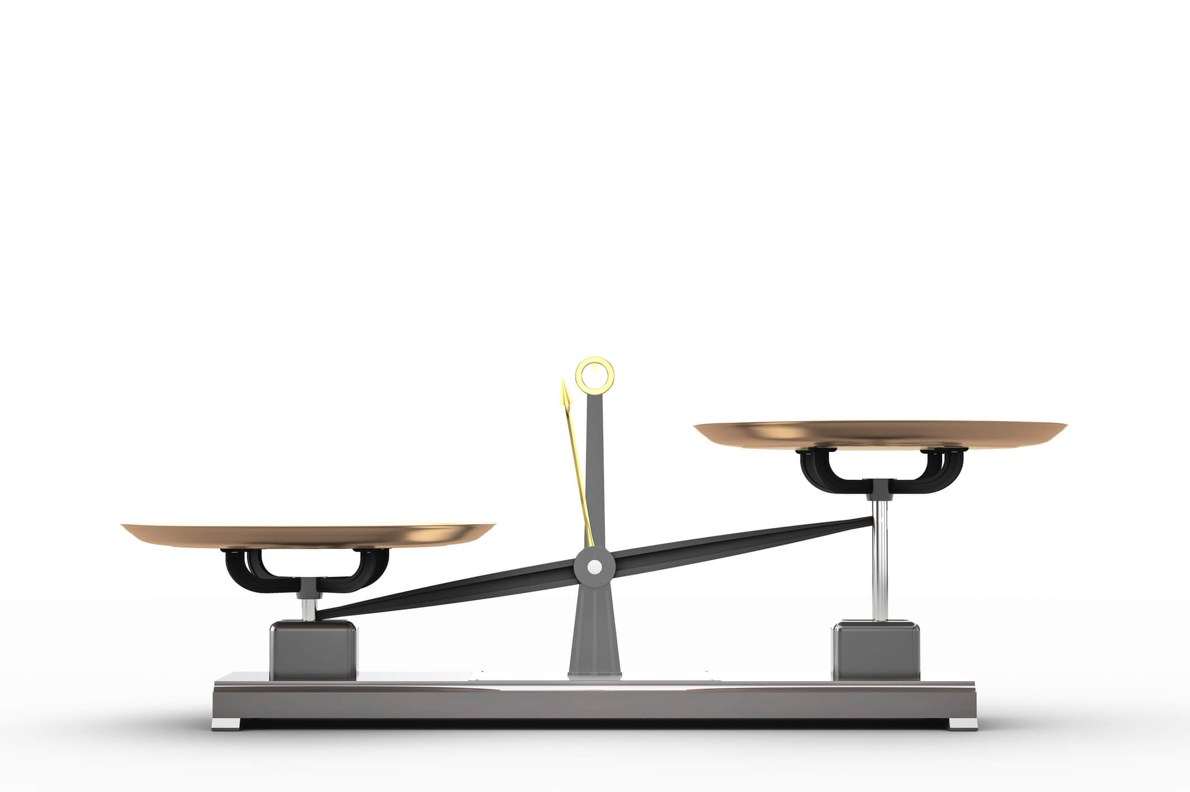
Cost minimisation analysis
Cost utility analysis
Slide 23
Notes:
CMA v CUA. Cost utility analysis model uses all relevant effects (clinical end points , safety end points from trials) and all costs (medicine acquisition, adverse events, monitoring and administration) into account and produces a cost per unit of health (ICER = cost per QALY). Cost minimisation assumes all effects are equal (not just clinical end points but adverse events, patient preference etc) and just considers differences in costs.
CUA preferred nearly always. Can only use CMA when all effects are the same for both medicines –very unlikely that all effects are the same compared to the comparator (no diffrerence in safety, patient preference – need to prove it, not just assume it!) In reality only likely to be the case for biosimilars , which we exclude anyway!

Slide 24


Make it relevant to NHS Wales & Welsh population
Slide 24
Notes:
Studies need to be relevant for Welsh population. Studies may be conducted at many different global locations . Is the population studied a good representation of the Welsh population e.g. in terms of ethnicity , , age , sex distribution etc.

Slide 25

Is the medicine for a sub-population?
Slide 25
Notes:
Studies should reflect indication. Population should reflect full indication and scope. If trials are only covering a sub-population submitting please tell us & show clearly that you are restricting within the indication and exactly how. Studies should use the licensed dose. Range finding studies are best omitted.

Slide 26
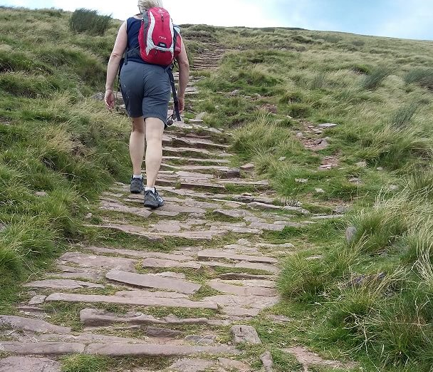
Treatment
pathway
relevant
to Wales?
Slide 26
Notes:
In CE model : treatment pathway modelled should be relevant to wales. Companies are encouraged to seek advice from Welsh clinicians. (Don’t necessarily assume we’re the same as other UK countries) [Pen –y –fan 886 m]

Slide 27

CE Model
–a transparent case?
Slide 27
Notes:
CE model – most plausible, transparent and robust case. Does the result have face validity ?e.g. pts with serious conditions living well past 100 years! EoL pts with average QoL for their age? Do modelled utilities (quality of life ) make sense for people with the condition?

Slide 28

Realistic
Alternative
scenarios?
Slide 28
Notes:
CE model (Sara) sensitivity analyses are these realistic alternative paths – explore the transparent and obvious limitations which are likely to reflect the ICER . examples – company explored small differences in model horizon which made little difference but QoL data were taken from patients with a different condition and no sensitivity on QoL, which had a far bigger impact. Are the scenarios and sensitivity analyses clinically relevant?

Slide 29

Slide 29
Notes:
PAS v list price. Providing WPAS has been agreed we will use this price in CE and BI. So don’t bother providing alternative scenarios with list price.
We’ve done some work comparing estimated Bis with the actual expenditure (published in pharmacoeconomics) . We found that it is very difficult to accurately estimate the BI therefore we’d urge you to consider doing sensitivity analyses with large variations from the original estimate such as +/- 50% . Experience shows that companies only make small variations which don’t make big BI changes –we’d urge you to be bolder. In addition resource costs from the cost-effectiveness model should be used in the BI (so costs or savings arising from e.g. differences in clinical staff administering the medicine should appear in the BI as well as the CE model) .
If there is an unknown PAS on the comparator companies are asked to explore the impact using sensitivity analyses at different % points.

Slide 30
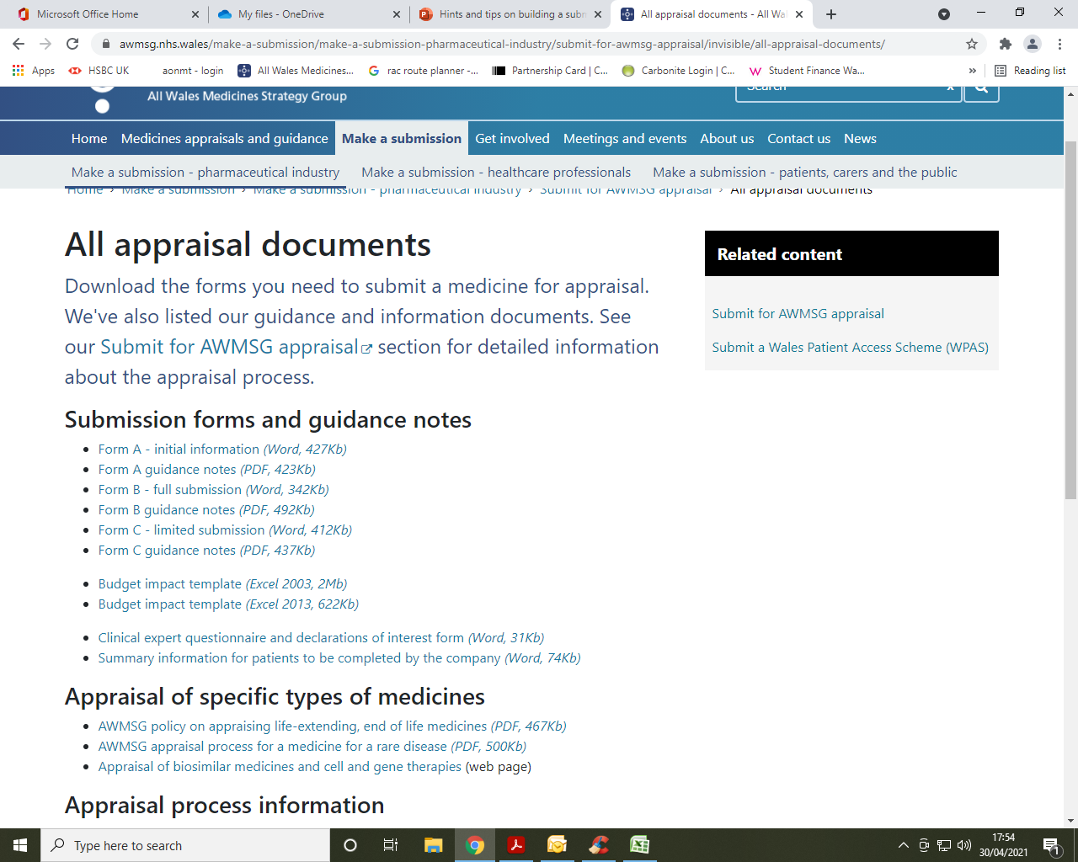
Slide 30

Slide 31
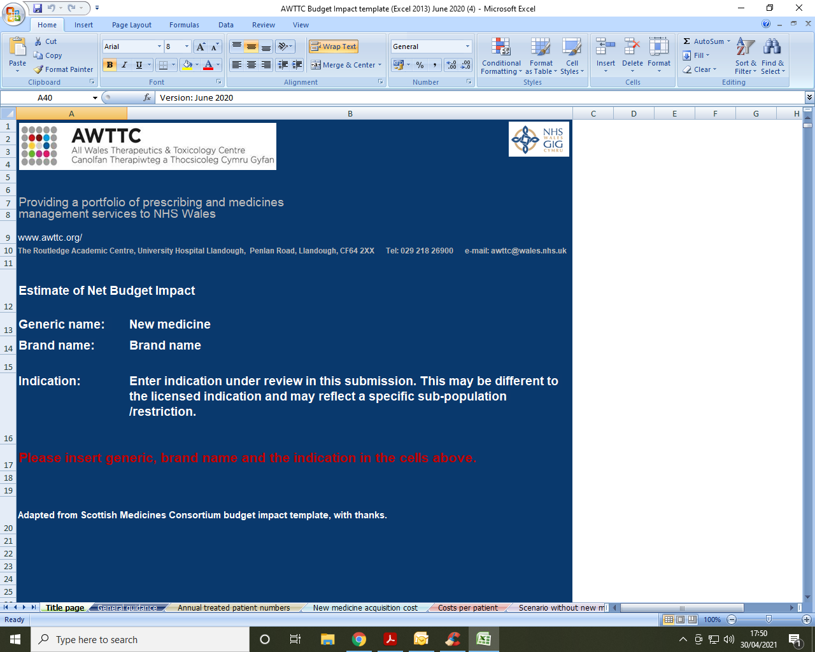
Slide 31

Slide 32
Budget impact: Medicine acquisition costs
Net costs | Year 1 | Year 2 | Year 3 | Year 4 | Year 5
Sub-population of eligible patients (indication under consideration) | 100 | 100 | 100 | 100 | 100
Uptake of new medicine (%) | 10% | 20% | 30% | 40% | 50%
Number of patients receiving new medicine allowing for discontinuations | 10 | 20 | 30 | 40 | 50
Medicine acquisition costs in a market without new medicine | £50,000 | £50,000 | £50,000 | £50,000 | £50,000
Medicines acquisition costs in a market with new medicine | £55,000 | £60,000 | £65,000 | £70,000 | £75,000
Net medicine acquisition cost | £5,000 | £10,000 | £15,000 | £20,000 | £25,000
Net supportive medicines costs | £0 | £0 | £0 | £0 | £0
Net medicine acquisition costs (savings/costs) - including supportive medicines where applicable | £5,000 | £10,000 | £15,000 | £20,000 | £25,000
These costs are calculated by subtracting 'scenario without new medicine' from 'scenario with new medicine'
Slide 32

Slide 33
Budget impact :Resource costs
Net resource implications | Year 1 | Year 2 | Year 3 | Year 4 | Year 5
Net administration costs | £100 | £200 | £300 | £400 | £500
Net diagnostic and monitoring costs | £500 | £1,000 | £1,500 | £2,000 | £2,500
Net adverse events costs | -£1,000 | -£2,000 | -£3,000 | -£4,000 | -£5,000
Net primary care costs | £0 | £0 | £0 | £0 | £0
Net secondary or tertiary costs | £0 | £0 | £0 | £0 | £0
Net Personal Social Services costs | £0 | £0 | £0 | £0 | £0
Net resource implications | -£400 | -£800 | -£1,200 | -£1,600 | -£2,000
Description
Net costs are obtained by subtracting 'scenario without new medicine' from 'scenario with new medicine'. These resource implications are NHS opportunity costs (e.g. increase or decrease in inpatient days due to the new medicine) which are not accounted for in the net acquisition cost calculations. These are identified here for potential service re-design purposes.
Slide 33

Slide 34
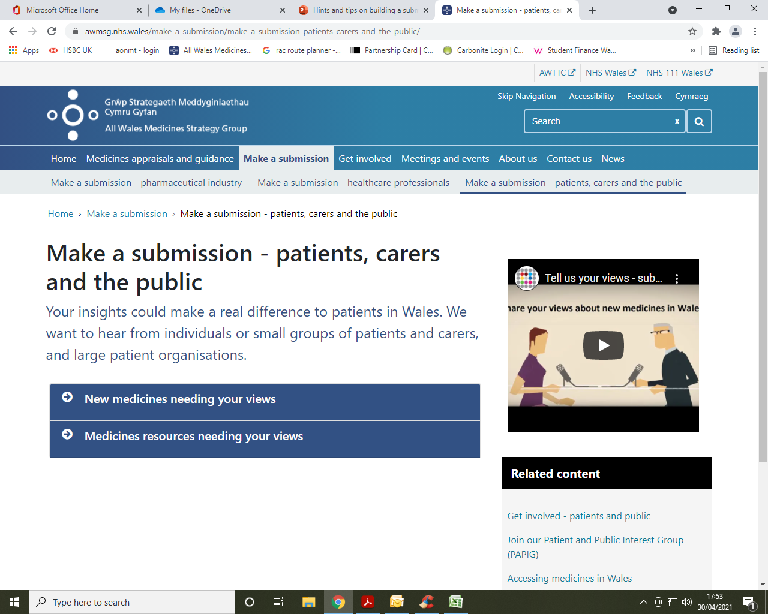
Patient organisations
Slide 34

Slide 35
Final tips..
CR ASAR –chance to correct factual inaccuracies, check you’ve identified confidential info and express difference of opinion.
CR-PAR- chance to express difference of opinion and justifications.
Send appropriate representatives for clinical and HE aspects to AWMSG (well briefed!)
Slide 35

Slide 36

‘We never will have all we need.
Expectation will always exceed capacity …
This service must always be changing, growing and improving, it must always appear inadequate’’
(Aneurin Bevin, 1948)
Slide 36
Notes:
Aneurin Bevan’s words are just as relevant 73 years later! Resource is scarce which is why we do HTA.
Ensure company reps at AWMSG are well briefed – clinical expert and HE expert needed. A positive recommendation at NMG is not a guarantee that AWMSG will be an easy ride.

Slide 37
Join at slido.com
#9460
Slide 37

Slide 38
Appraisal Updates
Helen Adams
Slide 38

Slide 39

NICE
MHRA
Statements of advice
Biosimilar medicines
Paediatric licence
extensions
Review process
AWMSG website

Slide 40
Diolch yn fawr
Thank you
Slide 40

Slide 41
Next Session……
Thursday 8 July
Appraisal (2) AWMSG policies
Review process
Slide 41

Slide 42

Slide 42

