Slide 1
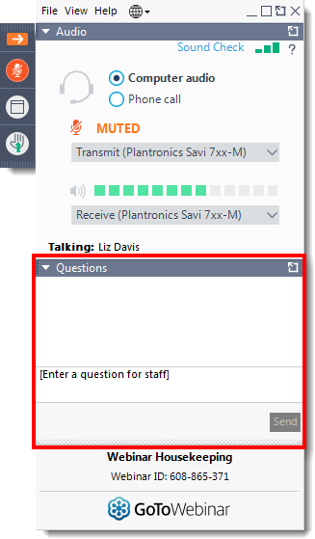
Today’s webinar
Questions
Please submit your questions to the speakers via the question function
Quiz
We will be hosting an interactive quiz on slido so please keep your mobile phone ready!

Slide 2

Market Access
‘Ensuring the right people get the right medicines at the right time’
https://awttc.nhs.wales/accessing-medicines/access-to-medicines-in-wales/

Slide 3
Overview
Market access – an overview
Steph Francis
Commercial Medicines Access Team (CMAT)
Tanya Bateman
Blueteq High Cost Drugs System – an update
Kath Haines

Slide 4


Join at slido.com
#9460

Slide 5
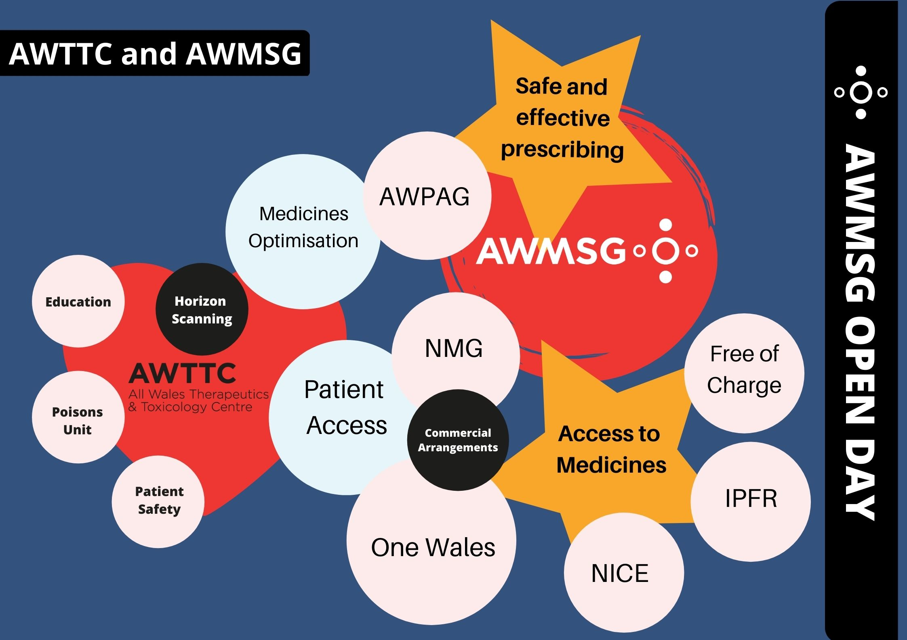

Slide 6


Early Engagement
AWTTC Horizon Scanning
To gather information about new medicines 12-18 months ahead of licence.
To support the AWMSG appraisal work programme
To identify high budget impact and high service impact medicines to assist in service planning.
We encourage pharmaceutical industry to inform AWTTC as soon as the estimated regulatory timings have been confirmed.
Information about new medicines and new licensed indications should be shared via UK PharmaScan or the AWTTC VAULT.

Slide 7
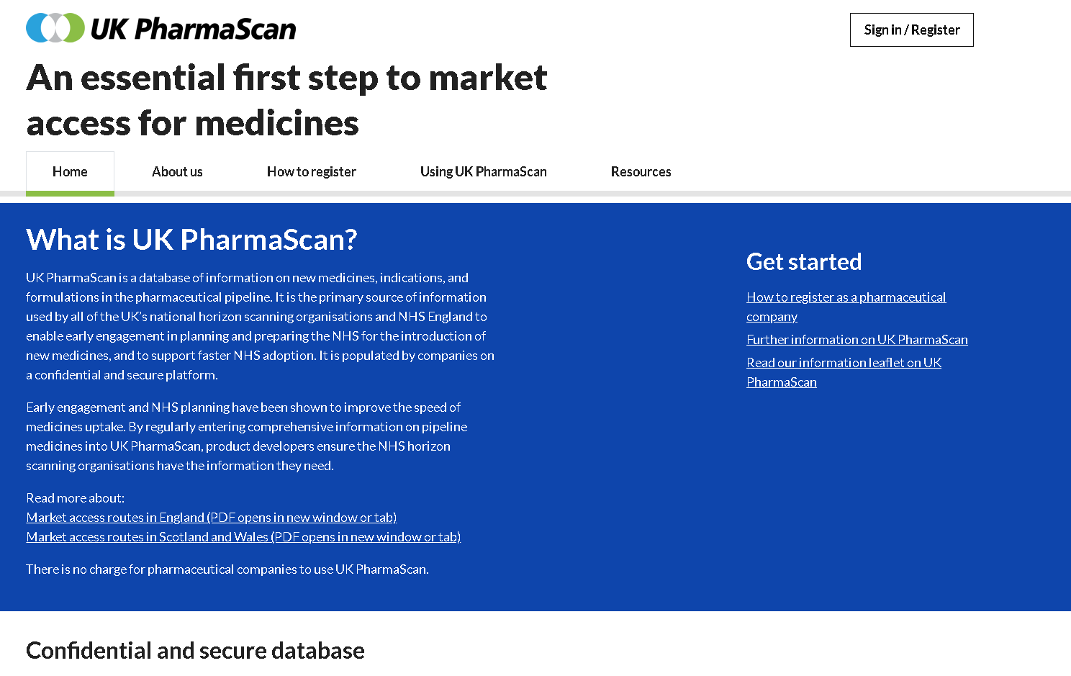
https://www.ukpharmascan.org.uk/

Slide 8
Routes of Access in Wales
IPFR
AWMSG
One Wales
HTA Appraisal
Access to Medicines
NICE
Free of Charge
EAMS

Slide 9

Timelines for Engagement
Medicine Available for use in NHS Wales
SOA
Marketing Authorisation
AWMSG/NICEApproval
PII/PIII trials
CHMP opinion
Horizon Scanning
Form A
Form B/C
Commercial
arrangements

Slide 10


Health Technology Appraisal
Preferred and most common way to approve a licensed medicine
Health boards in Wales are expected to make a new medicine available to patients within two months of NICE publishing its Final Appraisal Determination (FAD) or Final Evaluation Determination (FED).
AWMSG's advice, the medicine should then be made available to patients in Wales within 60 days of the ratification date.

Slide 11
New Treatment Fund (NTF)
The New Treatment Fund, launched by Welsh Government in January 2017, ensures patients across Wales have faster access to new medicines.
Health boards and trusts have a 60-day deadline to make a newly recommended medicine available for prescribing.
In order to monitor compliance with the NTF, and report to the Welsh Governement, health boards regularly report on how quickly they add the new medicines onto their formularies.
Annual reports on the formulary status of medicines recommended for use within NHS Wales by NICE and AWMSG are compiled by AWTTC.

Slide 12
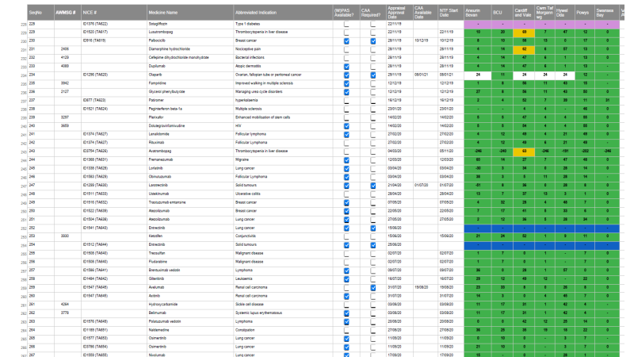
NTF monitoring

Slide 13
AWMSG Health Technology Appraisal
15 medicines appraised (20 medicines appraised for 2021 calendar year [8 full submissions; 4 limited submissions; 8 paediatric extensions])
8 medicines recommended (15 medicines recommended for 2021 calendar year)
6 medicines recommended for “optimised” use (5 medicines recommended for “optimised” use for 2021 calendar year)
1 medicine not recommended
25 Statements of Advice issued on non-appraised medicines to NHS Wales (20 medicines for 2021 calendar year)
A total of 40 medicines on which advice provided to NHS Wales

Slide 14
One Wales Medicines process
Access to medicines not usually available for a group of patients.
For licensed medicines advice is interim to HTA advice and a submission to AWMSG or NICE is expected.
For off-label/unlicensed medicines there must be no licensed medicine routinely available that will meet the patients’ needs and:
  the medicine is not licensed for the indication of interest; OR
  the requested use of the medicine is outside of
  accepted treatment pathway
  Medicines are identified by intelligence from All Wales IPFR data, Health Board IPFR panels, WHSSC, Chief Pharmacists or clinical experts

Slide 15
Individual patient funding request (IPFR)
Access to medicines not usually available for individual patients
If a patient and their clinician agree that a medicine that isn’t routinely available would benefit the patient, their clinician can submit an Individual Patient Funding Request (IPFR) asking the health board, or the Welsh Health Specialised Services Committee (WHSSC), to fund the medicine.
Requests may also be made for licensed medicines that are not recommended after a health technology assessment (HTA).
The All Wales Therapeutics and Toxicology Centre (AWTTC) works with IPFR panels and WHSSC to ensure the IPFR process in Wales is fair and consistent.

Slide 16
Individual health board decisions
Medicines may be considered for use by individual health boards if they meet the AWMSG exclusion criteria for appraisal.

Slide 17
All-Wales free of charge medicine supply
In the absence of, or whilst awaiting publication of health technology assessment advice, some pharmaceutical companies might wish to offer NHS Wales a free of charge medicine supply agreement to enable patients and clinicians access to a particular medicine at no cost.
The all-Wales free of charge medicine supply guidance introduces new controls to ensure equity and consistency in patient and clinician access to medicines offered to NHS Wales as free of charge.
Health board chief pharmacists and AWTTC co-ordinate the free of charge medicine supply agreements on behalf of NHS Wales

Slide 18
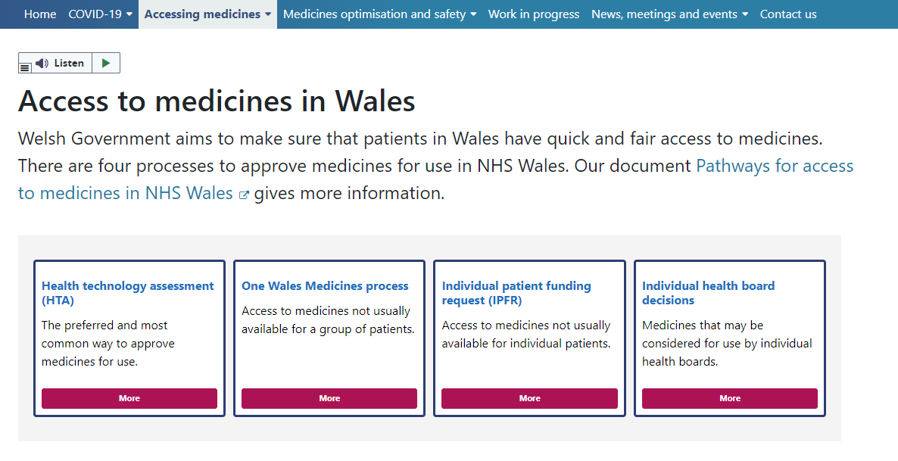
https://awttc.nhs.wales/accessing-medicines/access-to-medicines-in-wales/

Slide 19
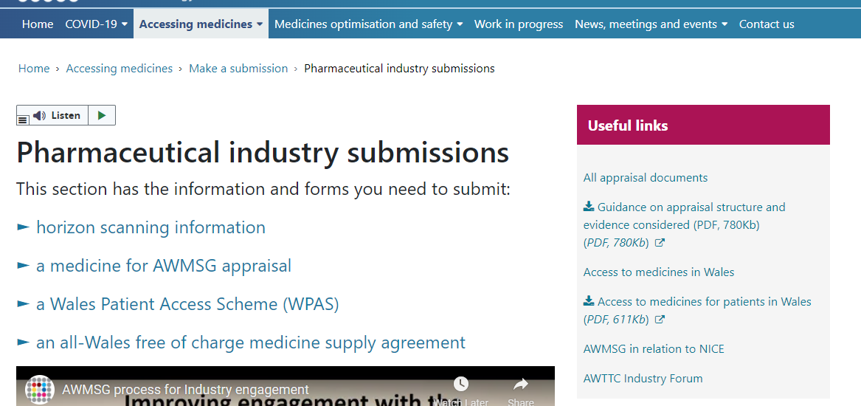
https://awttc.nhs.wales/accessing-medicines/make-a-submission/pharmaceutical-industry-submissions/

Slide 20
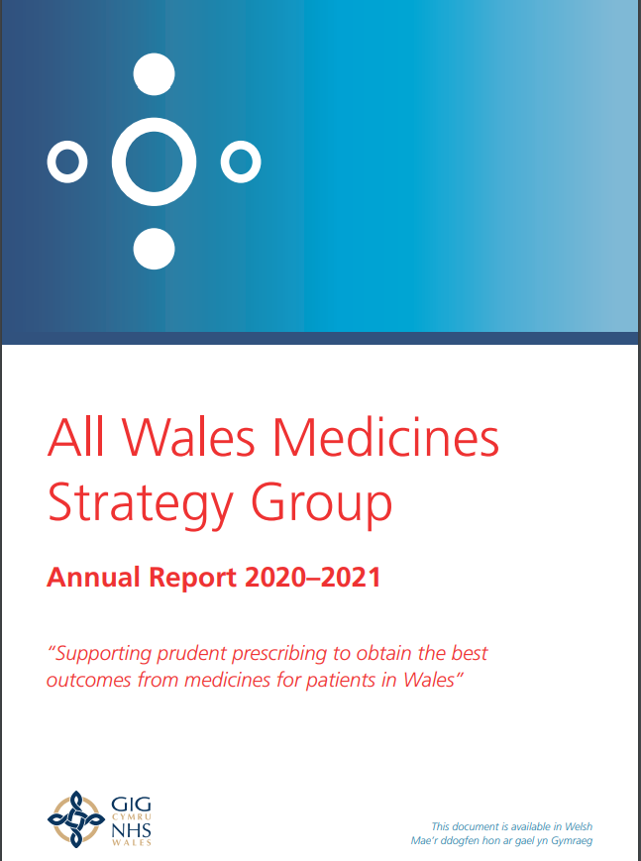
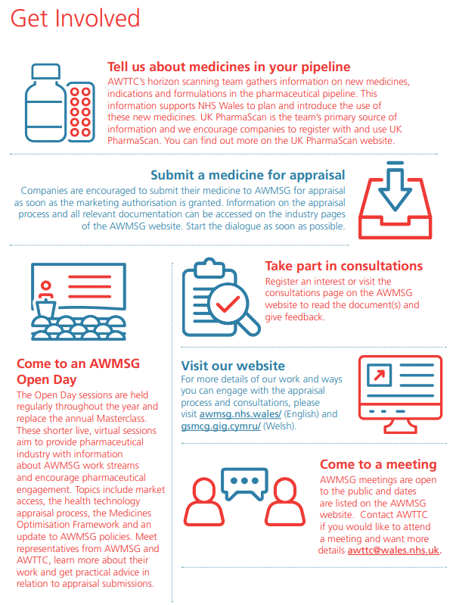
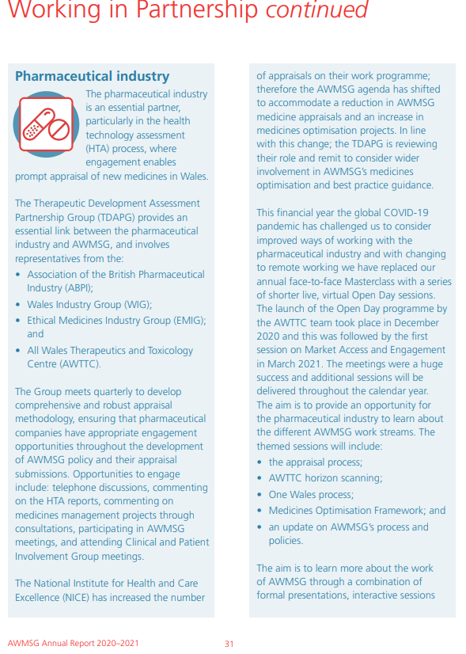
AWMSG Annual Report 2020-2021
https://awttc.nhs.wales/files/awmsg/awmsg-annual-reports/awmsg-annual-report-2020-2021/

Slide 21






Commercial Medicines Access Team (CMAT)
Multi-organisational team NHSWales.CA@Wales.nhs.uk

Slide 22









Commercial Medicines Access Team
Providing support to NHS Wales

Slide 23
Commercial Arrangements
Includes:
Patient Access Schemes
Other Commercial Agreements
Managed as:
Local – data and claims managed by the HB or Trust
Hybrid – CMAT support data management but HB or Trust manage claims
Central – CMAT manage both data and a single invoice claim on behalf of the HBs and VCC for NHS Wales

Slide 24
The Impact of a Commercial Arrangement on timely Patient Access
Simple PAS
Commercial arrangement
Letter from supplier with price confirmation
CMAT load ready into restricted VAULT workspace
FAD published
CMAT immediately transfer FAD and PAS information into the “live” reference tool for all HBs and VCC
Local implementation plans completed within 60 days
Medicine available to prescribers and patients
Early engagement with CMAT
Options regarding the CA and implications for NHS Wales
Draft CA from supplier shared with CMAT
Review and negotiations completed between CMAT and supplier
All legal and financial issues are considered and agreed
Final draft agreement reviewed by both parties from a legal perspective
Final CA signed by both parties in readiness for FAD
Repeat Simple PAS steps 2 to 6
Delay engagement with CMAT
Initial CA discussions and options considered
Draft CA from supplier shared with CMAT
Review and negotiations completed between CMAT and supplier
All legal and financial issues are considered and agreed
Final draft agreement reviewed by both parties from a legal perspective
Final CA signed by both parties
Repeat Simple PAS steps 2 to 6
No Delay Minimum Delay Maximum Delay

Slide 25
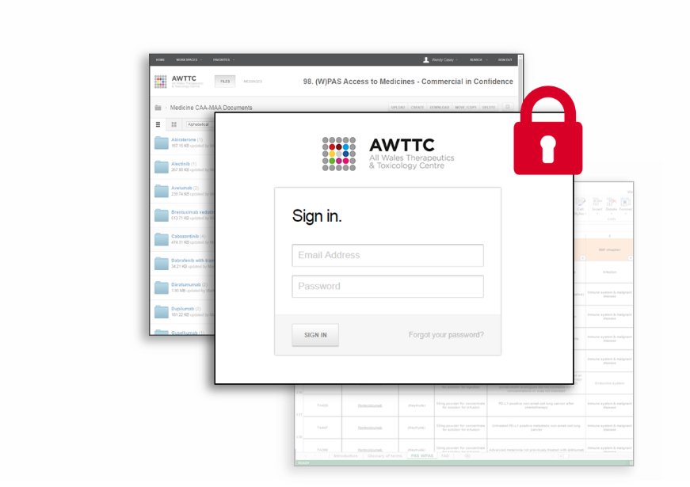
AWTTC- VAULT
A secure online repository managed by AWTTC
A role-based permission system to control access
Trusted process to support NHS Wales

Slide 26
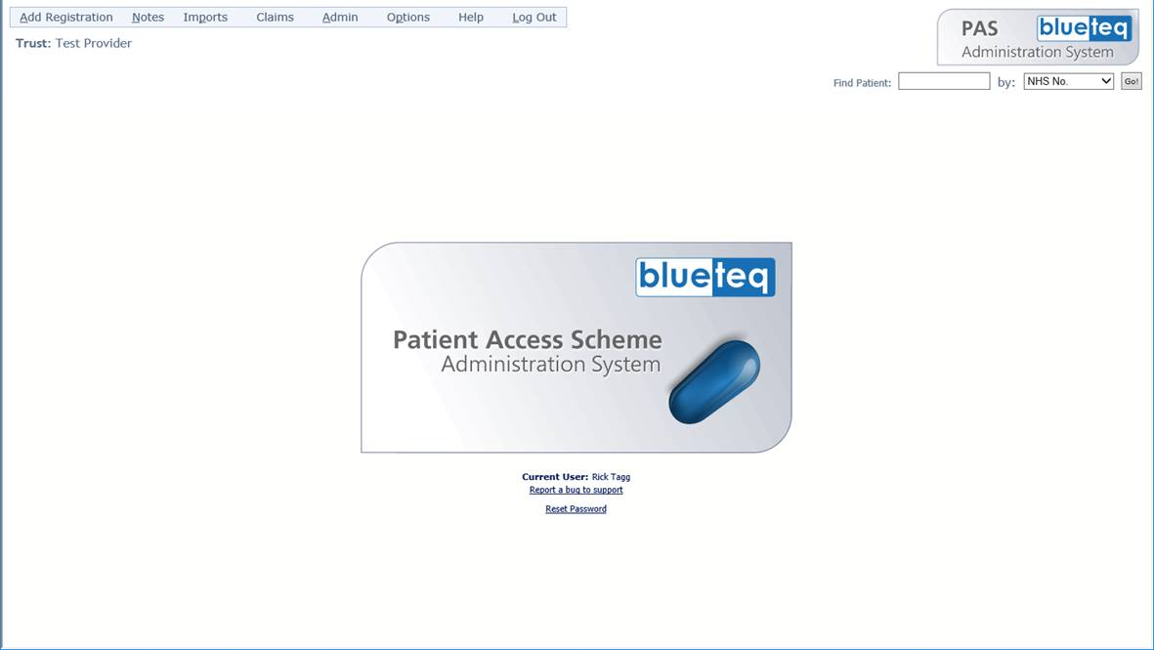
Blueteq Patient Access Scheme Administration System
Monthly audit on Simple Patient Access Schemes
Exception reports created for Health Boards and Velindre Cancer Centre
Early alert to potential non-compliance with agreed pricing (PAS or contract price)

Slide 27
Welsh Health Specialised Services Committee (WHSSC)/ Blueteq High Cost Drugs System
The Blueteq High Cost Drugs (HCD) software programme was procured for Wales by the Welsh Health Specialised Services Committee (WHSSC) and Welsh Government in 2019, to support the implementation of advanced therapy medicinal products (ATMPs) commissioned through WHSSC, as supported by the ATMP Programme Board.
This will support NHS Wales to prescribe and manage the ever-increasing complexities associated with these high-cost therapies. Since August 2020, one of the Medicine Access and Efficiency project managers has been seconded on a part time basis to manage the development and implementation of the WHSSC Blueteq HCD system.

Slide 28
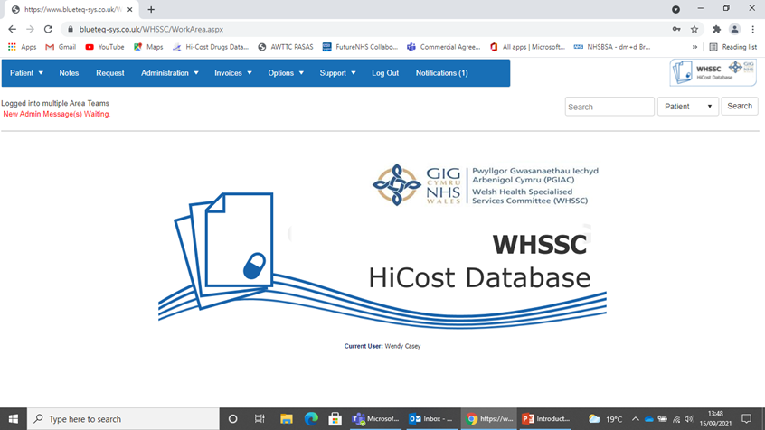
What is the Blueteq High Cost Drugs (HCD) system?
The Blueteq HCD system is used to authorise NICE and AWMSG approved high cost drugs for treatment across a range of disease conditions.
The system was procured for NHS Wales by WHSSC and Welsh Government in 2019 to support the implementation of all HCDs commissioned by WHSSC.

Slide 29
Blueteq HCD system…….next steps
Roll-out across Health Boards and Velindre Cancer Centre
All Wales Steering Committee in place to sign off approval forms for system inclusion
Each Health Board looking at a specific therapeutic area for central consideration
Regular NHSE liaison to ensure parity where possible

Slide 30
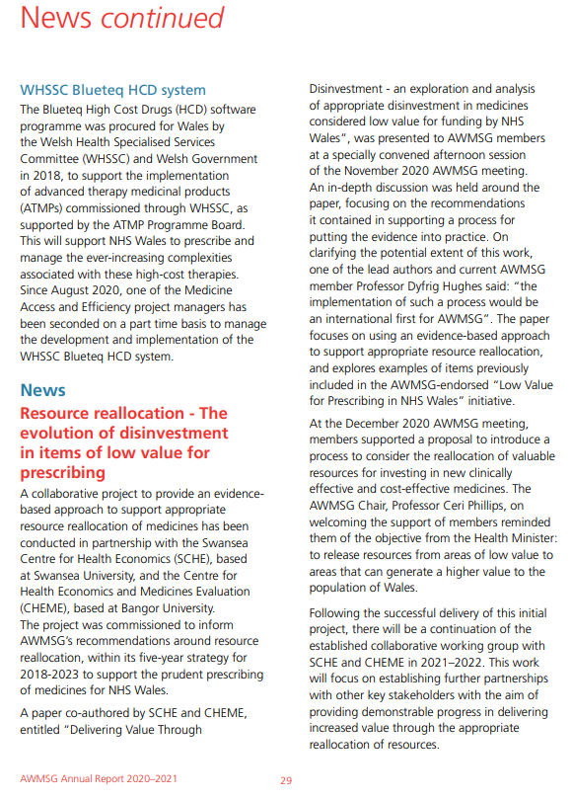
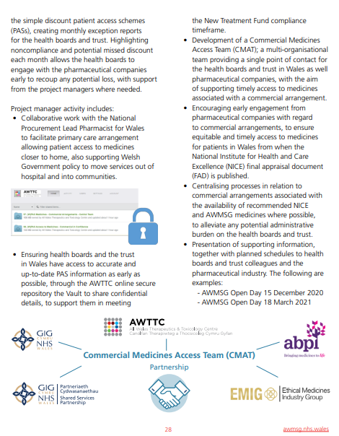
https://awttc.nhs.wales/files/awmsg/awmsg-annual-reports/awmsg-annual-report-2020-2021/

Slide 31
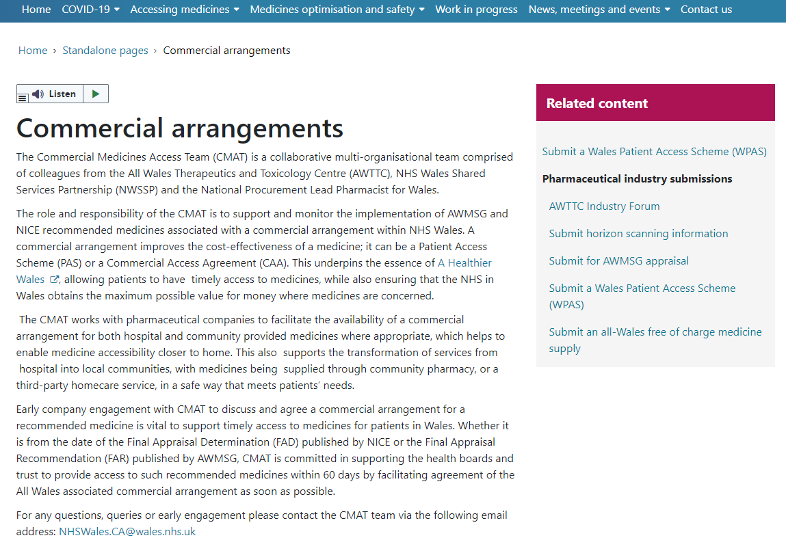
https://awttc.nhs.wales/standalone-pages/commercial-arrangements/

Slide 32
Diolch yn fawr - Thank you
NHSWales.CA@Wales.nhs.uk

Slide 33


Slide 34
Next Session……
Thursday 23rd June

