Slide 1
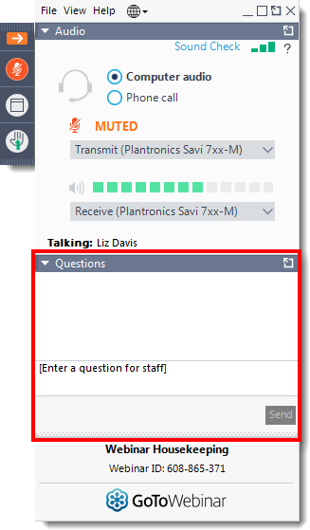
Today’s webinar
Questions
Please submit your questions to the speakers via the question function
Quiz
We will be hosting an interactive quiz on slido so please keep your mobile phone ready!

Slide 2

Market Access and
Early Engagement
‘How can we ensure timely access to medicines for people in Wales?’

Slide 3
Overview
Market access and early engagement – an overview
Steph Francis
Statements of advice (SOA)
Rosie Spears
Commercial arrangements (CA)
Wendy Casey, Tanya Bateman & Kath Haines

Slide 4
Market Access and
Early Engagement
‘How can we ensure timely access to medicines for people in Wales?’

Slide 5


Join at slido.com
#9460

Slide 6
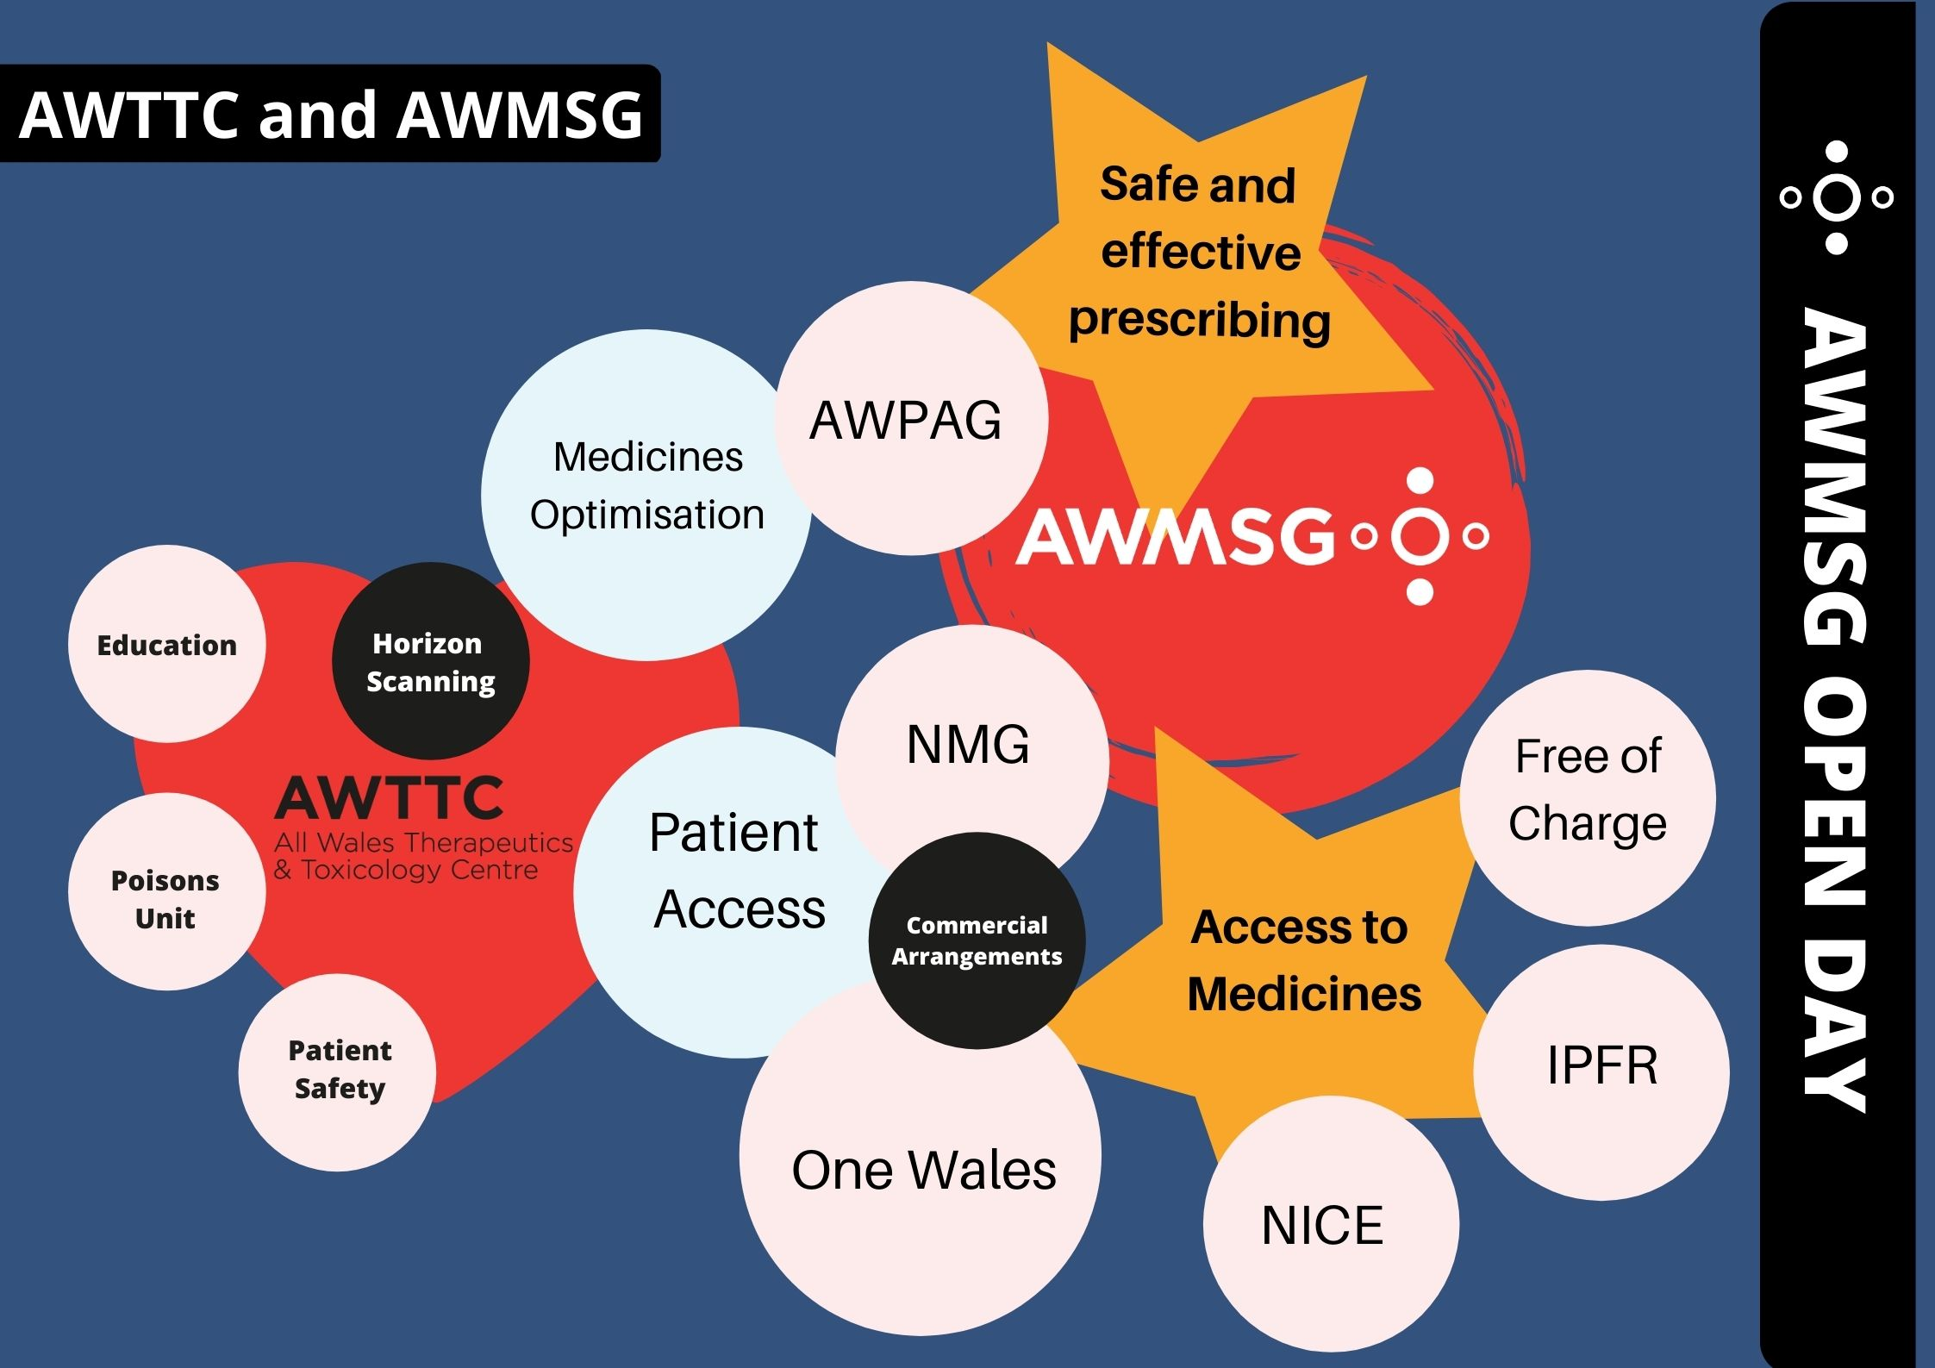

Slide 7

Timelines for Engagement
Medicine Available for use in NHS Wales
SOA
Marketing Authorisation
AWMSG/NICEApproval
PII/PIII trials
CHMP opinion
Horizon Scanning
Form A
Form B/C
Commercial
arrangements

Slide 8
Timelines for Engagement
Medicine Available for use in NHS Wales
SOA
PII/PIII trials
CHMP opinion
Marketing Authorisation
AWMSG/NICEApproval
Horizon
Scanning
Form A
Form B/C
Commercial
arrangements

Slide 9


Early Engagement
AWTTC Horizon Scanning
To gather information about new medicines 12-18 months ahead of licence.
To support the AWMSG appraisal work programme
To identify high budget impact and high service impact medicines to assist in service planning.
We encourage pharmaceutical industry to inform AWTTC as soon as the estimated regulatory timings have been confirmed.
Information about new medicines and new licensed indications should be shared via UK PharmaScan or the AWTTC VAULT.

Slide 10
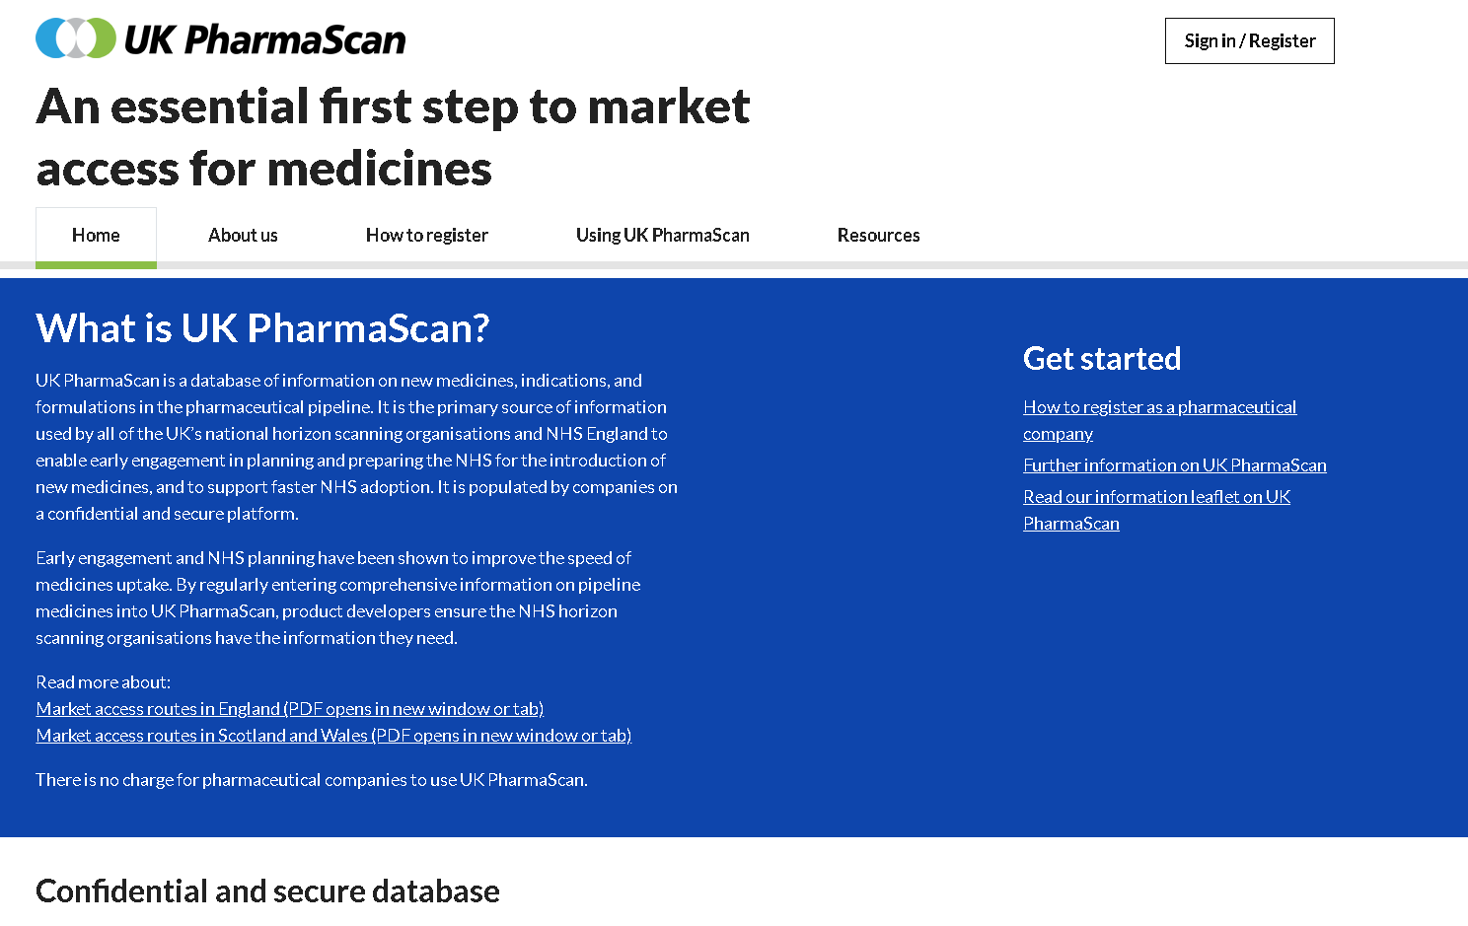
https://www.ukpharmascan.org.uk/

Slide 11


Early Engagement
Initial appraisal submission (Form A)
Should be submitted on receipt of positive CHMP opinion
Assists AWTTC in determining whether a medicine meets the criteria for appraisal
Enables AWTTC to gather useful information to assist in horizon scanning
Ensures AWTTC identify which medicines are likely to have a WPAS/PAS
Provides AWTTC with information regarding NICE timelines.

Slide 12
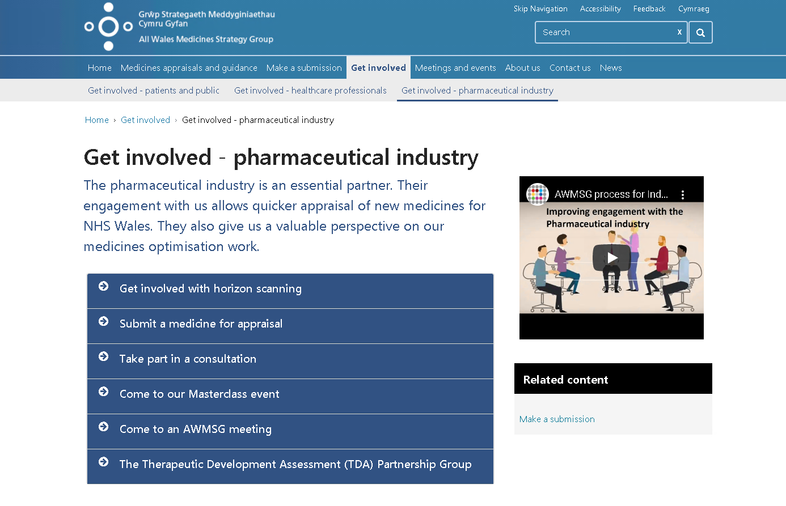
https://awmsg.nhs.wales/get-involved/get-involved-pharmaceutical-industry/
https://youtu.be/HNHTQ_4Ivhk

Slide 13
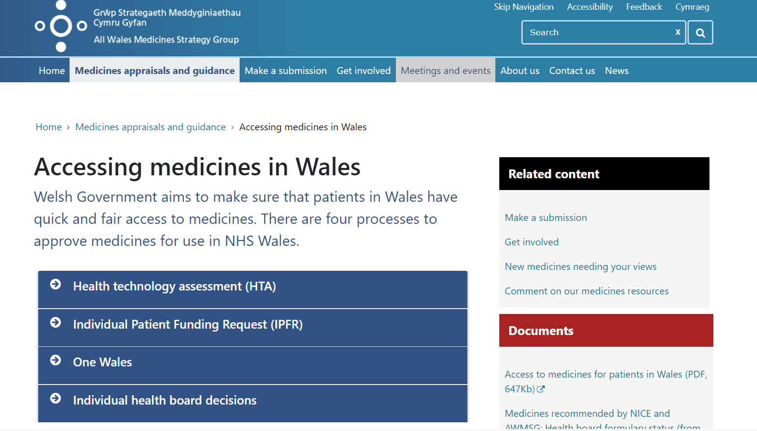
https://awmsg.nhs.wales/medicines-appraisals-and-guidance/accessing-medicines-in-wales/

Slide 14
Timelines for Engagement
Medicine Available for use in NHS Wales
SOA
PII/PIII trials
CHMP opinion
Marketing Authorisation
AWMSG/NICEApproval
Horizon
Scanning
Form A
Form B/C
Commercial
arrangements

Slide 15
What is a Statement of Advice?
Generic name (Trade name®) Formulation
Name of applicant company
Month Year
Statement of Advice In the absence of a submission from the holder of the marketing authorisation, generic name (Trade name®) cannot be endorsed for use within NHS Wales for the treatment of full indication.

Slide 16
How do we arrive at an SOA?
Positive
CHMP opinion
NICE due within 12 months of licence?
Yes
Excluded
No
Form A requested
SOA issued
3 months after marketing authorisation granted
No response from company
Excluded
Form A received
Submission for appraisal by AWMSG requested
AWMSG appraisal
Submission received
Company do not provide a submission

Slide 17
Reasons for company non-engagement

Slide 18
Thank you

Slide 19


Slide 20
Timelines for Engagement
Medicine Available for use in NHS Wales
SOA
PII/PIII trials
CHMP opinion
Marketing Authorisation
AWMSG/NICEApproval
Horizon
Scanning
Form A
Form B/C
Commercial
arrangements

Slide 21
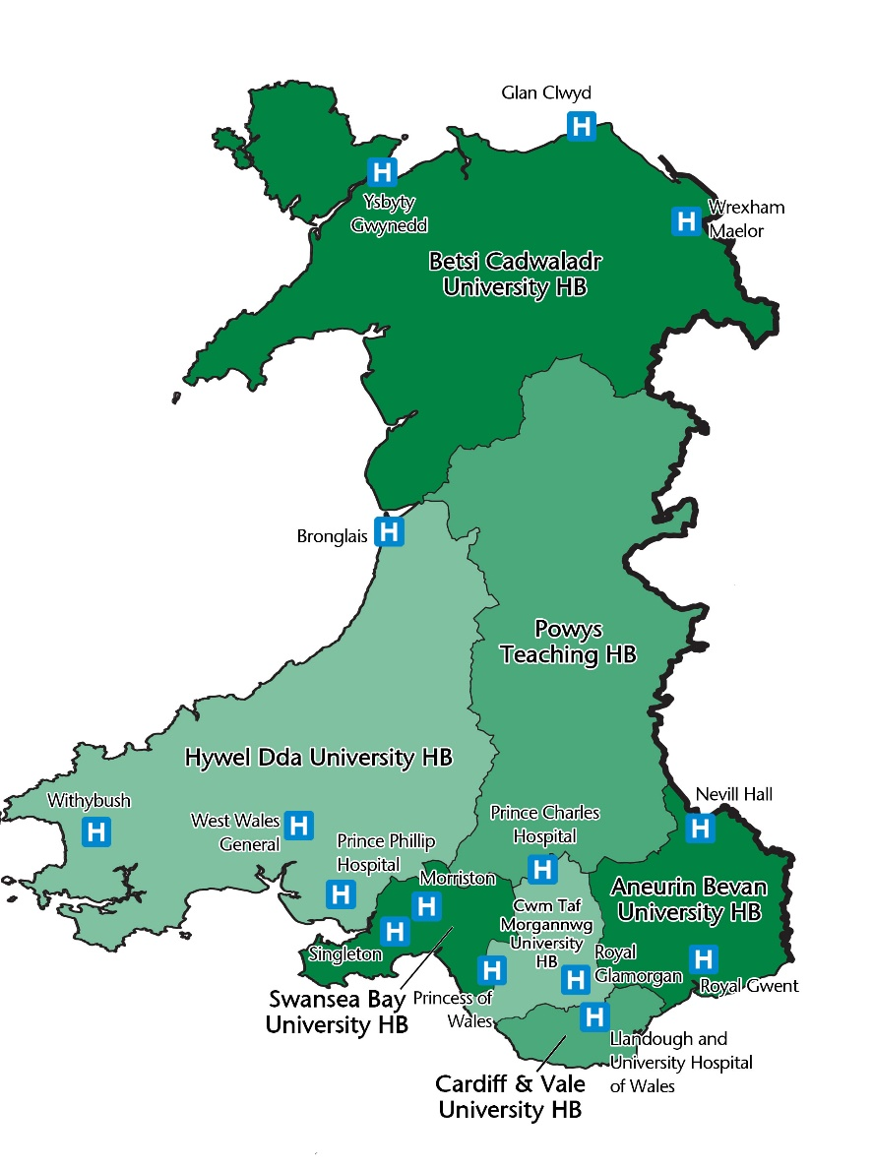
Invest to Save Project
  September 2017 to April 2020
  Successful AWTTC Collaborative All Wales project: to ensure effective implementation of Patient Access Schemes across Wales.
  Outcome: Two permanent Medicine Access & Efficiency project managers appointed

Slide 22






Commercial Medicines Access Team (CMAT)
Multi-organisational team NHSWales.CA@Wales.nhs.uk

Slide 23



CMAT Strategic Aim
A Healthier Wales
Prudent health care principles
Pharmacy: Delivering a Healthier Wales
Simple PAS
Commercial arrangements:
Local – data and claims managed by the HB or Trust
Hybrid – CMAT support data management but HB or Trust manage claims
Central – CMAT manage both data and a single invoice claim on behalf of the HBs and VCC for NHS Wales

Slide 24









Commercial Medicines Access Team
Providing support to NHS Wales

Slide 25
The Impact of a Commercial Arrangement on timely Patient Access
Simple PAS
Commercial arrangement
Letter from supplier with price confirmation
CMAT load ready into restricted VAULT workspace
FAD published
CMAT immediately transfer FAD and PAS information into the “live” reference tool for all HBs and VCC
Local implementation plans completed within 60 days
Medicine available to prescribers and patients
Early engagement with CMAT
Options regarding the CA and implications for NHS Wales
Draft CA from supplier shared with CMAT
Review and negotiations completed between CMAT and supplier
All legal and financial issues are considered and agreed
Final draft agreement reviewed by both parties from a legal perspective
Final CA signed by both parties in readiness for FAD
Repeat Simple PAS steps 2 to 6
Delay engagement with CMAT
Initial CA discussions and options considered
Draft CA from supplier shared with CMAT
Review and negotiations completed between CMAT and supplier
All legal and financial issues are considered and agreed
Final draft agreement reviewed by both parties from a legal perspective
Final CA signed by both parties
Repeat Simple PAS steps 2 to 6
No Delay Minimum Delay Maximum Delay

Slide 26
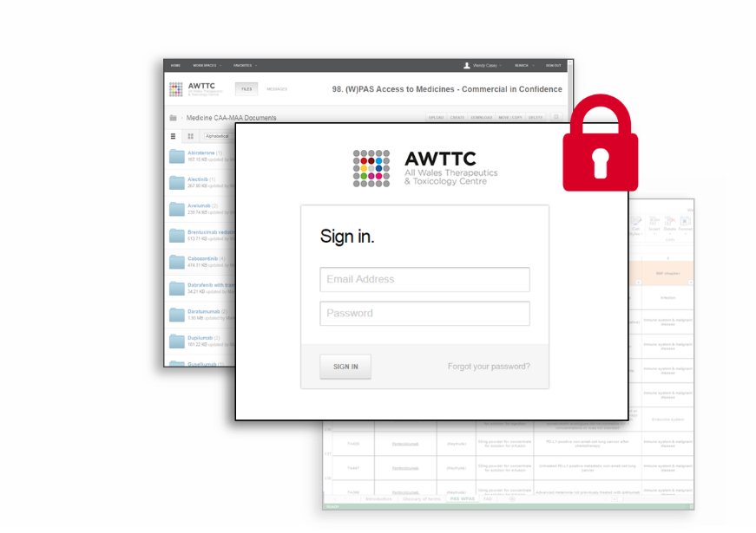
AWTTC- VAULT
A secure online repository managed by AWTTC
A role-based permission system to control access
Trusted process to support NHS Wales

Slide 27
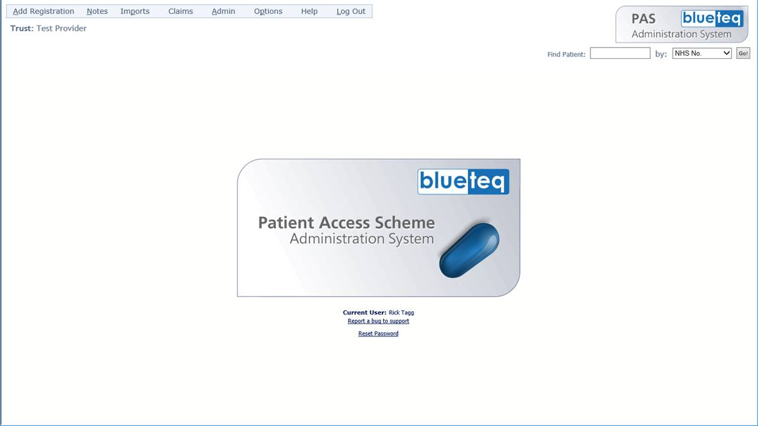
Blueteq Patient Access Scheme Administration System
Monthly audit on Simple Patient Access Schemes
Exception reports created for Health Boards and Velindre Cancer Centre
Early alert to potential non-compliance with agreed pricing (PAS or contract price)

Slide 28
Diolch yn fawr - Thank you
NHSWales.CA@Wales.nhs.uk

Slide 30
Next Session……
Thursday 10 June
Appraisal (1) Process timelines and updates
Making a good submission
Join at slido.com
#9460

Slide 31
Thank you

