Slide 1
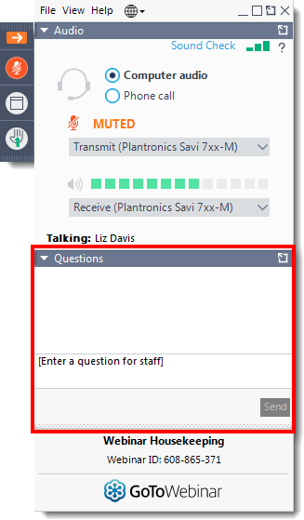
Today’s webinar
Questions
Please submit your questions to the speakers via the question function
Quiz
We will be hosting an interactive quiz on slido so please keep your mobile phone ready!

Slide 2

Overview
One Wales Medicines Process
Rosie Spears
Medicines Optimisation: Our recent work
Tom Curran
Q&A
AWTTC team

Slide 3
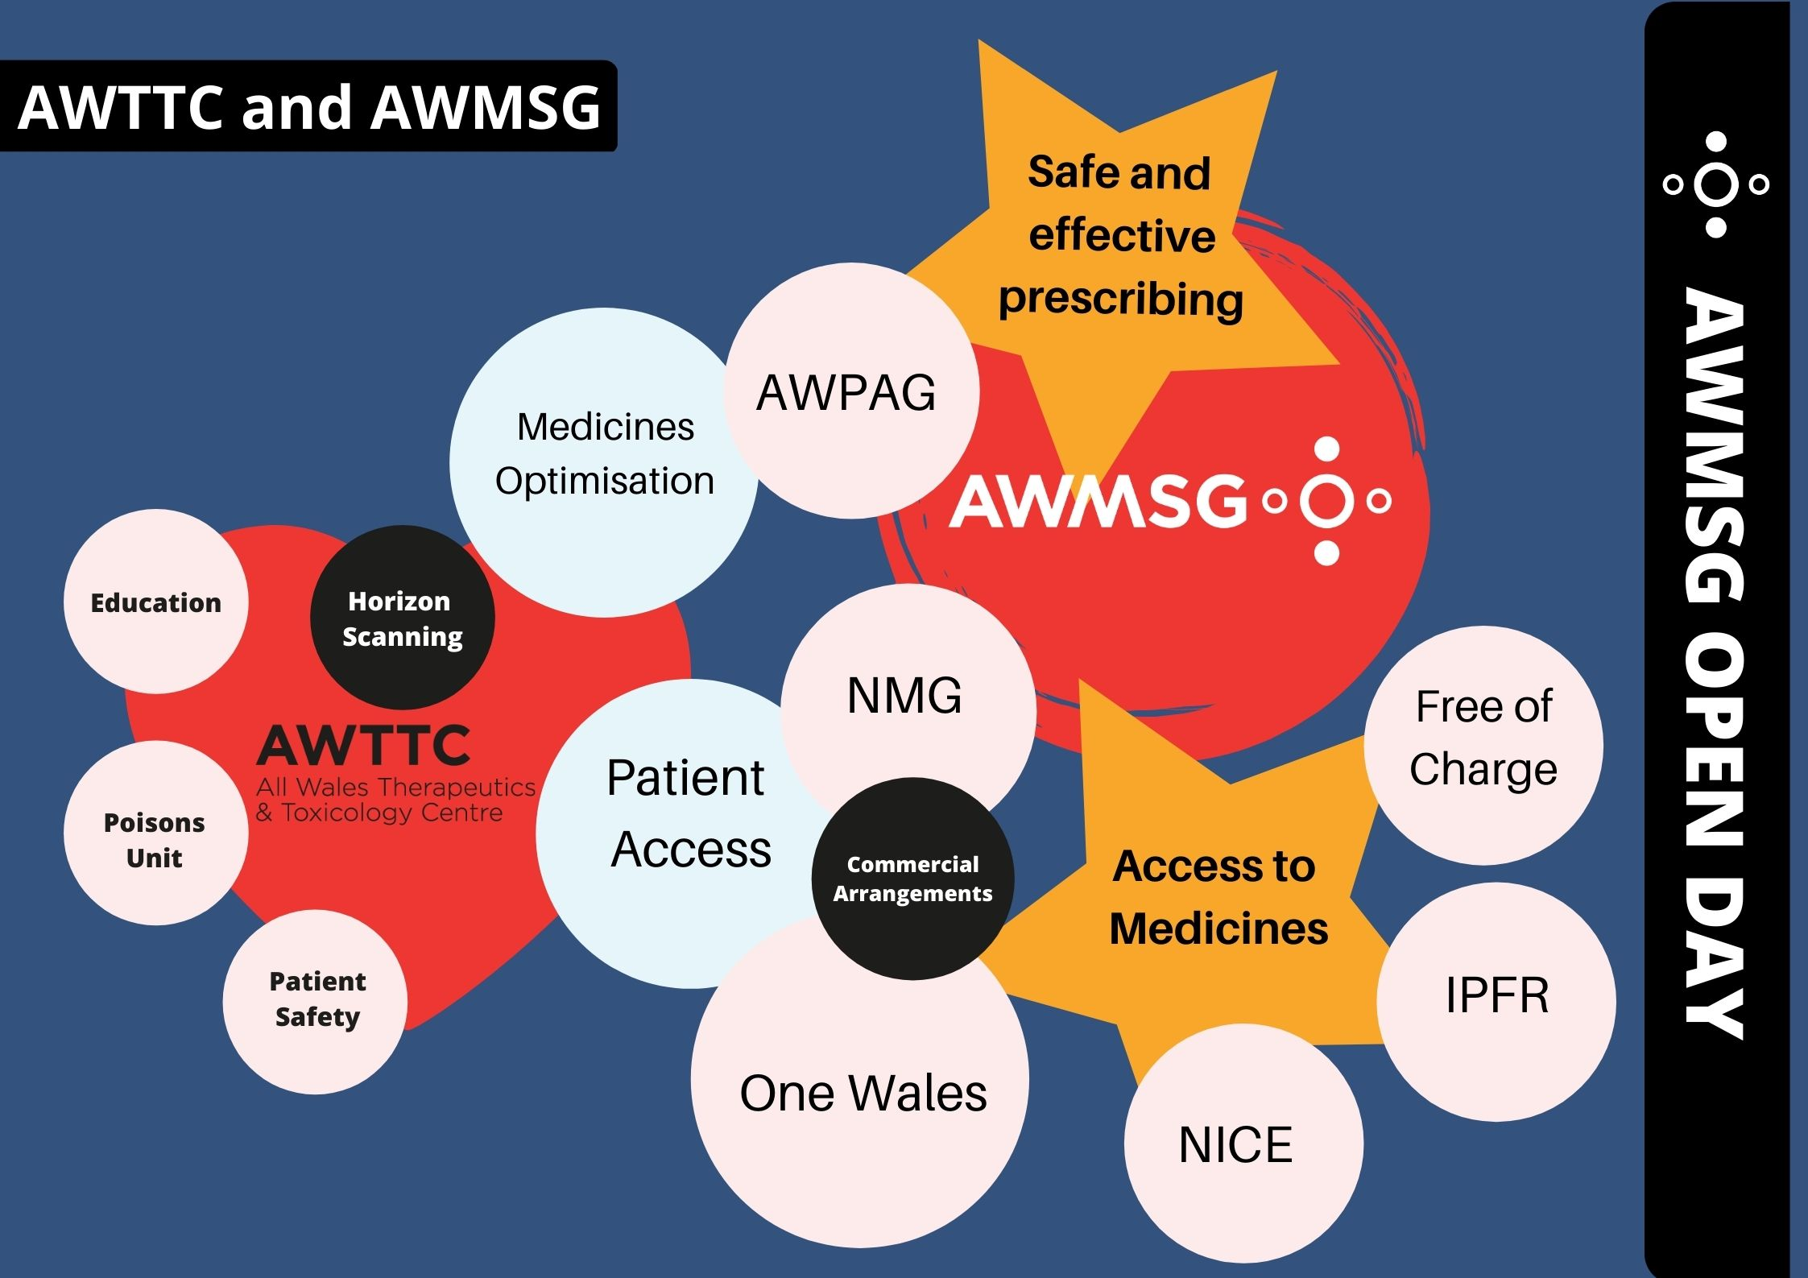

Slide 4
One Wales Medicines Process
One Wales team, AWTTC

Slide 5
This session will cover
Who we are
Why we have a One Wales process
How the process fits in with other routes of access in Wales
Who can engage with the process
How the process works
Industry involvement
Review process

Slide 6

Who we are
Gail Woodland – Senior Pharmacist, Team Leader
Rosie Spears, Katherine Chaplin and Clare Elliott – Senior Scientists
Carolyn Hughes, Rachel Jonas and Bridget-Ann Kenny – Scientists
Laura Phillips – Administrative support

Slide 7

Why we developed the One Wales medicines process
In an absence of health technology assessment (HTA) advice Individual Patient Funding Requests (IPFRs) are used to access treatments not routinely funded
The IPFR process is not appropriate for cohorts of patients with the same clinical presentation
The One Wales Medicines process enables access to medicines where there is an unmet clinical need for a cohort of clearly defined patients
Notes:
For patient cohorts there has been potential for inequity of access between health boards

Slide 8
Routes of Access in Wales
IPFR
AWMSG
One Wales
HTA Appraisal
Access to Medicines
NICE
Free of Charge
EAMS

Slide 9
Treatments may be licensed or unlicensed
For licensed medicines advice is interim to HTA advice and a submission to AWMSG or NICE is expected.
For off-label/unlicensed medicines there must be no licensed medicine routinely available that will meet the patients’ needs and:
  the medicine is not licensed for the indication of interest; OR
  the requested use of the medicine is outside of
  accepted treatment pathway
Notes:
Licensed meds One Wales allows time for additional clinical or cost effectiveness data to be collected
Outside treatment pathway = i.e. the specific sequence of treatment/s has not been approved by NICE/AWMSG

Slide 10

How we choose medicines for One Wales
Medicines are identified by intelligence from All Wales IPFR data, Health Board IPFR panels, WHSSC, Chief Pharmacists or clinical experts
The process is not driven by pharmaceutical companies and is not a substitute for full HTA of licensed medicines
The work programme is agreed with the AWMSG Steering Committee
Notes:
A medicine request form is available to download from the AWTTC website

Slide 11
The Process
AWTTC perform literature search and collate all evidence to prepare a draft Evidence Status Report which is forwarded to MA holder and clinicians for comment
One Wales Medicines Assessment Group (OWMAG) convened.
Final ESR and recommendation from the group forwarded NHS Wales Chief Executive Management Team (CEMT)
Following CEMT endorsement NHS Wales and MA holder informed of the OW Wales decision
Medicine and patient cohort identified and meets criteria for One Wales process
Marketing authorisation holder contacted to request best available evidence. Relevant clinician and patient groups to input into the process. MA holder requested to submit a commercial arrangement (if applicable)
One Wales decision displayed on the AWTTC website
Notes:
Approval to proceed sought from AWMSG Steering committee.
MA holder expected to provide clinical and cost effectiveness evidence and a commercial arrangement if OW is interim to HTA for a licenced medicine.
ESR may be updated in light of comments received, particularly for areas of uncertainty highlighted by AWTTC
Final decision also disseminated on the pharmacy forum SHARE with standard wording for formulary pharmacists to add to local HB formularies.
DHCW add link to AWTTC website advice on formulary.

Slide 12


Join at slido.com
#9460
Notes:
Questions 1 and 2 here

Slide 13
Answers
For One Wales positive decisions, the medicine must be made available within 60 days of the Chief exec endorsement. False
However
Health boards should ensure the medicine or medicines is/are included on their formulary.
A medicine will only be considered through One Wales if there is no routinely funded alternative available. True
For off-label medicines. A routinely funded alternative is: a medicine appraised by NICE or AWMSG and received a positive recommendation or; not appraised due to appraisal criteria but listed on local formularies.
Notes:
One Wales medicines are not included in the New Treatment Fund

Slide 14
Industry involvement
For licensed medicines:
  Engage in a future NICE or AWMSG HTA
  Submit a confidential commercial arrangement
  Provide clinical and cost-effectiveness evidence and budget impact information
  Opportunity to develop and use a data collection tool and liaise with clinicians to implement data collection, and to collate outcome data for AWTTC
  Make comment on the draft ESR
For unlicensed medicines:
  Provide clinical and/or cost effectiveness evidence where available
  Inform AWTTC of new evidence or of plans to license an unlicensed medicine
  Make comment on the draft ESR
Notes:
A HTA submission is expected within a specified time, normally 12 to 18 months of the One Wales decision.
This maybe in the form of a simple discount or confirmation of any existing arrangements can be extended to the medicine/indication under consideration.

Slide 15
Join at slido.com
#9460
Notes:
Questions 3,4,5

Slide 16
Answers
A commercial arrangement cannot be offered if there is a pre-existing PAS for the licensed product - False
A commercial arrangement can be offered that is lower than any pre-existing schemes. The commercial arrangement will expire on subsequent receipt of ministerial ratification of AWMSG advice or publication of the NICE final appraisal document (FAD). All future arrangements should be in place on receipt of HTA advice.
A medicine being used off-label that subsequently receives a licence will continue to be made available through One Wales. - False
The company should inform AWTTC prior to licensing coming through. The medicine will remain available through One Wales for up to 18 months, until HTA advice is available

Slide 17
The One Wales review process
AWTTC requests new evidence, patient numbers and outcome data from clinicians and/or the MA holder
AWTTC produces a review report including any new evidence, guidelines, patient numbers and outcome data.
Using information included in the review report OWMAG reviews the decision and makes a recommendation to uphold the current recommendation or to re-assess the decision in the light of new evidence
The OWMAG review recommendation is sent to CEMT for endorsement
Once endorsed the review decision is communicated to NHS Wales and the MA holder and displayed on the AWTTC website.
Notes:
12 months after the first assessment and then every 1-3 years according to agreement by OWMAG. Internal review undertaken annually.

Slide 18

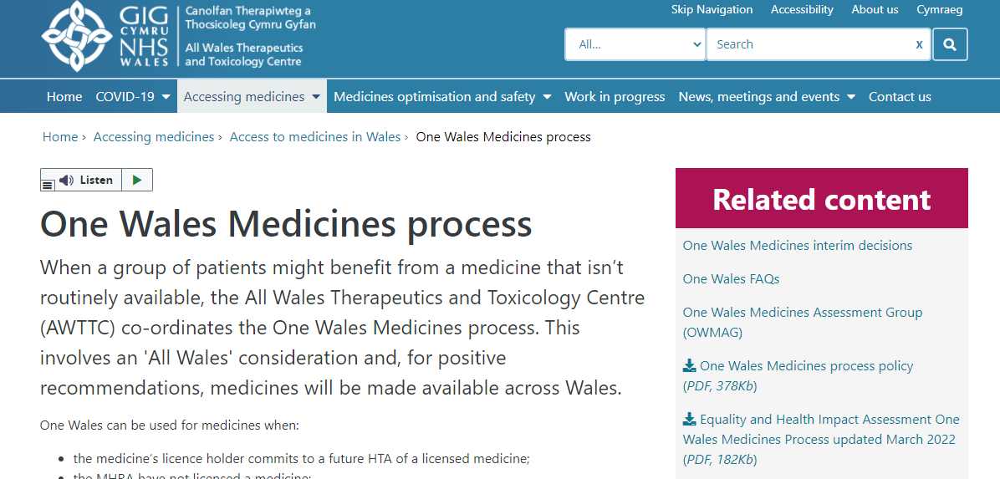
More information can be found here
https://awttc.nhs.wales/accessing-medicines/access-to-medicines-in-wales/one-wales-medicines-process/

Slide 19

Medicines Optimisation:
Our recent work
Tom Curran
Senior Scientist, AWTTC

Slide 20
Overview
Brief introduction to the development process
Summary of what we have published recently
The Medicines Optimisation work we have on the horizon
National Prescribing Indicators for 2022-23
Data analysis work – Inhaler decarbonisation dashboard

Slide 21
What do we mean by “medicines optimisation”?
Medicines optimisation is about ensuring that the right patients get the right choice of medicine, at the right time.
Supporting patients to:
  improve their outcomes
  take their medicines correctly
  avoid taking unnecessary medicines
  reduce wastage of medicines
  improve medicines safety.

Slide 22






Prescribing guidance
Patient information leaflets
Medicines Optimisation
Audit materials
Medication charts and records
National Prescribing Indicators
Prescribing
analysis

Slide 23
Overview of the process
Project proposal
Development
AWPAG
Consultation
AWPAG
AWMSG Steering Committee
AWMSG
AWPAG: All Wales Prescribing Advisory Group
AWMSG: All Wales Medicines Strategy Group

Slide 24
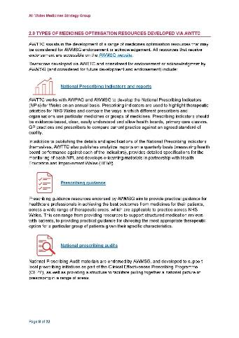

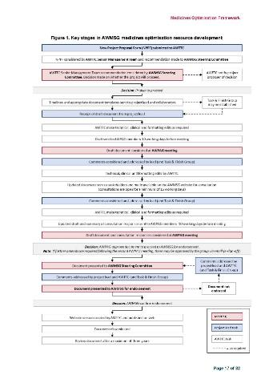
Medicines Optimisation Framework
What medicines optimisation means
The resources we produce
How new projects can be proposed
The development process
Consultations
Review of publications
Future work
AWTTC.nhs.wales
“Framework”

Slide 25

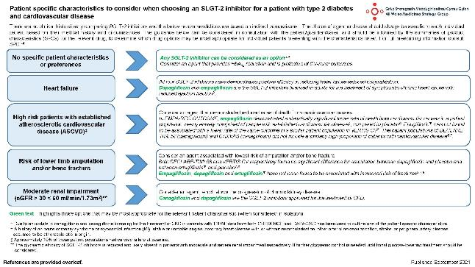
Some of our work in the last 12 months…
All Wales advice on SGLT-2 Inhibitors in type 2 diabetes and cardiovascular disease
review of the evidence for SGLT-2i use in T2DM in relation to cardiovascular and renal outcomes
prescribing recommendations on the role of SGLT-2 inhibitors in this patient population
One-page summary for HCPs choosing an SGLT-2 inhibitor

Slide 26

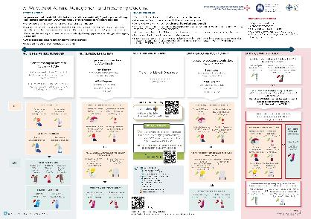

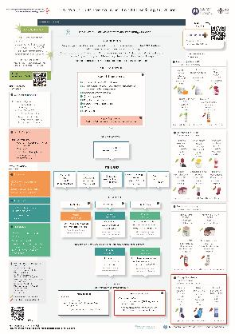
Some of our work in the last 12 months…
Management and prescribing guidelines – Asthma (adults) and COPD
Updated to encourage consideration of the decarbonisation agenda of NHS Wales
Environment impact associated with the use of inhalers – DPIs versus MDIs
More recent inhaler options also incorporated where appropriate

Slide 27

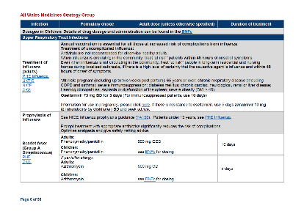

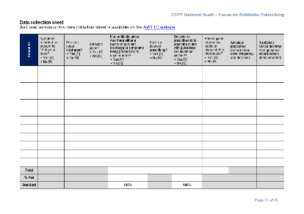


Some of our work in the last 12 months…
Antimicrobial guidelines and audit materials
Comprehensive advice on the antimicrobial management of common infections in primary
Reflects latest national guidance plus local pathogen and antimicrobial susceptibility data in Wales
Additional supporting guidelines focusing on C. diff and recurrent UTI also published

Slide 28

Some of our work in the last 12 months…
Tramadol educational resources
Update – review of current evidence and revision of information in the wider context of pain management (e.g. not appropriate for non-cancer pain)
Summary of prescribing data, link to useful resources, audit materials and information for patients

Slide 29

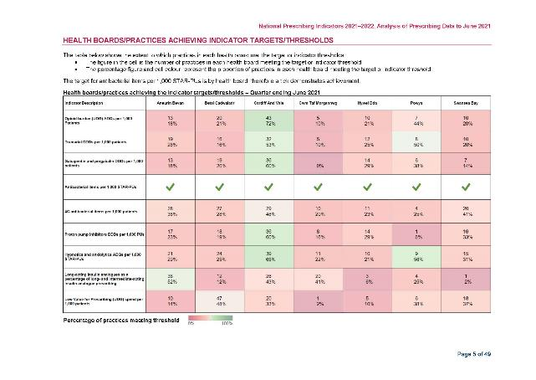

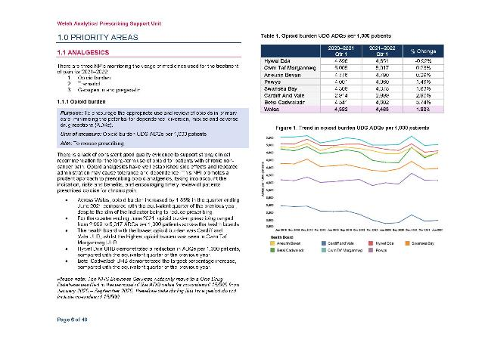
Some of our work in the last 12 months…
Routine reporting on
National Prescribing Indicators

Slide 30
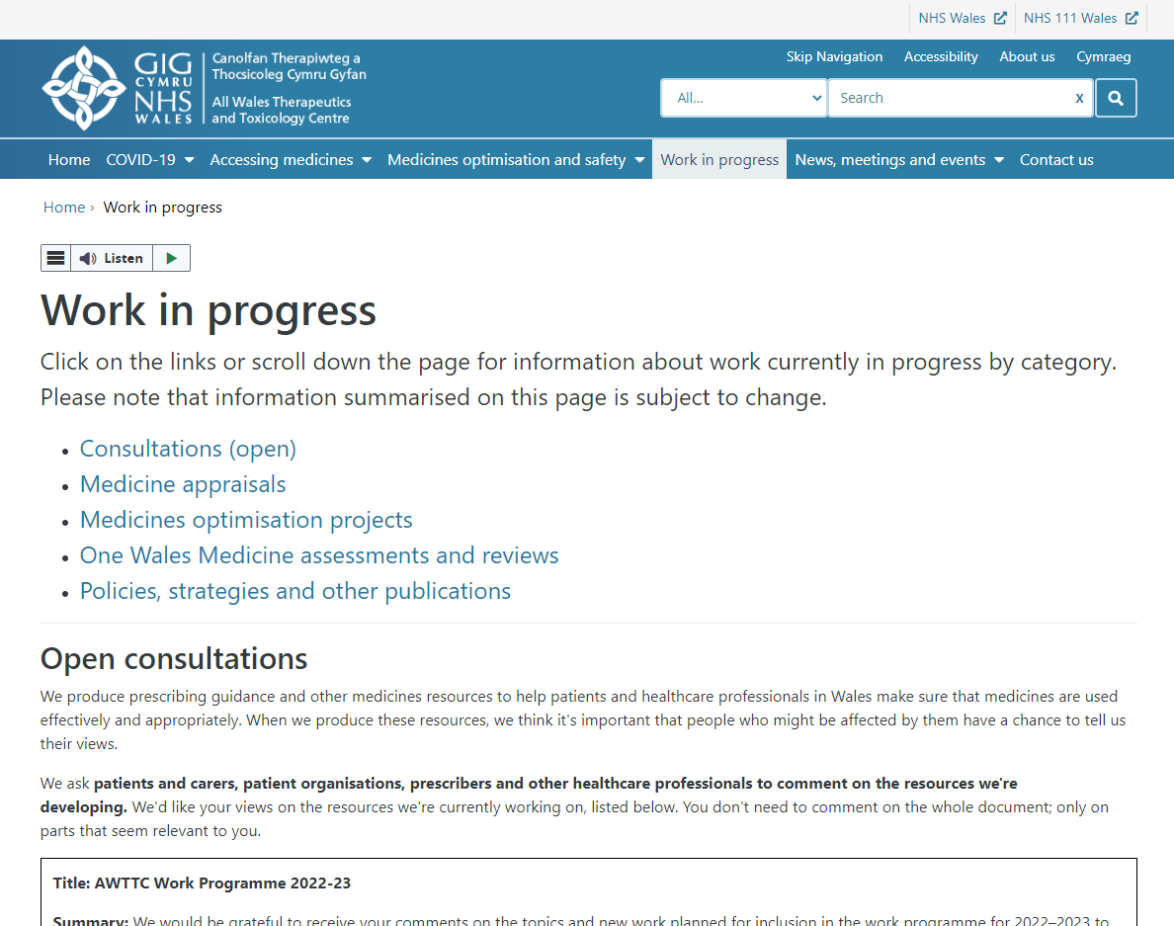
What’s coming up?
Care home medicines optimisation toolkit
All Wales chronic pain resources
Value-based prescribing
All Wales guidance for prescribing intervals (2022 update)
Polypharmacy – guidance for prescribing (2022 update)
Understanding unlicensed medicines

Slide 31


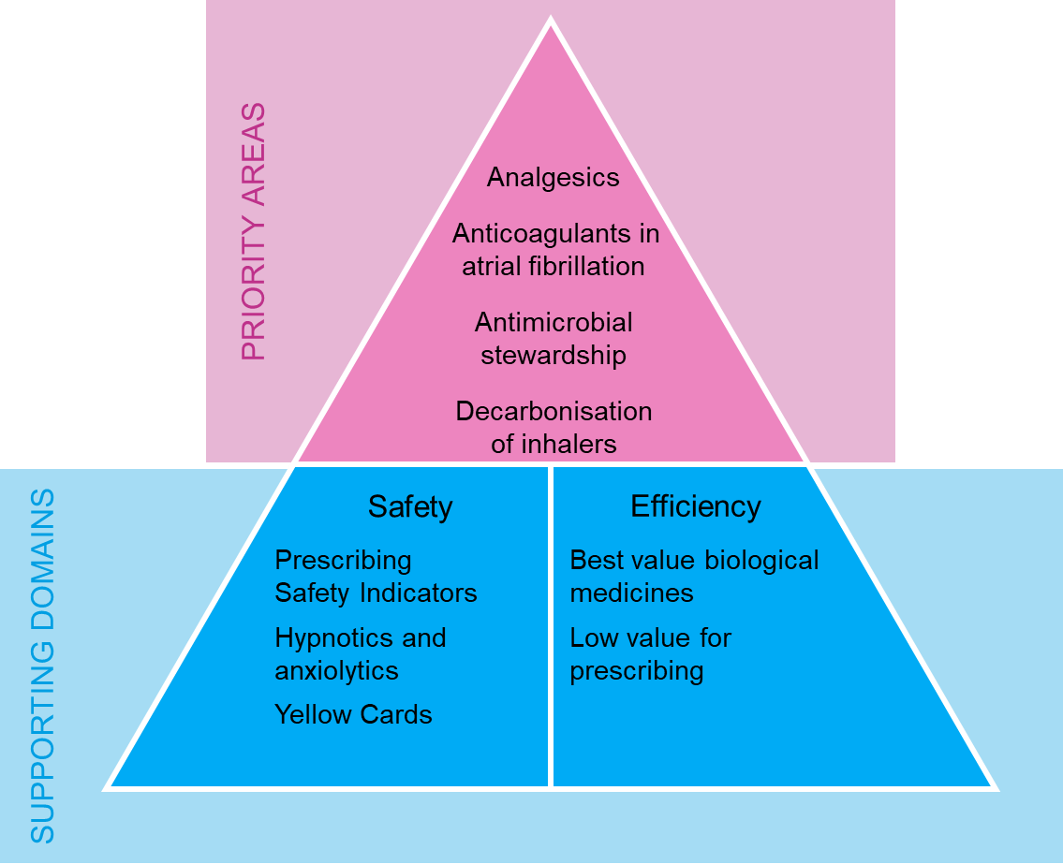

NPIs 2022-2023
“…used to highlight therapeutic priorities for NHS Wales and compare the ways in which different prescribers and organisations use particular medicines or groups of medicines.”

Slide 32
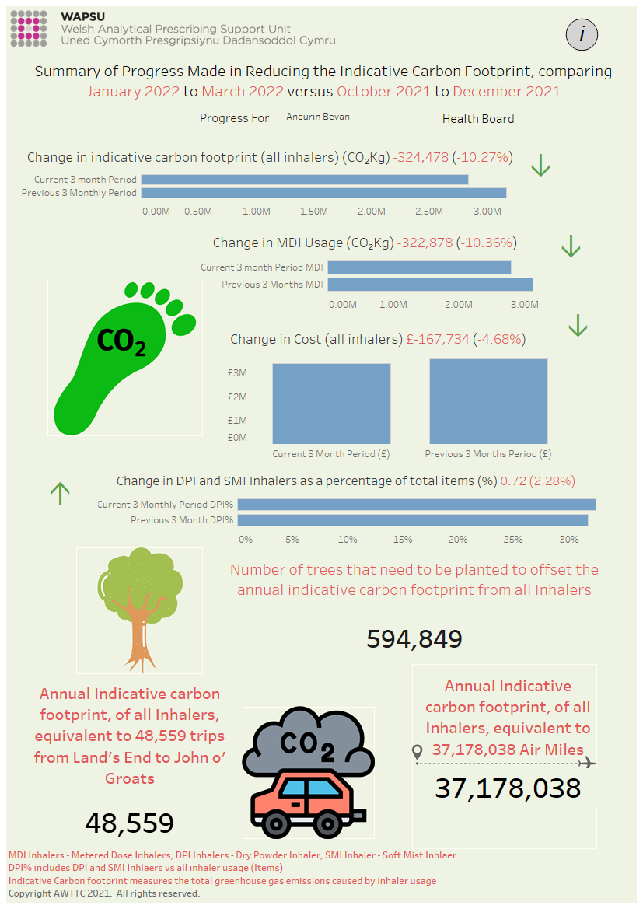
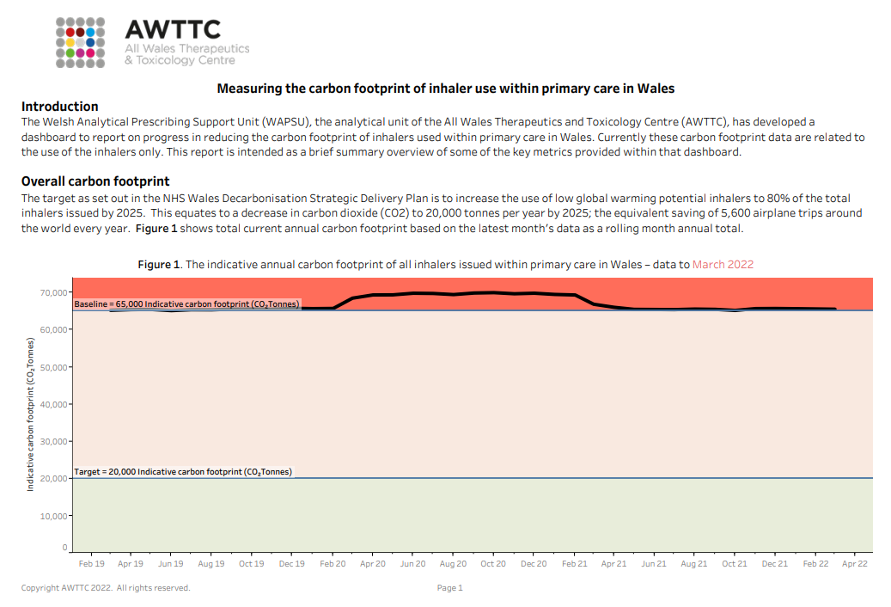
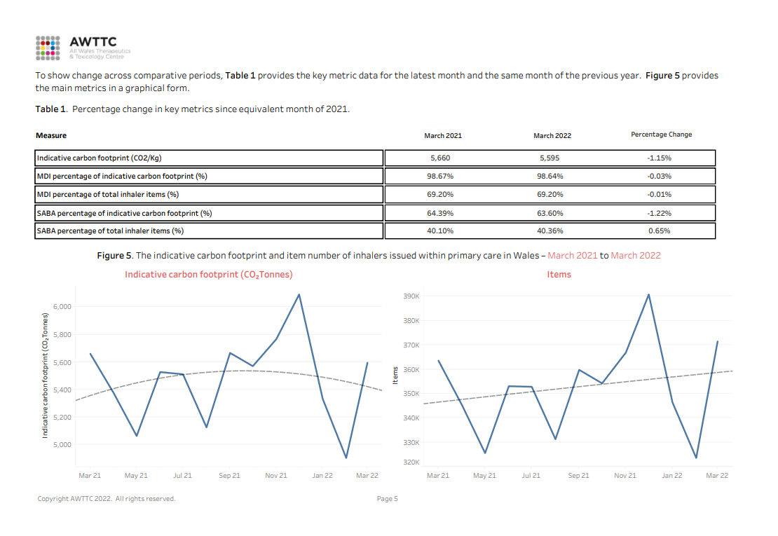
Data analysis work – Decarbonisation dashboard
Server for Prescribing Information Reporting and Analysis (SPIRA)
Monthly “NHS Wales inhaler carbon footprint reports” – openly available

Slide 33
Summary
Explore our resources and share your feedback
Submit project ideas
Get involved in our consultations
Thank you!
Diolch!

Slide 34


