Slide 1

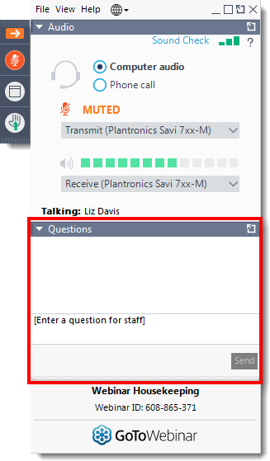
Today’s webinar
Questions
Please submit your questions to the speakers via the question function
Quiz
We will be hosting an interactive quiz on slido so please keep your mobile phone ready!

Slide 2
Appraisal Process II

Slide 3
Overview
An update on AWTTC communication and engagement
Ruth Lang
The appraisal process – A quick recap of key points
Steph Francis
Process for appraising medicines licensed for use in children
Claire Ganderton and Kelly Wood
Q&A session

Slide 4
An update on AWTTC
Ruth Lang

Slide 5

2021
2002

Slide 6
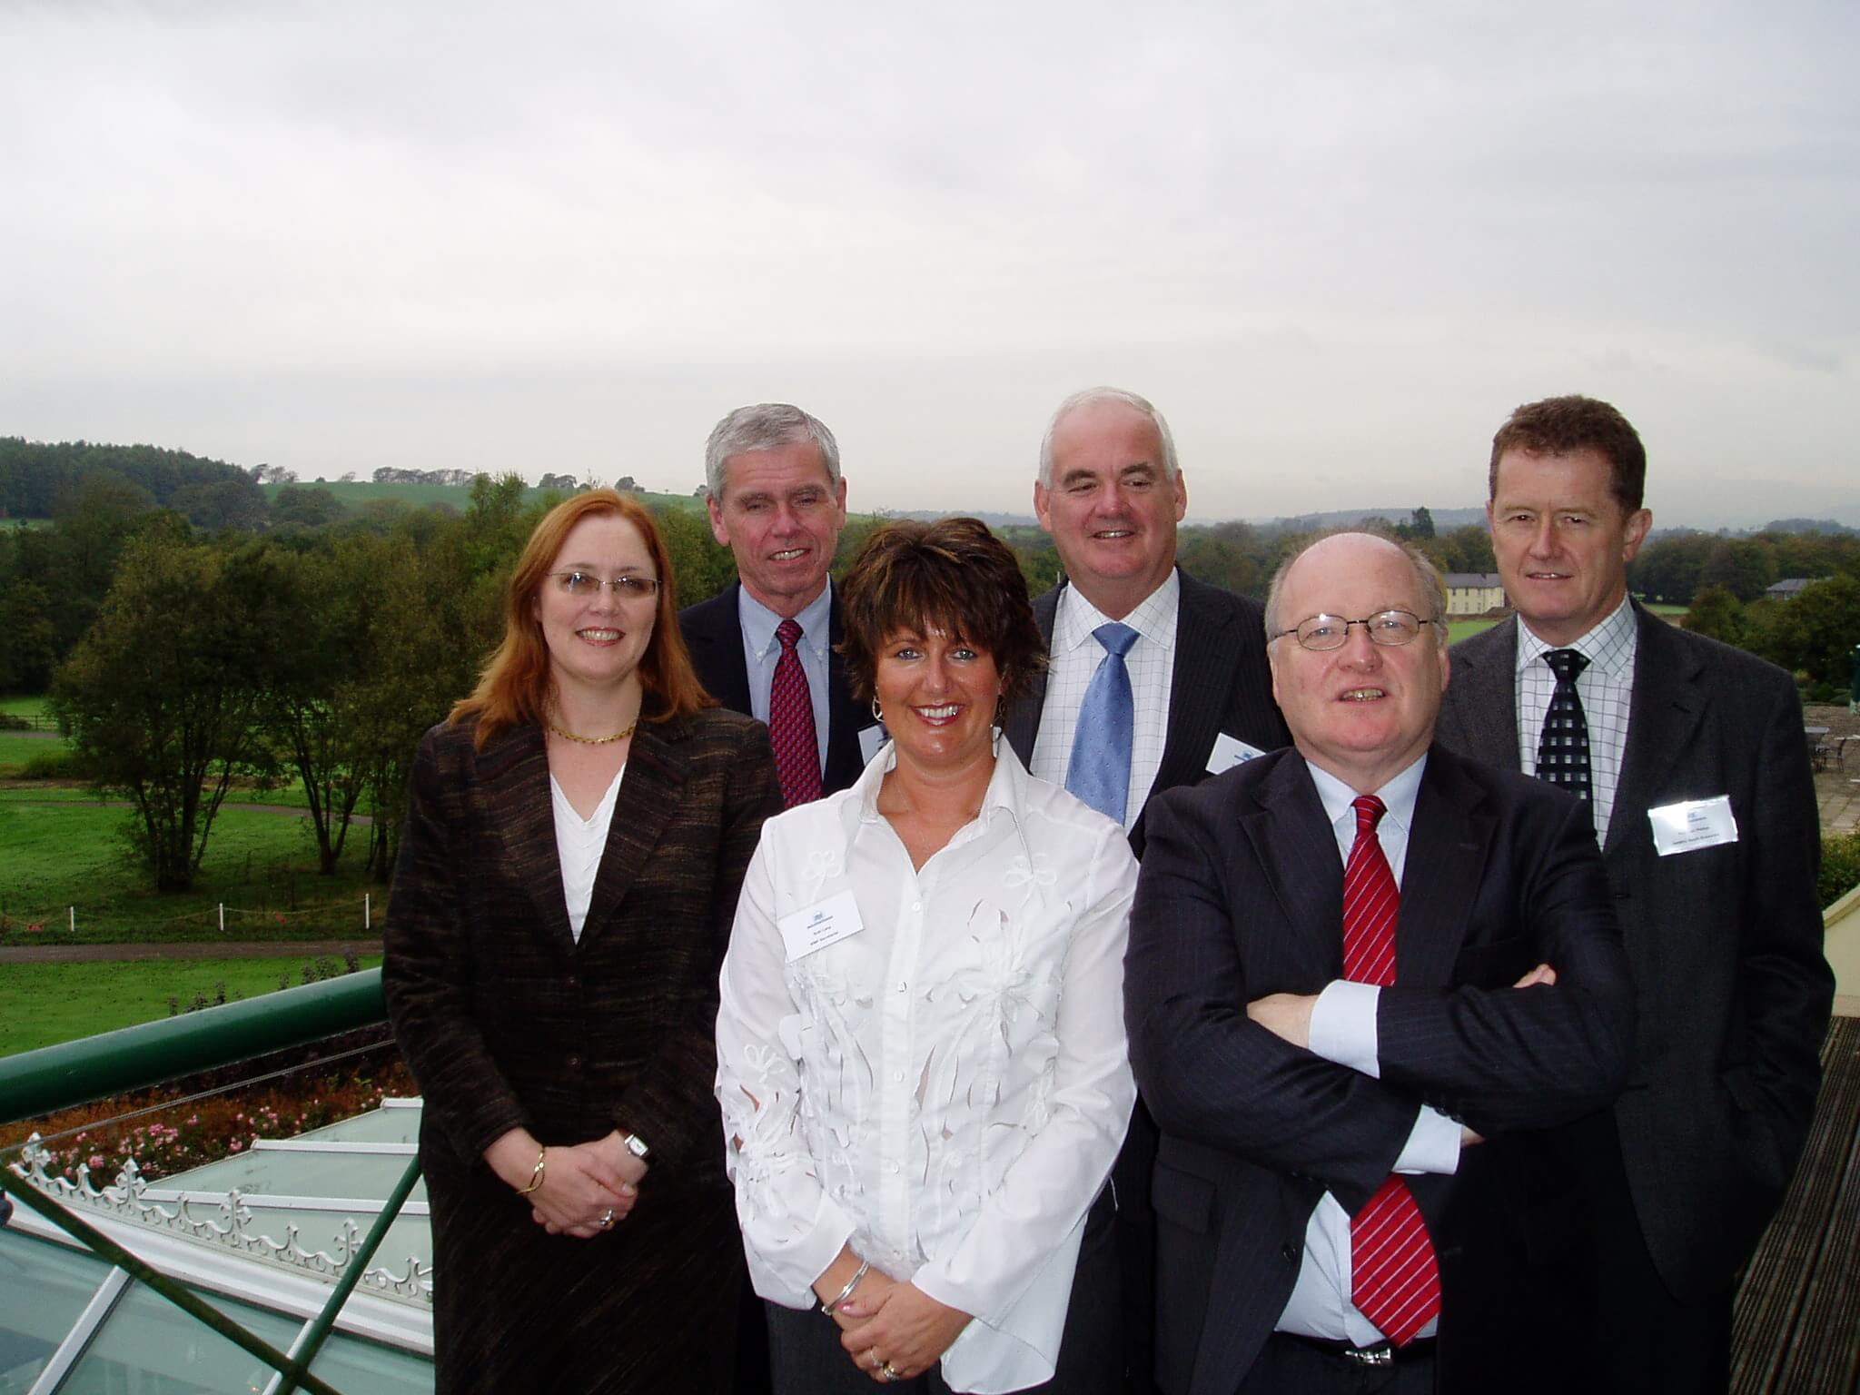
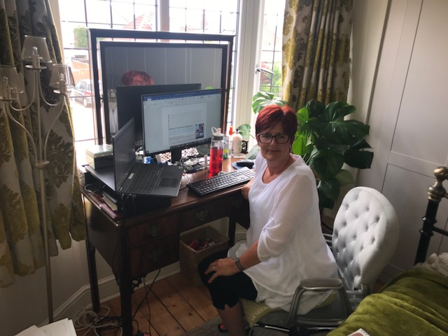

Slide 7

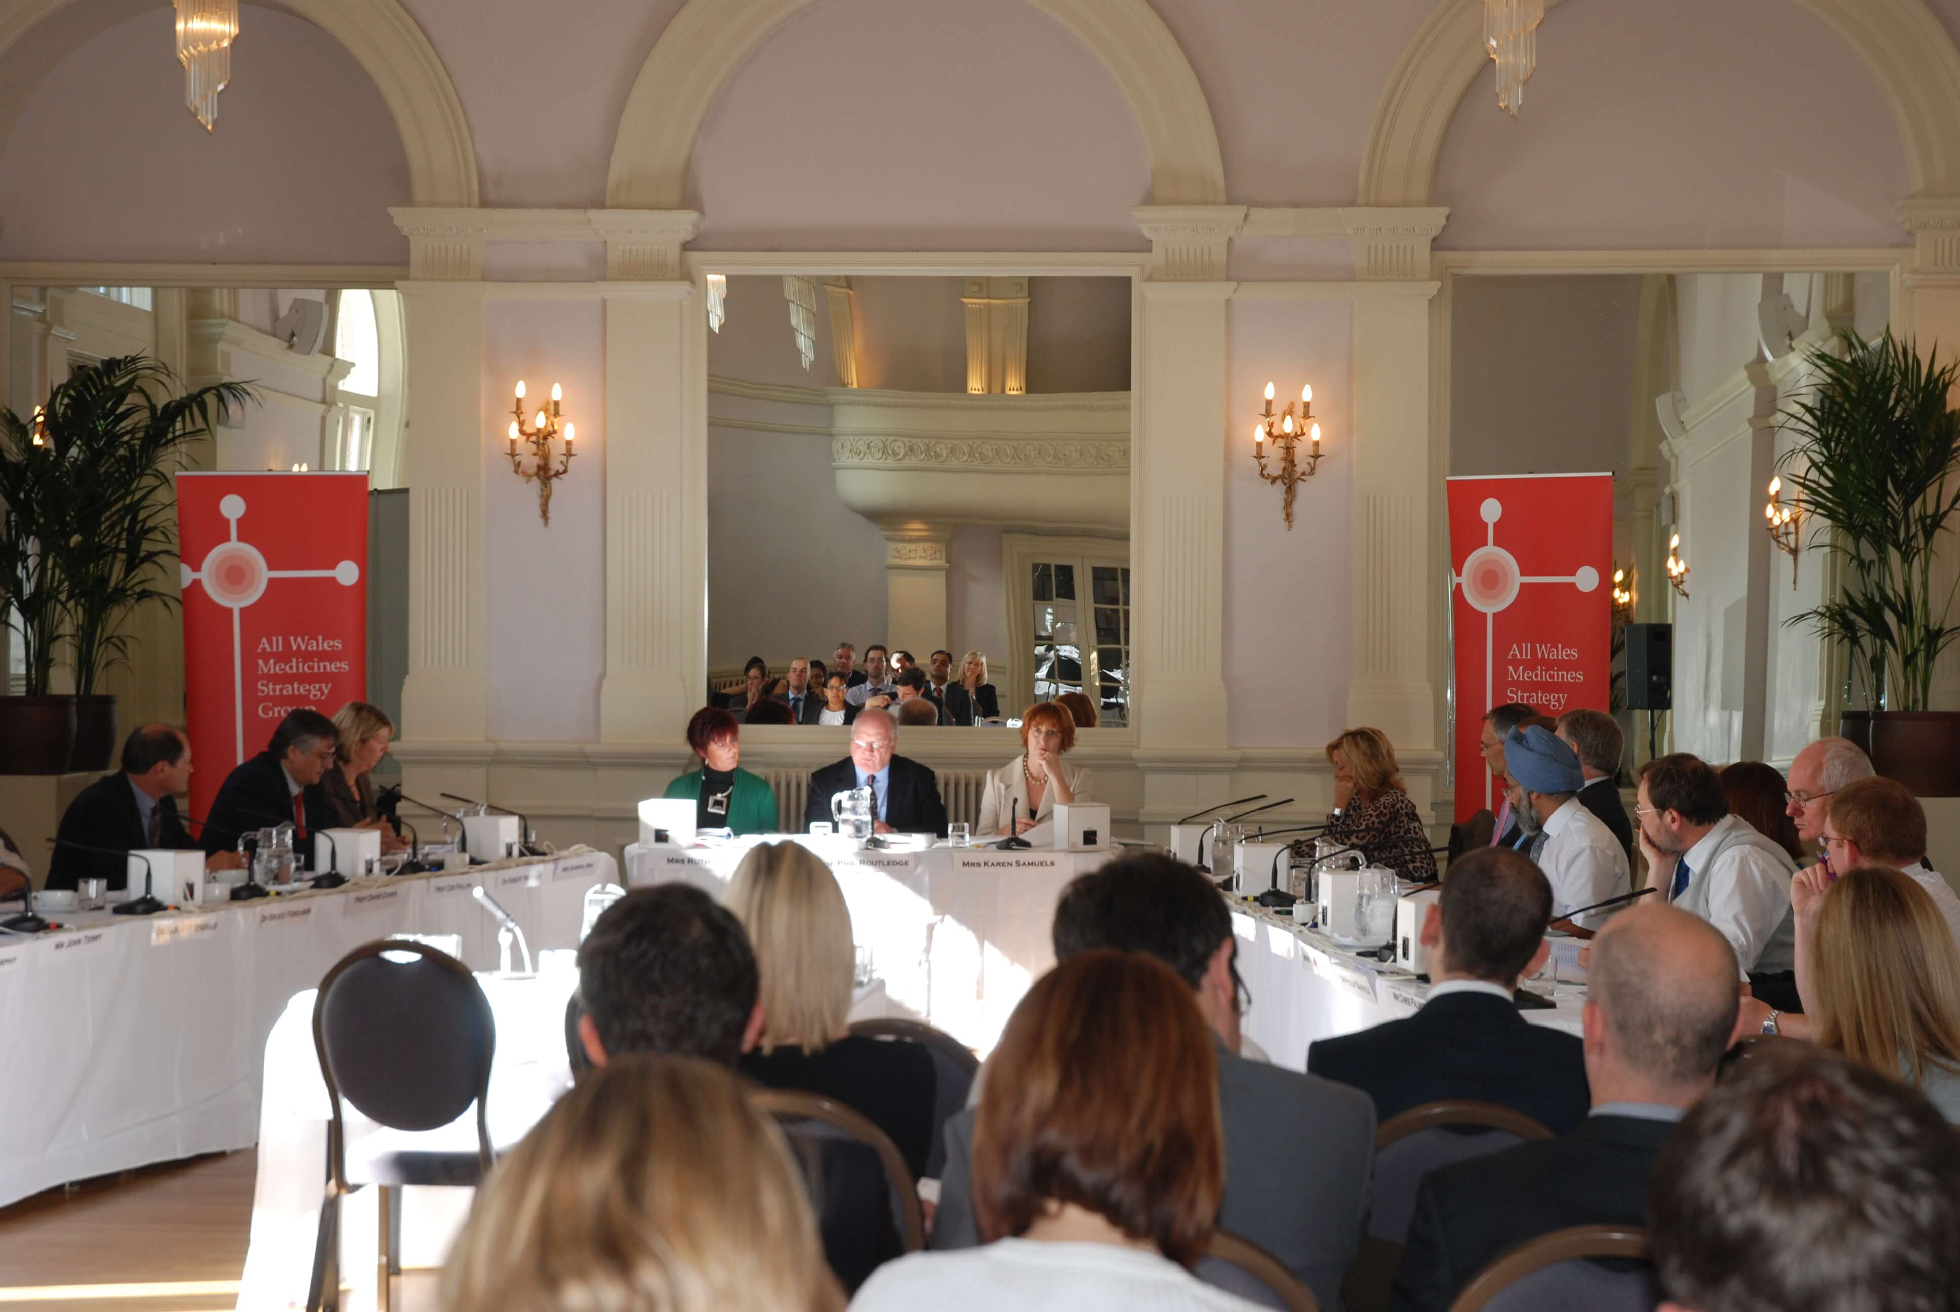

Slide 8



PAST
NOW
ABPI representative
Lay representative
Company attendance
Vote in private
Remit
Subgroups
All medicines not on NICE work programme
> £2000
April 2007
AWPAG/NIF
AWPAG/NMG

Slide 9
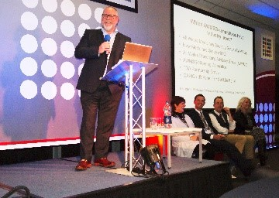
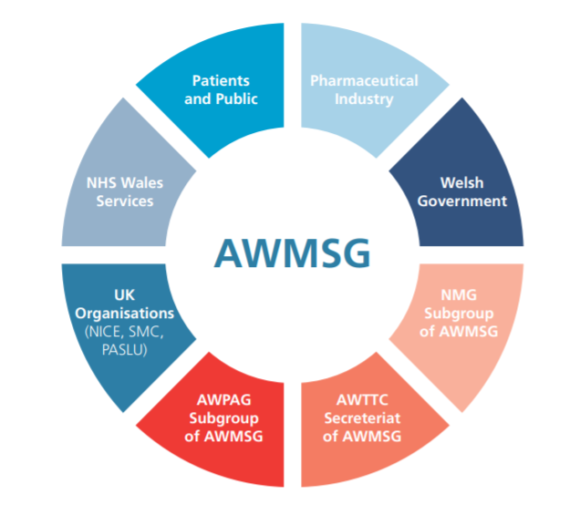

Slide 10
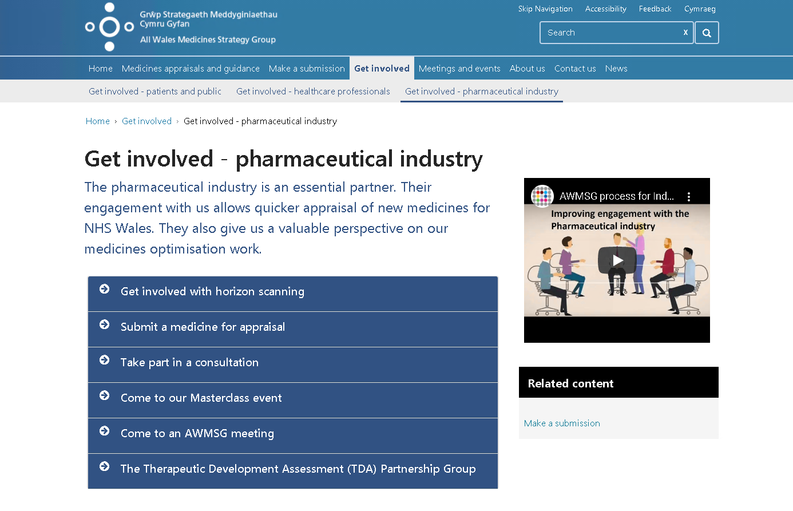
https://awmsg.nhs.wales/get-involved/get-involved-pharmaceutical-industry/
https://youtu.be/HNHTQ_4Ivhk

Slide 11


Slide 12
Appraisal process
Quick recap
Steph Francis

Slide 13

Timelines for Engagement
AWMSG Process for Industry engagement
Medicine Available for use in NHS Wales
Statement of advice
Marketing Authorisation
AWMSG/NICEApproval
PII/PIII trials
CHMP opinion
Horizon Scanning
Form A
Form B/C
Commercial
arrangements

Slide 14
Timelines for Appraisal
Clinical Expert
Clinical Expert
Patient Views
WG
Ratification
NMG
AWMSG
FAR to
Welsh Government
Papers sent to NMG
Papers sent to AWMSG
ASAR prepared
CR/ASAR
Form B/C submitted
ASAR to company
PAR to company
FAR to company
Form A
Paed
AWMSG
Week 0
Week 8
Week 10
Week 12
Week 14
Week 15
Week 16
Week 18
Week 19
Week 20/21

Slide 15
The newly revised process for appraising medicines licensed for use in children
Claire Ganderton & Kelly Wood

Slide 16

Background
Limited appraisal process
Feedback from AWMSG members
Changes elsewhere in UK
Data regarding limited submissions involving
paediatric licence extensions
Image credit: istockphoto.com/NiwatSingsamarn
Notes:
Lurasidone (Latuda®) for the treatment of schizophrenia in adolescents aged 13 years to 17 years and conestat alfa (Ruconest®) for the treatment of acute angioedema attacks in adults, adolescents and children (aged 2 years and above) with hereditary angioedema (HAE) due to C1 esterase inhibitor deficiency

Slide 17
Medicines recommended for use in NHS Wales via the limited submissions process (2014-2019)
+ 90 Statements of Advice
90 medicines received a licence extension for paediatric use, but were not submitted to AWMSG for appraisal

Slide 18


Background (cont’d)
Consultation - Therapeutic Drug Assessment Partnership Group and the Patient and Public Information Group
December 2020 - AWMSG endorsed the new process
March 2021 – AWMSG appraised and recommended first medicine using the new process

Slide 19

Join at slido.com
#9460

Slide 20

Are all medicines with a licence extension for paediatric use eligible to be appraised using the paediatric licence extension process?
Answer:
No

Slide 21

Medicines need to meet certain criteria to be eligible for appraisal using the paediatric licence extension process. How many criteria are there?
Answer:
3
the licence extension must be for use of the medicine in patients aged under 18 years
the medicine has been accepted for use in adults (aged 18 years and older) by AWMSG or NICE; and that advice or guidance must still apply
the licence extension must match the adult indication that was accepted for use by AWMSG or NICE, in every respect except for the target age group of patients.
Image credit: istockphoto.com/Ogichobanov

Slide 22


Which organisation(s) must have recommended the medicine for use in adults for the indication covered in the submission?
Answer:

Slide 23
You only need to submit a Form A for the paediatric licence extension process?
Answer:
True
Meets criteria for
appraisal as a licence extension for paediatric use
Form A
(initial submission)
Assessment
Draft recommendation
Meets criteria for
appraisal as a Full submission
Meets criteria for
appraisal as a limited submission
Form B
(Full submission)
Form C
(Limited submission)

Slide 24
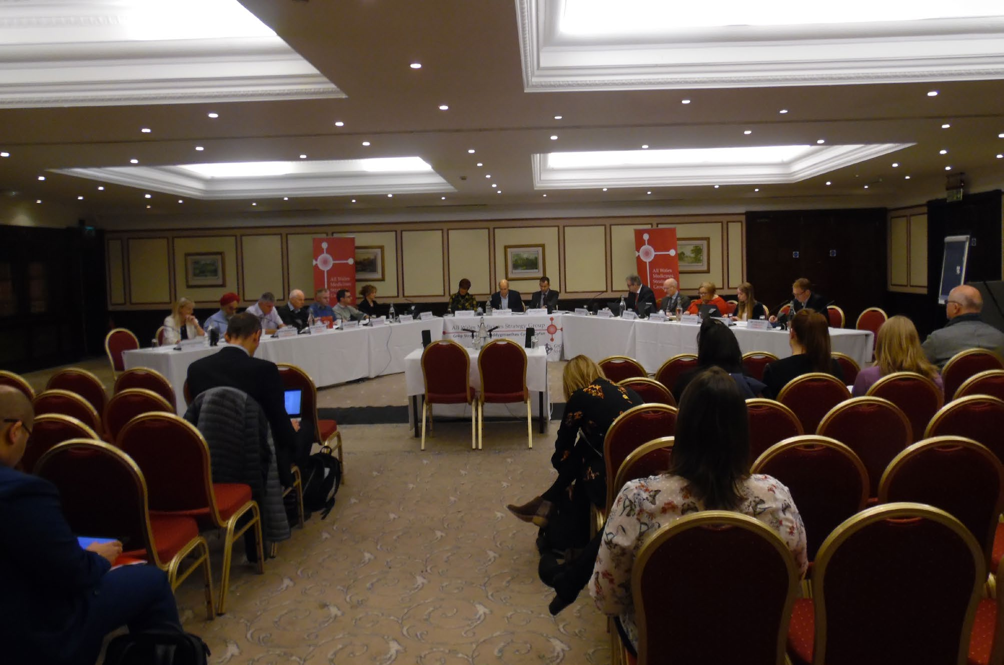
If a submission meets AWMSG’s criteria for appraisal as a licence extension for paediatric use, which group will appraise the medicine?
Answer:
AWMSG

Slide 25
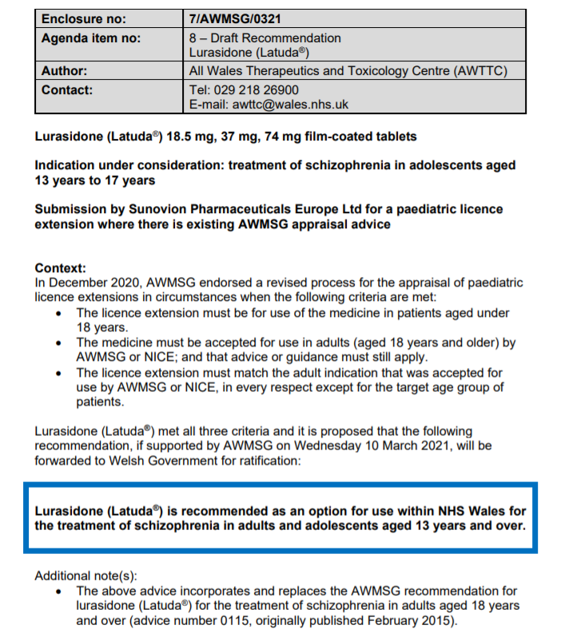
The appraisal process for licence extensions for paediatric use includes a preliminary appraisal recommendation by the New Medicines Group (NMG)?
Answer:
False

Slide 26
Is the company expected to attend the AWMSG meeting?
Answer:
No

Slide 27
Process overview: limited vs. paediatric licence extension appraisal
Meets criteria for
appraisal as a licence extension for paediatric use
AWMSG
Assessment
Draft recommendation
FORM A
Initial submission
Week 8
Week 14
Week 18
FORM C
NMG
AWMSG
Meets criteria for appraisal as a limited submission
ASAR
PAR
ASAR: AWMSG Secretariat Assessment Report; PAR: Preliminary Appraisal Recommendation
https://awmsg.nhs.wales/files/appraisal-process/awmsg-appraisal-process-timeline-flowchart-pdf-104kb/

Slide 28
Feedback on the process from company delegates
Process Transparent
Process very straightforward

Slide 29


Improved access to medicines for children and adolescents
Reduced inequity vs adults (routine access)
Encourage company engagement?

Slide 30
Further information
Full details of the process can be found on the AWMSG website at:
https://awmsg.nhs.wales/make-a-submission/make-a-submission-pharmaceutical-industry/submit-for-awmsg-appraisal/
Email us at: awttc@wales.nhs.uk

Slide 31
Diolch yn fawr
Thank you

Slide 32


Slide 33
Next Session……
Thursday 23 September
Medicines Optimisation Framework
National Prescribing Indicators

